Slide 1
Recommender
Systems
- Kaustubh Sable

Slide 2
Word2vec for Music Recommendations
What is Word2Vec?
Neural network models that were initially introduced for learning word embeddings that are highly useful for Natural Language Processing tasks.

Slide 3
Two main models:
Continuous Bag-of-Words model
Skip-gram model

Slide 4
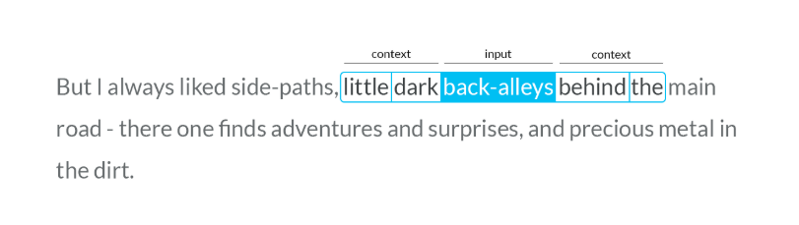
Word2vec Skip-gram model
Shallow neural network with a single hidden layer that takes in a word as input and tries to predict the context of words around it as output.

Slide 5
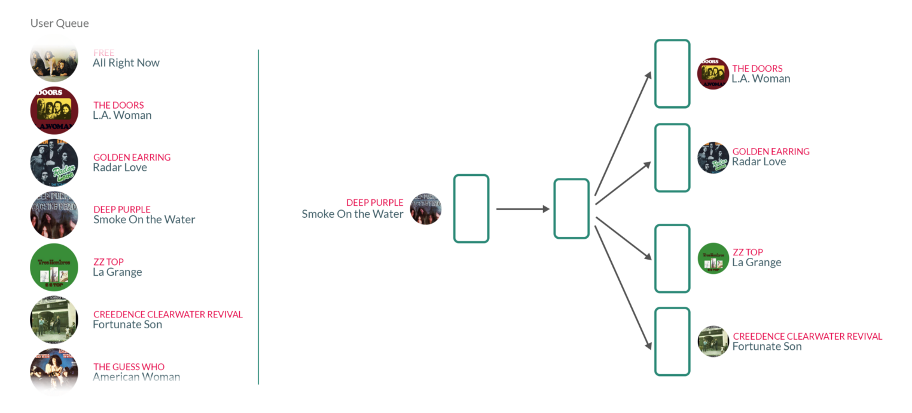
What the neural network would look like with songs instead of words:

Slide 6
How to visualize this space?
Using Word2vec, we have transformed our problem of finding songs that appear in similar contexts into mathematical numbers that capture those local co-occurrences. We can look at the weights as coordinates in a high dimensional space, with each song being represented by a point in that space.
Using t-SNE!
- Each point in the space will represent a song.

Slide 7
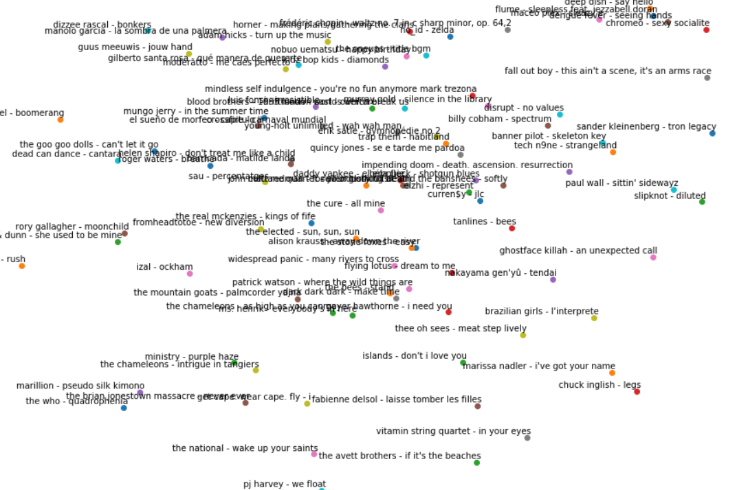
Song vector space:

Slide 8
How do song vectors help to recommend song to a particular user?
Here is an animation:
https://cdn-images-1.medium.com/max/1400/1*xbNM_CnEIWQtGbsLmZtE-A.gif

Slide 9
Code includes the following phases:
Preprocessing and feature engineering
Training the Word2Vec Music Recommender
Evaluation (using NDCG)
Example recommendations
Visualizing embeddings

Slide 10
Code Walkthrough
Python notebook

Slide 11
What’s ahead?
Studying about advertisement based recommender systems.

Slide 12
References
Related research Paper: https://arxiv.org/pdf/1804.04212.pdf
Related Blog: https://towardsdatascience.com/using-word2vec-for-music-recommendations-bb9649ac2484

