Slide 1
Recommender
Systems
- Kaustubh Sable

Slide 2
Agenda
NDCG
Word2Vec
  Concept
  Clarifications
  Other applications

Slide 3
Normalized Discounted Cumulative Gain (NDCG)
NDCG is a measure of ranking quality.
In Information Retrieval, such measures assess the document retrieval algorithms.
So, is it a valid measure for evaluating recommendation engine?
A recommendation engine recommends a set of documents from a superset which the engine finds to be most relevant to the user.

Slide 4
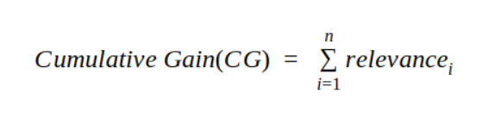
Cumulative Gain(CG)
Every recommendation has a relevance score associated with it. Cumulative Gain is the sum of all the relevance scores in a recommendation set.

Slide 5
Example:
For the documents ordered by the ranking algorithm as
D1, D2, D3, D4, D5, D6
the user provides the following relevance scores:
3,2,3,0,1,2
Then,
CG₆ = 3 + 2 + 3 + 0 + 1 + 2

Slide 6
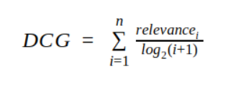
Discounted Cumulative Gain(DCG)
The premise of DCG is that highly relevant documents appearing lower in a search result list should be penalized.

Slide 7

Normalized Discounted Cumulative Gain(NDCG)
Depending on various factors, the number of recommendations served may vary for every user. Thus, the DCG will vary accordingly.
We need a score which has a proper upper and lower bounds so that we can take a mean across all the recommendations score to report a final score. NDCG brings in this normalization.
where iDCG refers to the DCG of the ideal order(iDCG).

Slide 8
Word2vec
What is Word2Vec?
Neural network models that were initially introduced for learning word embeddings that are highly useful for Natural Language Processing tasks.
Created by a group of researchers from Google in 2013.

Slide 9
Word embeddings
A way to convert a piece of text in a numerical format that our machines can read.

Slide 10
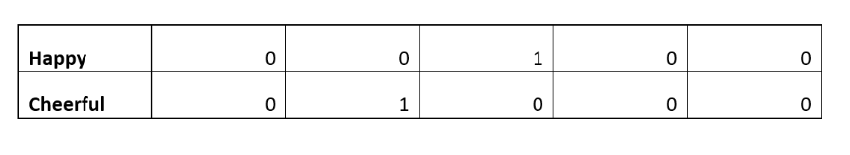
Before Word2Vec . . .
Count Vectorizer algorithm:
For 5 word vocabulary:

Slide 11
It had limitations though:
No notion of similarity between the vectors of semantically similar words.
In case of large corpus, these vectors are very sparse and hence inefficient.

Slide 12
Word2Vec has a solution...
It works on the idea of Distributional semantics which means that we can understand the meaning of a word by understanding the company (context) that a word keeps.
Notes:
So, in order to learn the representation of a word, we will try to learn the context in which a particular word appears and will hope that this word’s vector will be similar to the vector of the context words.

Slide 13
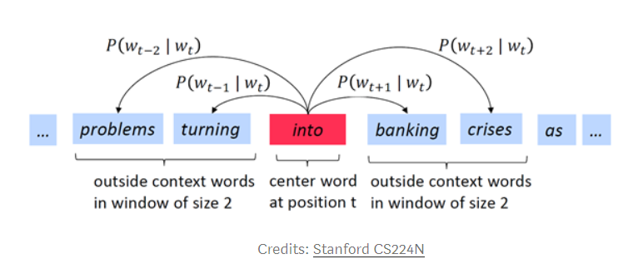
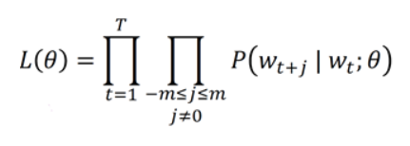
Skip-gram Algorithm
Identify context words for the specified window
Maximize the likelihood of the context words given the center word.

Slide 14
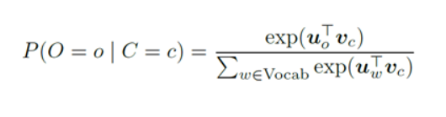
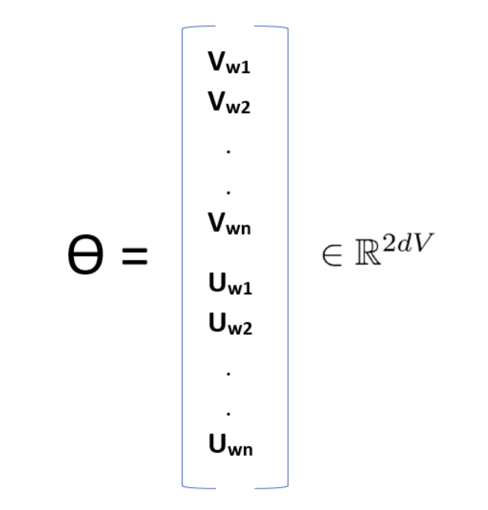
How can we calculate the probability of context word given the center word?
We will represent each word by two sets of vectors, Uw and Vw. We will use Uw when w is the context word and Vw when w is the center word.
Only one model parameter ϴ:
Notes:
Center word o and context word c

Slide 15
Few clarifications:
Will it work with any number of songs, playlists, users?
Feeding sets of songs to the algorithm
What happens if we input k songs?
N-gram model
Sentiment of the song in considered?
Mel-spectrogram is one of the ways.

Slide 16
Word2Vec
What all problems it can solve?
Finding the degree of similarity between two words
Finding odd one out
Things like woman + king - man = queen.
It can be used to perform Machine Translation.
Four Production Examples:
Music recommendations at Spotify and Anghami
Listing recommendations at Airbnb
Product recommendations in Yahoo Mail
Matching advertisements to search queries on Yahoo Search.

Slide 17
What’s ahead?
Study about advertisement based recommender systems and try out one of the algorithms.

Slide 18
References
NDCG: https://towardsdatascience.com/evaluate-your-recommendation-engine-using-ndcg-759a851452d1
Word2Vec applications: http://mccormickml.com/2018/06/15/applying-word2vec-to-recommenders-and-advertising/
Word2Vec: https://medium.com/analytics-vidhya/maths-behind-word2vec-explained-38d74f32726b
CNN implementation for Music RecSys: https://github.com/VikramShenoy97/Music-Recommendation-Using-Deep-Learning

