Slide 1
Recommender
Systems
- Kaustubh Sable

Slide 2
A Deep learning approach for Online Advertisement in Recommender Systems

Slide 3
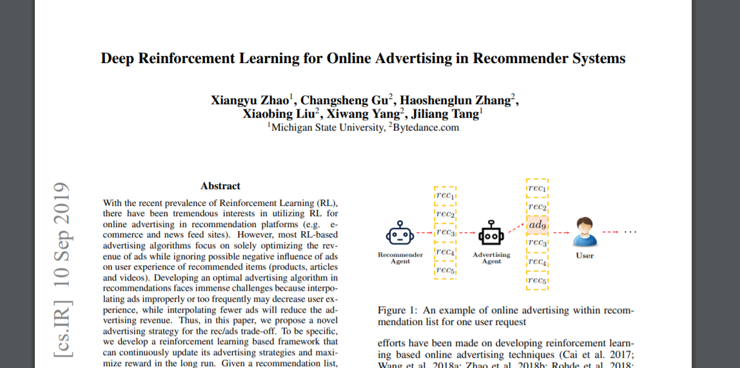

Slide 4
What does this paper propose?
Creates a Deep-Q Network (DQN) that can determine following three tasks:
whether to interpolate an ad or not in the recommendation list
and if yes, (ii) the optimal ad and
the optimal location to interpolate.
Training is based on users’ offline log, which records the interaction history between behavior policy (the advertising strategy in use) and users’ feedback.

Slide 5
Autoencoder Based Recommendation
AE is an unsupervised model attempting to reconstruct its input data in the output layer. In general, the bottleneck layer is used as a salient feature representation of the input data.
Almost all of its variants (denoting AE, variational AE, connective AE, and marginalized AE) can be applied to the recommendation task.

Slide 6
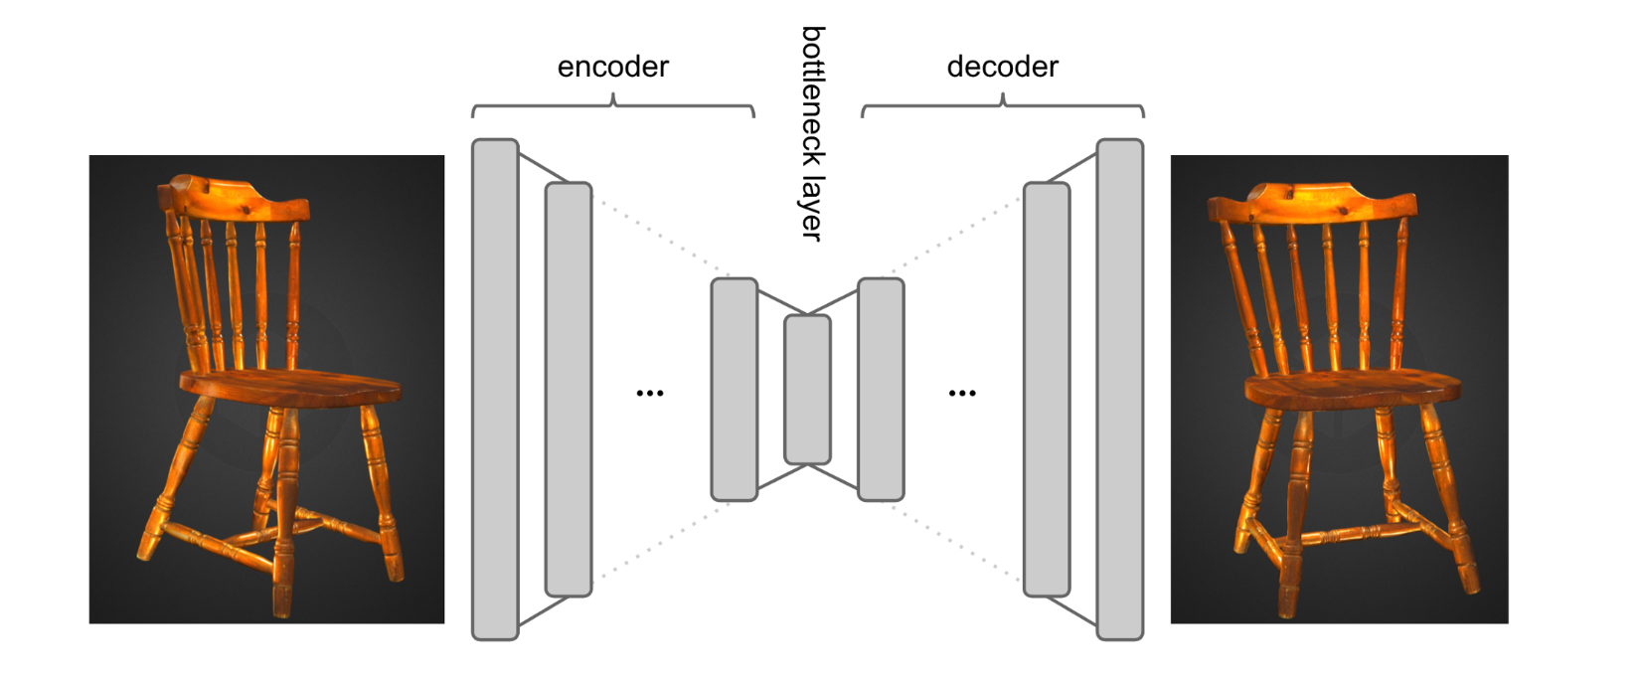
AE can be used to learn the lower-dimensional feature representations at the bottleneck layer.

Slide 7
Collaborative Deep Ranking
Collaborative Deep Ranking is devised specifically in a pairwise framework for the top-n recommendation. The paper shows that the pairwise model is more suitable for ranking lists generation.

Slide 8
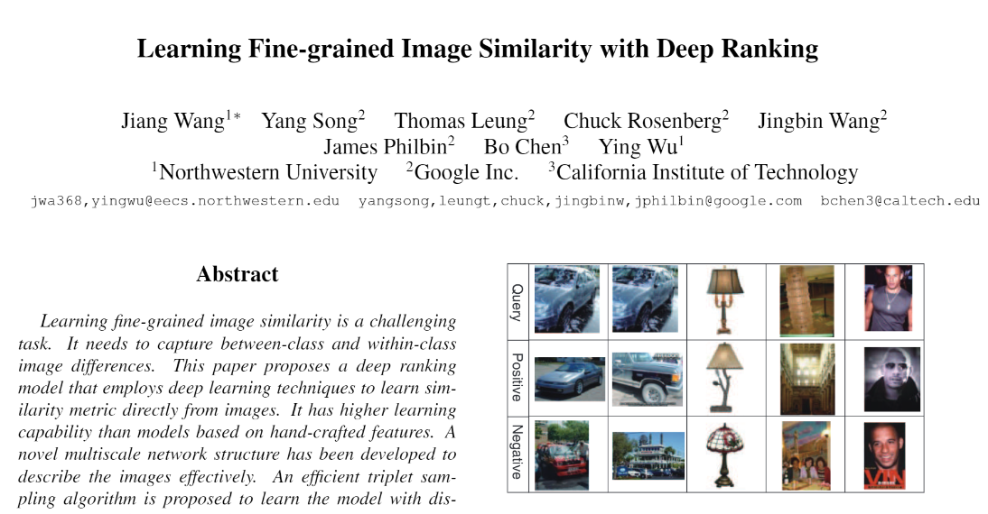

Slide 9
What does this paper propose?
Deep ranking model that employs deep learning technique to learn similarity metric directly from images.
An efficient triplet sampling algorithm is proposed to learn the model.
Simple evaluation metric.

Slide 10
What’s ahead?
Working on Deep Ranking code execution.

Slide 11
References
Deep Reinforcement Learning for Online Advertising in Recommender Systems: https://arxiv.org/pdf/1909.03602.pdf
Deep Ranking research paper:
https://github.com/USCDataScience/Image-Similarity-Deep-Ranking/blob/master/deep_ranking.pdf

