Slide 1







FORD GOBIKE
Exploratory Data Analysis Using Python
A Data-Driven Study of Bike-Share Ridership, Behaviour & Business Strategy
Python
Pandas
NumPy
Matplotlib
Seaborn
Jupyter Notebook
Prepared By
Kaustubh Sahu

Slide 2


Project Overview
Understanding the business behind the bike-share data
Business Objectives
About Ford GoBike
Profile riders by user type, age & gender
A pioneering bike-share system on the U.S. West Coast, operating a dense network of docking stations across San Francisco and neighbouring cities to enable flexible, short-distance urban travel.
Uncover monthly, weekday & hourly ride patterns
Analyse ride duration across customer groups
Identify top start/end stations for planning
Translate patterns into business recommendations
Problem Statement
Dataset Snapshot
Twelve months of fragmented trip records hold valuable signals on demand, station usage, and rider behaviour — but raw data alone cannot reveal them. This project unifies and analyses that data to expose actionable patterns for smarter operations.
2M+
12
16+
Trip Records
Months Merged
Variables
Ford GoBike Exploratory Data Analysis
2

Slide 3





Dataset & Data Preparation
From twelve raw monthly files to one analysis-ready dataset
Collect
Integrate
Clean
Validate
12 monthly CSV files located via glob
Merged with pandas.concat into one DataFrame
Nulls, duplicates & invalid values resolved
Types corrected; ready for analysis
Data Cleaning Summary
Why It Matters
Missing Values
Rows missing gender / birth year removed
A clean, unified dataset spanning a full year of operations removes seasonal blind spots and prevents demographic or duration analysis from being skewed by bad data — forming a trustworthy base for every insight that follows.
Duplicates
Duplicate trip records identified & dropped
Invalid Ages
Records outside a plausible 10–100 range filtered
2M+ rows · 16+ attributes · 1 full year
Datatypes
start_time / end_time parsed as datetime objects
Ford GoBike Exploratory Data Analysis
3

Slide 4









Feature Engineering & Workflow
Turning raw timestamps into analysis-ready signals
Raw Data
Cleaning
Feature Engineering
EDA
Business Insights
Engineered Features
ride_month
ride_day
ride_hour
age
ride_duration_min
Calendar month — reveals seasonal ridership swings
Day of week — compares weekday vs. weekend usage
Hour of day — exposes morning/evening commute peaks
Derived from birth year — powers demographic analysis
Seconds converted to minutes — intuitive trip length
Ford GoBike Exploratory Data Analysis
4

Slide 5
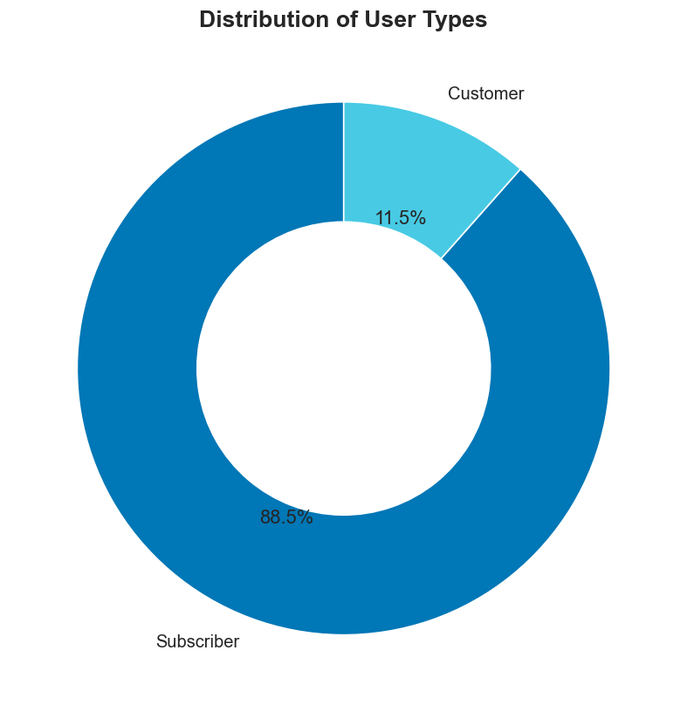
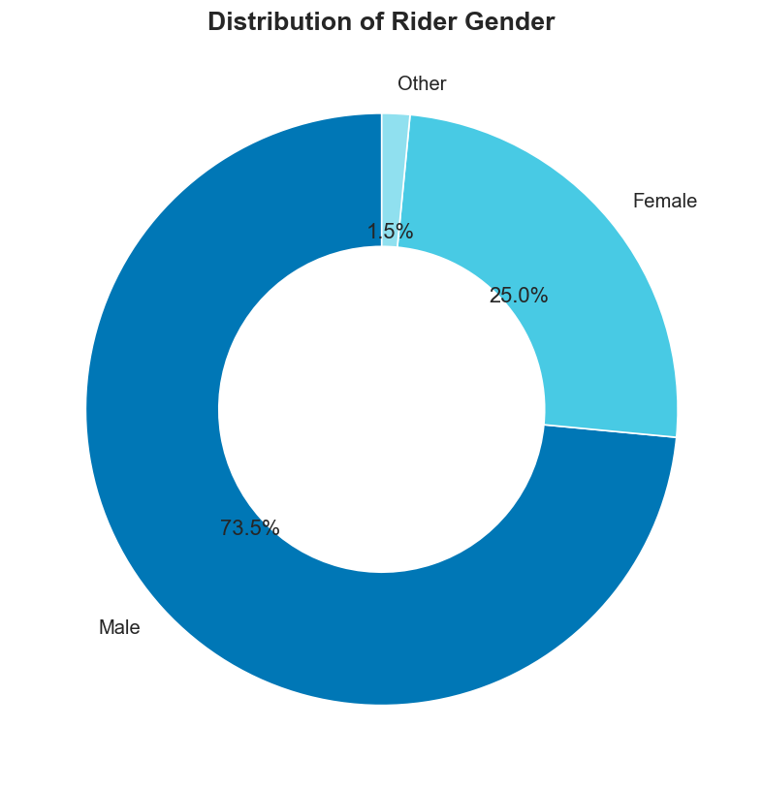
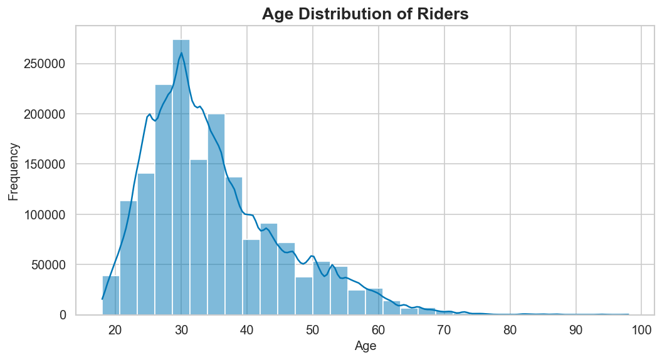
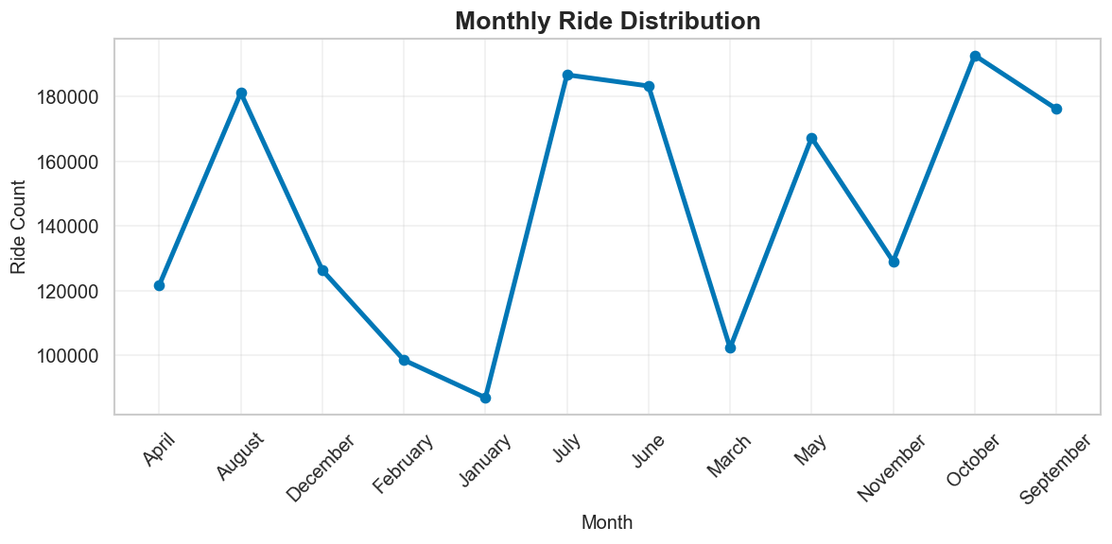
Univariate Analysis
Who rides, and when — examined one variable at a time
Subscribers make up 88.5% of all rides — a stable, commuter-driven base.
Riders skew heavily male (73.5%) — a clear inclusion opportunity.
Core riders are 25–35 — target messaging for working professionals.
Ridership peaks Jun–Oct — scale fleet ahead of the warm season.
Ford GoBike Exploratory Data Analysis
5

Slide 6
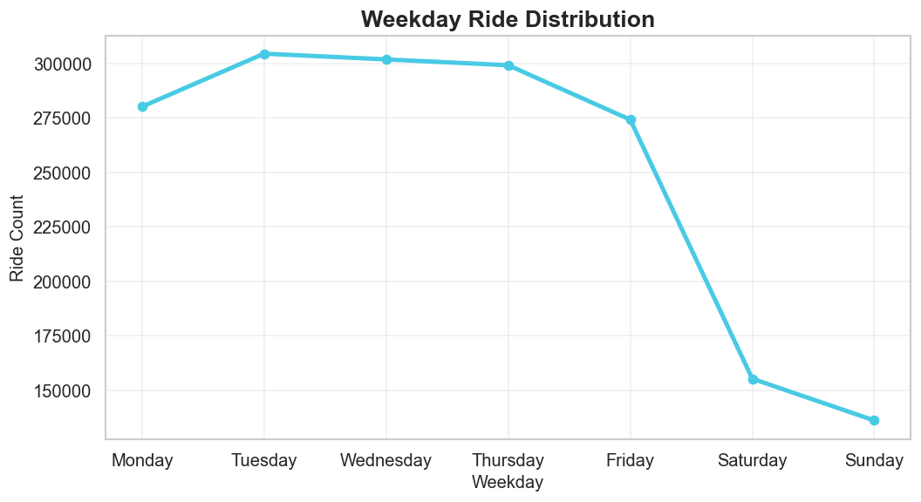
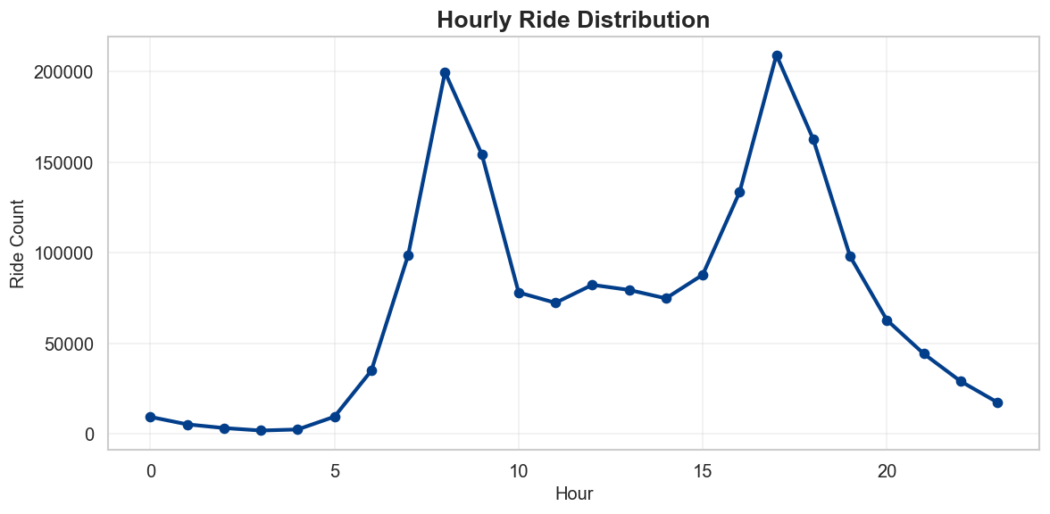
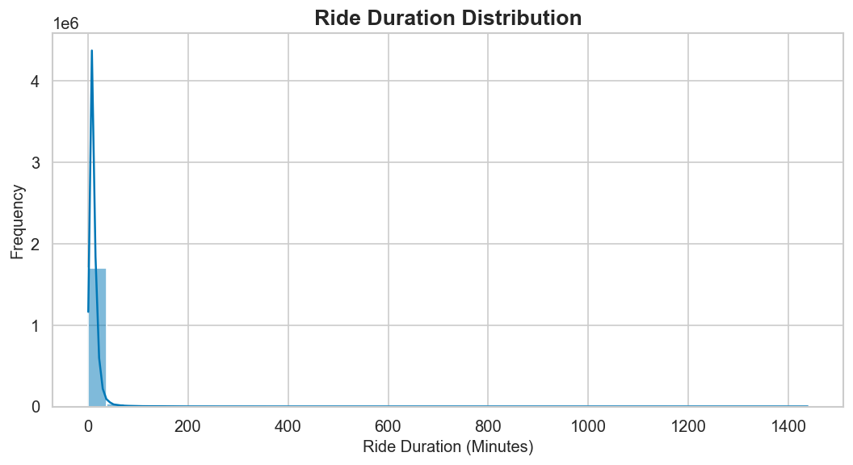
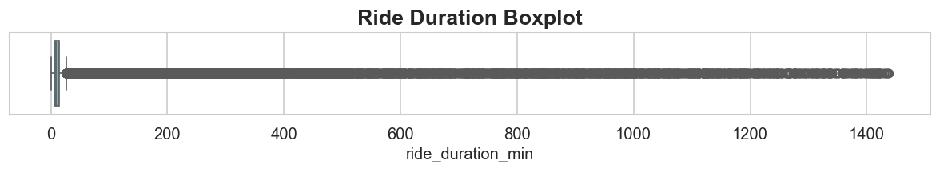
Ride Pattern Analysis
When rides happen and how long they last
Weekday Ride Distribution — peaks on Tuesday
Hourly Ride Distribution — bimodal 8 AM / 5 PM peaks
Ride Duration — most trips under 15 minutes
Duration Boxplot — long-tail outliers beyond 1,000 min
Tuesday
Peak Day
8 AM & 5 PM
Peak Hours
< 15 min
Typical Duration
Ford GoBike Exploratory Data Analysis
6

Slide 7
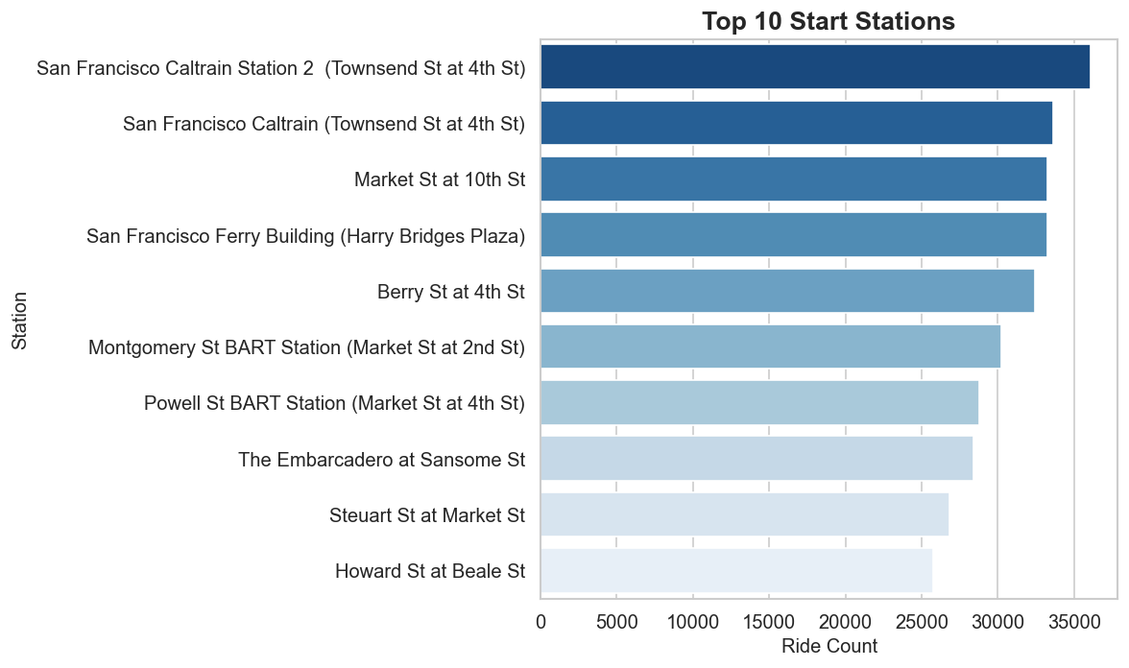
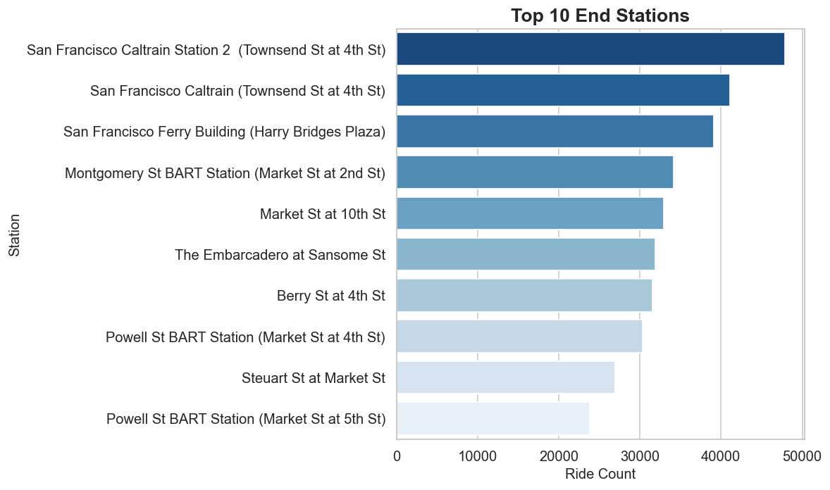

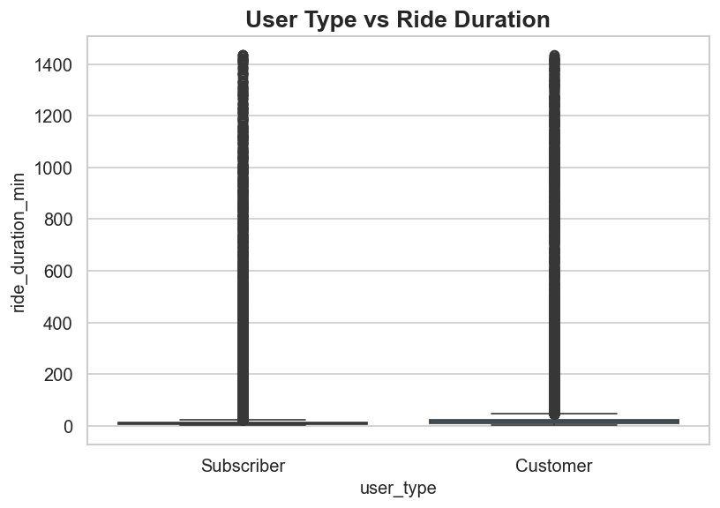
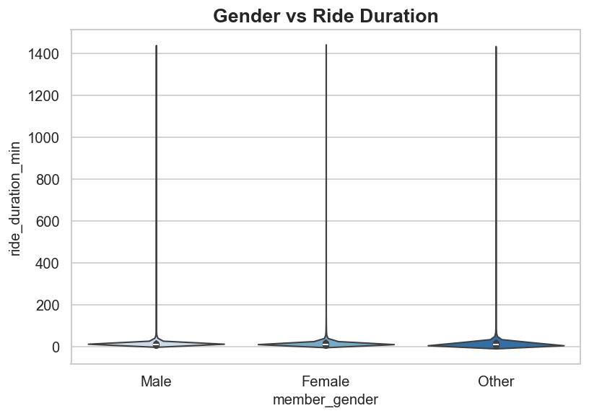
Station & Customer Analysis
Where rides begin and end, and how behaviour differs by rider group
San Francisco Caltrain Station 2 tops both rankings — confirming Ford GoBike's role as a first-and-last-mile transit connector.
Top 10 Start Stations — transit hubs dominate
Top 10 End Stations — same hubs, two-way gateways
Key Takeaway
Duration behaviour differs by user type (Subscribers = efficient commuters) far more than by gender — pricing should target usage pattern, not demographic.
User Type vs Duration — Subscribers ride tighter & shorter
Gender vs Duration — shape is consistent across genders
Ford GoBike Exploratory Data Analysis
7

Slide 8
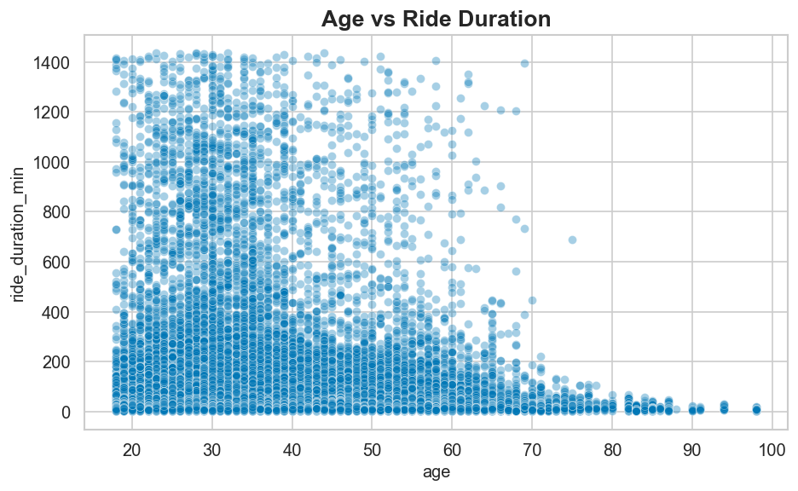
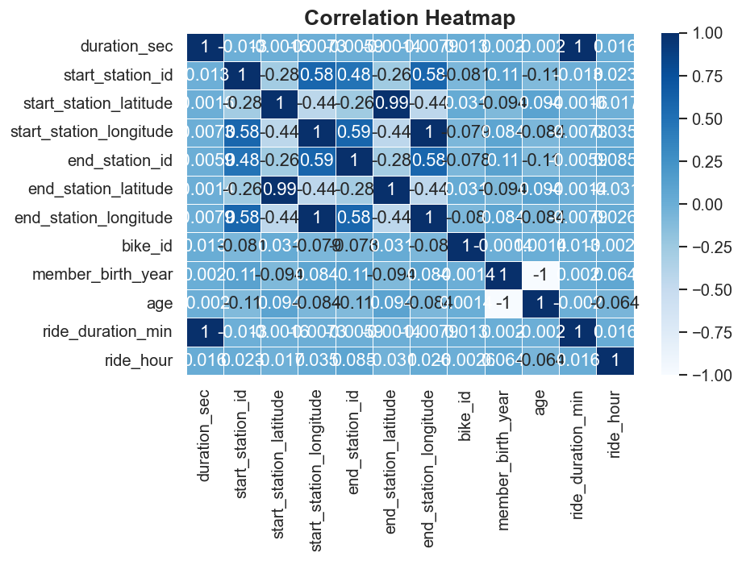
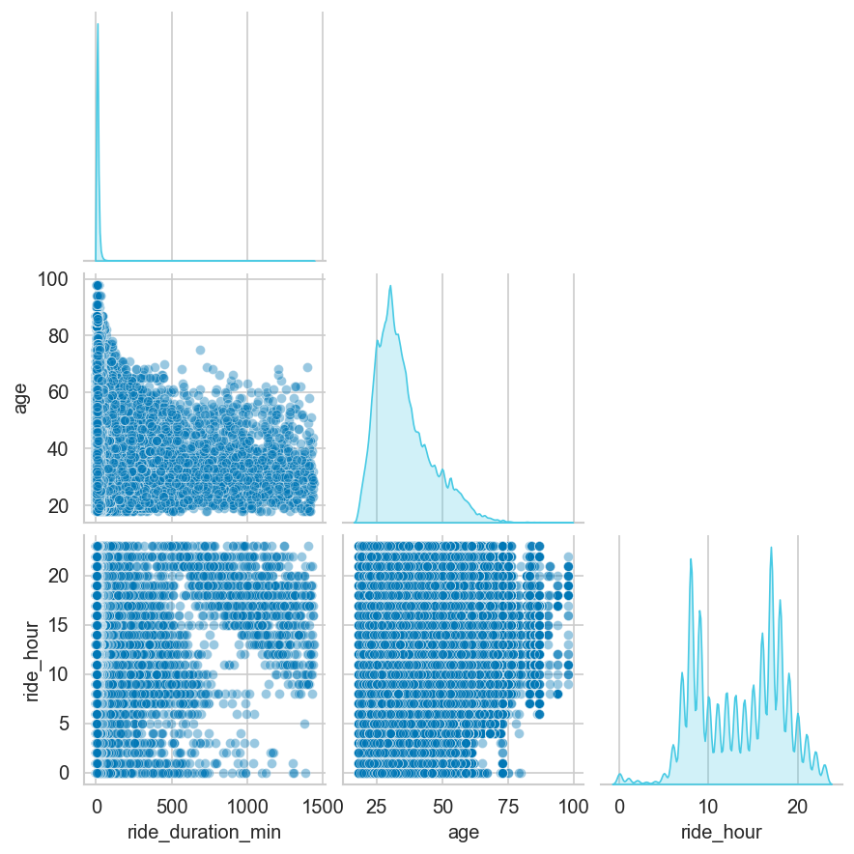
Correlation & Multivariate Analysis
Do these variables move together?
Age vs Duration — weak relationship overall
Correlation Heatmap — most variables weakly linked
Pairplot — confirms independence of key variables
Summary
Beyond the structurally expected links (station latitude/longitude, and age with birth year), nearly all variables show weak or negligible correlation with one another. Ride duration is not strongly explained by age, hour, or station alone — pointing to unmeasured factors like trip purpose and route choice, and motivating richer data collection for future predictive modelling.
Ford GoBike Exploratory Data Analysis
8

Slide 9


Key Business Insights
What the data tells Ford GoBike about its riders
Subscriber-Anchored
Commuting Drives Demand
Young Adults Lead
Subscribers account for 88.5% of all rides, anchoring recurring revenue.
Weekday volume dwarfs weekends — usage is work-trip driven.
Riders aged 25–35 form the single largest demographic group.
Two Daily Peaks
Transit Hubs Rule
Short & Efficient Trips
Bimodal demand at 8 AM and 5 PM signals classic commuter behaviour.
Caltrain, BART & Ferry-adjacent stations drive the busiest activity.
The vast majority of rides are completed in under 15 minutes.
Ford GoBike Exploratory Data Analysis
9

Slide 10






Business Recommendations
Turning insight into operational and growth strategy
Fleet Redistribution
Dynamic Bike Allocation
Reposition bikes toward high-demand stations before AM/PM peaks.
Scale fleet size seasonally, up for spring/summer, down in winter.
Weekend Promotions
Customer Conversion
Introduce leisure-oriented pricing to lift quiet weekend utilisation.
Use referral & loyalty offers to convert Customers into Subscribers.
Predictive Forecasting
Station Capacity Optimisation
Invest in demand models using weather, events & transit context.
Expand docks at consistently high-traffic transit-adjacent hubs.
Ford GoBike Exploratory Data Analysis
10

Slide 11





Conclusion & Future Scope
From exploratory findings to a forward-looking analytics roadmap
Future Scope
Project Summary
A full year of Ford GoBike trip data was integrated, cleaned, enriched, and explored end-to-end — converting 2M+ raw records into a coherent, decision-ready view of ridership.
Machine Learning
Demand Prediction
Major Findings
Predictive models for station-level demand
Incorporate weather, events & transit schedules
Subscriber-driven, commuter-oriented service
Two sharp daily peaks around 8 AM & 5 PM
Demand concentrated at transit-hub stations
Customer Segmentation
Interactive Dashboards
Ride duration mostly short; outliers need monitoring
Cluster riders into nuanced behavioural personas
Real-time Power BI monitoring for operations
Business Value
Turns a large operational dataset into a genuine decision-support resource for fleet planning, customer growth, and strategic investment.
Real-Time Analytics
Move from reactive to proactive demand shaping
Ford GoBike Exploratory Data Analysis
11

Slide 12
Thank You
Questions?
Prepared by
Kaustubh Sahu

