Slide 1

JTP Co., Ltd.
Kaustubh Londhe
Smart Food Management
Intelligent Platform for Zero Food Waste
1.3 Billion Tonnes of food wasted annually
(c) JTP Co., Ltd. All Rights Reserved.

Slide 2
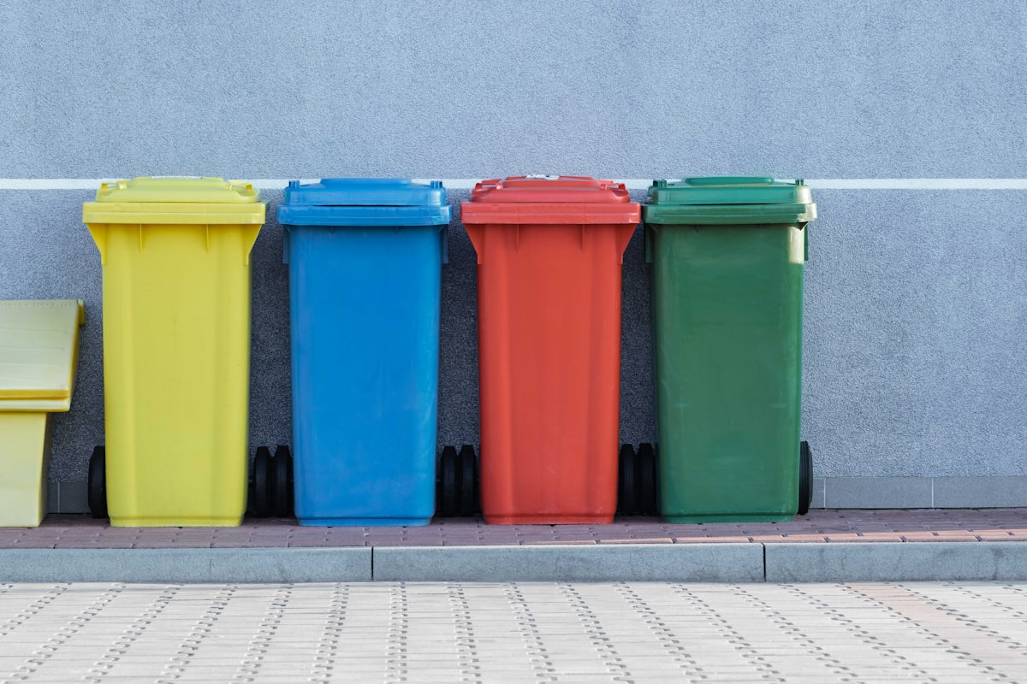
THE CRISIS
Every Day, Food Goes to Waste
1.3B
$1 Trillion
828 Million
Tonnes
Food wasted yearly
Economic loss annually
People go hungry
(c) JTP Co., Ltd. All Rights Reserved.

Slide 3
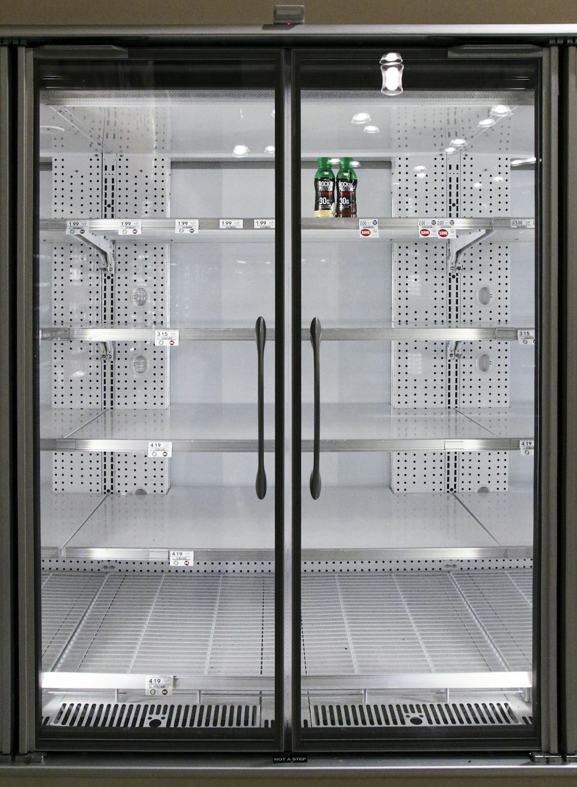
THE CHALLENGE & SOLUTION
THE PROBLEM
THE SOLUTION
Forgotten Food
Smart Inventory Tracking
→
Households throw away food because they forget what is in their fridge
Automatic reminders before food expires. Never waste forgotten items again.
(c) JTP Co., Ltd. All Rights Reserved.

Slide 4

THE CHALLENGE & SOLUTION
THE PROBLEM
THE SOLUTION
Wasted Surplus
Surplus Food Marketplace
→
Restaurants & stores discard surplus with no way to redistribute
Connects donors with food banks & NGOs instantly. Every extra meal finds a home.
(c) JTP Co., Ltd. All Rights Reserved.

Slide 5

THE CHALLENGE & SOLUTION
THE PROBLEM
THE SOLUTION
Unused Ingredients
AI Recipe Suggestions
→
People do not know how to use leftover ingredients creatively
Creates delicious meals from what you already have. Turn leftovers into feasts.
(c) JTP Co., Ltd. All Rights Reserved.

Slide 6

FEATURES
Six Superpowers in One Platform
Smart Expiry Alerts
AI Recipe Suggestions
Community Food Sharing
Never let food expire unnoticed
Cook smart with what you have
Share surplus with neighbors
Waste Analytics Dashboard
Donation Network
Multi-platform Access
Track and reduce your waste
Connect with food banks easily
Use on any device, anywhere
(c) JTP Co., Ltd. All Rights Reserved.

Slide 7
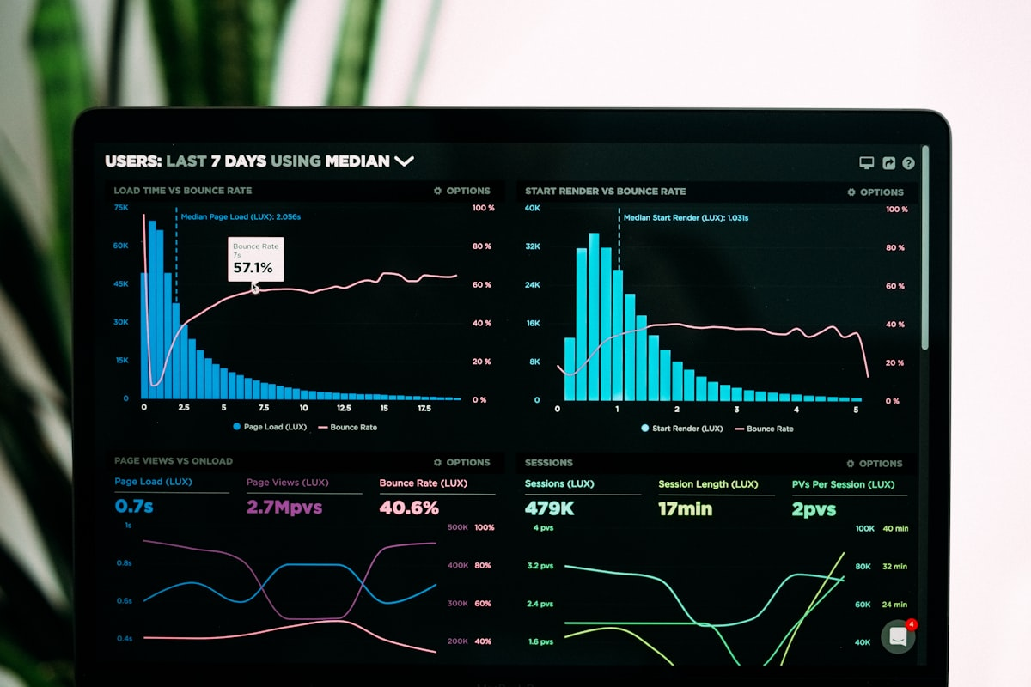
ARCHITECTURE
How It Works For You
Works on any device
Seamless experience on phone, tablet, or computer
Lightning-fast & beautiful
Instant responses with an intuitive, clean design
Your data is always safe
Bank-level security protecting your information
Smart AI that learns your habits
(c) JTP Co., Ltd. All Rights Reserved.
Gets better and more personalized the more you use it

Slide 8

PROJECTED IMPACT
The Impact We Will Create
50%
10M+
Zero
Less household food waste
Meals redistributed
Food expires forgotten
(c) JTP Co., Ltd. All Rights Reserved.

Slide 9

THE FUTURE
Our Journey Forward
1
2
3
4
Smart Inventory & Alerts
AI Recipes & Community Sharing
Marketplace & Donation Network
Global Expansion & Partnerships
(c) JTP Co., Ltd. All Rights Reserved.

Slide 10
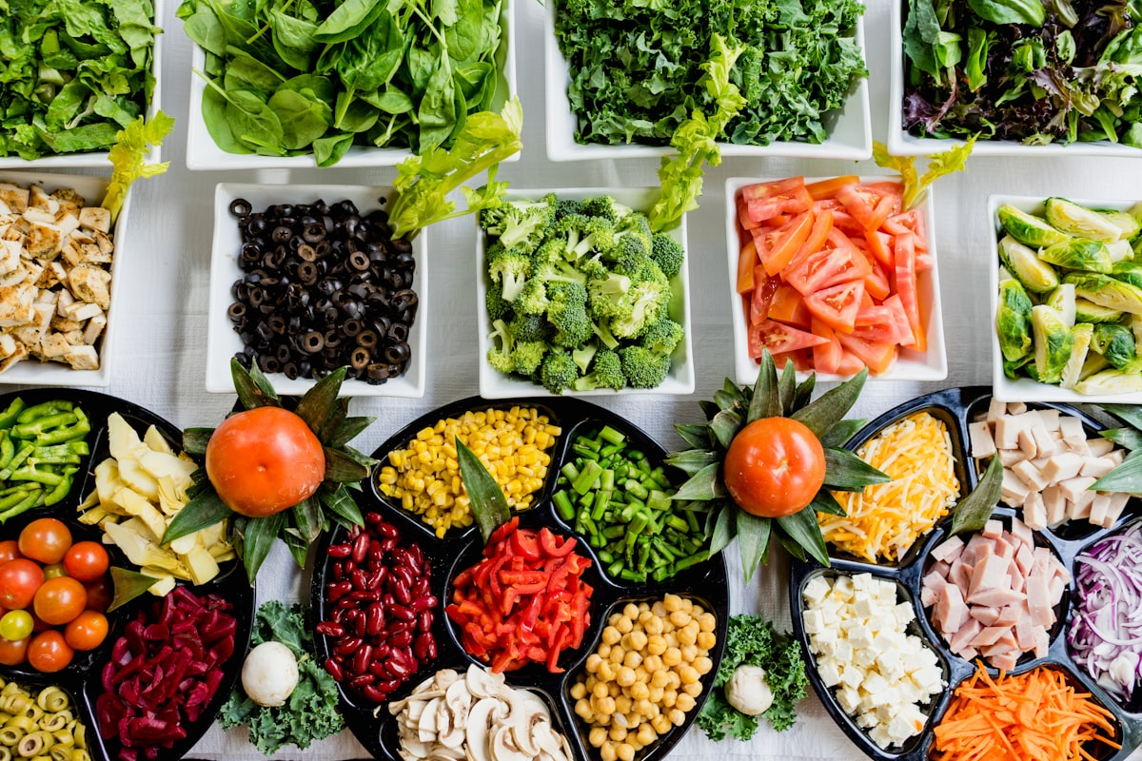
Smart Food Management
Every Meal Matters. Zero Waste. Full Plates.
JTP Co., Ltd.
(c) JTP Co., Ltd. All Rights Reserved.

