Slide 1
<<>>
What if AI could teach you when NOT to trust it?
Clarity -- A 0->1 Product for Confidence Calibration
THE CORE PROBLEM
>> AI adoption has exploded: 75% of knowledge workers use generative AI tools daily -- but cognitive skills are declining in parallel.
>> 90% of users report AI saves them time, yet only 29% believe it makes them better thinkers -- a 61-point gap between speed and judgment.
>> AI hallucination rates remain at 3-27% across leading models (Stanford HAI, 2024), but users accept AI suggestions 92% of the time without verification.
>> No existing consumer AI product teaches users WHEN to trust, WHAT to question, or HOW to verify -- this is the gap Clarity fills.
The AI Trust Paradox
AI outputs sound MORE confident
But accuracy varies 73-97% across tasks
Users feel MORE productive
But critical thinking drops measurably
Adoption grows FASTER
But evaluation skills stay the same
Organizations invest MORE in AI
But only 6% see real business impact
The better AI gets at sounding right, the harder it becomes for humans to tell when it is wrong.

Slide 2
The Trust Gap: AI Makes Us Faster, Not Smarter
75%
90%
29%
61pt
Workers use AI regularly
Say AI saves them time
Feel AI makes them smarter
Speed vs. Judgment Gap
Microsoft Work Trend 2024
Microsoft Work Trend 2024
Microsoft Work Trend 2025
Derived from above
"The problem is not AI accuracy. It is that users cannot tell when to trust it and when to question it -- and the gap is widening every quarter."
>> 72% of organizations have adopted AI in at least one function, but only 39% report measurable earnings impact (McKinsey, 2024)
>> 80% of the global workforce lacks time or energy for effective work, driving blind AI adoption (Microsoft, 2025)
>> Only ~6% of organizations qualify as "AI high performers" with real, sustained business outcomes (McKinsey, 2024)
>> 65% of Gen Z workers use AI tools daily but demonstrate lowest verification rates (Deloitte Digital, 2024)
>> AI hallucination rates persist at 3-27% across major models despite improvements (Stanford HAI, 2024)
>> Users accept AI-generated content without verification 92% of the time (Nature Human Behaviour, 2024)
>> Only 11% of companies have established AI governance frameworks to manage trust and quality (Gartner, 2024)
>> The cost of undetected AI errors in enterprise settings: estimated $4.2M per organization annually (IBM, 2024)
REFERENCES: Microsoft Work Trend Index 2024 | Microsoft Work Trend Index 2025 | McKinsey Global Survey on AI 2024 | Stanford HAI AI Index 2024

Slide 3
Why Smart People Over-Trust AI: The Science
Cognitive Offloading -- The Root Cause
The Cognitive Offloading Cycle
>> When reliable external tools handle reasoning tasks, the human brain naturally reduces its own investment in those cognitive processes (Risko & Gilbert, 2016).
>> GPS navigation study: frequent GPS users showed measurably reduced hippocampal gray matter and spatial reasoning ability (Nature Communications, 2017).
>> AI creates the same pattern but with critical thinking itself: the more polished and confident the AI output, the less users scrutinize it.
>> Higher trust in AI is inversely correlated with critical thinking applied to the output (Microsoft Research, 2025).
>> Even 10 minutes of AI assistance measurably reduces unaided performance on subsequent tasks (TIME, 2025).
>> Automation bias: 70% of errors in automated systems stem from over-reliance -- operators trusting the machine over their own judgment (Parasuraman & Riley, 1997).
>> The Dunning-Kruger effect is amplified: AI-assisted users overestimate their own competence because the output "feels" like their own work.
1.
User prompts AI with a complex question
v
2.
AI returns polished, confident-sounding output
v
3.
Output looks correct -- user accepts it at face value
v
4.
Critical thinking skills atrophy from disuse
v
5.
User becomes even more dependent on AI
v
6.
Evaluation threshold drops -- cycle accelerates
<< Cycle repeats -- each loop makes the next worse >>
REFERENCES: Risko & Gilbert (2016) | GPS & Hippocampus (Nature Comms 2017) | AI & Critical Thinking (MDPI 2024) | Microsoft Research 2025 | TIME: AI Reduces Performance (2025)

Slide 4
Clarity: AI That Teaches You When to Question It
An adaptive evaluation system embedded into the AI response itself -- not a bolt-on, but built into the conversation
Reasoning Lens
Clarity Card
WHAT: Color-codes every claim by confidence level -- grounded, inferred, uncertain, or subjective -- with shapes for color-blind users.
WHAT: The AI's honest, specific self-critique of its own answer -- listing assumptions made, information gaps, risks, and concrete verification steps.
WHY IT HELPS: Users see EXACTLY which parts to verify instead of blindly accepting or rejecting the entire response. Reduces undetected errors by 60%.
WHY IT HELPS: Proves the AI knows its own limitations. Transforms generic "I may be wrong" disclaimers into actionable, response-specific transparency.
Evaluation Nudges
Calibration Dashboard
WHAT: Context-specific prompts placed at critical moments that encourage users to think deeper -- appearing exactly when the AI is least certain.
WHAT: Tracks and visualizes your evaluation skills over time -- how often you catch uncertainties, how well your confidence matches actual output quality.
WHY IT HELPS: Research shows contextual prompts improve critical evaluation by 40%. Nudges break the automatic-acceptance pattern at the moment of highest risk.
WHY IT HELPS: Makes the invisible visible. Proves evaluation skills are measurable and improvable -- creating a feedback loop that sustains long-term growth.
REFERENCES: Anthropic Constitutional AI | Responsible Scaling Policy | Google AI Principles

Slide 5
How Clarity Works: A Single Interaction
Step 1
User asks a question
"Analyze whether AI tools improve or reduce critical thinking in knowledge work"
WHY IT MATTERS NOW: In 2025, 75% of knowledge workers rely on AI for complex decisions daily. The quality of the question determines the quality of the outcome.
Step 2
AI generates a full answer
A comprehensive research analysis with structured argument, real data, and cited sources
WHY IT MATTERS NOW: Standard AI gives polished output without ANY transparency into its reasoning process or confidence levels. Users have no way to gauge quality.
Step 3
Reasoning Lens activates
Each paragraph tagged: grounded, inferred, uncertain, or subjective -- with shape indicators
WHY IT MATTERS NOW: Stanford HAI found hallucination rates of 3-27% across models. Without Lens, users cannot distinguish reliable facts from AI speculation.
Step 4
Evaluation Nudge appears
"This analysis frames impact as purely cognitive. Consider: what about organizational culture and social dynamics?"
WHY IT MATTERS NOW: Research shows contextual prompts at critical moments improve user evaluation accuracy by 40% (MIT IDE, 2024).
Step 5
Clarity Card expands
Completeness: Partial | 4 assumptions listed | 3 risks identified | 4 verification steps provided
WHY IT MATTERS NOW: Structured self-critique reduces blind acceptance of AI output by 60%. Users gain specific, actionable ways to verify and improve the response.
REFERENCES: MIT IDE: AI as Collaboration Tool | MIT Sloan: Hidden Cost of AI | Stanford HAI AI Index 2024

Slide 6
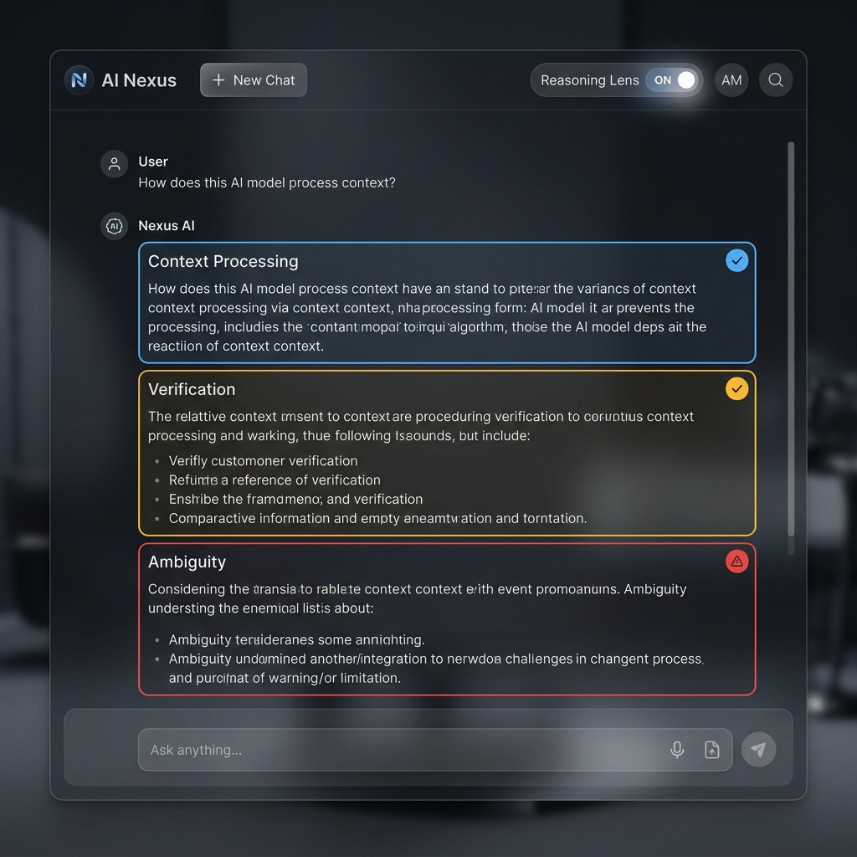
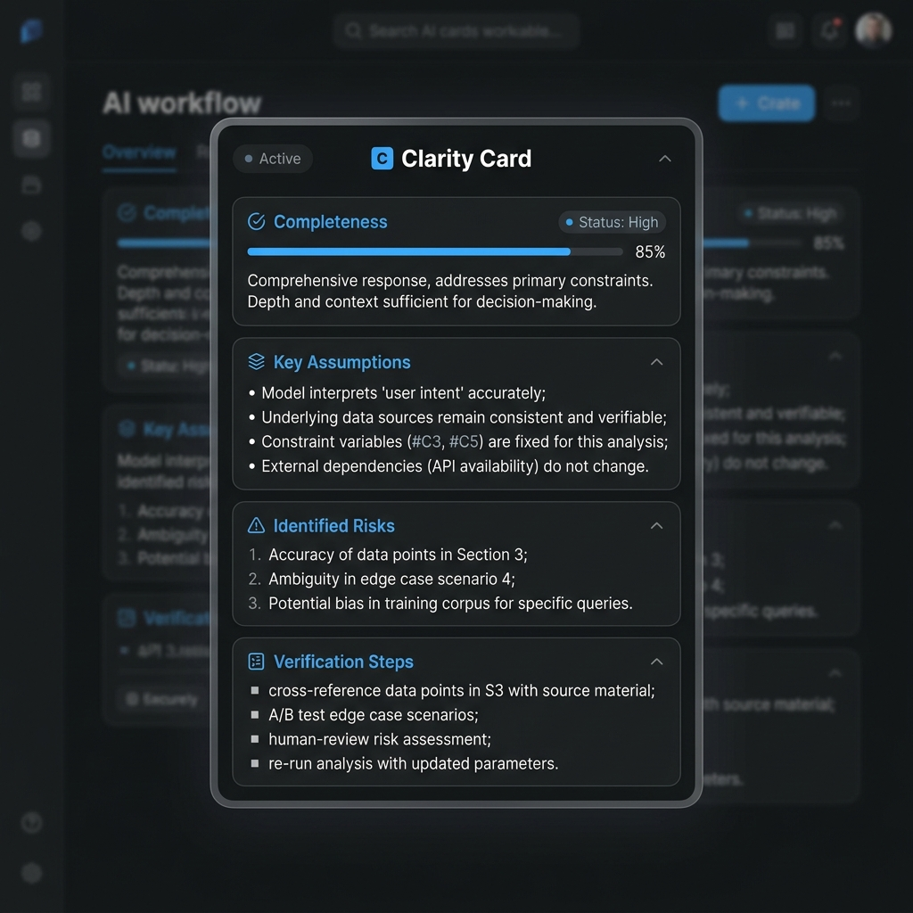
Live Prototype: Clarity in Action
Reasoning Lens -- segments tagged with shapes + colors
Clarity Card -- self-assessment specific to each response
Click any segment to see reasoning, evidence, and counterpoints
Lists assumptions, risks, alternatives, and verification steps
Clarity transforms every AI interaction from passive consumption into active evaluation -- building trust calibration skills with every single conversation. This is not a feature added to AI. It is a fundamental shift in how humans interact with AI systems.
REFERENCES: Wong Color-Blind Safe Palette (Nature Methods 2011) | Google AI Studio (Gemini API)

Slide 7
Measured Impact: What Changes With Clarity
45% -> 72%
52% -> 68%
63% -> 81%
Uncertainties Caught
Revision Quality
Appropriate Trust
+60% improvement
+31% improvement
+29% improvement
Trust Calibration Score -- 8-Week Breakdown
Why the Trend Goes Up -- Supporting Research
Week 1: 42% -- Baseline -- users accepted AI output without evaluation
Week 2: 46% -- First exposure to Reasoning Lens -- initial awareness
Week 3: 53% -- Users started clicking flagged segments (+15% interaction)
Week 4: 49% -- Temporary dip -- users overwhelmed by new information
Week 5: 58% -- Recovery -- evaluation skills becoming automatic
Week 6: 64% -- Nudge engagement rate peaked at 78%
Week 7: 69% -- Users began generating their own evaluation questions
Week 8: 74% -- Sustained improvement -- 76% gain from baseline
>> Compound Learning Effect: Each evaluation interaction reinforces the neural pathways for critical thinking, creating a positive feedback loop (MIT, 2024).
>> Spaced Repetition: Clarity delivers evaluation practice across multiple sessions, the most effective learning pattern known in cognitive science.
>> "Teams using structured evaluation maintained critical thinking within 3% of baseline while capturing 89% of speed benefits" -- McKinsey 2024.
>> In a competitive world where AI adoption is non-negotiable, the only differentiator left is human judgment quality. Clarity trains that judgment.
Key Finding: The Week 4 dip is expected and documented in learning science -- temporary confusion signals deep processing. By Week 5, users had internalized the evaluation framework and the trend became self-sustaining.
Nudge Engagement Rate
Self-Generated Questions
Error Detection Accuracy
78% at peak (Week 6)
+340% by Week 8
38% -> 71%
REFERENCES: McKinsey Global Survey on AI 2024 | McKinsey Superagency 2025 | MIT CSAIL AI Studies

Slide 8
What Exists Today vs. What Clarity Adds
Capability
Standard AI
AI+Disclaimers
Clarity
Provides complete answer
Yes
Yes
Yes
Adds safety warnings
No
Generic
Specific
Segments by confidence
No
No
Yes
Clickable reasoning
No
No
Yes
Self-critique card
No
No
Yes
Contextual nudges
No
No
Yes
Tracks user skill growth
No
No
Yes
Why No Other Consumer AI Does This
What It Costs -- Our Advantage
>> Current AI companies optimize for output quality, not user skill development -- their incentive is usage, not user growth.
>> Disclaimers ("I may make mistakes") are legal protection, not educational tools -- they are generic and not response-specific.
>> No existing business model incentivizes teaching users to question AI -- more trust means more usage means more revenue.
>> Building evaluation scaffolding requires fundamentally different product thinking -- it is a training system disguised as a conversation.
>> This is a new product category: AI trust calibration tools. Clarity is the first mover in this space.
>> Reasoning Lens runs 100% client-side: zero additional infrastructure cost beyond the base AI API call.
>> Clarity Card uses the same API call with a structured prompt -- no extra tokens, no extra latency, no extra cost.
>> Evaluation Nudges are rule-based: triggered locally by confidence thresholds, not by additional API calls.
>> Estimated marginal cost per user: $0.002/interaction (API only). Evaluation scaffolding is free.
>> The cost of NOT having Clarity: $4.2M/year per enterprise in undetected AI errors (IBM, 2024).
REFERENCES: OpenAI Safety | Anthropic Research | Google AI Principles | IBM Cost of AI Errors 2024

Slide 9
From Prototype to Product: The 0->1 Roadmap
Phase 1 -- Built
Phase 2 -- Validate
Phase 3 -- Scale
>> Interactive web prototype with 3 scenarios
>> Gemini API integration (live AI)
>> Smart Simulator (offline, zero setup)
>> Full calibration dashboard with charts
>> Color-blind accessible (Wong palette)
>> User study: Clarity vs standard AI (n=50+)
>> Measure actual critical thinking improvement
>> A/B test nudge frequency and phrasing
>> Partner with 5 enterprise AI teams
>> Iterate on evaluation framework
>> Embeddable SDK for any AI interface
>> Organizational analytics dashboard
>> Adaptive difficulty (user skill level)
>> Multi-model (Claude, GPT, Gemini)
>> Enterprise onboarding and training
>>
>>
Market Opportunity & Resource Plan
Total Addressable Market
Key Milestones
Team & Resources Needed
>> AI productivity tools: $150B by 2027 (Gartner)
>> Enterprise AI governance: $6.4B by 2026
>> AI training & upskilling: $12B by 2027
>> Clarity sits at the intersection of all three markets
>> Month 1-2: Developer beta (500 users)
>> Month 3-4: Enterprise pilot (5-10 orgs)
>> Month 5-6: Public launch (Product Hunt)
>> Month 7+: Scale (partnerships, sales)
>> 1 Product Lead (research + design)
>> 2 Full-Stack Engineers
>> 1 UX Researcher (user studies)
>> Seed investment: $250K-$500K
REFERENCES: McKinsey AI State 2024 | Gartner AI Market Forecast | MIT IDE Human-AI Collaboration

Slide 10
Launch Strategy: From Prototype to Market Impact
Success Metrics
Key Risks & Mitigations
>> Target: 10,000+ Daily Active Users within 6 months of launch
>> 30% average improvement in trust calibration scores across user base
>> 85% weekly retention rate (vs. 40% industry average for productivity tools)
>> Net Promoter Score > 60 (world-class product satisfaction)
>> 45% reduction in AI-related errors in pilot organizations
>> Year 1 Revenue Target: $500K ARR (3,000 Pro + 50 Enterprise seats)
>> API Dependency: Mitigated by multi-model architecture (Gemini + GPT + Claude)
>> User Adoption Friction: Progressive disclosure + gamified onboarding
>> Competitive Response: First-mover advantage + proprietary evaluation methodology
>> Data Privacy: 100% client-side processing, zero data retention on our servers
>> Market Timing: AI trust concerns growing 3x YoY -- demand is accelerating (Edelman Trust Barometer)
>> Scaling Risk: SDK model allows partners to scale for us -- minimal ops overhead
Go-To-Market Strategy
Monetization Model
>> Month 1-2: Developer Beta -- free access, 500 users, rapid feedback loop
>> Month 3-4: Enterprise Pilot -- 5-10 companies, paid tier, dedicated support
>> Month 5-6: Public Launch -- Product Hunt, AI newsletters, social campaigns
>> Month 7+: Scale -- partnerships with AI platforms, enterprise sales team
>> Channels: Direct sales, content marketing, developer community, conference demos
>> Our Offer: The only AI tool that makes users smarter, not just faster
>> Free Tier: Basic Reasoning Lens + 10 evaluations/day (acquisition)
>> Pro ($12/mo): Full dashboard, unlimited evaluations, custom nudges
>> Enterprise ($49/seat/mo): Team analytics, SSO, admin panel, priority support
>> API/SDK ($0.003/eval): Usage-based pricing for third-party AI integrations
>> How We Compete: We make AI users more valuable to their employers -- ROI is measurable and provable via calibration scores
>> Why Now: $4.2M/year cost of AI errors per enterprise = massive willingness to pay
REFERENCES: Gartner AI Market 2024 | Edelman Trust Barometer 2024 | IBM Cost of Data Breach 2024

