Slide 1
Product Bundling

Slide 2
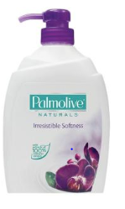
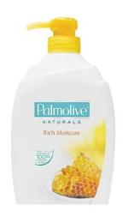
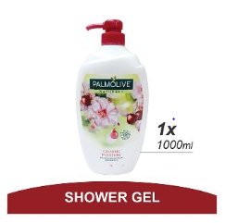
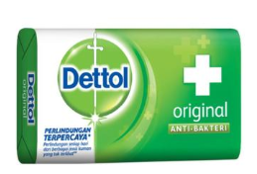
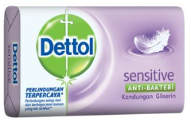
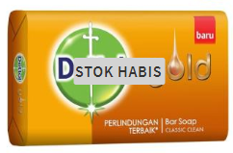
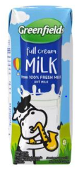
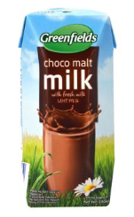
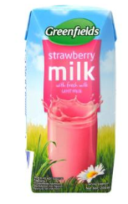
Product Bundles (1/2)
Product A
Product B
Product C
Bundle Type
Allow user to select bundle size(2 or 3), fragrance type and quantity of each products
Milk and Black Orchid Shower Milk Bath Soap
Milk and Honey Shower Milk Bath Soap
Milk and Strawberry Shower Milk Bath Soap
Allow user to select bundle size(2 or 3), fragrance type and quantity of each products
Dettol Soap
Dettol Sensitive Soap
Dettol Gold Soap
Allow user to select bundle size(2 or 3), fragrance type and quantity of each products
Full Cream Milk
Chocolate Flavored Milk
Strawberry Flavored Milk

Slide 3

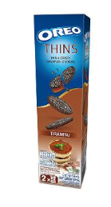
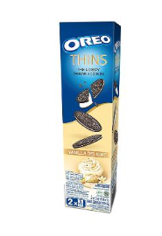
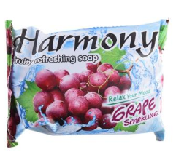
Product Bundles (2/2)
Product A
Product B
Bundle Type
Allow user to select quantity of each products
Closeup Toothpaste
Dettol Soap
Allow user to select quantity of each products
Oreo Biscuits: Chocolate
Oreo Biscuits: Vanilla
Allow user to select quantity of each products
Dettol Gold Soap
Fruity Refreshing Soap

Slide 4
Product Bundles (2/2)
Data Selection Criteria
6 months data from 2018-01-01 to 2018-06-30
Order Status BP, CX, D, FP, NCX, PU or C
Order type B2C
Customers who have bought atleast 2 different C3’s
Step 1
Count # of unique customers for all possible C3 combos (C3¹-C3², C3²-C3^{3,}, etc)
Step 2
For a given Sales Catalog, segment all combos in to High, Medium and Low segments based on #Customers
Step 3
Select Combos (for eg A1-B1 or B1-A1), where A1-B1 also lie in high segment and B1-A1 also lie in high segment.

