Slide 1
Product Bundling

Slide 2
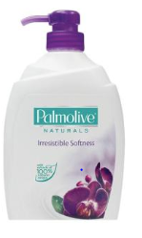
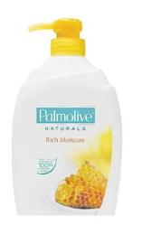
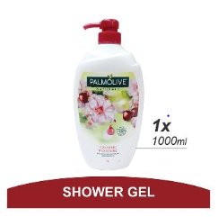
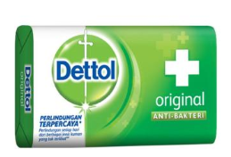
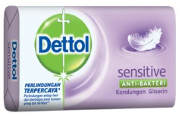
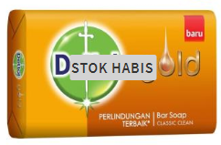
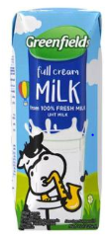
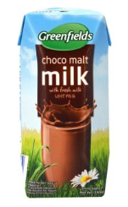
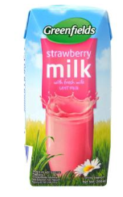
Product Bundles (1/2)
Product A
Product B
Product C
Bundle Type
Discount
Allow user to select bundle size(2 or 3), fragrance type and quantity of each products
2 Product: 11%
3 Products: 14%
Milk and Black Orchid Shower Milk Bath Soap
Milk and Honey Shower Milk Bath Soap
Milk and Strawberry Shower Milk Bath Soap
Allow user to select bundle size(2 or 3), fragrance type and quantity of each products
2 Product: 15%
3 Products: 20%
Dettol Soap
Dettol Sensitive Soap
Dettol Gold Soap
Allow user to select bundle size(2 or 3), fragrance type and quantity of each products
2 Product: 15%
3 Products: 20%
Full Cream Milk
Chocolate Flavored Milk
Strawberry Flavored Milk

Slide 3

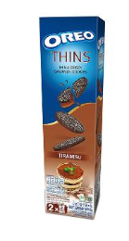
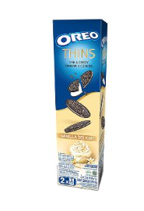
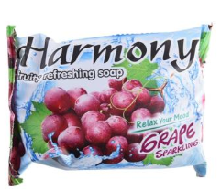
Product Bundles (2/2)
Product A
Product B
Bundle Type
Discount
Allow user to select quantity of each products
15%
Closeup Toothpaste
Dettol Soap
Allow user to select quantity of each products
15%
Oreo Biscuits: Chocolate
Oreo Biscuits: Vanilla
Allow user to select quantity of each products
15%
Dettol Gold Soap
Fruity Refreshing Soap

Slide 4
procedure
Step 1: Target Data
Online supermarket division of an e-commerce firm in Indonesia is chosen for Product Bundling
Step 2: Manual Pruning
Bulk buyers are excluded from the analysis
Step 3: Data Modification
Overall, any user tends to place second order on 25th day after the first purchase
Since the division launched in April’18, only 6 months of data was used – this also eliminated the big promotion days of Q4’18
Only the top products which contribute to 40% of the orders are taken into consideration
All products purchased inside 25 days are considered to be a single transaction for each user
Products which are repeatedly ordered inside 25 days by most users are chosen for the analysis
Step 4: Defining Associations
Apriori Algorithm is used to generate association rules
Support level of 10% and Confidence level of 50% are used
Step 5: Validation
Top 5 - 6 rules with the highest Lift and which satisfy the following are selected -
Higher probable buyers & make business sense & are similarly priced

