Slide 1



AUDIO EMOTION RECOGNITION SYSTEM USING DEEP LEARNING
Kaustubh haridas Tikar-10526351
Msc. Data Analytics
Project Guide: Prof. Abhishek Kaushik

Slide 2

Introduction
Speech is one of the most well-known methods in which human machine correspondence is built up.
We describe speech emotion recognition (SER) systems as assembly of methodologies that process and categorize speech signals to distinguish the rooted emotions.
RAVDESS dataset is used for this purpose which consists of 8 emotions neutral, calm, happy, sad, angry, fearful, disgust and surprised speech and songs of 24 expert entertainers.
CNN and LSTM models of Deep Learning are implemented further which will provide importance to different aspects and objects in the input and finally will differentiate them from each other
Recognizing human emotions by machine gives a big advantage in areas such as games, virtual reality, robotics, call center, etc.

Slide 3
Motivation
Speech emotion recognition (SER) intends to perceive the basic enthusiastic condition of a speaker from her voice.
There are numerous uses of recognizing the feeling of the people like in the interface with robots, sound observation, online E-learning, business applications, clinical investigations, diversion, banking, call focuses and so on.
The main objective is to introduce a Audio Emotion Recognition (AER) system which can provide better accuracy and gain an in depth knowledge of Deep Neural Network.
To understand emotions in a better way to improve classification process.

Slide 4

Literature review
The study (Haiqing Zheng, 2019)puts emphasis on recognizing the musical/song by using deep neural network. The design of emotion recognition consists of four networks. At the very beginning is the ID CNN layer followed by TD-FC layer. Then comes BiGRU layer for mining the needed temporal for emotion recognition. And finally a system is built by risking a CNN layer on time-distributed layer producing an accuracy of 48%.But the accuracy appears to be quite low as compared with alternate standard model.
Whereas in (Mohan Ghai, 2017) SER is carried out to gain emotion such as anger, boredom, disgust, anxiety, sadness, happiness and neutral. Feature extraction was further done by combining 25 frames in segments and using this segments as data point’s leads to obtain increased features and averaging effect. Further energy is extracted from intensity of speech and then by combining MFCC feature and energy, clear view of emotion of speech are determined. Then SVM is applied followed by gradient boosting and Random Forest algorithm. Random forest gained maximum accuracy of 81.05%. And anger class received the highest accuracy and it was minimum for happiness.

Slide 5
Literature review
In (Jun Deng, 2017), focus is on exploring deep learning technique on anger detection on speech. Then a LSTM RNN architecture consisting one self-connected linear memory cell with three multiplicative gate which has one input gate, a forget gate and an output gate. Further, a network with two LSTM and two convolution layers is proposed with 200 hidden units per LSTM layers. The BLSTM model has obtained a maximum accuracy UARs of 80.1 % and 79.4 % for ComParE feature and log-mel filter bank and it was observed that deep neural network performs quite better.

Slide 6
Novelty in research and solution to the problem
In this research an attempt was made to gain an improved AER system compared to previous studies.
We are working on a dataset which consists of combination of both speech and songs.
Arrangement of data was made according to our eight proposed emotions. Eight folders are created with all of the emotion from 01 to 08 and then exported the files using OS library.
Here feature extraction is carried out using MFCC with 40 MFCC features.
Highest accuracy was obtained for CNN in comparison to other models as solution to the problem.

Slide 7
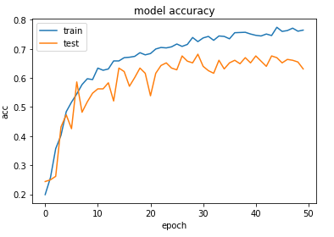
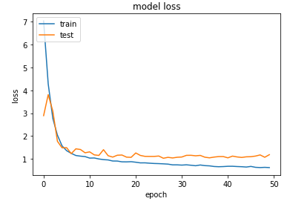
Result for cnn
Model accuracy for CNN
Model loss for CNN

Slide 8

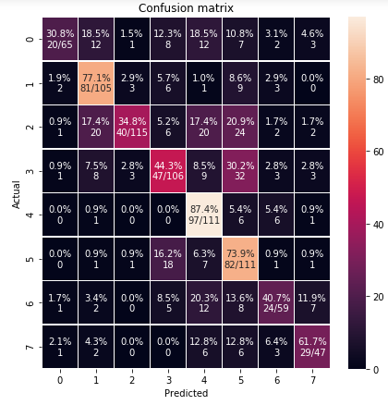
confusion matrix for cnn model

Slide 9
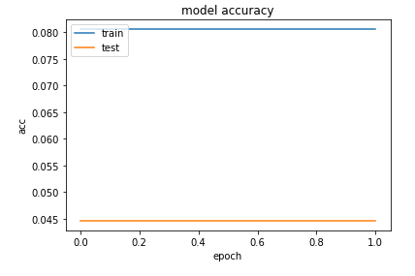
Result for lstm
Model accuracy for LSTM

Slide 10
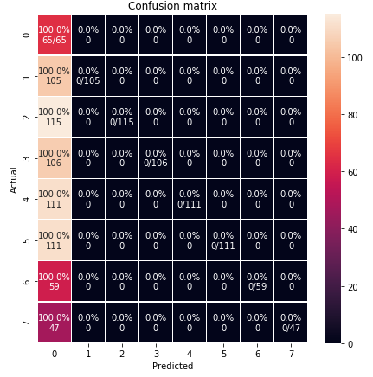
confusion matrix for Lstm model

Slide 11
Model Results
Models | Accuracy
Convolution Neural Network(CNN) | 76.44%
Random forest classifier | 69.54%
Decision Tree Classifier | 45.75%
SVM | 31.71%
Adaboost Ensemble Technique | 30.04%

Slide 12

Limitations and future work
Accuracy of recognition for both accent-based recognition and also the emotion-based recognition system for speech can be increased by increasing the number of records.
A single utterance may have different emotions where each part may represent some part of the utterance and boundary between these parts is not easy to determine hence making it difficult for predicting short emotion from the utterance.
In future multiple modality can be used for recognizing the human emotions and accordingly a fusion methodology can be implemented.
Multiparty conversational emotion recognition can be carried out.

Slide 13
thank you

