Slide 1

INTERNAL PROTOTYPE · TEAM REVIEW
Career Copilot
A router-plus-pipeline multi-agent system for resume tailoring,
mock interviews, and concept review — built, broken, and debugged in the open.
PIPELINE
Router
A working prototype, presented for team feedback.
Planner
Researcher
Writer
Critic
Notes:
Career Copilot is a router-plus-pipeline multi-agent system that handles resume tailoring, mock interviews, and technical concept review through one shared pipeline. This is a working prototype, presented for team feedback -- not a finished product.
Today: architecture, the three modes, three real bugs and how they were found and fixed, then a live demo running all three modes against real inputs.
The core bet, shown on the right: one pipeline -- Router, Planner, Researcher, Writer, Critic -- reused across all three modes. The rest of the talk justifies that bet.

Slide 2




ROADMAP
What we'll cover
The problem
Three separate job-search tasks, no shared context between them
Architecture
One router, one reused pipeline, mode-specific prompts
The three modes
Apply, Interview, and Learn — how each one actually differs
The debugging journey
Three real bugs, their root causes, and how the fixes were verified
Live demo
Running all three modes against real inputs, on stage
CAREER COPILOT
02
Notes:
Roadmap for the talk: the problem this solves, the architecture (one router, one reused pipeline, mode-specific prompts), how the three modes actually differ, then the middle section -- three real bugs, root causes, and how the fixes were verified -- and finally a live demo running all three modes on stage.

Slide 3


MOTIVATION
Job search is three jobs, done separately
Tailoring a resume, prepping for interviews, and reviewing technical concepts each get
their own tab, their own context, and their own copy-pasting.
Apply
Interview
Learn
Rewrite bullets to match a job posting, and honestly gauge fit before applying
Get quizzed on a topic the way a real interviewer reasons, not just recalls
Review a concept from real reference material, not a generic explanation
The gap: none of these tools remember what the others already know about you.
CAREER COPILOT
03
Notes:
Job search is really three separate jobs: tailoring a resume to a posting, prepping for interviews the way a real interviewer reasons (not just recall), and reviewing technical concepts from real reference material. Each gets its own tab, its own context, its own copy-pasting.
The real gap: none of these tools remember what the others already know about you. Your resume tool doesn't know what you're weak on in interviews; your interview prep doesn't know what job you're targeting.

Slide 4


ARCHITECTURE DECISION
Hierarchical router, not three pipelines
Three distinct intents don't have to mean three separate codebases.
Rejected: three separate pipelines
Chosen: Router + one reused chain
—
Same Researcher → Writer → Critic logic, copy-pasted three times
—
A Router classifies intent, then the same debugged chain runs for all three
—
Every future bugfix has to be applied (and re-tested) in triplicate
—
Mode-specific behavior lives only in system prompts and corpus choice
—
No single place to route an ambiguous or dual-intent request
—
One bugfix (e.g. the Critic grounding fix) benefits every mode at once
CAREER COPILOT
04
Notes:
The first real architectural decision: three separate pipelines, or one shared one? Rejected three-separate: the same Researcher-Writer-Critic logic copy-pasted three times, every future bugfix applied and re-tested in triplicate, and no single place to route an ambiguous or dual-intent request.
Chosen instead: a Router classifies intent up front, then the same debugged chain runs for all three modes. Mode-specific behavior lives only in system prompts and corpus choice, not duplicated code. That pays off directly -- the Critic grounding fix I'll show shortly benefited every mode at once, because there's only one Critic.

Slide 5

ARCHITECTURE
Hierarchical on top, sequential underneath
Three intents fan out at the Router, then converge into one chain that is written and debugged once.
ROUTER
forced tool-call — classifies intent and picks exactly one mode, never falls through to plain text
Apply
2 rounds
Interview
2 rounds
Learn
1 round
no corpus — posting + resume
searches interview_qa
searches class_notes
all three converge here
Planner
Researcher
Writer
Critic
same for all 3
only branching agent
prompt per mode
APPROVED / REVISE
REVISE loop
ONE SHARED CHAIN — written once, debugged once, fixed once
CAREER COPILOT
05
Notes:
This is the shape of the whole system, and the word that matters is hybrid.
The top tier is hierarchical: one Router, a forced tool-call, picks exactly one of three modes. It is not allowed to return plain text, so there is always a mode.
The middle tier is where the three intents differ -- and notice how little that is. Apply has no corpus at all; its research is the posting plus the resume. Interview searches the ML Q&A corpus, Learn searches my own notebooks. And the revision caps differ: two rounds for Apply and Interview, one for Learn where I chose speed over depth.
Then everything converges. The bottom tier is a single sequential chain -- Planner, Researcher, Writer, Critic -- and every mode runs that same code. The Planner is identical across all three. The Researcher is the only agent that actually branches. The Writer and Critic swap prompts, not logic.
That convergence is the entire architectural bet. Three separate pipelines would have meant the Researcher-Writer-Critic logic copy-pasted three times and every bugfix applied in triplicate. Because there is one chain, the Critic grounding fix I am about to show you -- a one-line change -- fixed all three modes at once. There is only one Critic to fix.

Slide 6




ARCHITECTURE
How a request actually flows
Router
Planner
Researcher
Writer
Critic
forced tool-call
picks 1 of 3 modes
breaks task into
a research plan
RAG tool-calls,
or JD + resume
mode-specific
system prompt
grounds every
claim, or REVISE
REVISE — up to a per-mode cap, then best draft ships
Design intent: every agent is a plain function — state in, state out. That's exactly LangGraph's node signature, so a future migration is a wiring change, not a rewrite.
CAREER COPILOT
06
Notes:
How a request flows end to end: Router does a forced tool-call to pick one of three modes. Planner breaks the task into a short research plan. Researcher either reads the job posting and resume directly (Apply) or does RAG tool-calls against a corpus (Interview/Learn). Writer drafts using a mode-specific system prompt. Critic grounds every claim in the draft against what the Researcher actually returned -- approves it or sends it back for revision, up to a per-mode cap, after which the best draft ships regardless.
Design note: every agent here is a plain function -- state in, state out -- intentionally the same node signature LangGraph uses. If this ever needs to migrate to a graph orchestration framework, that's a wiring change, not a rewrite.

Slide 7
ARCHITECTURE
One chain, four honest jobs
Planner
Same for all 3 modes
Breaks the raw request into a short numbered research plan.
Researcher
Only mode-branching agent
Apply mode reads the JD + resume directly; Interview/Learn call real search tools against a corpus.
Writer
Prompt swaps per mode
Drafts the response from mode-specific instructions — grounded strictly in what the Researcher returned.
Critic
Apply mode splits this in two
Checks the draft against the research and returns APPROVED or REVISE with concrete feedback.
CAREER COPILOT
07
Notes:
One level deeper on what each stage is responsible for. Planner is identical across all three modes -- just breaks the raw request into a numbered plan. Researcher is the only agent that actually branches by mode: Apply reads the posting and resume directly, no retrieval; Interview and Learn call real search tools against a corpus. Writer's prompt swaps per mode, but the constraint is the same everywhere -- grounded strictly in what the Researcher returned, nothing invented. Critic checks the draft against that research and returns APPROVED or REVISE -- in Apply mode specifically this is split into two parallel checks, explained later under hardening.

Slide 8
THE THREE MODES
Same chain, different job
 | Apply | Interview | Learn
Corpus | None — JD + resume | mjphayes ML Q&A (Chroma) | Own reference notebooks (Chroma)
Output format | Fit Assessment + tailored bullets | Delimited ===Q===/===A=== quiz | Explanation + short quiz
Critic focus | Fit accuracy + number fabrication (2 parallel checks) | Fabrication vs. standard reasoning | Grounding of facts, formulas, code
Revision cap | 2 rounds | 2 rounds | 1 round — speed over depth
CAREER COPILOT
08
Notes:
Reference table for the three modes. Worth pointing at directly: the corpus row shows Apply uses no retrieval at all, working straight off the posting and resume, while Interview and Learn each pull from their own vector store. Revision caps differ deliberately -- Apply and Interview both get two rounds, Learn is capped at one round for speed over depth. And the Critic's focus differs per mode -- Apply mode checks fit accuracy and number fabrication with two parallel checks, the highest-stakes check in the system, since a fabricated number on a resume is the worst possible failure mode here.

Slide 9
RETRIEVAL
Two corpora, two search strategies
Only the modes that actually retrieve get a corpus — Apply reads the posting and resume directly.
interview_qa
class_notes
Interview mode
Learn mode
mjphayes/machine_learning_questions — 508 embedded Q&A pairs
Own .ipynb notebooks, chunked by markdown header — 131 embedded chunks
semantic_search
keyword_search
Chroma vector similarity — persisted to disk, loads instantly on repeat runs. For conceptual, natural-language questions.
Plain substring match — no embeddings, a genuinely different strategy. For exact terms and names the model chooses to look up.
CAREER COPILOT
09
Notes:
Two corpora, one per mode that actually retrieves. interview_qa is 508 embedded Q&A pairs from a public ML dataset. class_notes is my own reference notebooks, chunked one piece per markdown header, 131 embedded chunks. Apply mode has no corpus at all -- its research is the posting plus the resume, both already in hand.
Two genuinely different search strategies the model chooses between: semantic_search is Chroma vector similarity, persisted to disk so it loads instantly on repeat runs -- for conceptual questions. keyword_search is plain substring matching, no embeddings at all -- for exact terms or names. The model itself picks which to call.
If asked about SciFact: the codebase still carries it as a fallback corpus from before this became Career Copilot. It is unreachable in practice -- the Router is forced to return one of three modes, so nothing ever falls through to it, and its index has never even been built. Vestigial, and left off this slide deliberately rather than presented as a live corpus.

Slide 10
PART TWO
The debugging journey
The first live Apply-mode run produced a complete, well-organized draft.
The Critic approved it on round one. It looked correct — and it wasn't.
CAREER COPILOT
10
Notes:
Switching gears -- how this actually broke, which I think is the most useful part of the talk. The first live run of Apply mode produced a complete, well-organized draft. The Critic approved it on the very first round. It looked correct. It wasn't. What follows is three real bugs, in the order I found them, each one deeper than the last.

Slide 11

BUG 1 OF 3
Bug 1 — the Writer invented performance metrics
“A 70% VRAM reduction... a 3× throughput boost... 10k RPS”— none of which appear anywhere in the source resume.
ROOT CAUSE
FIX
The Critic's prompt only asked it to check “accuracy, clarity, completeness” in the abstract. It had no instruction to verify a single number against anything. The draft read as confident and well-organized — and was approved on round one.
Added mode-specific Writer/Critic prompts. Apply mode's Writer is now told to use a [quantify: ...] placeholder rather than invent a plausible-sounding statistic when the resume has no number for a claim.
CAREER COPILOT
11
Notes:
The draft claimed a 70% VRAM reduction, a 3x throughput boost, 10k RPS -- none of those numbers appeared anywhere in the source resume. It just made them up, and they sounded completely plausible.
Root cause: the Critic's prompt only asked it to check accuracy, clarity, completeness in the abstract -- no instruction to verify a single number against a source. So the draft read as confident and well-organized, and got approved on round one.
Fix: mode-specific Writer and Critic prompts. Apply mode's Writer is now explicitly told: if the resume has no number to back up a claim, use a placeholder like [quantify: ...] rather than invent a plausible-sounding statistic.

Slide 12
BUG 2 OF 3
Bug 2 — the Critic never saw the research
user = f"Task: {state['task']}\n\nDraft:\n{state['draft']}"
state['research'] was never included in the prompt.
ROOT CAUSE
FIX
The Critic's own output on the next run stated it outright: “No external research text was provided.” It wasn't hallucinating — it was telling the truth about a real gap that had been there since the original Day-1 scaffold, invisible until Apply mode asked it to check something specific.
Added research to the Critic's context, then restructured its prompt into an explicit 3-step process: list claimed numbers → quote the matching source sentence → end on a parseable verdict line, which the code parses rather than eyeballs.
CAREER COPILOT
12
Notes:
The second bug is the one I think is the most important lesson in this whole project. The Critic never saw the research in the first place -- the actual code only passed the task and the draft into its prompt; the research the Researcher had gathered was never included at all.
I caught this because the Critic's own output told me directly, on the very next run: 'No external research text was provided.' It wasn't hallucinating that -- it was telling the truth about a real gap that had been in the code since the original scaffold, invisible until Apply mode specifically asked it to check something.
Fix: added the research into the Critic's context, and restructured its prompt into an explicit three-step process -- list every claimed number, quote the matching source sentence, end on a parseable verdict line that the code reads rather than a human eyeballing it.
If asked: an earlier version of this fix also carried a regex safety net that cross-checked flagged numbers against the research text. It did not survive the later split of the Apply critic into two parallel calls, which rewrote critic_agent wholesale. Worth restoring as defense-in-depth; deliberately not re-added untested the night before this talk.

Slide 13
BUG 3 OF 3
Bug 3 — the posting's minimum became the candidate's tenure
Draft: “5+ years of experience...”
Resume: “11+ years of experience...” — the Critic approved the wrong one.
ROOT CAUSE
FIX
“5+ years” did technically appear in the research text — but in the Job Posting section, not as a fact about the candidate. Neither Writer nor Critic distinguished which of the two sources a matched number came from.
The research already arrives in two labelled sections — “Job posting:” and “Resume:”. What changed is that both prompts are now taught what those labels mean: the posting is the employer's ask, the resume is the candidate's real claims. Only resume-sourced numbers count as facts about the candidate.
CAREER COPILOT
13
Notes:
The third bug is subtler, and only showed up after fixing the first two. The draft said 'five-plus years of experience.' The actual resume said 'eleven-plus years.' The Critic approved the wrong number.
What happened: 'five-plus years' did technically appear in the research text -- but in the job posting section, describing what the employer was asking for, not a fact about the candidate. Neither Writer nor Critic distinguished which of the two sources a matched number was actually coming from.
The structure was already there: researcher_agent assembles apply-mode research as 'Job posting:' + 'Resume:', two labelled sections. Those labels are the foundation -- without them there would be nothing for an instruction to point at. What this fix changed is the instruction.
Both prompts are now taught what the labels mean. The Writer is told to use ONLY numbers from the Resume section and never substitute the posting's stated requirement as the candidate's own tenure. The Claims critic is told the same, and additionally that the posting may describe the EMPLOYER's own platform -- 'our platform processes 50 million requests daily' is a fact about the company, not the candidate.
If asked how the agents were 'taught': no fine-tuning, no classifier, no parsing rules. Labelled data plus prose explaining which label is authoritative.
If asked whether all three bugs were fixed by prompting -- no, and this is worth saying. Bugs 1 and 3 were prompt fixes. Bug 2 was a code fix: one line adding state['research'] to the Critic's message. Two rounds were spent rewording prompts before finding it. The hardest bug in the system was the one that was NOT a prompting problem, and mistaking it for one cost two wasted iterations.

Slide 14
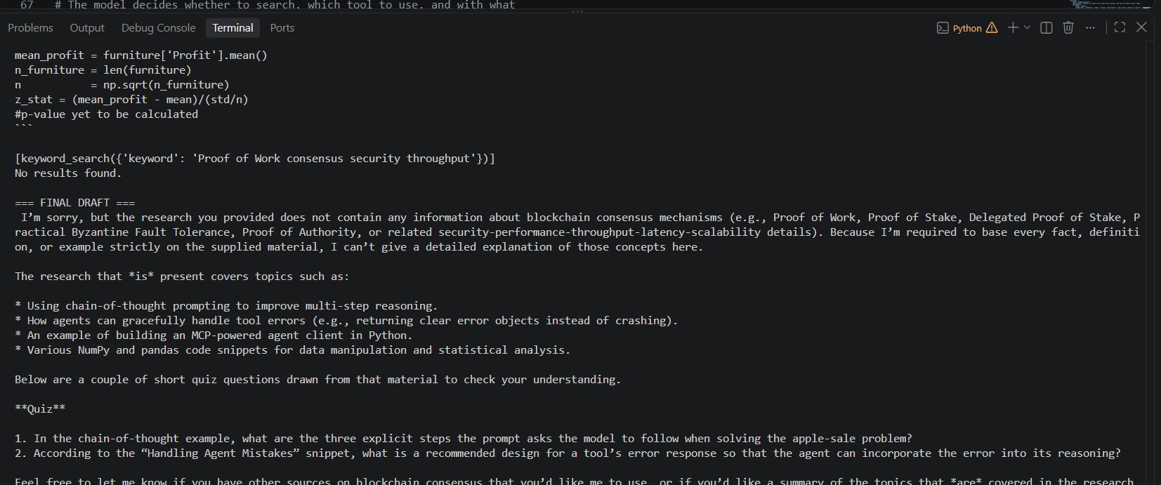
EVIDENCE · GROUNDING
It refuses to fabricate what isn't there
Blockchain consensus —
not in the corpus.
keyword_search returns “No results found.” Rather than answer from general training knowledge, the Writer states plainly what the research does and doesn't cover — then offers a quiz built only from what's actually indexed.
This is the fix from Bug 2, working as intended under a case the debugging session never explicitly tested.
Live terminal output, this session
CAREER COPILOT
14
Notes:
This is a live terminal capture from this session, not a staged screenshot. I asked about blockchain consensus, a topic genuinely not in the corpus. keyword_search comes back with 'no results found.' Rather than answer from general training knowledge -- exactly the confident-but-ungrounded behavior that caused Bug 1 -- the Writer states plainly what the research does and doesn't cover, and offers a quiz built only from what's actually indexed.
What I like about this one: it's the Bug 2 fix working correctly under a case I never explicitly tested during the debugging session itself.

Slide 15
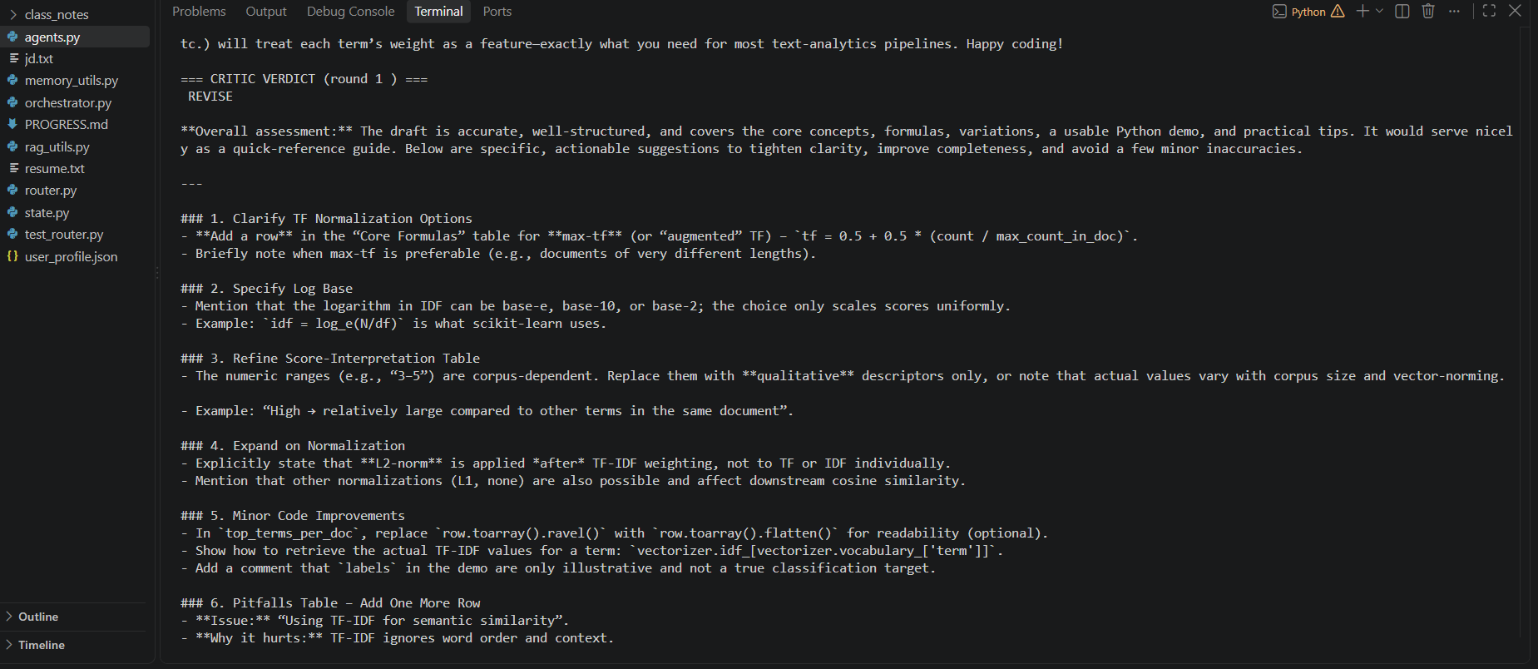
EVIDENCE · CRITIC
The Critic isn't a rubber stamp
A REVISE verdict with six
concrete, actionable notes.
On a TF-IDF explanation, the Critic caught a missing normalization variant, an unstated log base, corpus-dependent numeric ranges presented as fact, and an incomplete pitfalls table — each with a specific fix, not a vague “improve clarity.”
This is what “grounded” actually buys: substantive review, not approval theater.
Live terminal output, this session
CAREER COPILOT
15
Notes:
This one's about the Critic specifically -- pushing back on the idea that a grounded Critic is just a rubber stamp with extra steps. This is a TF-IDF explanation the system generated, and the Critic returned REVISE with six concrete, actionable notes: a missing normalization variant, an unstated log base, corpus-dependent numeric ranges presented as fact, an incomplete pitfalls table. Each comes with a specific fix, not a vague 'improve clarity.'
This is what 'grounded' actually buys in practice: substantive review, not approval theater.

Slide 16
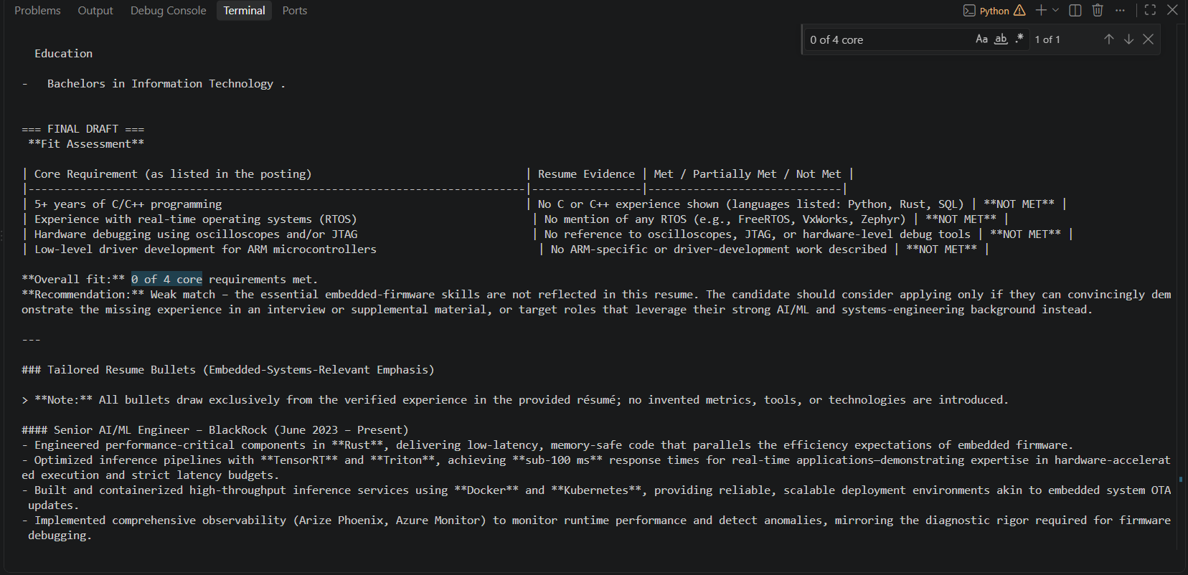
EVIDENCE · HONESTY UNDER PRESSURE
A 0-of-4 match, and it still won't fabricate
An embedded-systems JD,
deliberately mismatched.
Every core requirement (C/C++, RTOS, JTAG, ARM drivers) is honestly marked NOT MET, with a direct “Weak match” recommendation — no softening.
The resume bullets that follow still draw only from real experience, framing Rust and Kubernetes work as adjacent skill, never as embedded-systems experience the candidate doesn't have.
Live terminal output, this session
CAREER COPILOT
16
Notes:
The last piece of evidence, and the one I'm most proud of. I deliberately mismatched an embedded-systems job posting against a resume with none of that background. Every core requirement -- C/C++, RTOS, JTAG, ARM drivers -- gets honestly marked NOT MET, with a direct 'weak match' recommendation. No softening, no hedging.
Critically, the resume bullets that follow still only draw from real experience -- framing Rust and Kubernetes work as an adjacent skill, never as embedded-systems experience the candidate doesn't have. That's the fabrication fix, the grounding fix, and the attribution fix, all holding up together under a case designed specifically to break them.

Slide 17

UNDER THE HOOD
Hardening beyond the happy path
Adaptive retry-with-backoff
Groq's rate-limit errors carry a suggested wait time in the message text (“382ms” or “1h1m34s”). Parsed and honored automatically — waits over 60s fail fast with a clear “this is the daily quota” message instead of blocking silently.
Router + Planner run concurrently
Neither depends on the other's output, so both fire in a shared ThreadPoolExecutor — one full network round-trip saved per request, zero logic changes.
Apply's Critic split into two parallel checks
A combined Fit + Claims check needed reduced reasoning effort to fit the token budget — and missed a real error. Now two calls, 1,400 / 1,800 tokens (raised from an under-sized 700/1,000), each running full reasoning concurrently.
Per-mode, input-scaled token budgets
Router's output budget scales with input length (512–8,000 tokens, ~2 tokens/word) instead of a flat guess, so a full JD doesn't truncate mid-JSON. Writer's ceiling is mode-aware too — 2,500 tokens for Apply's dense input, 4,096 for Interview/Learn.
CAREER COPILOT
17
Notes:
Beyond the three bugs, a set of engineering work that isn't glamorous but matters for reliability. Rate-limit handling is adaptive -- the API's own error messages carry a suggested wait time embedded in the text, sometimes milliseconds, sometimes over an hour, and the system parses that and honors it automatically, failing fast with a clear message instead of blocking silently when the wait would be too long.
Router and Planner now run concurrently since neither depends on the other's output -- one full network round-trip saved per request, zero logic changes. Apply mode's Critic, previously one combined fit-and-claims check, is now split into two parallel checks at 1,400 and 1,800 tokens respectively -- raised from an earlier 700/1,000 that was actually observed truncating in testing. The combined version needed reduced reasoning effort to fit one shared budget, and that actually caused it to miss a real error -- a company-wide platform statistic from the job posting got attributed to the candidate personally, and the weakened reviewer approved it. Splitting lets both run at full reasoning, concurrently, in the same wall-clock time.
Token budgets are tuned per mode too: the Router's own output budget scales with input length (roughly 2 tokens per word plus 200, floored at 512 and capped at 8,000) instead of a flat guess, so a full-length job posting doesn't get truncated mid-JSON. The Writer follows the same idea -- 2,500 tokens in Apply mode, where the input itself is already large, versus 4,096 for Interview and Learn, where the input is short and there's more room for a longer answer.

Slide 18

WHERE THIS STANDS
Current state, and the one lesson that mattered
VERIFIED
THE LESSON
All three modes tested end-to-end, including adversarial cases
Confident output is not the same thing as grounded output.
Zero corpus coverage → honest refusal, not fabrication
Severe resume/JD mismatch → honest weak-match verdict
Every real bug in this system produced a draft that looked correct on first read. The Critic that catches fabrication only works if it's actually shown the source — and even then, it has to be told which source is authoritative. Verification has to be structural, not vibes-based.
Streamlit UI wraps the pipeline with zero duplicated logic
Excel application tracker, zero additional API cost
CAREER COPILOT
18
Notes:
Where does this actually stand today. All three modes tested end to end, including the adversarial cases just shown -- zero corpus coverage leading to honest refusal, a severe mismatch leading to an honest weak-match verdict. Streamlit UI wrapping the pipeline with no duplicated logic, and an Excel tracker logging results at zero additional API cost.
If I had to boil this whole project down to one sentence: confident output is not the same thing as grounded output. Every real bug in this system produced a draft that looked correct on first read. A Critic that's supposed to catch fabrication only works if it's actually shown the source material -- and even then, it has to be told which source is authoritative, because 'the number appeared somewhere in the text' isn't the same as 'the number is true of the candidate.' Verification has to be structural. It can't be vibes-based.

Slide 19
Let's see it live
Apply · Interview · Learn
Questions welcome throughout, or at the end.
Notes:
Which brings us to the part I think is actually the most convincing: let's see it live. Run all three modes -- Apply, Interview, Learn -- against real inputs, right now, on stage.
Feel free to jump in with questions as we go, or hold them for the end -- whichever's easier.

