Slide 1
Custom Active BMS Design for Commercial Battery Packs
Group 23: Shivam Hallale – 612305027
Kaustubh Joshi - 612305035
Siya Jadhao - 612305031
Mentor: Prof. Vinodini Bhole

Slide 2
System Architecture Block Diagram
VOLTAGE AND CURRENT MEASUREMENT
Coulomb Counting Circuit
ADC and Multiplexer
MICROCONTROLLER
CELL – BALANCING CIRCUIT
BATTERY PACK
BATTERY PROTECTION CIRCUIT
EXTERNAL LOAD/CHARGING SOURCE

Slide 3
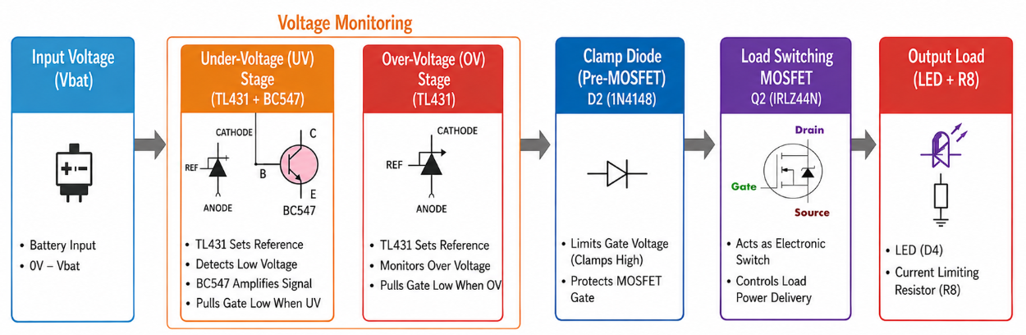
Protection Circuit

Slide 4
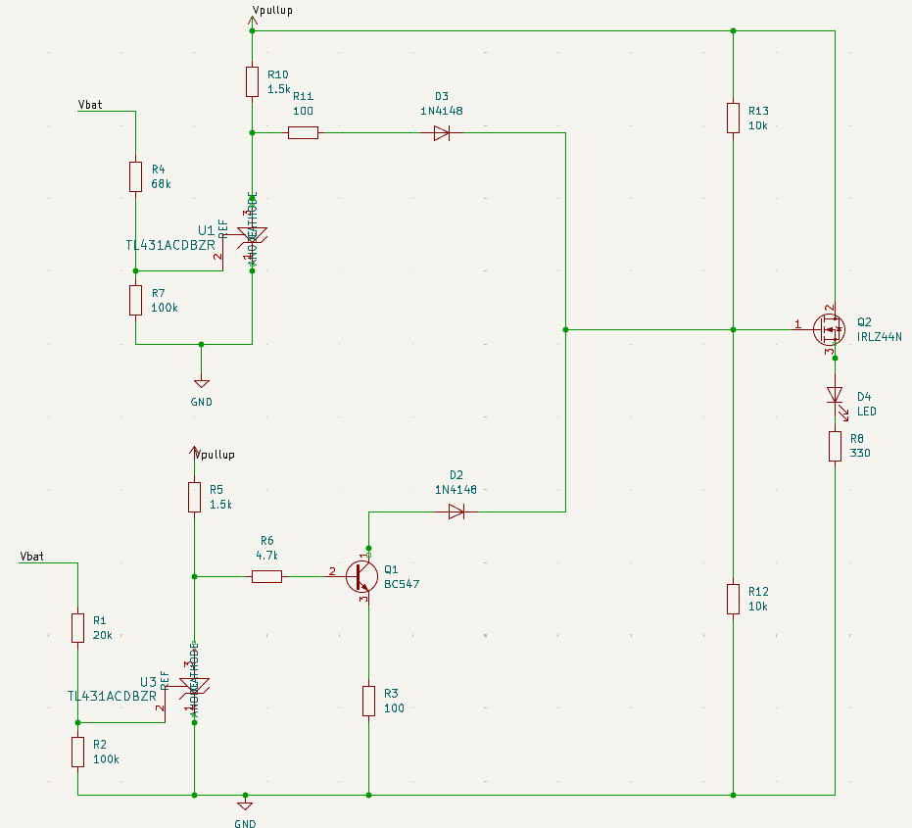
Sets overvoltage threshold
WIRED OR CONFIGURATION OF DIODE
Load Switch + Load
Precision Voltage Comparator
Sets undervoltage threshold
MOSFET Gate Driver

Slide 5
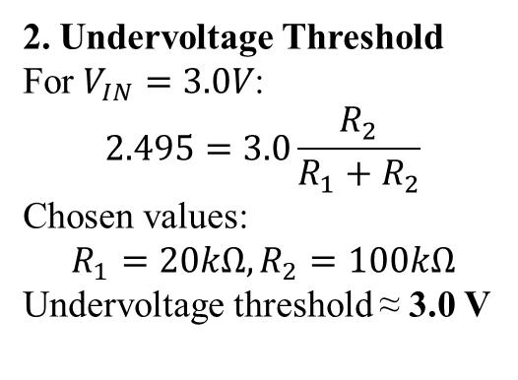
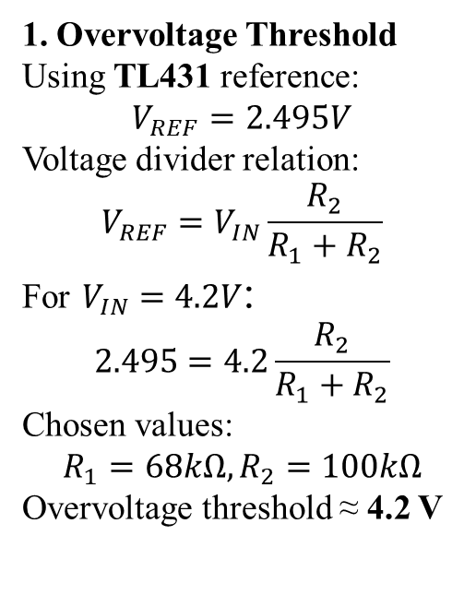
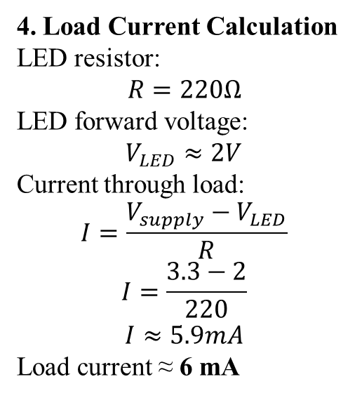
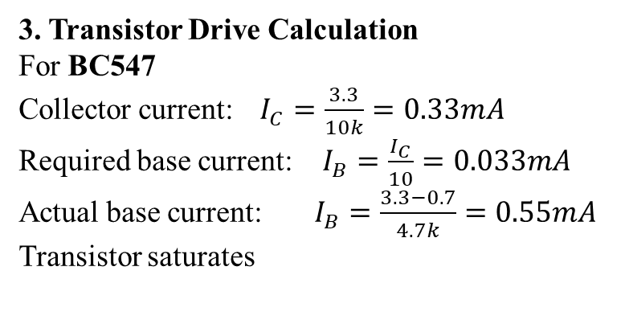
Design Calculations
1. Overvoltage Threshold
Using TL431 reference:
$$V_{REF}=2.495V$$
Voltage divider relation:
$$V_{REF}=V_{IN}\frac{R_{2}}{R_{1}+R_{2}}$$
For $V_{IN}=4.2V$:
$$2.495=4.2\frac{R_{2}}{R_{1}+R_{2}}$$
Chosen values:
$$R_{1}=68kΩ, R_{2}=100kΩ$$
Overvoltage threshold ≈ 4.2 V
2. Undervoltage Threshold
For $V_{IN}=3.0V$:
$$2.495=3.0\frac{R_{2}}{R_{1}+R_{2}}$$
Chosen values:
$$R_{1}=20kΩ, R_{2}=100kΩ$$
Undervoltage threshold ≈ 3.0 V
4. Load Current Calculation
LED resistor:
$$R=220Ω$$
LED forward voltage:
$$V_{LED}≈2V$$
Current through load:
$$I=\frac{V_{supply}−V_{LED}}{R}$$
$$I=\frac{3.3−2}{220}$$
$$I≈5.9mA$$
Load current ≈ 6 mA
3. Transistor Drive Calculation
For BC547
Collector current: $I_{C}=\frac{3.3}{10k}=0.33mA$
Required base current: $I_{B}=\frac{I_{C}}{10}=0.033mA$
Actual base current: $I_{B}=\frac{3.3−0.7}{4.7k}=0.55mA$
Transistor saturates

Slide 6
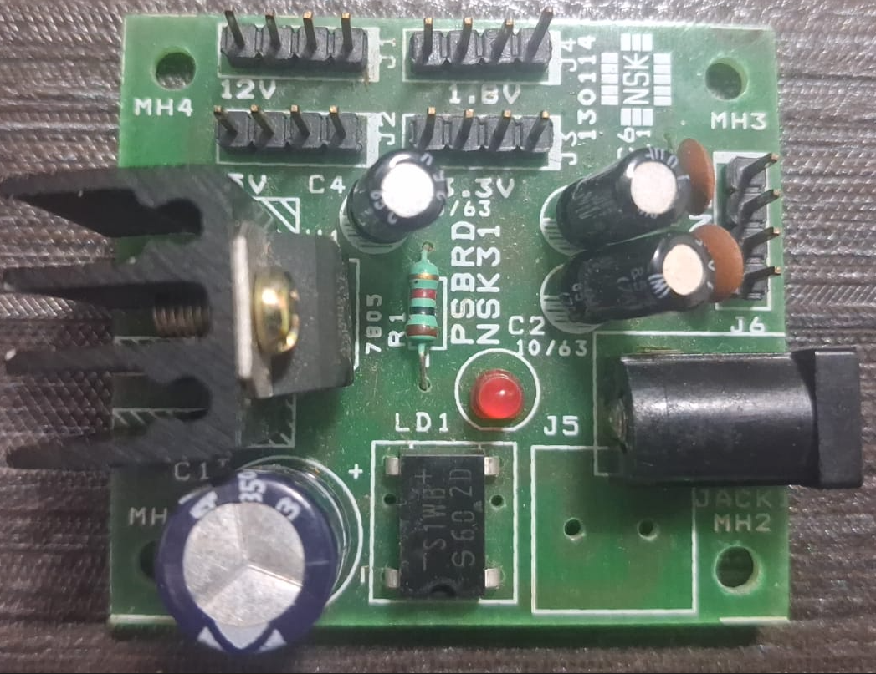
Breadboard Testing
Power Supply Board
This is a Power Supply Board from NSK31
Output headers labeled:
1.8V
3.3V
5V
12V
It is powered by an adapter

Slide 7
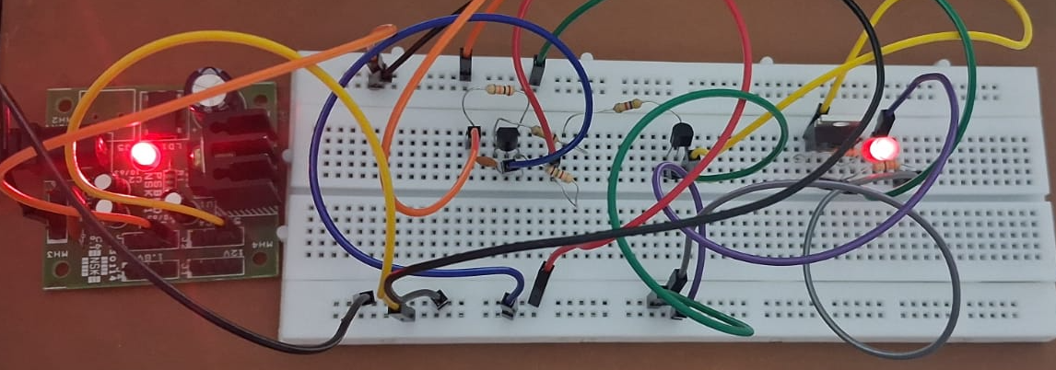
Undervoltage Detection Circuit
Normal Operating Condition Vbat=3.3V

Slide 8
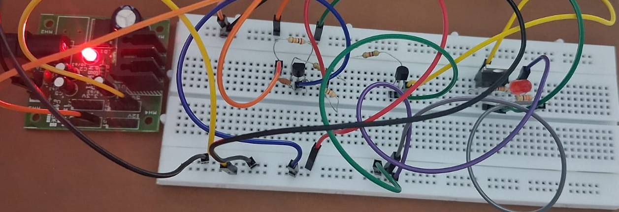
Undervoltage Detection Circuit
Undervoltage Condition Vbat=1.8V

Slide 9
Results
Undervoltage Circuit:
Voltage | Operating Condition | LED
1.8V | Undervoltage | OFF
3.3V | Normal | ON
5V | Overvoltage | ON
12V | Overvoltage | ON

Slide 10
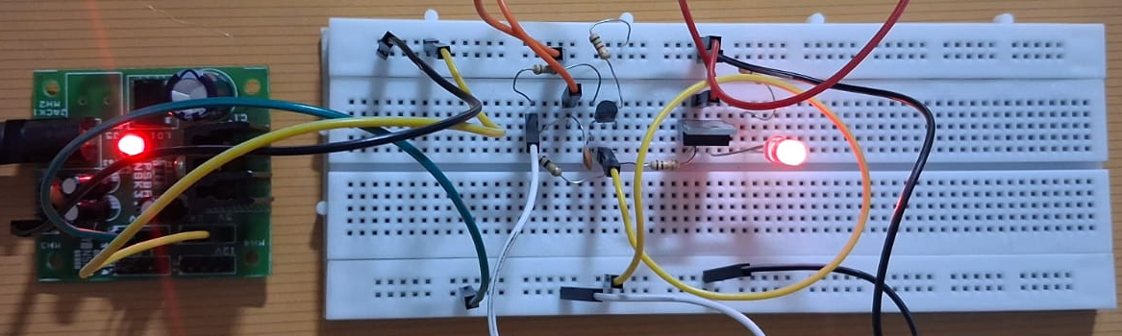
Overvoltage Detection Circuit
Normal Operating Condition Vbat=3.3V

Slide 11
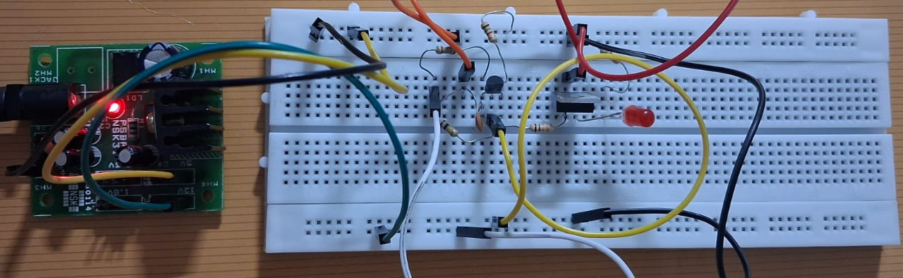
Overvoltage Detection Circuit
Overvoltage Operating Condition Vbat=12V

Slide 12
Results
Overvoltage Circuit:
Voltage | Operating Condition | LED
1.8V | Undervoltage | ON
3.3V | Normal | ON
5V | Overvoltage | OFF
12V | Overvoltage | OFF

Slide 13
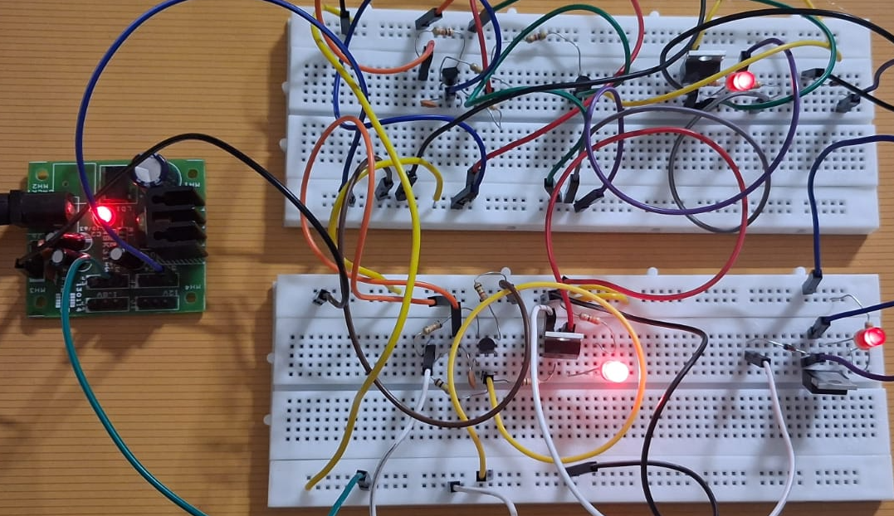
Combined Circuit
Normal Operating Condition Vbat=3.3V

Slide 14
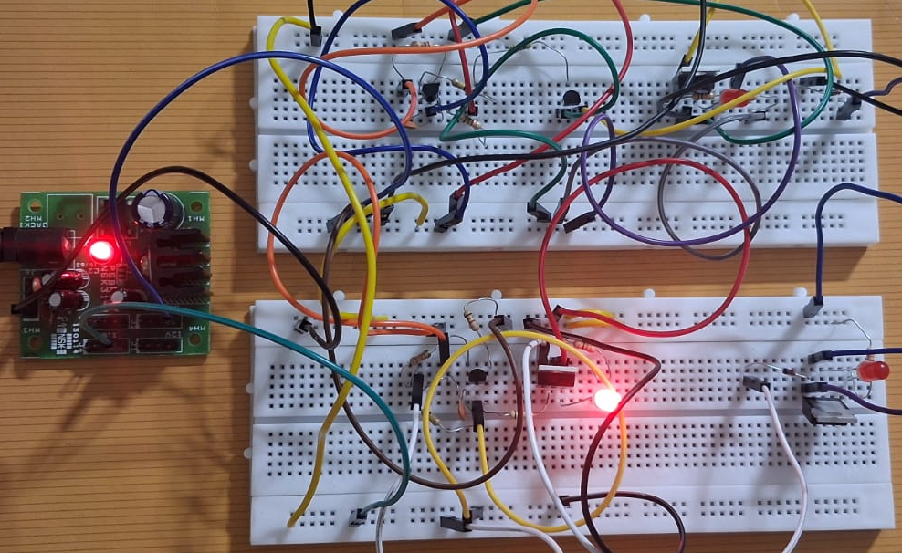
Combined Circuit
Undervoltage Operating Condition Vbat=1.8V

Slide 15
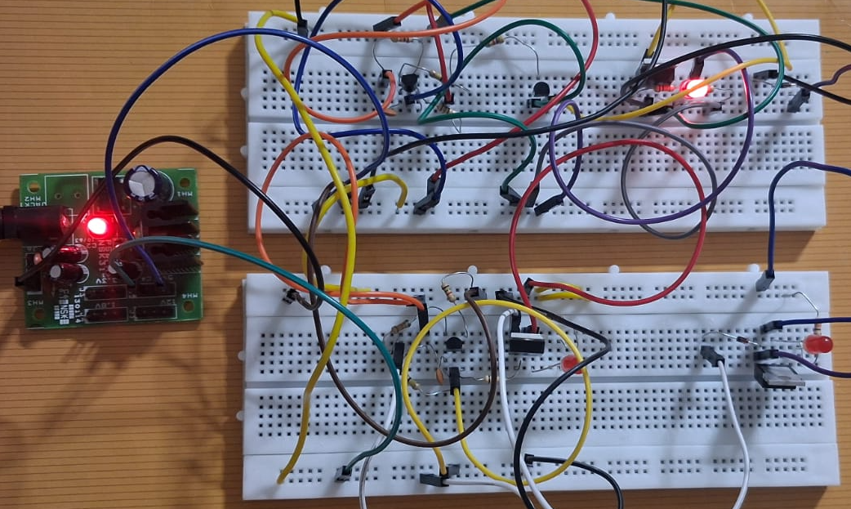
Combined Circuit
Overvoltage Operating Condition Vbat=12V

Slide 16
Results
Combined Circuit:
Voltage | Operating Condition | LED 1 | LED 2 | LED3
1.8V | Undervoltage | OFF | ON | OFF
3.3V | Normal | ON | ON | ON
5V | Overvoltage | ON | OFF | OFF
12V | Overvoltage | ON | OFF | OFF

Slide 17
Design Choice: TL431 vs Op-Amp Comparator
Parameter | TL431 | Typical Op-Amp (e.g. LM358)
Internal reference voltage | 2.495 V ±1% | No internal reference
Supply voltage range | 2.5 V – 36 V | 3 V – 32 V
Cathode current | 1 mA – 100 mA | Output current ≈ 20 mA max
Component count | 1 IC + 2 resistors | 1 op-amp + reference + 4–6 resistors
Power consumption | ≈2.5 mW (at 1 mA) | ≈1–2 mA quiescent current
Accuracy | ±1% reference | Depends on external reference
Cost (approx) | ₹8–₹12 | ₹20–₹40
Reason for Selecting TL431
Built-in 2.495 V precision reference
Fewer components required
Simpler circuit design
Lower cost and power consumption

Slide 18
TL431 Adjustable Shunt Voltage Reference
Parameter | Required in Circuit | TL431 Value | Justification
Reference voltage | Stable threshold reference | 2.495 V | Provides accurate voltage detection
Threshold adjustment | Adjustable detection limits | Adjustable via resistor divider | Allows setting 3.0 V and 4.2 V thresholds
Accuracy | Precise detection required | ±1% typical | More accurate than Zener diode
Output type | Ability to pull control node LOW | Current sinking output | Suitable for window detection
Component count | Simple circuit preferred | Only few resistors required | Reduces circuit complexity

Slide 19
BC547 NPN Transistor
Parameter | Required in Circuit | BC547 Value | Justification
Transistor type | NPN switching transistor | NPN | Suitable for gate-driving stage
Collector current | ≈0.33 mA required | 100 mA max | Large safety margin
Current gain (β) | Enough to saturate transistor | 110–800 | Ensures reliable switching
Voltage rating | >3.3 V | 45 V | Safe operation
Cost & availability | Easily available device | Very common transistor | Practical for implementation

Slide 20
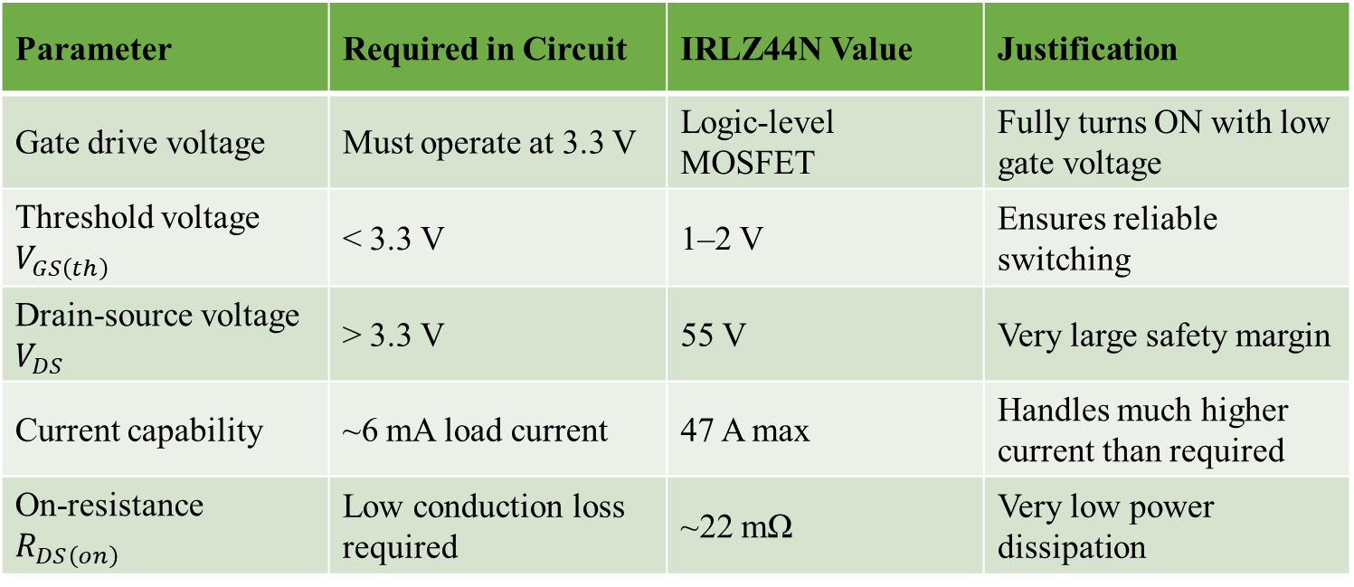
IRLZ44N Logic-Level N-Channel MOSFET
Parameter | Required in Circuit | IRLZ44N Value | Justification
Gate drive voltage | Must operate at 3.3 V | Logic-level MOSFET | Fully turns ON with low gate voltage
Threshold voltage $V_{GS\left(th\right)}$ | < 3.3 V | 1–2 V | Ensures reliable switching
Drain-source voltage $V_{DS}$ | > 3.3 V | 55 V | Very large safety margin
Current capability | ~6 mA load current | 47 A max | Handles much higher current than required
On-resistance $R_{DS\left(on\right)}$ | Low conduction loss required | ~22 mΩ | Very low power dissipation

Slide 21
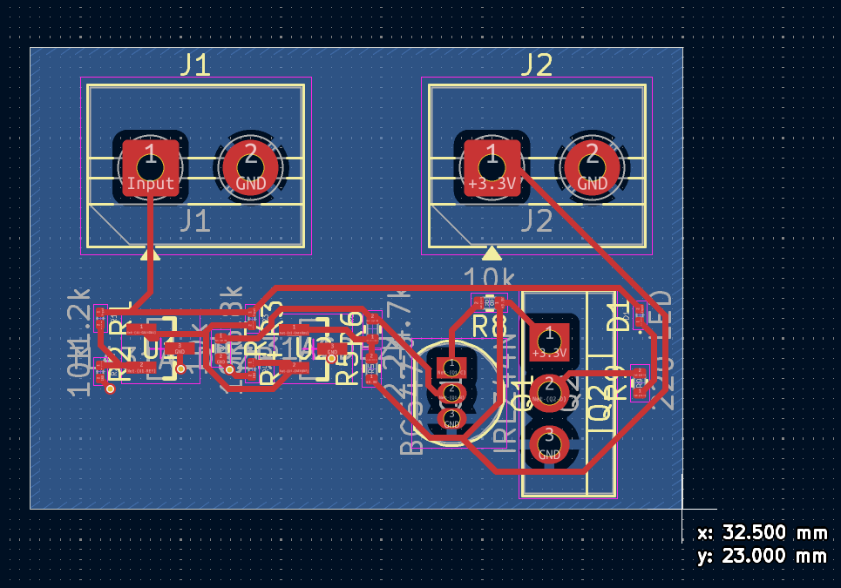
PCB Design
The PCB implements the voltage protection circuit in a compact single-layer layout with organized component placement and routing.
Connectors:
J1 receives the monitored input voltage (Vin) and ground
J2 supplies +3.3 V and GND for circuit operation
Component Placement:
TL431 devices placed near the sensing network for accurate voltage detection.
BC547 transistor positioned between detection and switching stages to drive the MOSFET gate.
IRLZ44N MOSFET located close to the output path for efficient load switching
Routing Parameters:
Signal trace width: 0.30 mm
Power trace width: 0.50 mm
Minimum clearance: 0.18 mm

Slide 22
Fuel Gauge Block Diagram
CURRENT MEASUREMENT
LOW PASS FILTER
MICROCONTROLLER
CURRENT INTEGRATOR
Bipolar to Unipolar Converter
Anti-Aliasing LPF
Analog Mux and ADC
VOLTAGE MEASUREMENT
LOW PASS FILTER

Slide 23
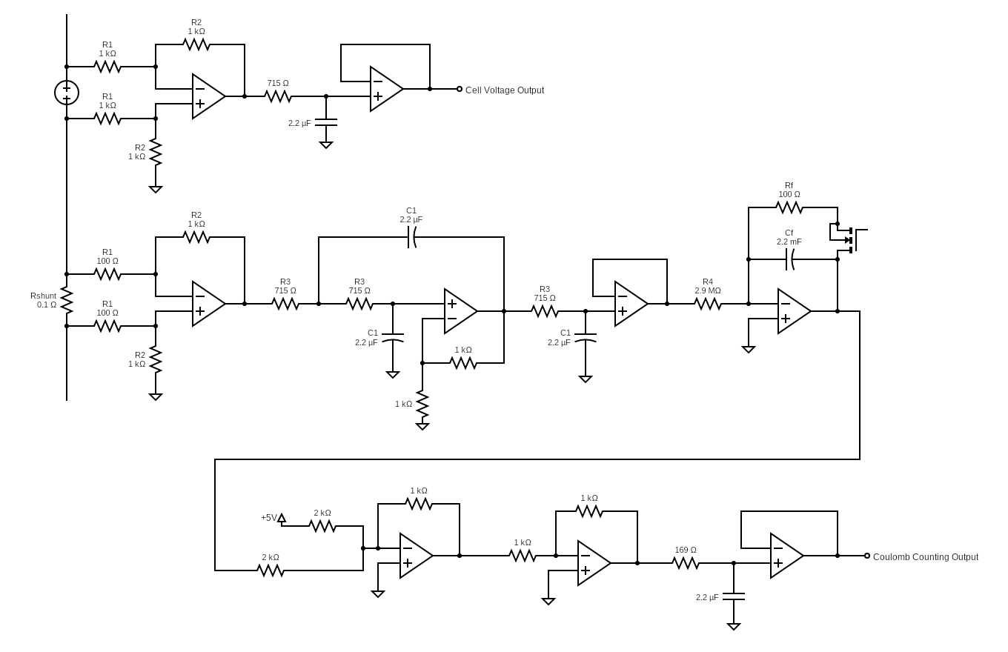
Complete Circuit Diagram of Fuel Gauge

Slide 24
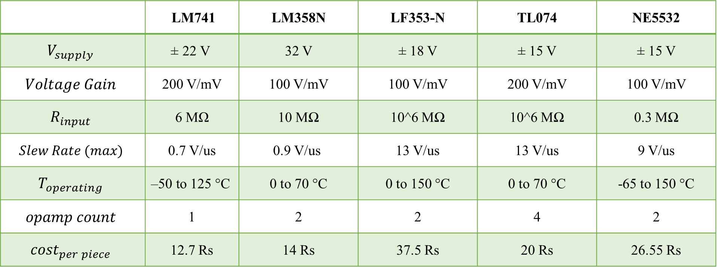
OP-AMP
 | LM741 | LM358N | LF353-N | TL074 | NE5532
$$V_{supply}$$ | $$\text{±}\text{ 22} \text{V}$$ | 32 V | ± 18 V | ± 15 V | ± 15 V
$$Voltage Gain$$ | 200 V/mV | 100 V/mV | 100 V/mV | 200 V/mV | 100 V/mV
$$R_{input}$$ | 6 MΩ | 10 MΩ | 10^6 MΩ | 10^6 MΩ | 0.3 MΩ
$$Slew Rate (max)$$ | 0.7 V/us | 0.9 V/us | 13 V/us | 13 V/us | 9 V/us
$$T_{operating}$$ | $$\text{–50 }\text{to}\text{ 125 °}\text{C}$$ | 0 to 70 °C | 0 to 150 °C | 0 to 70 °C | -65 to 150 °C
$$opamp count$$ | 1 | 2 | 2 | 4 | 2
$${cost}_{per piece}$$ | 12.7 Rs | 14 Rs | 37.5 Rs | 20 Rs | 26.55 Rs

Slide 25
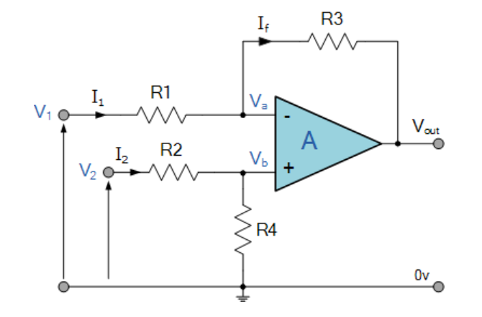
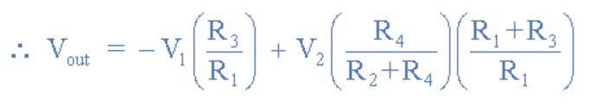

Voltage Measurement Circuit
Differential Voltage OP-AMP circuit [3]
If R1=R2=R3=R4=1Kohm then we get,

Slide 26
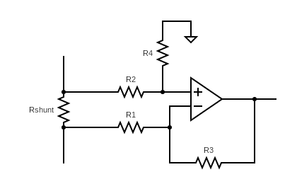
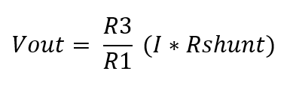
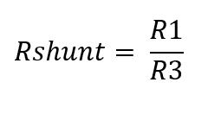
Current Measurement
Similar to Voltage measurement.
Measure voltage across shunt resistor.
Set resistors such that Vout = current (i)
The values of resistors used are:
Rshunt = 0.1 ohm
R1 = 100 ohm, R3 = 1k ohm

Slide 27
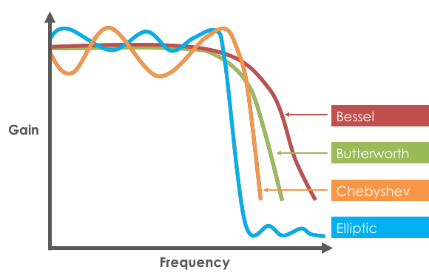
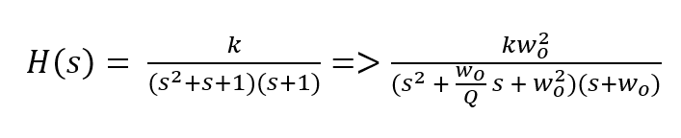
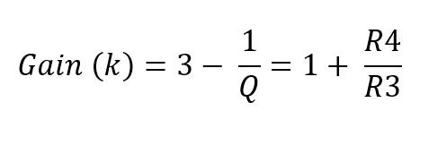
3rd Order Butterworth Low Pass Filter [Sallen Key Topology]
Maximally Flat magnitude filter (no ripple)
Combination of 1st order RC circuit and 2nd order Sallen-Key Filter
Normalized & unnormalized 3rd order Butterworth Polynomial:

Slide 28
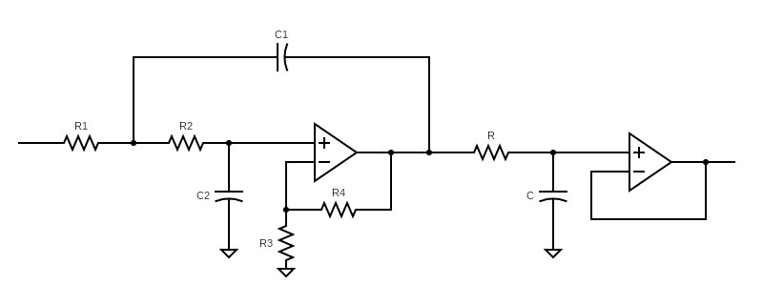
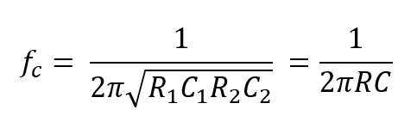
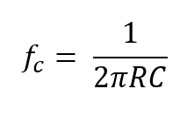
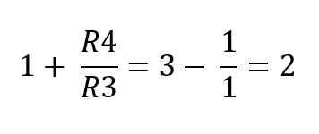
3rd Order Butterworth Low Pass Filter [Sallen Key Topology]
To simplify design process,
R1=R2=R
C1=C2=C
R3 and R4 are used to set gain.
Hence, cutoff frequency of
R3 = R4 = 1k ohm
Final output of LPF = 2*i

Slide 29

3rd Order Butterworth Low Pass Filter [Sallen Key Topology]
The cut-off frequency directly depends upon the switching frequency of the cell-balancing circuit.
The switching rate is set to 100Hz, hence the cut off frequency should be 100Hz.
Let C = 2.2uF then,
R = 723.43 ohms => 715 ohm

Slide 30
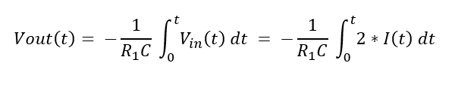
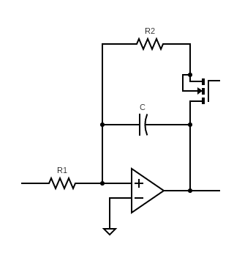
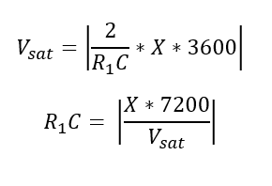
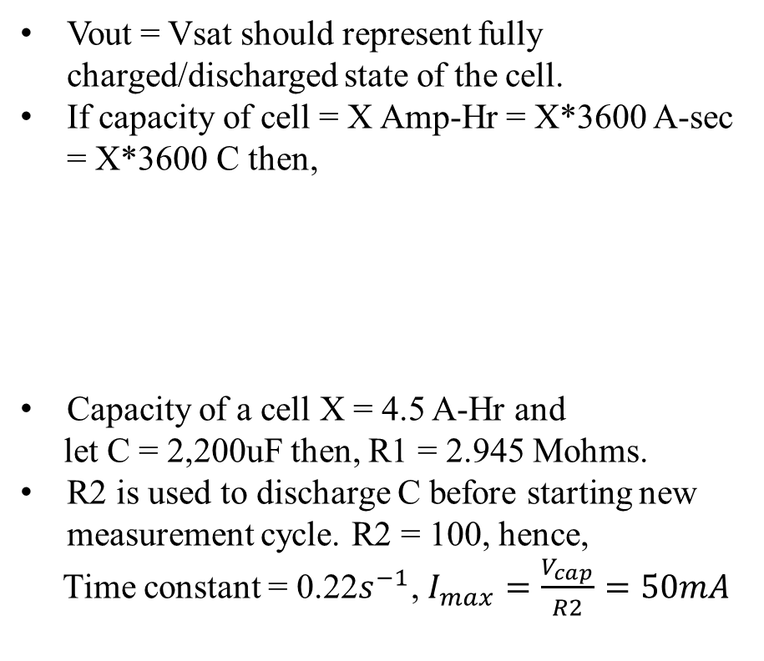
Integrator
Vout = Vsat should represent fully charged/discharged state of the cell.
If capacity of cell = X Amp-Hr = X*3600 A-sec = X*3600 C then,
Capacity of a cell X = 4.5 A-Hr and
let C = 2,200uF then, R1 = 2.945 Mohms.
R2 is used to discharge C before starting new measurement cycle. R2 = 100, hence,
Time constant = 0.22$s^{−1}$, $I_{max}=\frac{V_{cap}}{R2}=50mA$

Slide 31
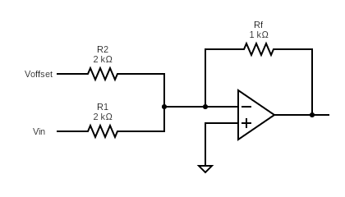
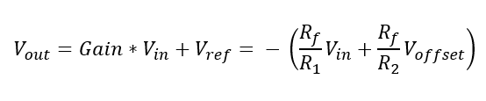
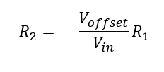
Bipolar to Unipolar Convertor [1]
The summing amplifier circuit can be used to convert a bipolar signal into a unipolar signal.
We are attenuating the signal from [-5,5V] to [0,5V]. Hence, the Gain is 0.5.
Let Rf = 1K ohm then, R1 = 2K ohm.
Vout should be zero when Vin is -5V.
Let Voffset = 5V then, R2 = 2K ohm

Slide 32
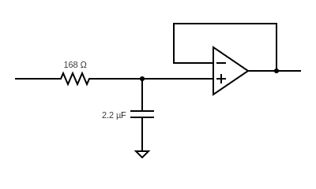

Anti-Aliasing Low Pass Filter
Low pass filter which follows Nyquist-Shannon Sampling Theorem
Sampling rate of ADC = 860Hz
Hence, cut off frequency of LPF should be less than or equal to 430Hz.
If we select C = 2.2uF then, R = 169 ohm

Slide 33
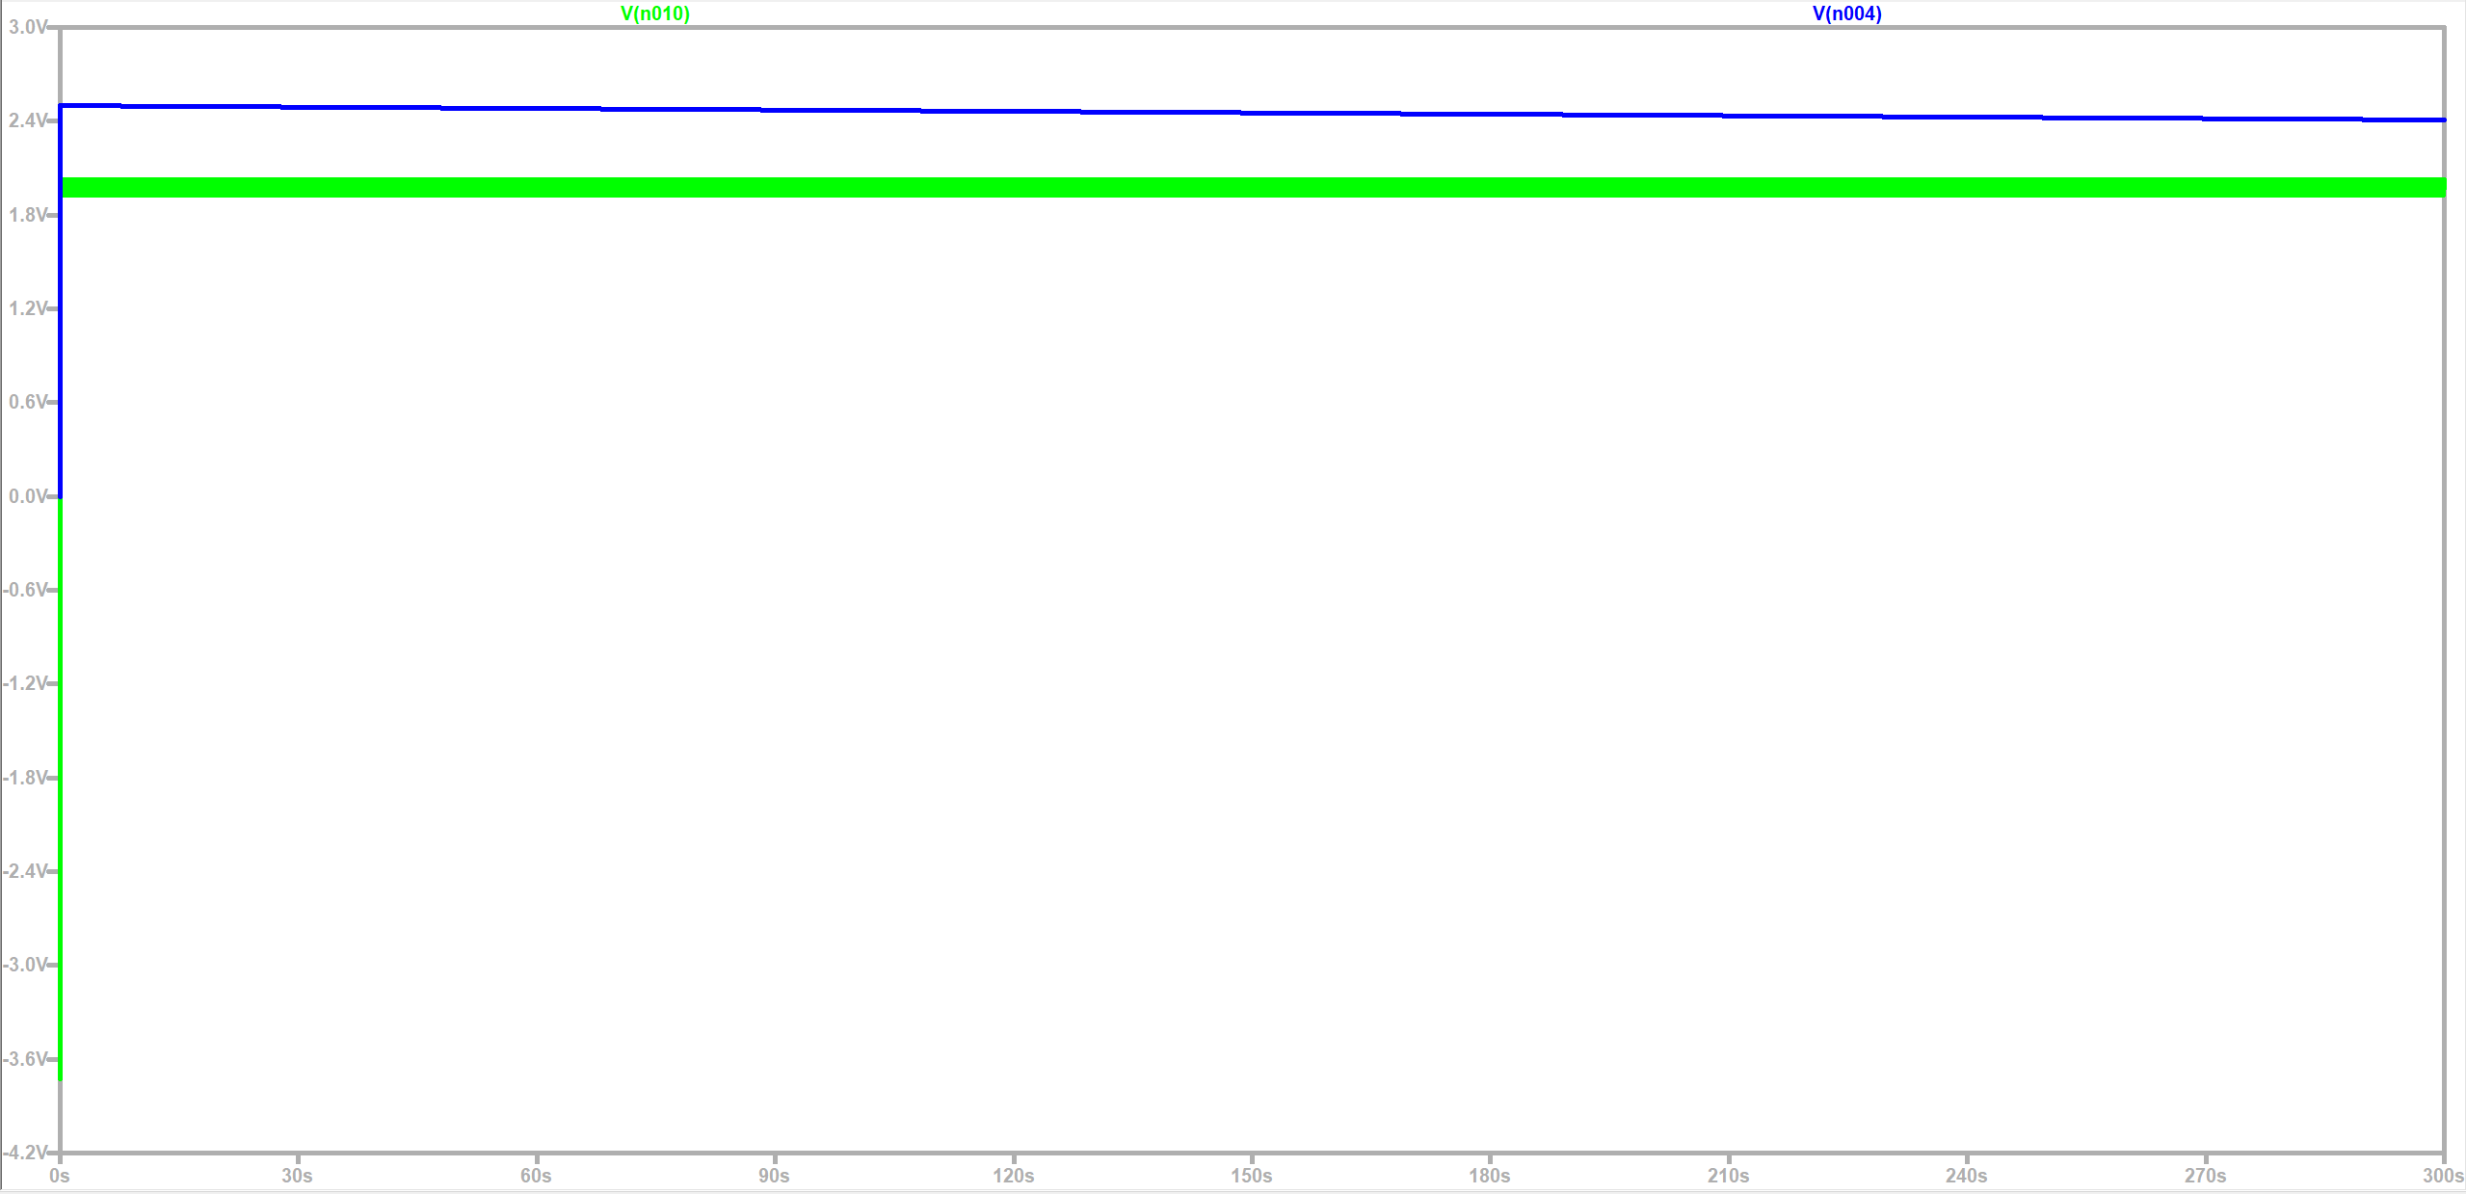
Simulation Results
Legend
Green line: Noisy current measurement signal
Blue line: Final Coulomb Counting output

Slide 34
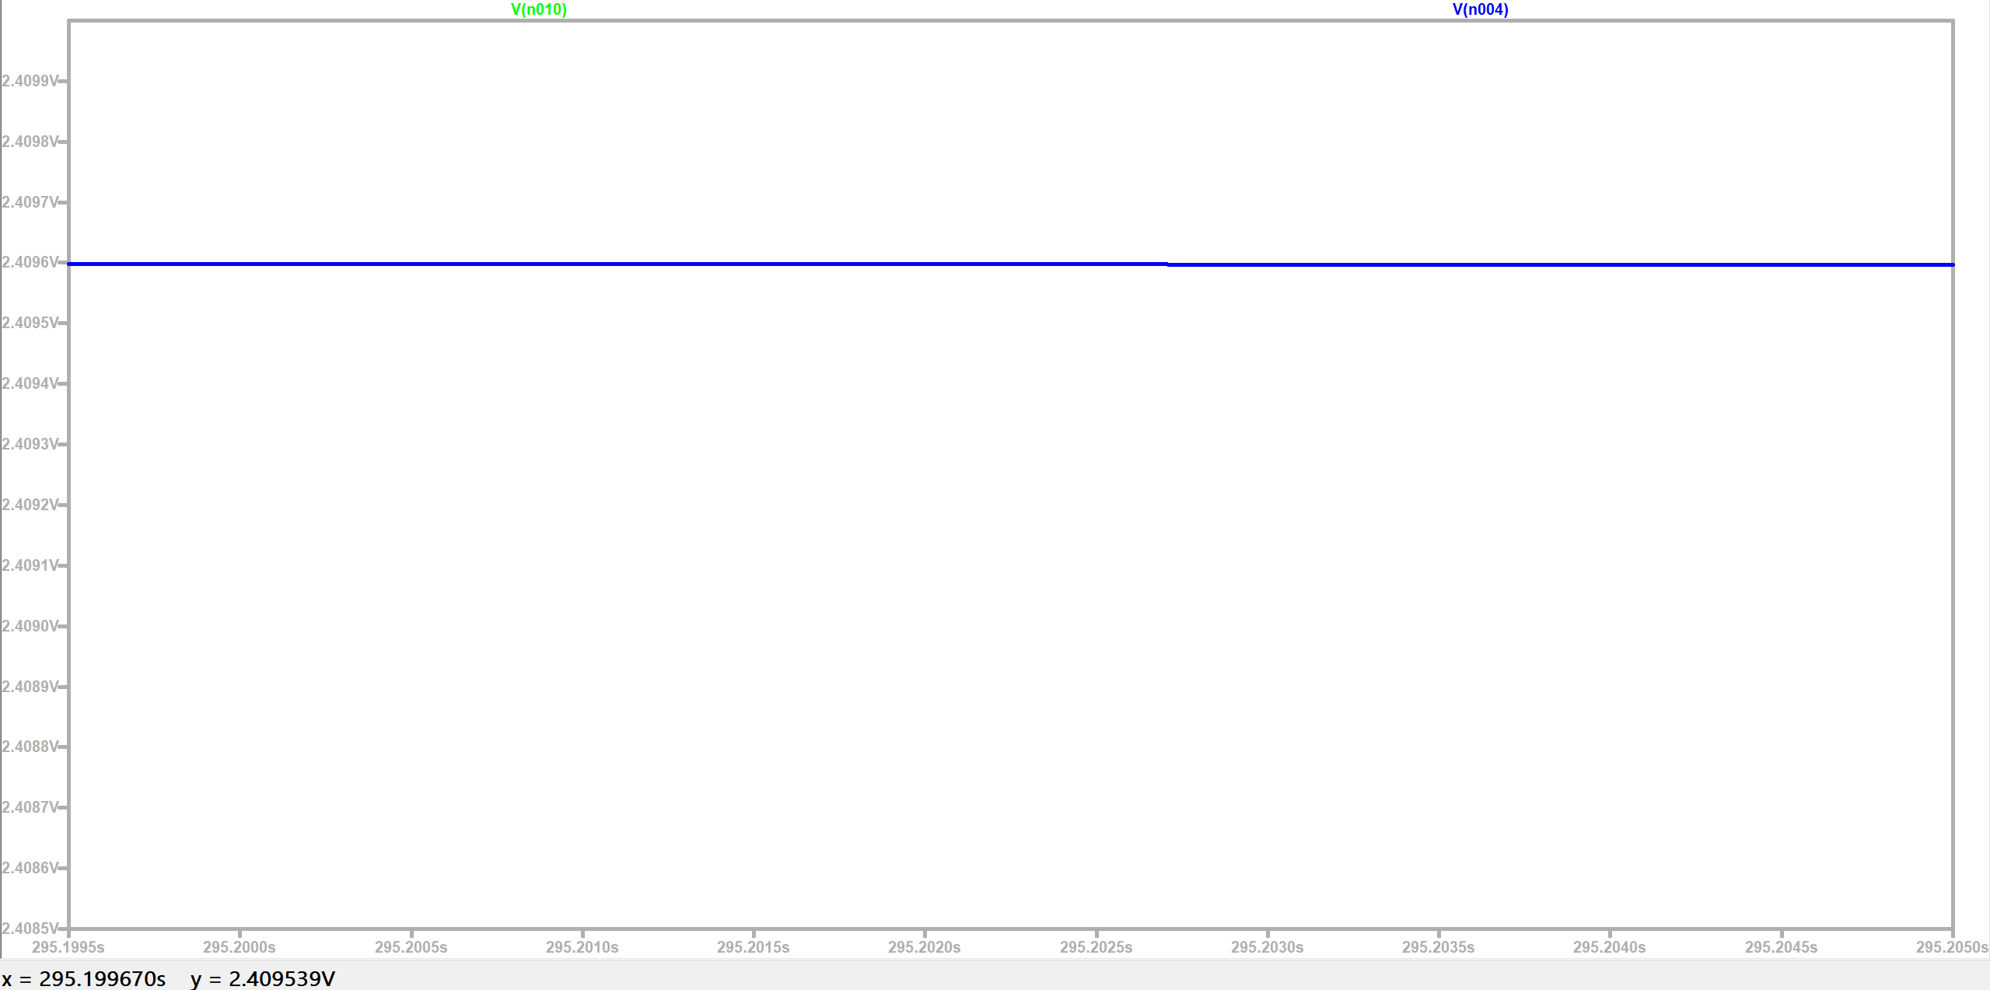
Simulation Results

Slide 35
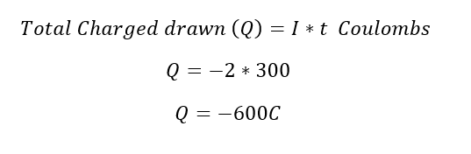
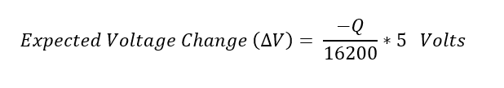
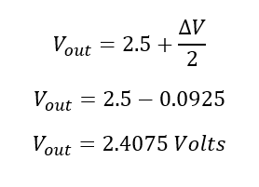
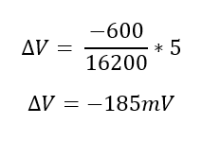
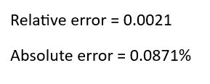
Manual Calculations to verify Simulations
Let’s assume that the cell is fully charged and its capacity is 4.5 Amp-Hr. It is connected to external load and the current is 2A.
5V represents complete discharged state, i.e., 16200C have been supplied to the load.

Slide 36
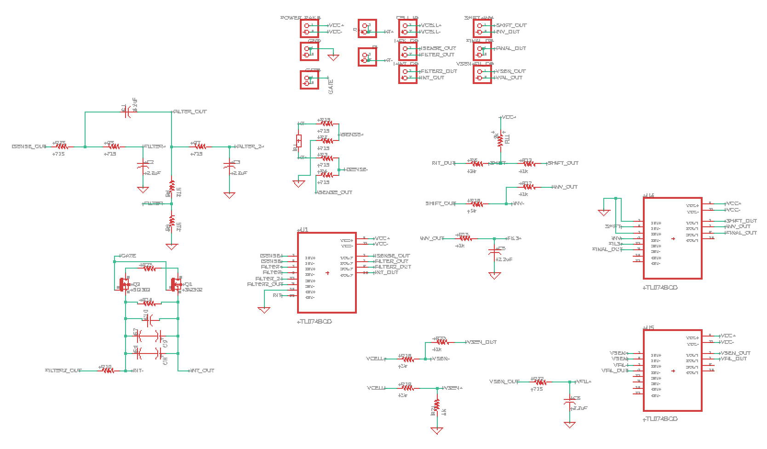
Fuel Gauge Schematic

Slide 37
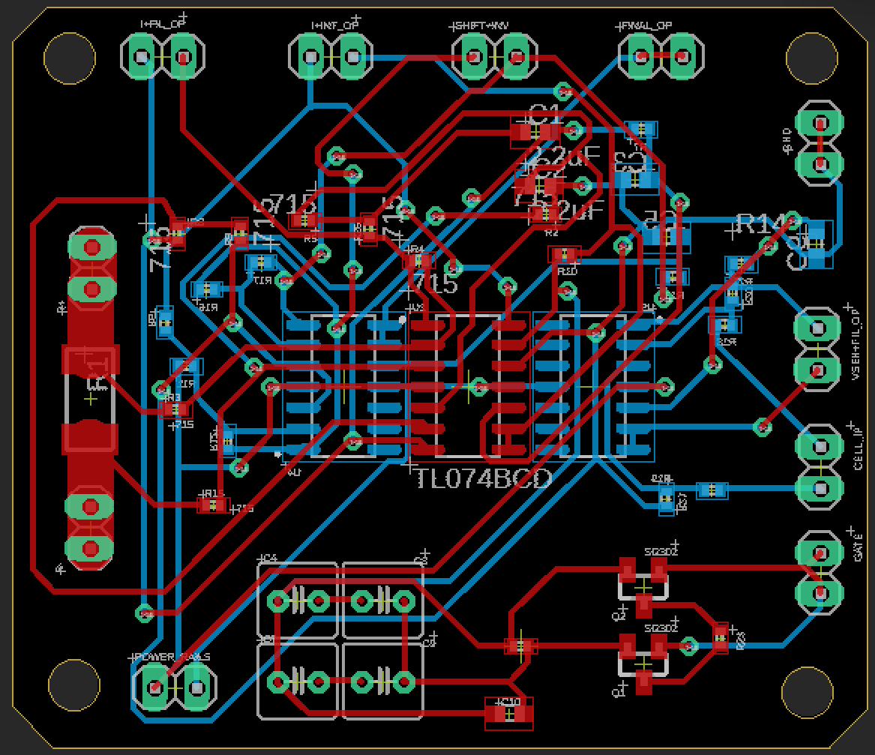
Fuel Gauge PCB Design
1 Header pin dedicated for each stage of SoC measurement.
Placed header pins on the perimeter for proper routing.
GND and Power pins are separated.
Trace width = 12mil, Drill = 12mil, Dia = 6mil
Current sense trace width = 110mil to handle currents upto 5A [1]
Manual routing to accommodate thicker trace.
Manual routing of few vias to avoid short circuit while soldering.
Manual routing of few traces to split 90 degree junctions into 120 degree junctions.
Checked ERC and DRC warnings & errors and resolved them (no input pin, stubs and airwires).
Board dimensions: 52.12mm x 45.33mm

Slide 38
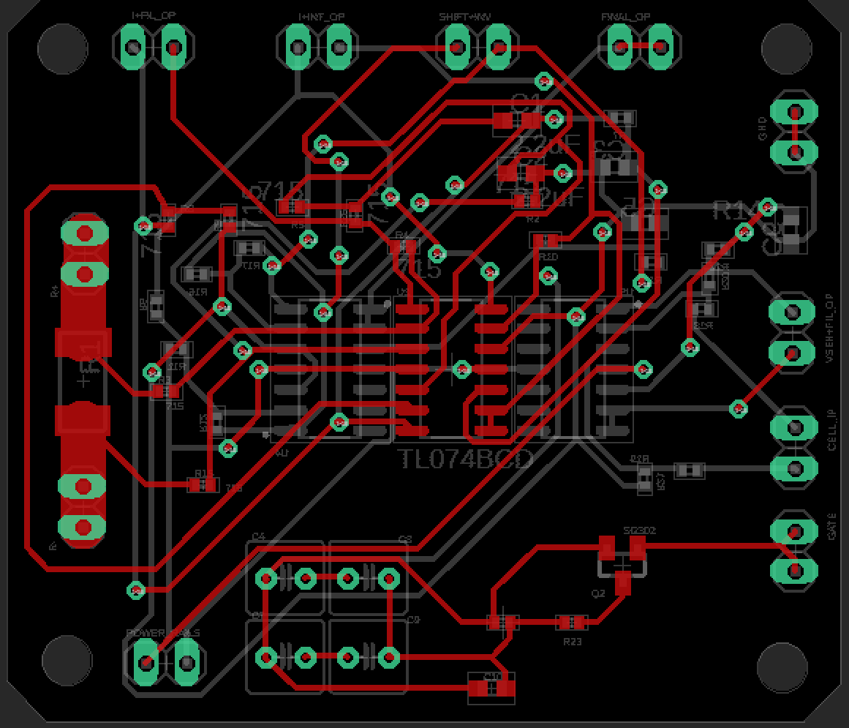
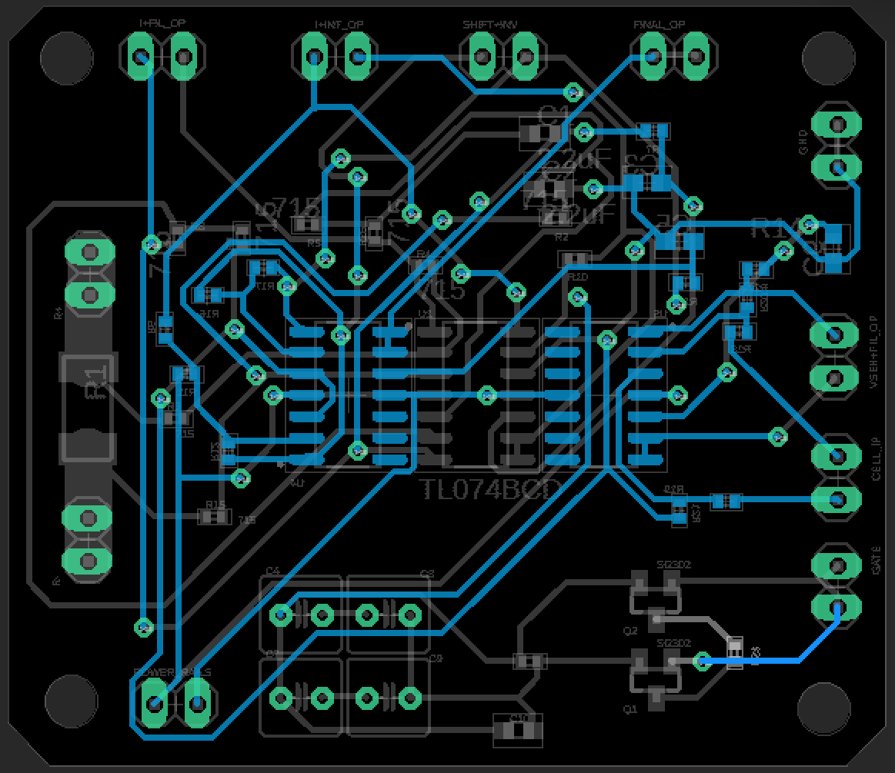
Fuel Gauge PCB Design
Top Layer
Bottom Layer

Slide 39
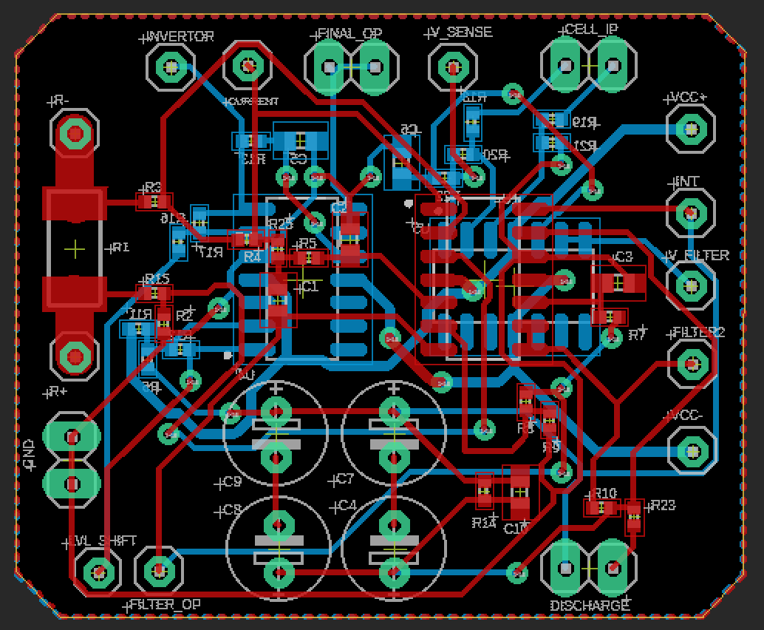
New Fuel Gauge PCB Design
Designed the PCB to be more compact
Reduced board dimensions from 52.12mm x 45.33mm to 39.42 mm x 32.63mm.
46% reduction in board area.
Improved Power rail trace width from 12mil to 20mil for better signal integrity.

Slide 40


Fuel Gauge PCB Design
Top Layer
Bottom Layer

Slide 41


Fuel Gauge Circuit Breadboard Testing

Slide 42

Fuel Gauge Breadboard Testing
In fuel gauge circuit, we need to measure voltage across sense resistor (1 ohm) to determine current.
Due to limitations of breadboard, we wouldn’t use sense resistor.
Voltage divider was used to “simulate” higher values of current.

Slide 43

Fuel Gauge Breadboard Testing Result
Time (minutes) | Output (volts) | Expected Output (Volts) | % Relative Error
0 | 2.55 | 2.5 | 2
5 | 2.88 | 2.78 | 3.59
10 | 3.21 | 3.06 | 4.9
20 | 3.85 | 3.63 | 5.24

Slide 44

Cell-Balancing Circuit
Balancing Switches
Balancing Capacitors
Charge Transfer Switches
Buffer Capacitors
Cell

Slide 45

MOSFET
 | SL100N03D | CMD3090L | SL60N02D | SL90N03D | 30N06-XBLW
$$V_{GS threshold(max)}$$ | 2.2 V | 2 V | 1 V | 2.5 V | 2.5 V
$$f_{switching (max)}$$ | 3.59 MHz | 27.77 MHz | 5.98 MHz | 9.25 MHz | 4.23 MHz
$$V_{DS (max)}$$ | 30 V | 30 V | 20 V | 30 V | 60 V
$$I_{D (max)}$$ | 100 A | 90 A | 60 A | 90 A | 30 A
$$R_{DS \left(on\right)} @V_{GS}=4.5V$$ | 5.3 mΩ | 8.5 mΩ | 5.0 mΩ | 5.2 mΩ | 7.2 mΩ
$${cost}_{per piece}$$ | 17 Rs | 7 Rs | 12 Rs | 11 Rs | 13 Rs

Slide 46
OP-AMP
 | LM741 | LM358N | LF353-N | TL074 | NE5532
$$V_{supply}$$ | $$\text{±}\text{ 22} \text{V}$$ | 32 V | ± 18 V | ± 15 V | ± 15 V
$$Voltage Gain$$ | 200 V/mV | 100 V/mV | 100 V/mV | 200 V/mV | 100 V/mV
$$R_{input}$$ | 6 MΩ | 10 MΩ | 10^6 MΩ | 10^6 MΩ | 0.3 MΩ
$$Slew Rate (max)$$ | 0.7 V/us | 0.9 V/us | 13 V/us | 13 V/us | 9 V/us
$$T_{operating}$$ | $$\text{–50 }\text{to}\text{ 125 °}\text{C}$$ | 0 to 70 °C | 0 to 150 °C | 0 to 70 °C | -65 to 150 °C
$$opamp count$$ | 1 | 2 | 2 | 4 | 2
$${cost}_{per piece}$$ | 12.7 Rs | 14 Rs | 37.5 Rs | 20 Rs | 26.55 Rs

Slide 47
ADC
 | ADS1115 | ADS1015 | MCP3008 | MCP3424
ADC Architecture | Sigma-Delta (ΣΔ) | Successive Approximation Register (SAR) | Successive Approximation Register (SAR) | Sigma-Delta (ΣΔ)
Resolution | 16 bits | 12 bits | 10 bits | 18 bits
PGA (Internal Amplifier) | YES (Integrated) | YES (Integrated) | NO | NO
Max Sample Rate | 860 SPS | 3300 SPS | 200 kSPS | 240 SPS
Power Consumption | Ultra-Low (150 µA) | Low | Low | Ultra-Low (140 µA)
Input Channels | 4 | 4 | 8 | 4

Slide 48

Analog Multiplexer
 | CD74HC4051 | CD74HC4067 | ADG412
Configuration | Single 8:1 MUX | Single 16:1 MUX | Quad SPST Switch
Select Inputs | 3 Select + 1 Enable | 4 Select + 1 Enable | 4 Independent Select
Analog Channels | 8 Channels | 16 Channels | 4 Individual Switches (1:1 each)
On-Resistance : $R_{(on)}$ | Low (70 Ω @4.5V) | Low (70 Ω @4.5V) | Very Low (< 5Ω)
Crosstalk / Isolation | Good | Good | Excellent (High-performance switch)
Cost | 31 Rs | 48 Rs | 112 Rs

Slide 49

BALANCING CIRCUIT
2 Cell Testing Circuit Designed
Includes:
Balancing Circuit for 2 CELLs
Switch Testing Provision
Regulated 5v, 3v3 supply
Measuring points for nodal voltages
Independent MOSFET triggering Provision
Jumper control to switch auto and manual mode

Slide 50

Actual Schematic
Switch
Switch
Switch
Cap
Cap
Switch
Switch
Switch
CELLS
Voltage Regulators

Slide 51
Component Justification
Component / Role | Design Requirement | Selected Device | Technical Justification
Power switching MOSFET | Low conduction loss, high pulse current capability | CMD3090L | Low RDS(on), adequate current rating thus suitable for High Current Balancing path
Floating bias N-MOS | Logic-level gate drive, fast switching | SI2302 | Low gate threshold, small gate charge thus suitable for low-power control switching
Floating bias P-MOS | High-side switching with low gate voltage, fast switching | SI2301 | High-side control in floating bias circuit, small gate charge
Charge diode | Fast recovery, low forward drop | SS14 | Schottky structure, thus low VF and fast switching for efficient charging of capacitor
5 V regulation | Stable supply rail voltage | 7805 | Provides fixed 5 V output, simple implementation
3.3 V regulation | Low-voltage logic supply | LM1117 | stable 3.3 V output, enough current rating to power STM32

Slide 52

Providing Bias to Floating G-S
TEST_G : Half Duty Cycle
0 : Capacitor charges
1 : Capacitor provides Bias to G-S

Slide 53


RC Value Calculations
Finding Value of Capacitor
$$C_{g}= \frac{Q_{g}}{V_{Q_{g}}}$$
$$Q_{g} = MOSFET Gate Charge = 18nC$$
$$V_{Q_{g}} =V_{DD} − V_{DiodeForwardDrop} = 5 − 0.5 = 4.5V$$
$$C_{g} = 4nF : Choose 10x Buffer Value = 47 nF$$
$${∴C}_{boot} = 47 nF$$
$$R_{g}= \frac{V_{DD} − V_{D}}{I_{PK}}$$
$R_{g}= 4.5/1.5$ = 3ohm
$${∴R}_{g}=3.3 ohm$$
$$Choosing Footprint$$
$$t_{charge}= 3×R_{g}×C_{boot} = 0.46 us (95\% charged)$$
Power dissipated (avg) by resistor:
$= \frac{1}{2}{C_{boot}V_{boot}}^{2}f$
= 0.5*47n*4.5*4.5*10k
= 4.75 mW
Thus 0603 footprint was chosen for $R_{g}$

Slide 54


Testing the Gate Driver Circuit (Modified Boot Strap Setup)
Switch can be turned on off by input signal(orange jumper)
Works with floating Source Voltage
Output Characteristics are same as MOSFET (mirrored in origin)
Id
Vds
OUTPUT CHARACTERISTICS

Slide 55

Balancing Circuit Testing
Perf. Board prototype
2 cell Balancing at a time
Gate Pulses controlled by STM32F411 microcontroller
Separate Gate driver circuit for each switch
Powered by the Cell Voltage itself

Slide 56


Balancing Circuit Testing
Cell 1 :
$V_{start}=2.8V$
$V_{end}=3.5V$
Cell 2 :
$V_{start}=3.9V$
$V_{end}=3.5V$
Settle time : 5000sec
(approx. 1.5 hr)
Cell Voltage Drained by both, Cell Balancing, Powering BMS circuit
Cell Voltage CHARACTERISTICS

Slide 57


PCB Design
Top side :
Balancing Capacitors
Cell terminal Blocks
I/P @ O/P test pins
Bottom side:
MOSFET grid circuit
Floating Bias Drivers
Voltage Regulators
Tester Switch Circuit
Traces: (1 oz Copper)
Power : 25mil
Signal : 6 mil
Via:
Drill : 12 mil
Dia : 16 mil
TOP
BOTTOM

