Slide 1

Access control, Static and Final
Kaustubh S Kabra
SE Computer-Shift1
ERP Number 34
Teams Number 20

Slide 2
access control
Access control is a mechanism, an attribute of encapsulation which restricts the access of certain members of a class to specific parts of a program. Access to members of a class can be controlled using the access modifiers. There are four access modifiers in Java. They are:
public
protected
default
private

Slide 3
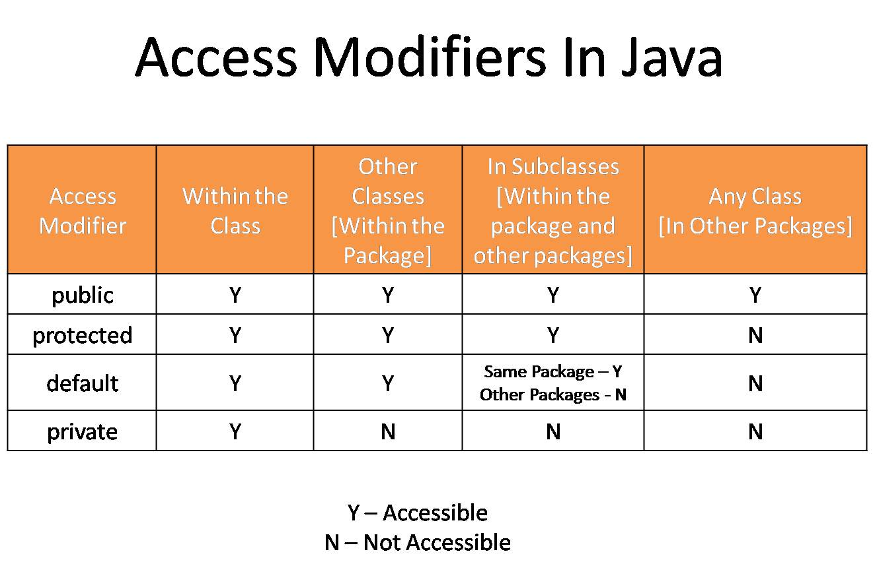
Accessibility restrictions of the four access modifiers is as shown below:

Slide 4
What is the purpose of access modifiers?
Access modifiers are keywords used to specify the accessibility of a class (or type) and its members. These modifiers can be used from code inside or outside the current application. Access modifiers in . NET are used to control the accessibility of each of the members of a type from different possible areas of code.

Slide 5
Java static keyword
The static keyword in Java is used for memory management mainly. We can apply static keyword with variables, methods, blocks and nested classes. The static keyword belongs to the class than an instance of the class.
The static can be:
Variable (also known as a class variable)
Method (also known as a class method)
Block
Nested class

Slide 6
Java static variable
If you declare any variable as static, it is known as a static variable.
The static variable can be used to refer to the common property of all objects (which is not unique for each object), for example, the company name of employees, college name of students, etc.
The static variable gets memory only once in the class area at the time of class loading.
Advantages of static variable
It makes your program memory efficient (i.e., it saves memory).
Understanding the problem without static variable

Slide 7
Java static method
If you apply static keyword with any method, it is known as static method.
A static method belongs to the class rather than the object of a class.
A static method can be invoked without the need for creating an instance of a class.
A static method can access static data member and can change the value of it.
Restrictions for the static method
There are two main restrictions for the static method. They are:
The static method can not use non static data member or call non-static method directly.
this and super cannot be used in static context.

Slide 8
Java static block
Example of static Block
class A2{
static{System.out.println("static block is invoked");}
public static void main(String args[]){
System.out.println("Hello main");
}
}
Output: static block is inviked
Hello main

Slide 9
Final Keyword In Java
The final keyword in java is used to restrict the user. The java final keyword can be used in many context. Final can be:
variable
method
class
The final keyword can be applied with the variables, a final variable that have no value it is called blank final variable or uninitialized final variable. It can be initialized in the constructor only. The blank final variable can be static also which will be initialized in the static block only. We will have detailed learning of these. Let's first learn the basics of final keyword.

Slide 10
Java final variable
If you make any variable as final, you cannot change the value of final variable(It will be constant).
Example of final variable
There is a final variable speedlimit, we are going to change the value of this variable, but It can't be changed because final variable once assigned a value can never be changed.
class Bike9{
final int speedlimit=90;//final variable
void run(){
speedlimit=400;
}
public static void main(String args[]){
Bike9 obj=new Bike9();
obj.run();
}
}//end of class

Slide 11
Java final method
Java final method
If you make any method as final, you cannot override it.
Example of final method
class Bike{
final void run(){System.out.println("running");}
}
class Honda extends Bike{
void run(){System.out.println("running safely with 100kmph");}
public static void main(String args[]){
Honda honda= new Honda();
honda.run();
}
}

Slide 12
Thank You

