Slide 1
MAE 248 Project Presentation
Kaustubh Kanagalekar

Slide 2
Overview of Report
Literature Review of control barrier functions (CBFs)
Introduction to CBFs and motivation
Different types
Current challenges faced with implementation

Slide 3
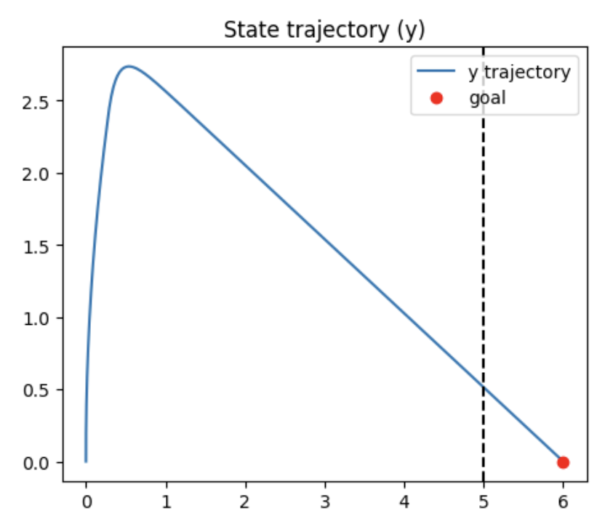
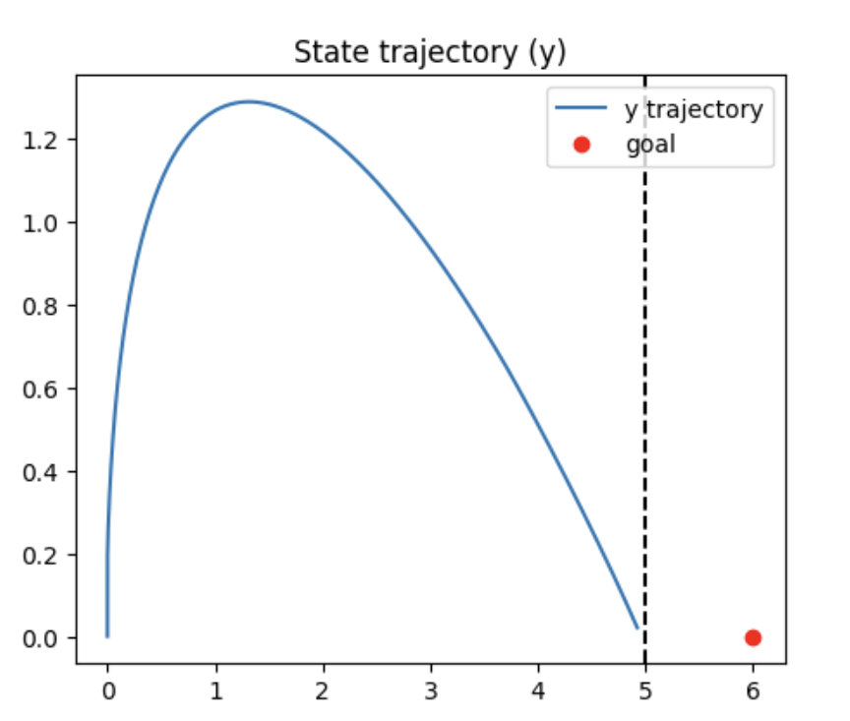
Overview
Type of safety filter
Related to CLFs (but are fundamentally different!)
Use QP for finding optimal control and enforcing CBF constraints
Control Barrier Functions: Theory and Applications. By Ames et al.

Slide 4
Different Types
Many different types:
backup barrier functions
reduced order control barrier functions
zeroing control barrier functions
reciprocal control barrier functions
exponential control barrier functions

Slide 5
Zeroing CBFs
h(x) → 0 as x → ∂C
Aggressively slows down system near boundary to ensure invariance
Better robustness due to direct enforcement
Control Barrier Function Based Quadratic Programs for Safety Critical Systems. By Ames et al.

Slide 6
Reciprocal CBFs
B(x) → ∞ as x → ∂C
Passively ensures safety due to natural resistance near boundary
Better handling of model uncertainty
Control Barrier Function Based Quadratic Programs for Safety Critical Systems. By Ames et al.

Slide 7
Comparison between RCBFs and ZCBFs
ZCBF | RCBF
h(x) → 0 as x → ∂C | B(x) → ∞ as x → ∂C
Aggressive control intervention | Natural resistance near boundary
Better robustness | Better handling of model uncertainty

Slide 8
Challenges Faced
Handling multiple safety constraints
Safe control design for discontinuous dynamics and non-smooth sets

Slide 9
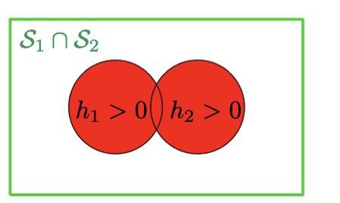
Handling Multiple Safety Constraints
Problem: multiple CBF constraints can cause viability domain to be very restrictive and unfeasible
Solutions:
Geometric approach: decoupling CBFs (finding and tuning CBFs individually)
Iterative algorithm: Remove remaining infeasible states when geometric approach does not fully resolve conflicts
Compositions of Multiple Control Barrier Functions Under Input Constraints. By Breeden et al.

Slide 10
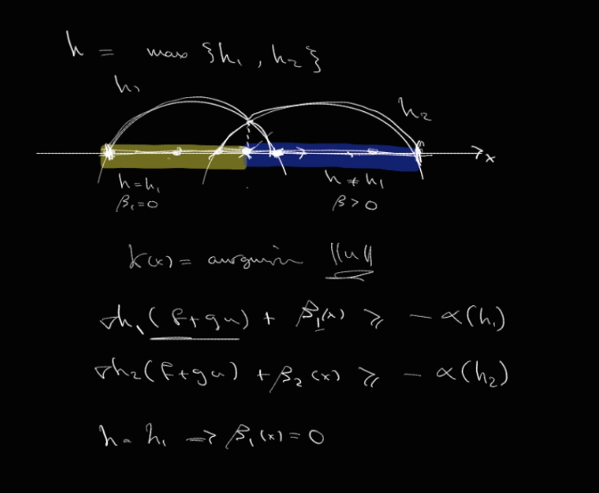
Safe Control Design for discontinuous dynamics and non-smooth sets
Problem: When dealing with discontinuities and non-smooth sets, traditional CBF methods often fail
Solutions:
To address the issue of overlapping CBFs and non-smooth boundaries: β(x) to enable smooth transitions between overlapping CBF boundaries
Safety-Critical Control of Discontinuous Systems with Nonsmooth Safe Sets. By Alyaseen et al.

Slide 11
Thank You!

