Slide 1
Machine Learning HomeWork Assignment
Kaustubh Shivshankar Shejole (BT20CSE112)

Slide 2
Use of HMM in partitioning the alphabet set into 2 sets using text from Shakespeare’s writings.
Dataset source: https://www.gutenberg.org/files/100/100-0.txt
Possible Candidate Algorithms:
1. Hidden Markov Models
2. Dynamic Programming
3. Artificial Neural Network

Slide 3
Why HMM was preferred?
1. Hidden Markov Models are highly efficient to get trained given an observation sequence.
2. HMMs give more optimal answer than Dynamic Programming.
3. HMMs can be understood by humans unlike ANNs.
4. Data was sequential and hence I preferred to choose Hidden Markov Model over others.

Slide 4
Python Library used:
1. numpy (import numpy)
2. requests (import requests)
3. BeautifulSoup (from bs4)
4. re (import re)

Slide 5
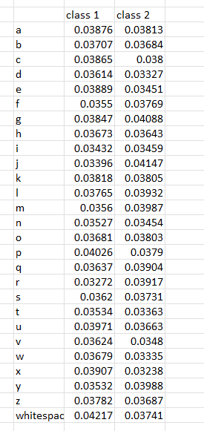
Initial Model:
pi = [0.51316, 0.48684]
a = [ [ 0.47468, 0.52532],
[0.51656, 0.48344]]
B with the observation states as 27, 26 lowercase alphabets with 1 as whitespace.
Initialized B with each value approximately 1/27 ensuring it is row-stochastic.
b^{T}

Slide 6
A: Used only one english sentence
'the quick brown fox jumps over the lazy dog and then rests peacefully'
O = [19, 7, 4, 26, 16, 20, 8, 2, 10, 26, 1, 17, 14, 22, 13, 26, 5, 14, 23, 26, 9, 20, 12, 15, 18, 26, 14, 21, 4, 17, 26, 19, 7, 4, 26, 11, 0, 25, 24, 26, 3, 14, 6, 26, 0, 13, 3, 26, 19, 7, 4, 13, 26, 17, 4, 18, 19, 18, 26, 15, 4, 0, 2, 4, 5, 20, 11, 11, 24]
Then we trained Model

Slide 7
A: Used only one english sentence (Contd.)
Threshold (new_value_of_log(P(O|lambda)) - old_value = 0.001
Number of epochs: 41
Results:
pi = [1.000000000000002, 8.356337684774142e-253]
A = [[3.982444907951401e-07, 0.9999996017555091],
[0.7981057649355989, 0.20189423506440118]]

Slide 8
A: Used only one english sentence (Contd.)
Matrix A suggests us that there are 2 classes:
Such that after Class1 there is high probability approximately 0.9999 that Class2 will appear,
Similarly Class1 after Class2 : 0.798
Class2 after Class2: 0.2018
We can guess that Class1 is of Vowels and class2 is of consonants.

Slide 9
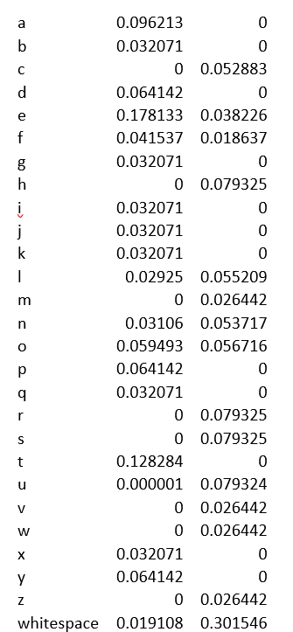
A: Used only one english sentence (Contd.)
b^{T} matrix :
As observation sequence was small the results of b are not that much useful and some of the alphabets are missing.
Solution : Use larger observation sequence

Slide 10
B: first 7000 characters from https://www.gutenberg.org/files/100/100-0.txt
Epochs: 100
pi = [1.0000000000000044, 2.4195963165377017e-182]
a =
[[0.27402870608541646, 0.7259712939145779],
[0.758025999436877, 0.24197400056312807]]

Slide 11
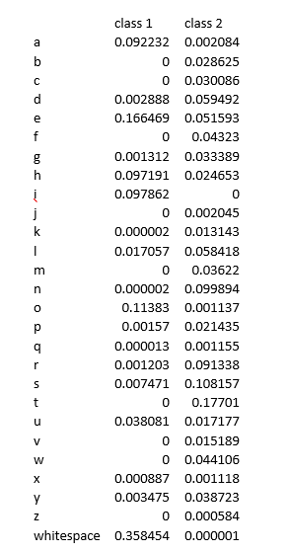
B: first 7000 characters from https://www.gutenberg.org/files/100/100-0.txt (Contd.)
b^{T}
b^{T}

Slide 12
B: first 7000 characters from https://www.gutenberg.org/files/100/100-0.txt
Two Classes:
['a', 'e', 'h', 'i', 'o', 'u', 'whitespace']
['b', 'c', 'd', 'f', 'g', 'j', 'k', 'l', 'm', 'n', 'p', 'q', 'r', 's', 't', 'v', 'w', 'x', 'y', 'z']
Approximately we can say 1 is vowels and 2 is consonants

Slide 13
C: After training on 20,000 characters for 100 epochs:
pi = [1.0000000000001337, 6.334675146516008e-190]
a = [ [0.29895489192080527, 0.7010451080792093],
[0.7528803039963917, 0.24711969600360517]]

Slide 14
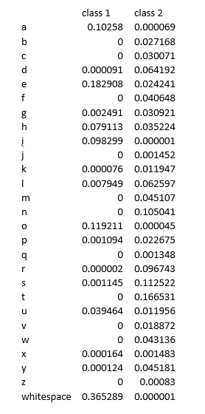
C: After training on 20,000 characters for 100 epochs (Contd.)
b^{T}

Slide 15
C: After training on 20,000 characters for 100 epochs (Contd.)
Now the classes formed are
['a', 'e', 'h', 'i', 'o', 'u', 'whitespace']
['b', 'c', 'd', 'f', 'g', 'j', 'k', 'l', 'm', 'n', 'p', 'q', 'r', 's', 't', 'v', 'w', 'x', 'y', 'z']

Slide 16
D: Training on 50,000 characters
pi = [0.999999999999367, 5.630214799842337e-183]
a = [[0.3152499483862772, 0.6847500516137502],
[0.7608142723368025, 0.23918572766313517]]

Slide 17
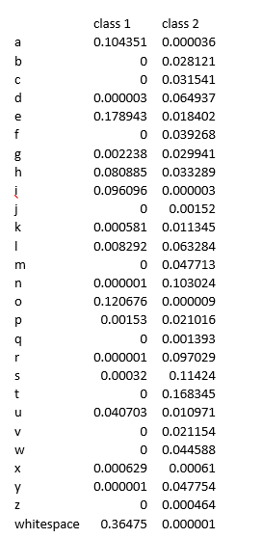
D: Training on 50,000 characters
(Contd.)
b^{T}

Slide 18
D: Training on 50,000 characters (Contd.)
Two classes are as follows: when difference > 0.001 is used
Class 1: ['a', 'e', 'h', 'i', 'o', 'u', 'whitespace']
Class 2: ['b', 'c', 'd', 'f', 'g', 'j', 'k', 'l', 'm', 'n', 'p', 'q', 'r', 's', 't', 'v', 'w', 'y']
log(P (O|lambda)) was initially -164691.65128603834 , after the 100 iterations it was -136737.95099821006.
This shows that the model has been improved significantly.

Slide 19
References
[1] A Revealing Introduction to Hidden Markov Models Mark Stamp Department of Computer Science San Jose State University January 12,2018
[2] https://www.youtube.com/watch?v=PMIdkmXmZlg
[3] https://www.youtube.com/watch?v=fZ28ZmroMy8

Slide 20
Thank You Sir

