Slide 1

SPAMbase
An Approach to Efficient Email Classification
Notes:
Hello Everyone !!! I hope everyone is doing good !!!! Welcome to SPAMbase !!! Our team consists Xinrui, YangYang, Min and Yihan !!

Slide 2

Introduction
Notes:
As you can see on the slide where a husky is sniffing out the spam mails and I am sure we huskies in the team has done very good job in filtering the spam mails !!

Slide 3
Workflow
Objective:
To build a robust spam filter using probabilistic principles with Bayes Theorem.
List the steps involved in the workflow:
Bayesian Approach
Data Processing
Model Training
Model Evaluation
Def - Access and load the dataset containing emails (spam and non-spam).
Notes:
Let me give you a tour of general workflow on this !!! Our objective is to build a robust spam filtering mails using Bayes Theorem !! Let me handover to Xinrui !!

Slide 4
Bayes’ theorem

Slide 5
Bayesian Approach
Bayes' theorem is expressed as:
P(A∣B)=P(B∣A)⋅P(A) / P(B)
P(B∣A) is the conditional probability of event B occurring given that event A has occurred.
​
​
P(A) and P(B) are the probabilities of events A and B occurring independently.
P(A∣B) is the conditional probability of event A occurring given that event B has occurred. Also called posterior probability.
Spam Filtering Example:
In email spam filtering, the goal is to determine whether an incoming email is a spam or normal email based on its content.
P(Word∣Spam) is the probability that the word appears in spam emails.
P(word) is the probability of email consists of certain context
P(Spam) is the possibility of spam email occurs in our inbox
P(Spam∣Word) is the probability that an email is spam given a certain word in the email. (What we want to Know)
Notes:
Bayes’ theorem is the most fundamental concept in probability theory. probability of an event, based on prior knowledge of conditions that might be related to the event

Slide 6

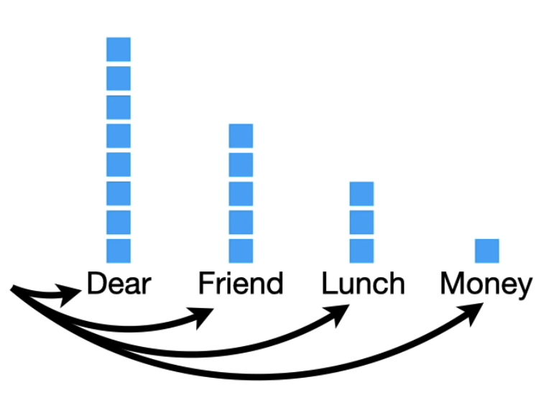
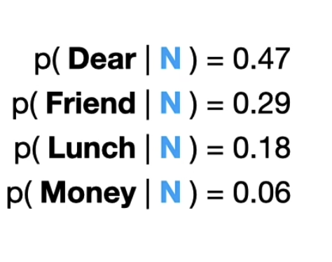


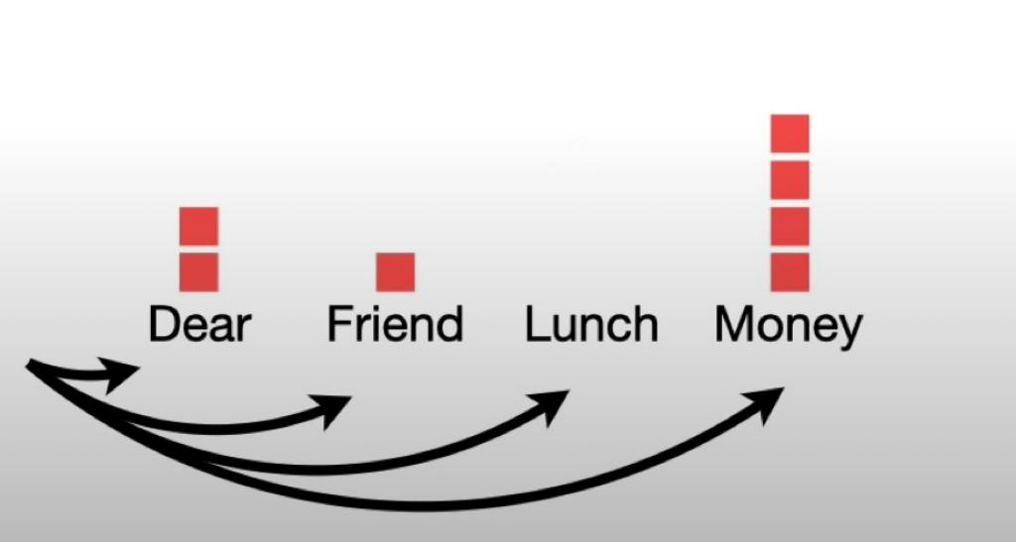
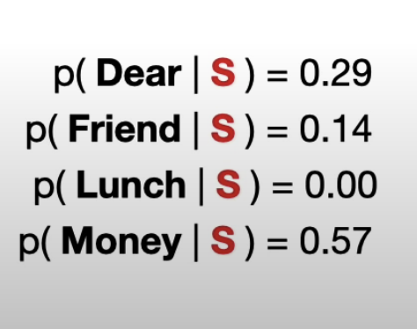


Slide 7

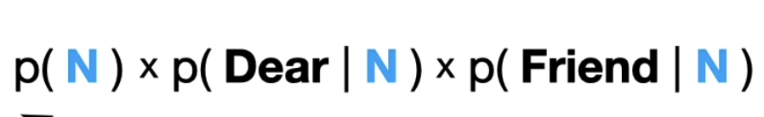



“Dear Friend”
P( Dear Friend ∣ N ) = P(Dear ∣ N ) x P( Friend ∣ N ) ???
"Naive" Bayes classifier assumptions come into play: assume that all words in are mutually independent

Slide 8
Data Processing

Slide 9


Data Processing - Data Source
The SMS Spam Collection is a public set of SMS labeled messages that have been collected for mobile phone spam research.
Input for Models: Machine learning models learn from data.
Model Interpretability: Understanding the relationship between features becomes easier when your data is well-organized.
Efficiency：from data preprocessing to model training and evaluation. This efficiency is particularly important when dealing with large datasets.
The Importance
of Data Processing
Notes:
Hello, everyone! The second part of our project is about data processing. Our data is from UC Irvine Machine Learning Repository called SMS Spam Collection. The data processing is very important. Because data is the input of models, if it is well-organized, it will boost your efficiency through the whole project and can help you better understand the relationship between features.

Slide 10
Data Processing - Split Dataset
Testing Subsets:25%
ham
spam
Training Subsets:75%
.txt
Q：Why people divide the dataset into training and testing subsets?
Model Evaluation: The testing subset serves as a completely independent dataset that wasn't seen by the model during training. This allows you to assess how well your model generalizes to new, unseen data.
Notes:
We divide the data into two sections, 25 percent for testing and 75 percent for training. They are all original text format. In this way, model can be evaluated by the new, unseen data.

Slide 11
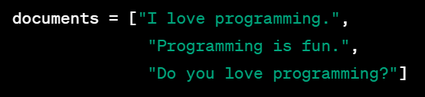
Data Processing - Feature Extraction
Meaningful features of the text: word frequencies
The techniques: CountVectorizer() from sklearn
Example:
How CountVectorizer() works?
1.Tokenization: tokenize the input text by splitting the text into words based on space and punctuation.
CountVectorizer()
2.Counting:The result is a matrix where each row represents a document, and each column represents a unique term.
Letter 1
[[ 1, 1, 1, 0, 0, 0, 0 ],
[ 0, 0, 1, 1, 1, 0, 0 ],
[ 0, 1, 1, 0, 0, 1, 1 ]]
“I”
“fun”
Notes:
So how it works? There is an example. Firstly when we receive the letter, it will be splitted into words by space and punctuation.Then we got a matrix. Each row represents a document so the first line is letter 1. It has three words so there are three one. And then each column represents a unique term. For example the first column is for the word I. In this way, data will be ready for the training model.

Slide 12
Model Training

Slide 13
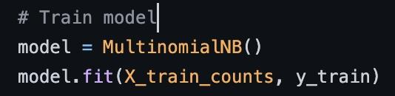
How does the code(model) works?
Notes:
We only use two lines of code to train the model.
How does it work? Let’s see!

Slide 14
Compare P(spam|words) and P(ham|words)
P(words|ham) * P(ham)
P(ham|words)
P(words)
based on database
P(wordA|ham) * P(wordB|ham) * P(wordC|ham) * P(wordD|ham) * P(ham)
This is what we want to find when training the model
P(words)
Notes:
So Based on the Baye’s theorem, we know that, to recognize the spam email, the main task for us is to compare these two probability.
Before that, we have to calculate these two parameters first using this formula. Let’s see, we have 3 parameters
P(ham)/P(spam) and P(words): the ratio of these two kinds of email are based on each database, and the frequency of the words are based on each email —> so these two parameters are really based on the database we use, we can calculate it beforehand
So what we really want to find when training: is the probability of, if it is a ham or spam email, what is the frequency of every words

Slide 15
Compare P(spam|words) and P(ham|words)
P(words|spam) * P(spam)
P(spam|words)
P(words)
based on database
P(wordA|spam) * P(wordB|spam) * P(wordC|spam) * P(wordD|spam) * P(spam)
This is what we want to find when training the model
P(words)
Notes:
The same with these probability

Slide 16
Compare P(spam|words) and P(ham|words)
P(wordA|spam) * P(wordB|spam) * P(wordC|spam) * P(wordD|spam) * P(spam)
P(spam|words)
P(words)
VS
P(wordA|ham) * P(wordB|ham) * P(wordC|ham) * P(wordD|ham) * P(ham)
P(ham|words)
P(words)
Notes:
2. After calculation, now we can compare these two probability
One thing we have to pay attention is that:
The denominator are the same
So we only need to get two training data:
The ratio of the spam and ham in the database
In spam and ham, the frequency of each words

Slide 17
Model Training
2 How to use database to train the model?
Notes:
Let’s the training process

Slide 18
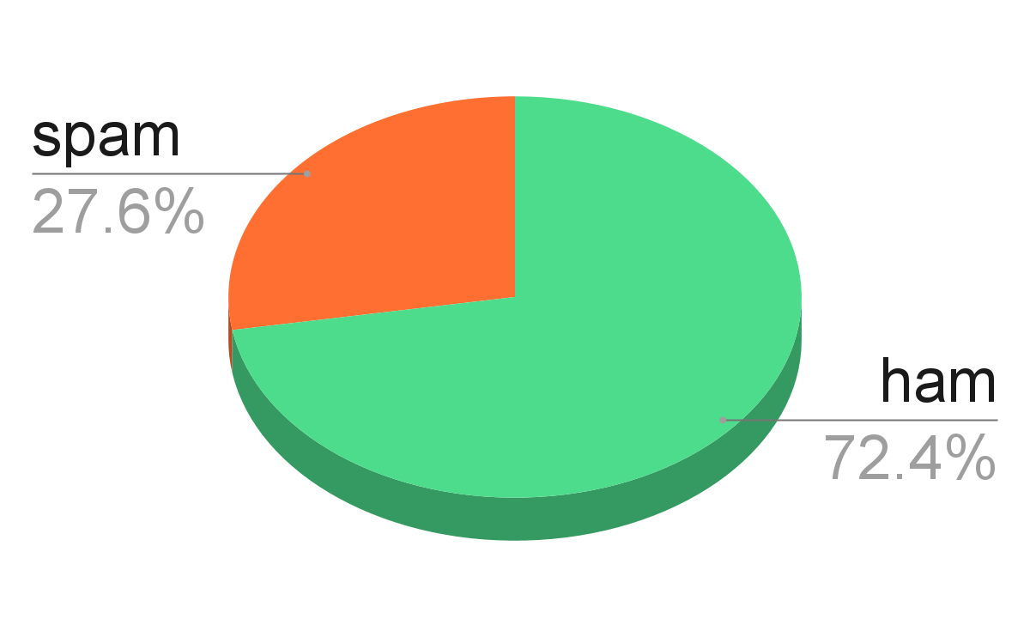
Training Process
For every email
P(spam) = 0.3
P(ham) = 0.7
Notes:
Remember, the main task is the find two parameters
First, for the whole database, we calculate the probability of spam the ham email

Slide 19
Training Process
2. For every words in each email
Subject: Congratulations! You have a chance to win big prizes!
Dear lucky user,
Today is your lucky day! You have been selected for a chance to win an exclusive reward. To claim your prize, simply click the link below and enter our free draw. Don't miss out on this opportunity to win big money with no investment for free.
Click now and start your journey to fortune!
Best regards,
The Contest Team
“win” “free” “money” “today”
Notes:
2. And for each email, each words, let’s just pick some words for example
We got the matrix, which is the frequency of them in an email

Slide 20
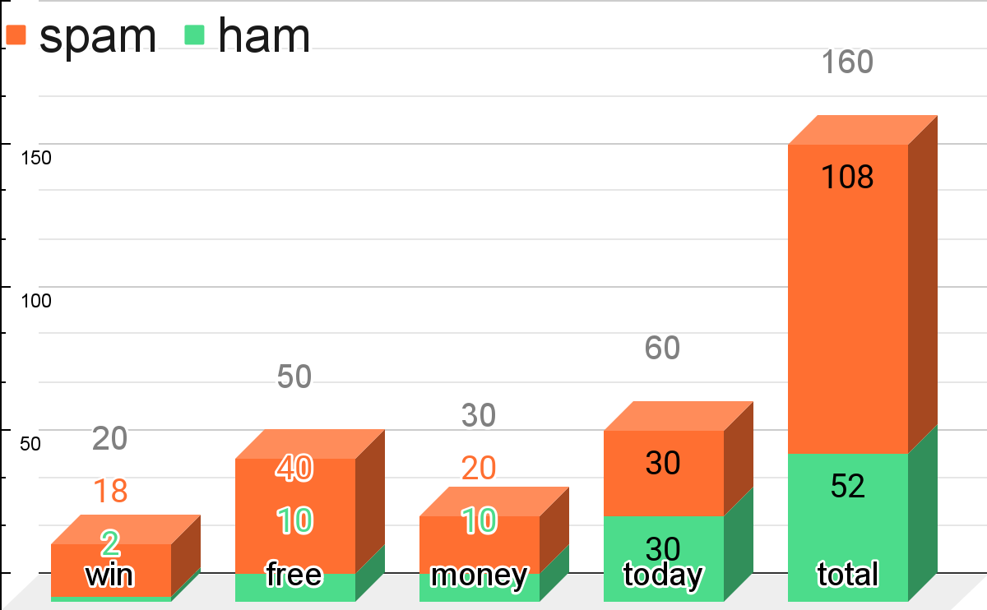
Training Process
2. For every words in each email
P("win"∣ham)=0.9, P("win"∣spam)=0.1
P("free"∣ham)=0.2, P("free"∣spam)=0.8
P("money"∣ham)=0.3, P("money"∣spam)=0.7
P("today"∣ham)=0.5, P("today"∣spam)=0.5
Notes:
And then calculate the second parameter
This is a bar chart showing the frequency of every words
For example, the word “win”:
It has occurred 20 times totally
In spam email, it has occurred 18 times
So we use 2 divided by 20 to get the probability is 0.1
The same with the following probability

Slide 21
Training Process
3. Compare P(S|W) and P(H|W)
P(wordA|spam) * P(wordB|spam) * P(wordC|spam) * P(wordD|spam) * P(spam)
(0.9 * 0.8 * 0.7 * 0.5) * 0.3
0.08
P(spam) = 0.3
P(ham) = 0.7
P(spam|words)
P("win"∣ham)=0.1, P("win"∣spam)=0.9
P("free"∣ham)=0.2, P("free"∣spam)=0.8
P("money"∣ham)=0.3, P("money"∣spam)=0.7
P("today"∣ham)=0.5, P("today"∣spam)=0.5
P(words)
V
P(wordA|ham) * P(wordB|ham) * P(wordC|ham) * P(wordD|ham) * P(ham)
(0.1 * 0.2 * 0.3 * 0.5) * 0.7
0.002
P(ham|words)
P(words)
Notes:
Now, we have worked out the two parameters we want, so we apply these data to the formula
For the probability of spam in the condition of the words is 0.08
For the other one is 0.002
So Definitely the Probability of spam email is more than ham email

Slide 22
Training Process
4. Final Result(Training Data)
Subject: Congratulations! You have a chance to win big prizes!
Dear lucky user,
Today is your lucky day! You have been selected for a chance to win an exclusive reward. To claim your prize, simply click the link below and enter our free draw. Don't miss out on this opportunity to win big money with no investment for free.
Click now and start your journey to fortune!
Best regards,
The Contest Team
“win” “free” “money” “today”...
P(spam|words) > P(ham|words)
If the word occurs,
it’s more likely to be a spam email
Notes:
So the final result is

Slide 23
Training Model
Notes:
Yeah so that’s how it works

Slide 24
Model Evaluation

Slide 25
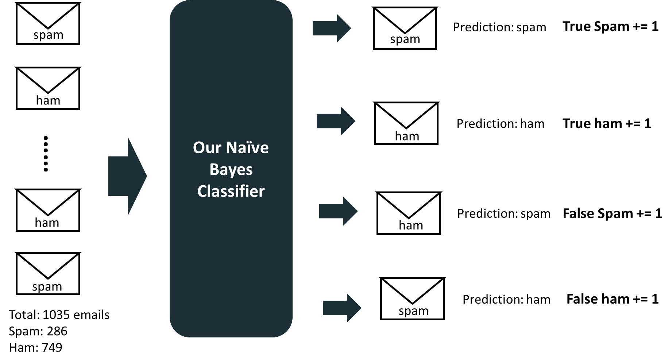
Model Evaluation

Slide 26
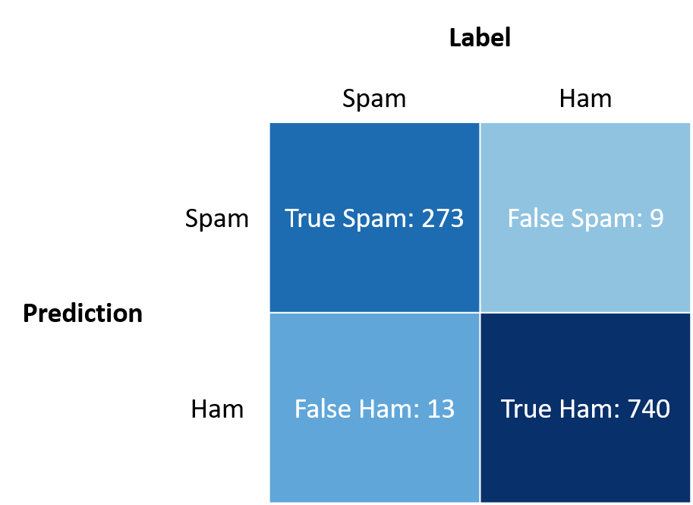
Model Evaluation

Slide 27
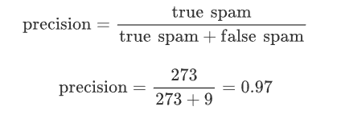
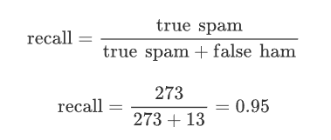
Model Evaluation

Slide 28
Potential Improvement
Expand train database
Add more features
Subjects of emails
Format of sender’s email addresses
The length of emails
Timestamps and sending frequency

Slide 29
Results and Discussion
Present the model's performance metrics obtained during evaluation.
Discuss the implications of the results and potential areas for improvement
Performance Metrics: Discuss the model's effectiveness in distinguishing between spam and non-spam.
Improvements and Challenges: Address areas for potential enhancement and difficulties faced in the process.
Display the model's performance metrics (accuracy, precision, recall).
Discuss the outcomes and potential improvements.
Notes:
We have presented the model’s performances and their metrics all the way long !!! We addressed areas for improvements and potential enhancements !!! Displayed the metrics all along !!! Thank you everybody for listening I hope you understood our project well !!

Slide 30
References
Hopkins,Mark, Reeber,Erik, Forman,George, and Suermondt,Jaap. (1999). Spambase. UCI Machine Learning Repository. https://doi.org/10.24432/C53G6X.
Naive Bayes text classification. (2009). Stanford.edu.
Scikit-learn: Machine Learning in Python, Pedregosa et al., JMLR 12, pp. 2825-2830, 2011.
“Naive Bayes, Clearly Explained!!!” Www.youtube.com, www.youtube.com/watch?v=O2L2Uv9pdDA&t=429s&ab_channel=StatQuestwithJoshStarmer.
Laplace smoothing in Naïve Bayes algorithm | by Vaibhav Jayaswal | Towards Data Science
Understanding Naïve Bayes algorithm | by Vaibhav Jayaswal | Towards Data Science
Spam Filter in Python: Naive Bayes from Scratch - KDnuggets

