Slide 1



IPL Data Analysis
By Kaustubha ram p
Batch No.: MIP-DA-12

Slide 2
Introduction
The Indian Premier League (IPL) is a Twenty20 cricket tournament organized by the Board of Control for Cricket in India (BCCI). Launched in 2008, it features international players forming teams. The tournament is held annually in India, with teams competing to qualify for the semi-finals and ultimately the final match. Its revenue from sponsorship, endorsement, and advertising spending has grown from Rs. 2,423 crore in 2008 to Rs. 15,766 crore in 2023.

Slide 3
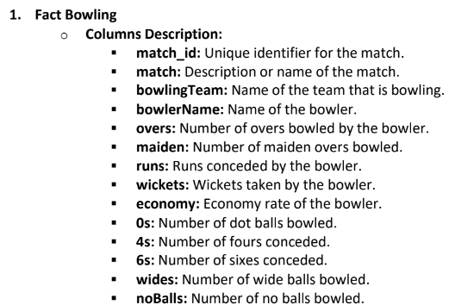
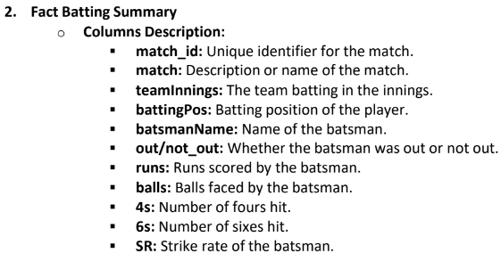
DATA

Slide 4
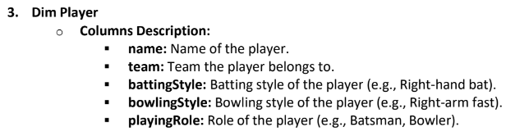
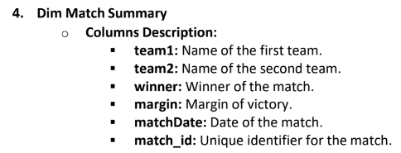
DATA

Slide 5
Main kpis
Number of wins
Win margin
Strike rate of batsman
Economy Rate of Bowler
Number of boundaries

Slide 6
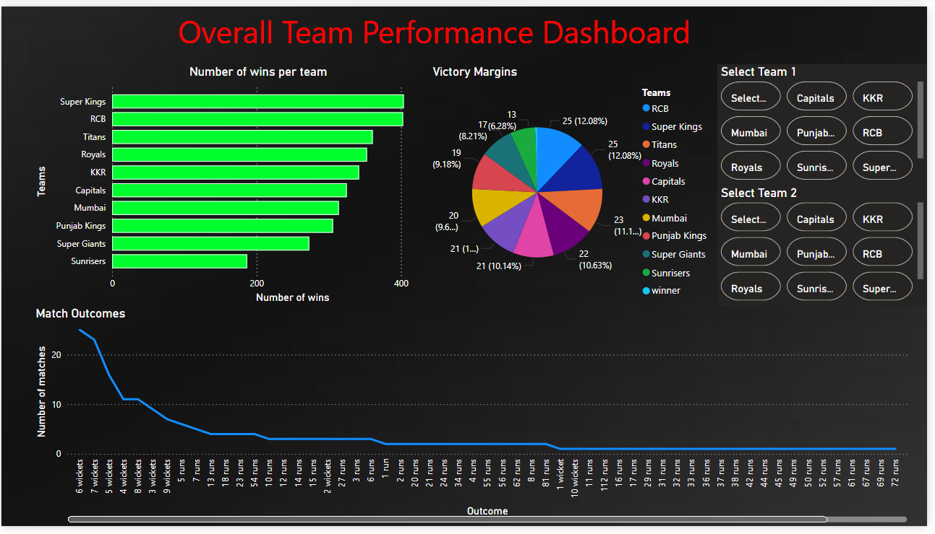
Team performance Dashboard

Slide 7
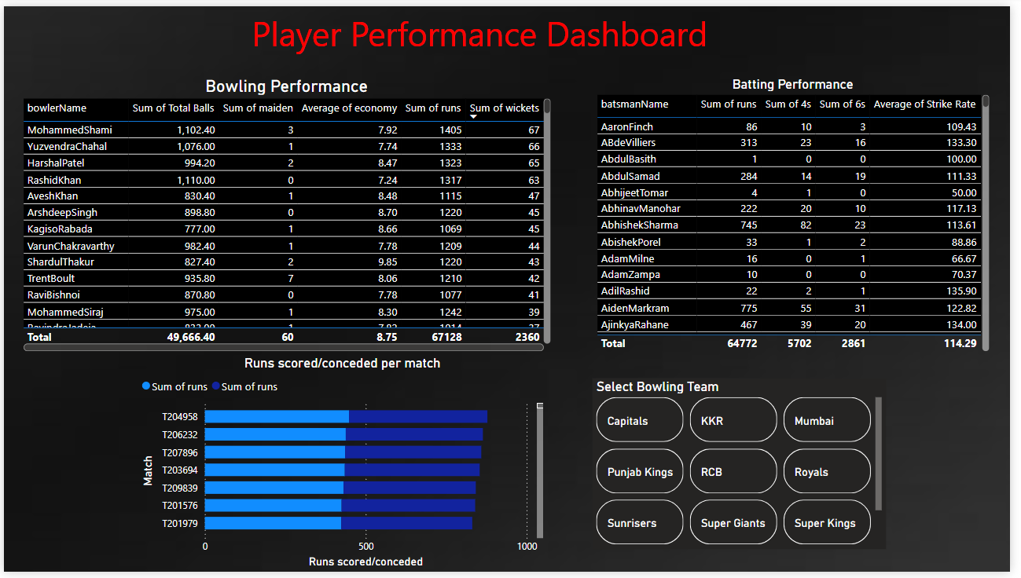
Player performance Dashboard

Slide 8
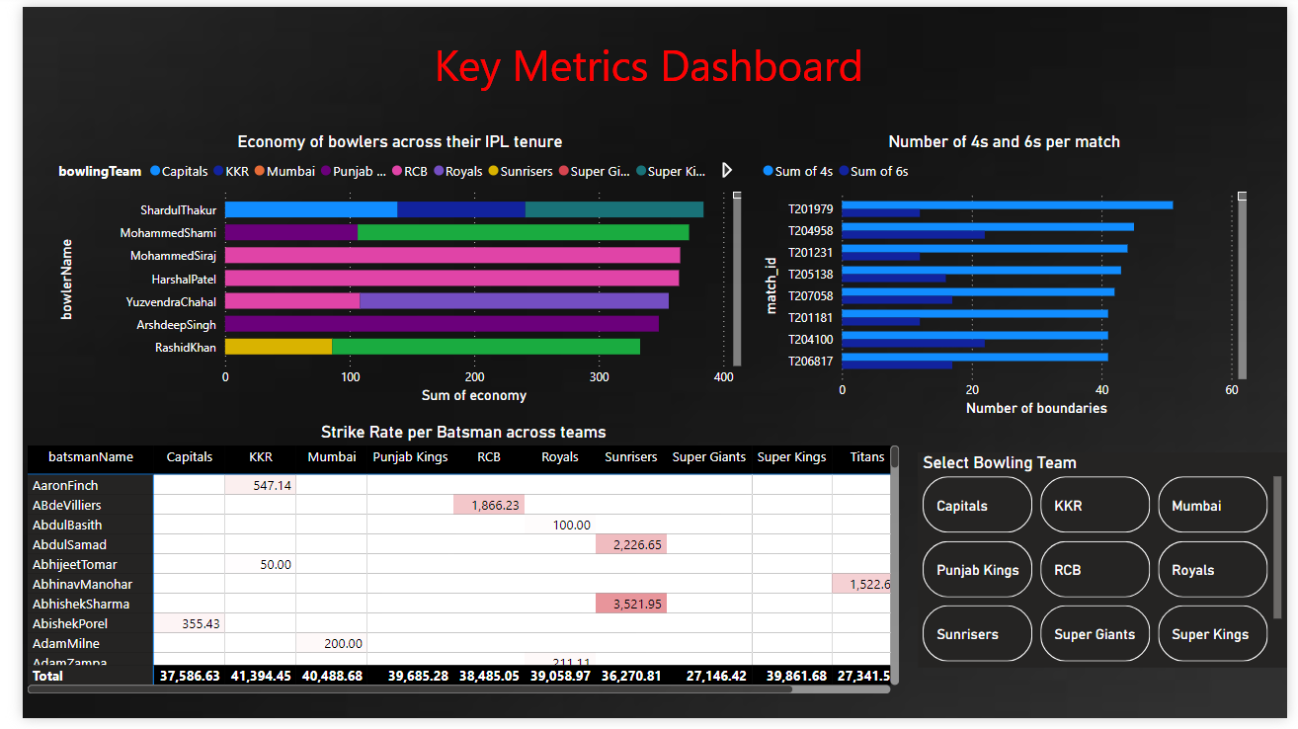
Key metrics Dashboard

Slide 9
Key Insights
Super kings and RCB are the teams with the most number of wins
The number of 4s hit in a match is generally more than the number of 6s
Sunil Narine has a good bowling economy despite having bowled nearly 1000 balls
The victory distribution is similar for almost all teams.: Super Kings and RCB have the highest number of wins and SRH has the lowest number of wins
David Wiese and Mark Wood have the highest strike rate

Slide 10
THANK YOU

