Slide 1


SOCIALLY RELEVANT PROJECT
DYSLEXIA FRIENDLY ASSISTANCE

Slide 2
MEET OUR TEAM
1)SOWMITHA M(2022115007)
2)JAYASHREE J(2022115010)
3)KAVIYA G(2022115106)

Slide 3
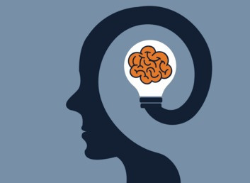
INTRODUCTION
Dyslexia refers to a neurological impairment that results in lack of reading, writing, and comprehension capability. It is one of the most popular learning disabilities that even affects individuals across various age groups. This learning disorder is a global problem affecting approximately 15% to 20% of the population. One of the most significant means of helping people with dyslexia at an early stage is to conduct intervention programs for literacy. Now, with the advent of artificial intelligence (AI) development, technology can provide tailor-made solutions through which dyslexic individuals can develop their reading-related capacities. .

Slide 4
MOTIVATION
Lack of Interactive Solutions: Existing tools provide text-to-speech and font adjustments but do not actively enhance reading skills over time.
Technology’s Potential: AI and machine learning can personalize learning experiences, making reading improvement engaging and effective.
Personal Inspiration: Inspired by the struggles of individuals with dyslexia, this project aims to create an interactive and adaptive solution to improve their reading skills and boost confidence.

Slide 5
SOCIAL RELEVANCE
A dyslexia assessment and intervention chatbot addresses several important social needs:
Improves Educational Access – Provides affordable and easily accessible dyslexia support, ensuring that students from all backgrounds receive the help they need.
Promotes Early Intervention – Identifies reading difficulties at an early stage, allowing timely support that improves long-term academic and career success.
Reduces Stigma – Offers a private, judgment-free environment where individuals can practice and improve their literacy skills without fear of embarrassment.
Empowers Individuals – Builds confidence in reading and writing by providing personalized strategies and real-time corrective feedback.
Source: https://www.dynaread.com/case-study-age-ten
https://www.discoveryaba.com/statistics/dyslexia

Slide 6
PROBLEM STATEMENT
Dyslexia is a widespread learning difficulty that affects an individual’s ability to read, write, and comprehend text effectively. While existing solutions primarily focus on assistive technologies such as font adjustments, text-to-speech conversion, and accessibility tools, they do not actively work toward reducing the effects of dyslexia over time.This project aims to address these challenges by assessing dyslexia severity through interactive games, creating a structured and personalized training schedule, and providing real-time corrective feedback during reading exercises. By ensuring continuous assessment and adaptive learning, the project seeks to offer a more effective and lasting solution for individuals with dyslexia.

Slide 7
OBJECTIVES
Develop an AI-based Dyslexia Training System to help individuals improve reading and cognitive skills.
Implement a NeuroTrainer module to visualize brain activity and track learning progress.
Design an interactive assessment system for kids and adults to evaluate dyslexia severity.
Add engaging animations and gamified elements to make learning enjoyable for children.
Build a user-friendly web platform for easy accessibility.
Adjust difficulty levels based on user performance to provide a customized learning experience.
Offer real-time feedback and progress tracking to monitor improvements effectively.

Slide 8
LITERAURE SURVEY
In "Word Recognition and Basic Cognitive Processes Among Reading-Disabled and Normal Readers in Arabic" (Abu-Rabia, Share, & Mansour, 2003), the authors compared the performance of reading-disabled and typical readers, highlighting deficits in visual word recognition and phonological processing among the former. Their study emphasizes that such difficulties are not merely orthographic but stem from fundamental cognitive impairments.
Other works, like "Effect of Intensive Training on Auditory Processing and Reading Skills" (Agnew, Dorn, & Eden, 2004), demonstrate that structured auditory training significantly enhances reading proficiency.This study supports the concept of neuroplasticity, showing positive effects of auditory interventions.
In "Current Status of Treatments for Dyslexia: Critical Review" (Alexander & Slinger-Constant, 2004), the authors critically examine existing therapeutic methods, highlighting phonological training as the prevailing approach.They also emphasize the value of early detection and the need for customized, multi-modal interventions to improve learning outcomes for individuals with dyslexia.

Slide 9
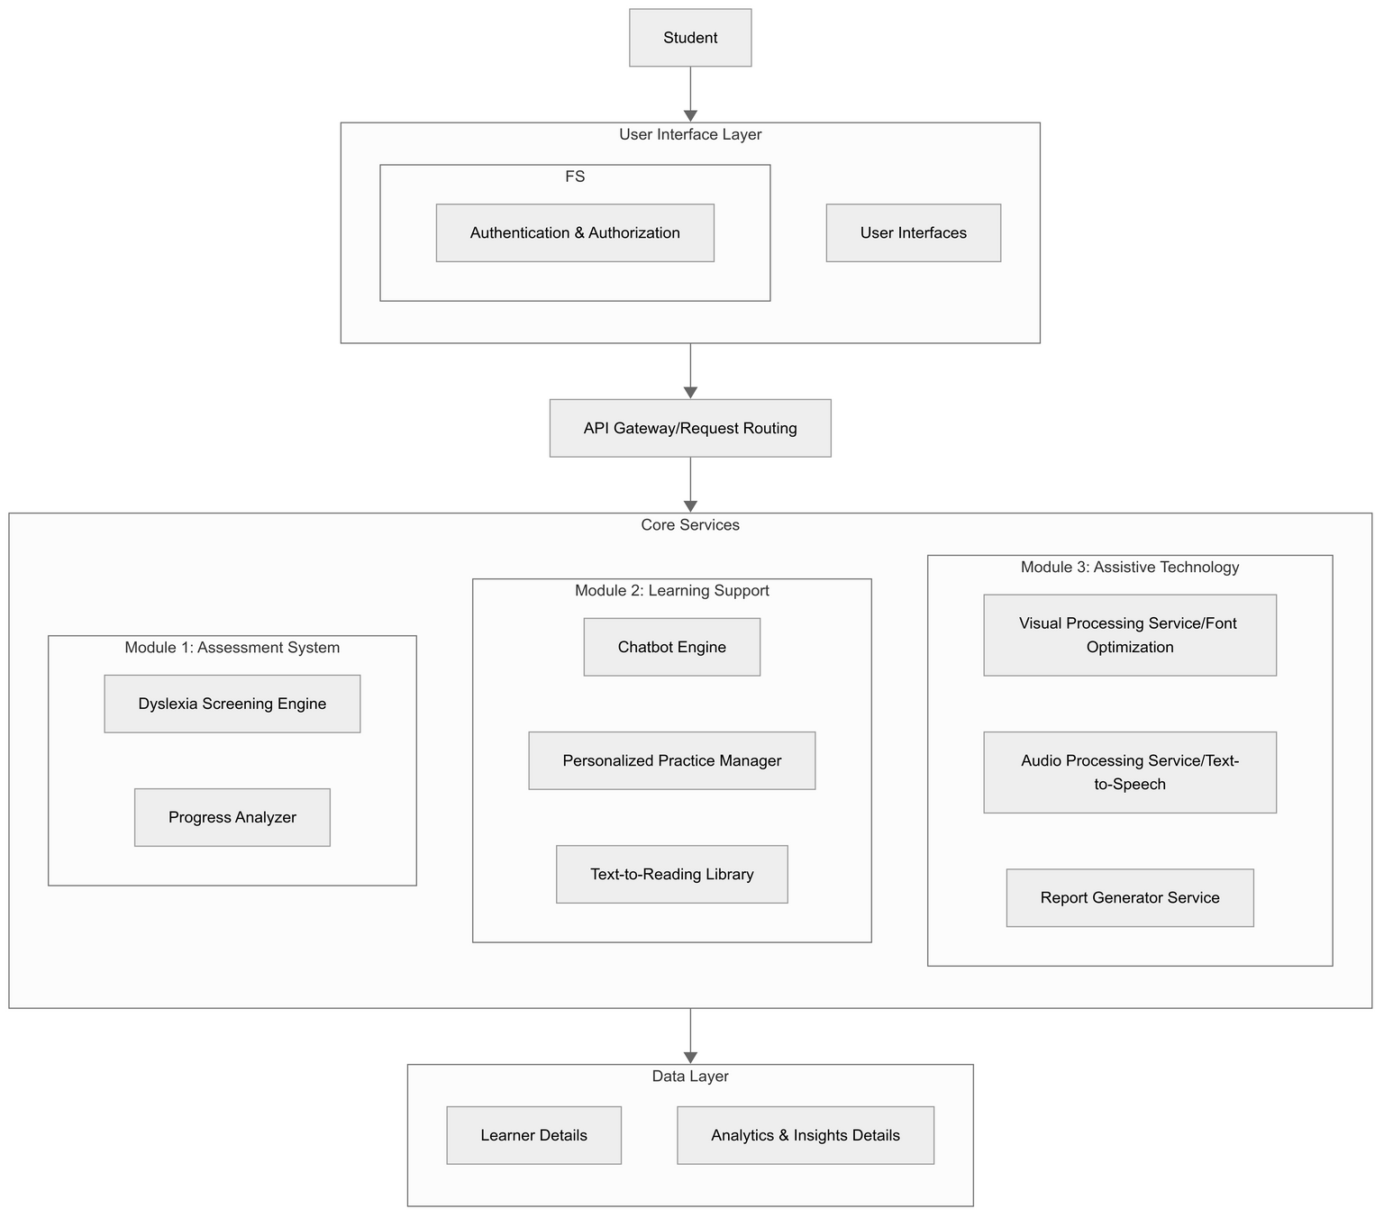
DETAILED ARCHITECTURE

Slide 10
MODULE DESCRIPTION
USER INTERFACE LAYER: This is the front-end layer where students interact with the system. It includes various user interfaces that provide access to the platform's features.
FS AUTHENTICATION & AUTHORIZATION: This component handles user authentication and authorization, ensuring that only authorized users can access certain parts of the system.
API GATEWAY /REQUEST ROUTING:
This layer acts as a traffic controller for the system:
a)API Gateway: Manages and routes incoming API requests from the user interface to the appropriate core services. It can also handle load balancing, security, and monitoring.
b)Request Routing: Ensures that requests are directed to the correct service, improving efficiency and reliability.

Slide 11
CORE SERVICES
This is the heart of the system, where the main functionalities are implemented. It is divided into three modules:
MODULE 1: ASSESSMENT SYSTEM
Dyslexia Screening Engine: This engine uses various assessments and algorithms to identify potential dyslexia in students. It might include tasks that test reading, writing, and phonological awareness.
Progress Analyzer: Tracks student performance over time, using data analytics to provide insights into their strengths and areas needing improvement. It can generate progress reports and suggest personalized learning paths.
MODULE 2: LEARNING SUPPORT
Chatbot Engine: An AI-driven chatbot that provides instant support to students. It can answer questions, provide explanations, and guide students through learning materials.
Personalized Practice Manager: This component creates customized practice exercises based on the student's performance and learning needs. It adapts to the student's progress, offering more challenging tasks as they improve.
Text-to-Reading Library: Converts text-based content into audio format, making it accessible for students who struggle with reading or prefer auditory learning.

Slide 12
MODULE 3: ASSISTIVE TECHNOLOGY
Visual Processing Service/Font Optimization: Adjusts the visual presentation of text to make it easier to read. This could include changing fonts, sizes, colors, and spacing to reduce visual stress and improve readability.
Audio Processing Service/Text-to-Speech: Converts text into speech, providing an alternative way for students to access content. This is particularly useful for students with reading difficulties or visual impairments.
Report Generator Service: Automates the creation of detailed reports on student performance, progress, and usage of the system. These reports can be used by educators and parents to track development and make informed decisions.
DATA LAYER
This layer is responsible for storing and managing all the data required by the system:
Learner Details: Contains personal and academic information about students, such as their profiles, learning history, and preferences.
Analytics & Insights Details: Stores data related to student performance, system usage, and other metrics. This data is used to generate insights, reports, and recommendations for improving the learning experience.

Slide 13
UNIQUENESS
Emotion Detection:
Use sentiment analysis to detect user frustration and provide encouragement.
2.Universal Adaptability:
Tailored for both children and adults, ensuring age-appropriate and skill-level-specific support for all user.
3.AI-Driven Neurofeedback:
Delivers real-time, personalized learning paths with neurofeedback to track progress, optimize brain activity, and enhance cognitive development.

Slide 14
TECHNOLOGY STACK
1. Web Interface
Frontend Framework: React.js / React Native – For building an interactive and responsive web application.
2. Backend Framework
Node.js,FastAPI (Python) – A high-performance, asynchronous framework for handling API requests efficiently.
3. Natural Language Processing (NLP)
GPT API (OpenAI) – Enables chatbot responses and adaptive learning for dyslexia assistance.
4. Speech Recognition
Google Cloud Speech-to-Text – Real-time speech analysis to evaluate reading accuracy.
5. Machine Learning Models
TensorFlow / PyTorch – For training AI models to detect and support dyslexic users.
6. Database (Storage Layer)
MongoDB – A flexible, document-based NoSQL database for storing user progress and training data.

Slide 15
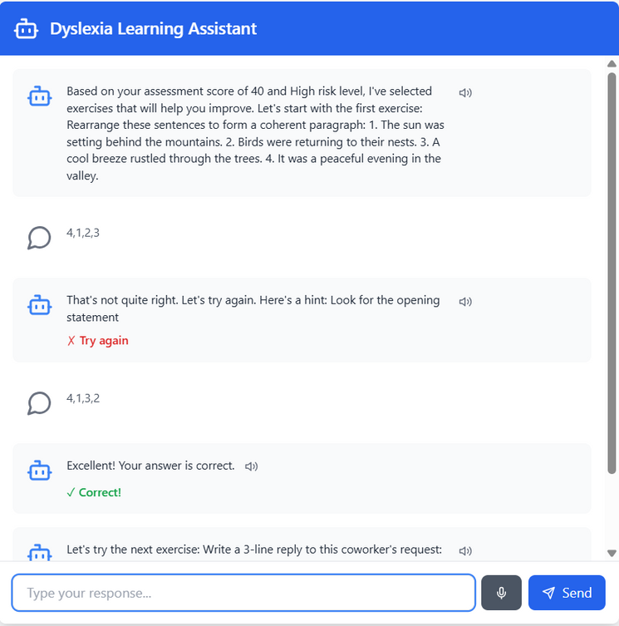
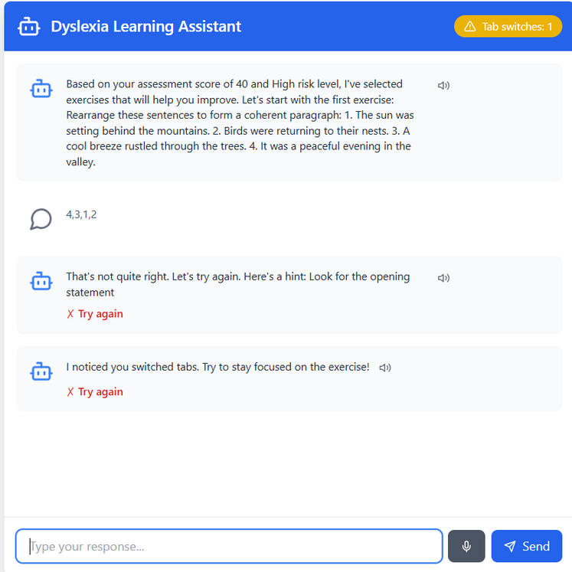
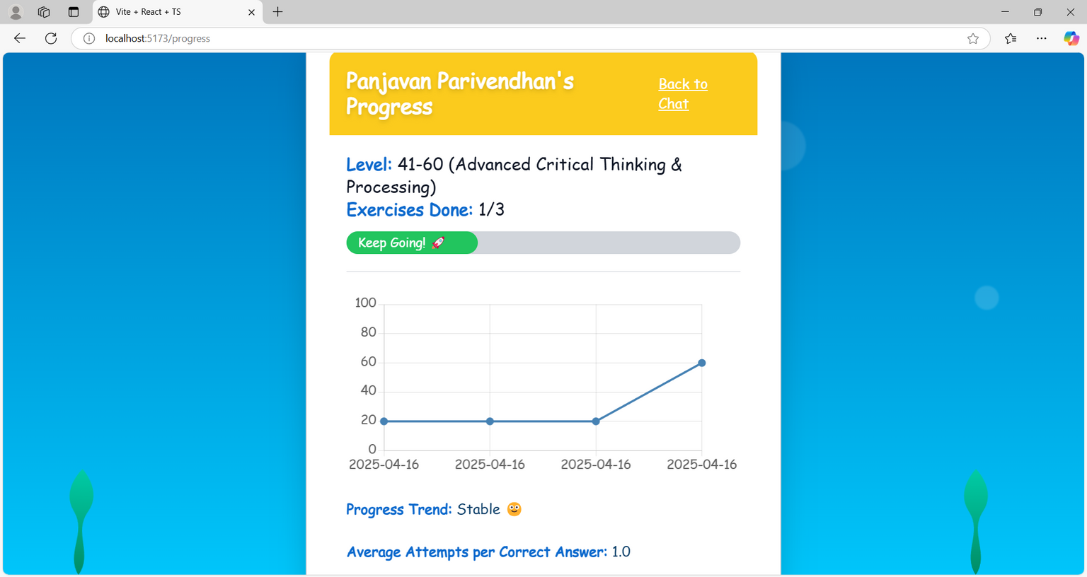
IMPLEMENTATION
ADAPTIVE LEARNING EXERCISES
TAB SWITCHING
PROGRESS TRACKING

Slide 16
OUTCOMES
AI-Powered Dyslexia Training System – A functional web-based system that assists individuals in improving reading and cognitive skills.
Dynamic Assessments – Separate interactive assessment modules for kids and adults to evaluate dyslexia severity.
Gamified Learning Environment – Engaging animations, dynamic backgrounds, and interactive elements to make learning enjoyable.
Personalized Training – Adaptive difficulty levels and custom exercises based on user performance.
User Dashboard – A tracking system for users to view their progress and receive feedback.
Responsive UI – A user-friendly, visually appealing interface accessible across different devices.

Slide 17
CHALLENGES FACED
Balancing Cognitive Load and Engagement:Designing exercises that are both effective and not overwhelming required careful calibration. Selecting the right mix of challenge and support was crucial to keep learners engaged without causing frustration or fatigue.
Selecting Reliable Emotion Detection Modalities:Choosing which emotional cues (e.g., text input, facial expression, voice tone) to prioritize for frustration detection posed a challenge, especially considering privacy concerns, hardware limitations, and accuracy across diverse user environments.

Slide 18
CONCLUSION
This project introduces an emotionally-aware learning platform for children with dyslexia, integrating assessments, adaptive exercises, chatbot guidance, and progress tracking for a personalized experience. It leverages emotional detection and frustration-aware NLP to maintain engagement. Features like word games, dynamic feedback, and tab-switch detection enhance motivation and integrity.
FUTURE WORK
Multimodal Emotion Detection: Enhance the emotional state model by integrating behavioral signals like tone of voice, facial expressions, or body language for richer and more accurate emotion recognition.
Language and Cultural Adaptability:Expand the platform to support multiple languages and culturally responsive content, ensuring that learners from diverse linguistic and cultural backgrounds receive equally effective interventions.
Peer Interaction and Collaborative Learning:Incorporate secure, moderated peer-to-peer learning features where children can work together on activities or share achievements, fostering social engagement and confidence.

Slide 19
REFERENCES
1) A. Senthilselvi; Aniket Kumar; S Aakash; G. Sreedhar; Balika J Chelliah - Enhancing Dyslexia Awareness: A ML Model for Early Identification and Support - 2024
2) Liurong Xu, Lan Luo,Runzhang Qin -Intelligent Learning Environment for Dyslexia Assistance: Intelligent Perception, Learning Analysis, and Affective Computing - 2022
3) H. M. Al-Barhamtoshy and D. M. Motaweh - Diagnosis of Dyslexia Using Computing System - 2017
4) A. Brennan, T. McDonagh, M. Dempsey, and J. McAvoy - “Cosmic Sounds: A Game to Support Phonological Awareness Skills for Children With Dyslexia” - 2022

Slide 20
THANK YOU

