Slide 1
TRINETRA
Integrated Video Management & Analytics Platform
Gujarat Police Innovation Challenge 2026
"We move events, not video."
Hybrid Architecture: Model 1 + Model 3 + Model 2

Slide 2
The Challenge
80,000+ fragmented CCTV cameras across 26+ departments — no unified platform
Heterogeneous infrastructure: different vendors, VMS platforms, protocols, storage
Government databases (VAHAN, SARTHI, eGujCop/CCTNS, AFIS, NAFIS) sit isolated from cameras
Raw video centralisation = 320 Gbps WAN + 86 PB/yr storage — physically infeasible
Watchlists live in binders while evidence sits on NVRs — no real-time correlation
Scale: 30+ cameras, 5 departments, 12 hours footage per camera (official dataset)
8 build areas: Feed Integration · AI Analytics · Vehicle Tracking · Video Intelligence · Object & Face Detection · Cybersecurity · Scalable Architecture · Live Monitoring

Slide 3
Proposed Solution Model: Hybrid (Model 1 + 3 + 2)
Model 1 — Registry & GIS Foundation (mandatory): centralised camera registry, GIS mapping, gap analysis, health monitoring, 28 departments, per-dept retention
Model 3 — VMS Federation Middleware: edge gateway adapters (RTSP/ONVIF/GB28181/vendor-API) federate heterogeneous feeds; detection at the edge
Model 2 — Unified Viewing & Analytics: central correlator, unified alerting, live viewing (HLS+WebRTC), ANPR, face recognition, records enrichment
Justification: 80,000 already-deployed cameras cannot be replaced; raw centralisation is 320 Gbps—infeasible;
Trinetra federates feeds through edge gateways, runs detection locally, and centralises only events —
scaling O(events), not O(video). Other proposals move video; Trinetra moves events.

Slide 4
Solution Overview & Key Innovations
O(events) scaling thesis: 1-2 Gbps event plane vs 320 Gbps raw video for 80,000 cameras
CCTNS-auto-populated watchlist: stolen/wanted/missing records sync automatically (source-tagged with FIR refs)
VAHAN/SARTHI/NAFIS enrichment: every alert carries owner details, vehicle info, DL status, fingerprint match
Pluggable AnalyticsEngine ABC: YOLOv8n + RapidOCR + InsightFace swap without touching the adapter or bus
AdapterRegistry: modular adapter framework — new vendor/protocol = register a new adapter, not redesign
On-demand live viewing: HLS + WebRTC (WHEP proxy) — streams pulled only when an operator watches
Face recognition: InsightFace ArcFace 512-d embeddings + cosine similarity matching against enrolled gallery
Fuzzy plate dedup: SequenceMatcher catches OCR variants (S/R confusion) within 30s on same camera

Slide 5
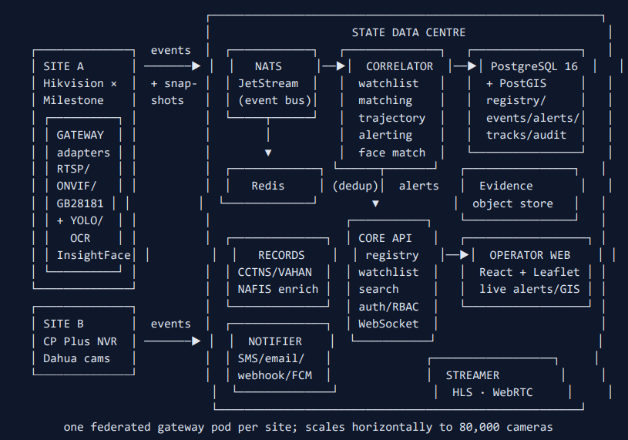
High-Level System Architecture

Slide 6
End-to-End Workflow
1. Gateway adapter observes vehicle at CAM-006 → YOLOv8n detects vehicle + RapidOCR reads plate (conf 0.91)
2. Evidence frame rendered → DetectionEvent published to NATS JetStream (1 KB event + 100 KB snapshot)
3. Correlator persists event, appends to trajectory session, matches normalized plate against Redis-cached watchlist
4. CCTNS-sourced watchlist HIT → alert generated with FIR reference + VAHAN owner/vehicle + SARTHI DL enrichment
5. Redis dedup window (60s) suppresses repeat alerts at the same camera
6. Alert published to bus → WebSocket fans to operator dashboard + notifier fans to SMS/email/webhook(CCTNS)/FCM
7. Operator clicks Track → map fetches route → ordered polyline across all cameras the vehicle passed
8. Event Search → plate/camera/time query + CSV export (the searchable event log for courts)

Slide 7
AI-Powered Video Analytics
Vehicle/Object Detection: YOLOv8n (COCO: car/motorcycle/bus/truck), conf ≥ 0.45, edge gateway, 6 MB model
ANPR: RapidOCR (ONNX Runtime) on vehicle crops + Indian plate regex, crop upscaling for legibility, edge gateway
Face Detection: InsightFace ArcFace — 512-d embedding per detected face, YuNet-free (OpenCV 5.0 compatible)
Face Recognition: cosine similarity ≥ 0.38 against enrolled gallery (Redis) → wanted/missing person alert
Face Enrollment: POST /api/v1/faces/enroll (upload photo + name) → ArcFace embedding → gallery
Anomaly Detection: gateway-side rules (crowd formation, unattended object) raising anomaly events
Color Detection: real dominant-color detection from vehicle crop (BGR average) — no hardcoded hints
Pluggable: AnalyticsEngine ABC — swap YOLO/InsightFace for any engine without touching adapter or bus
Fuzzy Plate Dedup: SequenceMatcher ratio ≥ 0.8 suppresses OCR variants (S/R confusion) within 30s

Slide 8
Watchlist Correlation & Real-Time Alerts
Inbound (auto-watchlist): CCTNS/eGujCop feed auto-syncs stolen/wanted/missing/blacklisted records → watchlist
source-tagged (cctns) + source_ref (FIR id) → manual watchlist becomes a live, database-backed watchlist
Outbound (real-time enrichment): on a plate hit, VAHAN vehicle/owner + SARTHI DL attached to the alert
NAFIS fingerprint/face match for persons → wanted/missing person alert with match score
Matching: exact normalized-plate match against Redis-cached active set; sub-ms per event
Deduplication: Redis SET NX EX (60s per watchlist-entry × camera) — one actionable alert, not a flood
Alert Prioritisation: category (stolen/wanted/missing/blacklisted/anomaly) → severity + routing policy
Fan-out: SMS (DCP) · email (Crime Branch) · webhook (CCTNS) · FCM (field units) — all audited
Visualisation: dashboard cards (evidence + source badge + VAHAN enrichment) · GIS map pins · WebSocket push
Cross-camera tracking: plate-keyed session linking (60-min gap window) → ordered polyline across cameras

Slide 9
Key Technologies, Frameworks & Tools
Backend: Python · FastAPI · SQLAlchemy async · PostgreSQL 16 + PostGIS · Redis 7 · NATS JetStream
AI/ML: YOLOv8n (Ultralytics) · RapidOCR (ONNX Runtime) · InsightFace (ArcFace) · OpenCV 5.0
Frontend: React 18 · Leaflet (GIS) · hls.js (live viewing) · WebRTC/WHEP (sub-second preview)
Protocols: RTSP · ONVIF · GB/T 28181 · HTTP-MJPEG · vendor-API · AsyncAPI (event bus) · OpenAPI (REST)
Media: ffmpeg (RTSP pull + HLS generation + transcode) · on-demand streaming (not continuous)
DevOps: Docker Compose (14 services) · Docker Desktop / WSL2 · deploy.ps1 (one-command deploy)
Testing: 34 unit tests (pytest) · TypeScript typecheck · Python compileall
Security: JWT + department-scoped RBAC · immutable audit trail · TLS · mTLS for records connectors
Architecture: AnalyticsEngine ABC (swappable AI) · AdapterRegistry (modular adapters) · RecordsConnector family

Slide 10
Scalability — 80,000 Cameras
Bandwidth: 80k × 4 Mbps raw = 320 Gbps (infeasible) vs Trinetra event plane = ~1-2 Gbps average (240 GB/day evidence)
Edge: ~3,200 gateway pods (1 per 16-32 cameras), 4 cores/8 GB each, CPU-quantized YOLOv8n @ 2-5 fps
Central: ~24 app nodes (16 vCPU/64 GB) + Postgres sharded by zone + ~20 L4 GPU (phase-2 face/Re-ID)
Storage: ~250 TB tiered (hot NVMe 30d / object 90d / archive 5yr) — raw video never centralised
Phased rollout: 50-camera pilot → district (2k) → range (10k) → state (80k) — each reuses the same images
Low-bandwidth: store-and-forward (JetStream + disk buffer), on-demand viewing, adaptive cadence, QoS AF41
HA/DR: RPO 15 min / RTO 1 h, Postgres WAL streaming, 3-copy JetStream, quarterly DR drills

Slide 11
Security, Interoperability & Deployment
Security: JWT (HS256/RS256) + department-scoped RBAC (admin/analyst/operator + dept scoping)
Immutable audit trail (every mutation logged) · TLS everywhere · mTLS for govt-DB connectors
PII discipline: watchlist entries carry purpose + FIR ref · chain-of-custody on all records lookups
Site gateways: outbound-only connections (no inbound firewall pinholes to police sites)
Interoperability: GB/T 28181 + ONVIF + RTSP (covers Hikvision/Dahua/CP-Plus estate)
AdapterRegistry: new vendor/protocol = register adapter, not redesign · normalised event schema
AsyncAPI event-bus contract + OpenAPI REST API — standardised integration mechanisms
Deployment: Docker Compose (pilot) → Kubernetes/Helm (state) · one-command deploy.ps1 script
28 departments with per-dept retention (7/15/30 days) · janitor enforcement · gap-analysis reports

Slide 12
Operational Benefits & Impact on Policing
Force multiplication: one control room cannot watch 80,000 feeds — automated matching turns the estate
into an active sensor grid. Effective monitoring capacity per operator rises ~100×
Faster stolen-vehicle recovery: ANPR hits on stolen plates at junction cameras → instant interception alerts
Investigation hours saved: plate/camera/time search in minutes instead of days of CCTV review across vendors
Face recognition: enroll a wanted person's face → automatic alert when they appear on ANY camera
CCTNS integration: watchlist auto-populated from eGujCop — no manual data entry, always up-to-date
Zero vendor lock-in: new cameras of any brand onboard through the registry in minutes
Cost: ₹95-140 Cr CAPEX (5yr) + ₹18-25 Cr/yr OPEX vs ₹400 Cr+ for naive raw-stream centralisation
Interoperability dividend: normalised event schema reusable by future state systems (traffic, disaster, CCTNS)

Slide 13
Delivered Today vs Roadmap
DELIVERED & RUNNING
ROADMAP
✅ ANPR on 30 live grid cameras (YOLOv8n + RapidOCR)
✅ Face detection + recognition (InsightFace ArcFace)
✅ CCTNS auto-watchlist + VAHAN/SARTHI/NAFIS enrichment
✅ Real-time alerts + fan-out (SMS/email/webhook/FCM)
✅ Cross-camera trajectory tracking on GIS
✅ Live viewing (HLS + WebRTC) + 30-camera mosaic
✅ 28 departments, dept-scoped RBAC, per-dept retention
✅ Gap analysis, health monitoring, CSV export
✅ GB/T 28181, AsyncAPI, OpenAPI
✅ Fuzzy plate dedup + real color detection
🔵 Real govt-DB connectors (need API access)
🔵 Real SMS/email/FCM gateways
🔵 Face-embedding gallery from CCTNS
🔵 Vehicle Re-ID (plate-miss frames)
🔵 Kubernetes/Helm productionization
🔵 Postgres RLS per department
🔵 On-demand clip retrieval RPC
🔵 Mobile alert app
🔵 Kalman/ByteTrack multi-object tracking
🔵 Fuzzy plate matching (edit-distance)

Slide 14
Why Trinetra
Deterministic, rehearseable demo — runs on the real government grid (30 cameras, 5 departments)
Hot-swap to government feed — one ingester command, no code change, no rip-and-replace
O(events) scaling thesis — 1-2 Gbps for 80,000 cameras vs 320 Gbps for raw centralisation
Pluggable AI + adapters — swap YOLO, InsightFace, or add a vendor without redesign
All 8 build areas delivered — Feed Integration, AI Analytics, Vehicle Tracking, Video Intelligence,
Object & Face Detection, Cybersecurity, Scalable Architecture, Live Monitoring
"Detect at the edge, correlate at the center — move events, not video."
Thank you — Gujarat Police Innovation Challenge 2026

