Slide 1


Go Green
Group : 4 (Hack Hustlers)
Problem Statement Title : Developing a mobile application that is used get the data on air pollution for paticular area and provide plant recommendation based on that.

Slide 2
Features
1
Environmental Monitoring: GoGreen could offer tools for monitoring environmental factors such as air quality, water quality, and pollution levels.
2
Use of google gemini : To provide relavent Solution regarding problem
3
we can provide real-time air polluted data of any area

Slide 3
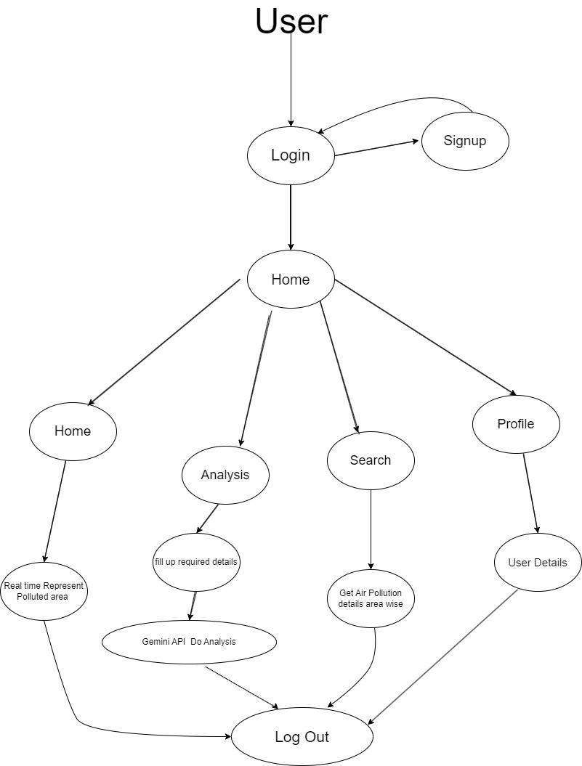
FLOW CHART

Slide 4
Thank
you!

