Slide 1
Python Hackathon (Jan 2023)
Team : Pings with Python
Members
Kavana Kundapur DAML 36, Team lead
Ami Sheth DA46
Sravani Tavva DAML 40
Uma Boyapati DAML 40
Sathya Poorani V S SMPO 10

Slide 2

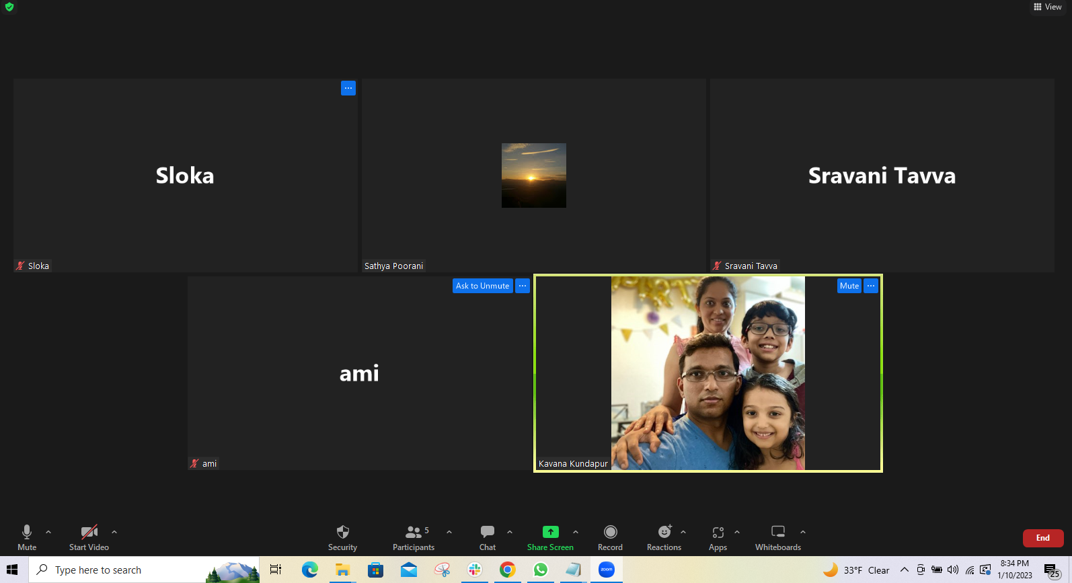
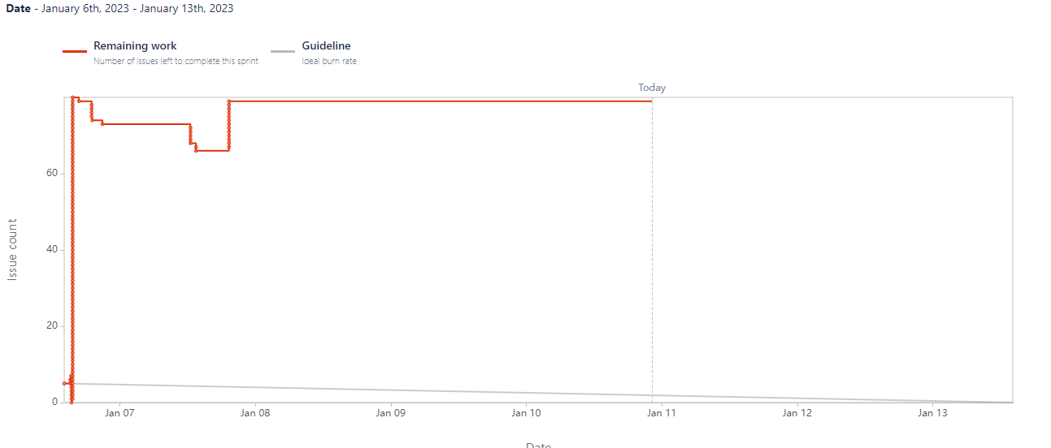
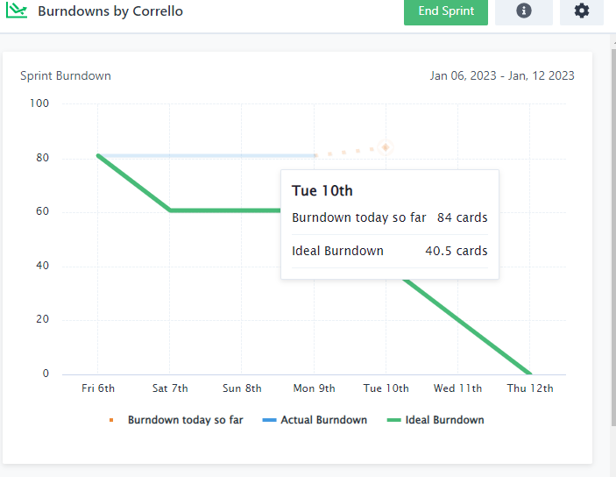
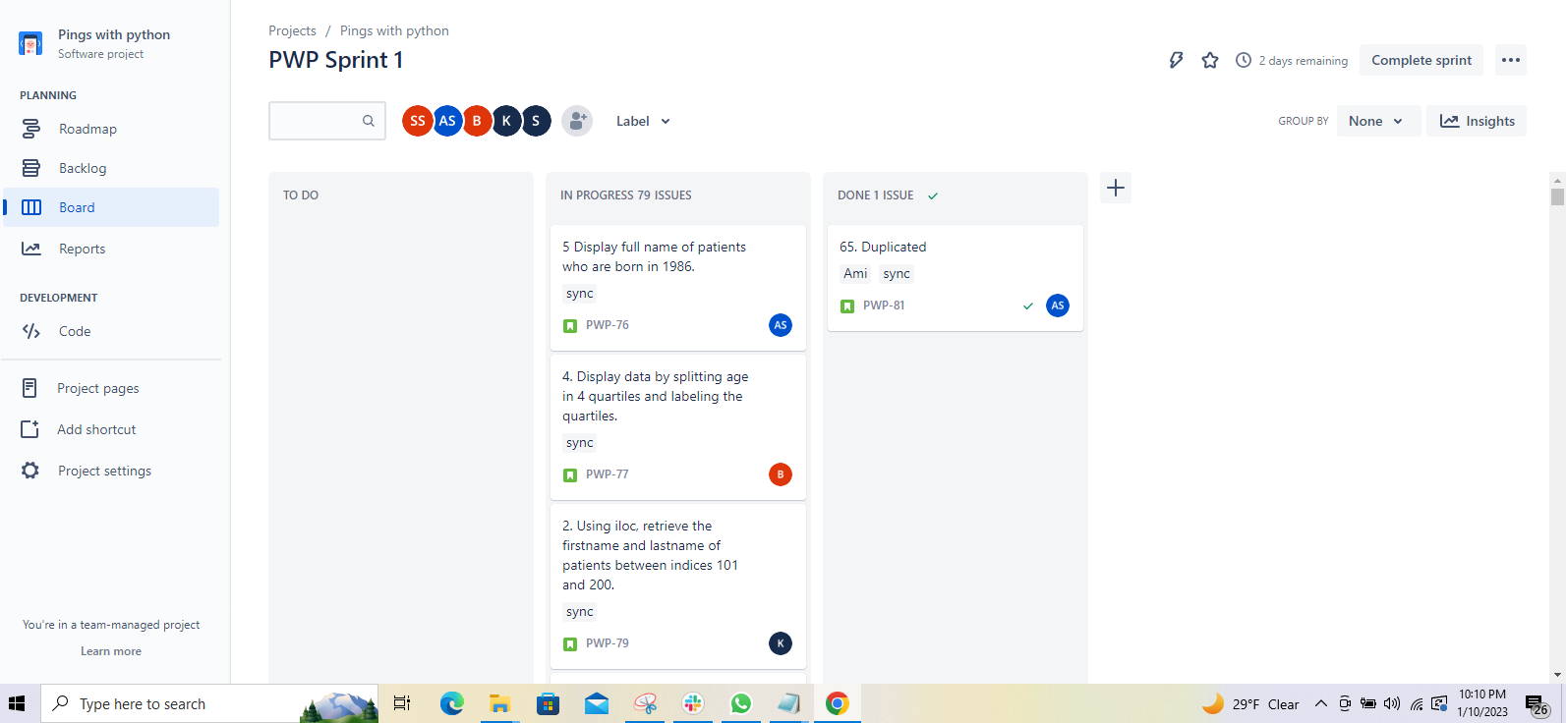
Agile Methodology
Created Trello and jira board for the team.
Trello and jira were integrated with slack.
Daily standup calls were conducted and captured with the time stamp.
Daily burndown charts were captured.
The status of the trello and jira boards were captured with time stamp.
Review and retrospective call was conducted.

Slide 3
Our Approach
Dividing and Assigning questions
Daily standup calls
Daily Team meetings to review and resolve the queries on zoom
Install new packages
Updates on Git
Review and Consolidation
Attempted 80 questions and Bonus questions added- 30

Slide 4
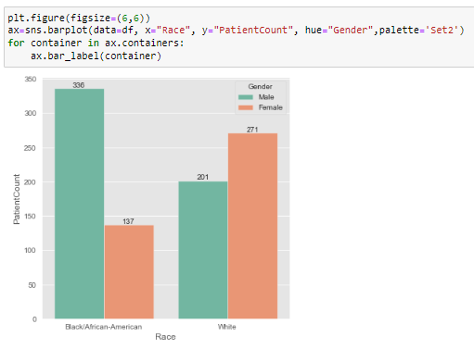
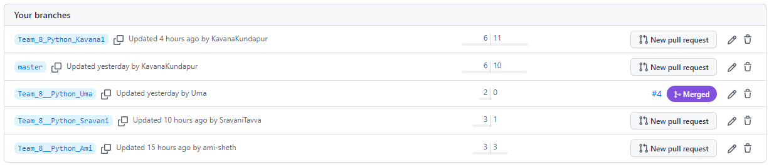
Technologies Explored
Jupyter Notebook
Git Desktop and Github
PGAdmin4
Zoom/Slack for meetings
Trello/Jeera

Slide 5
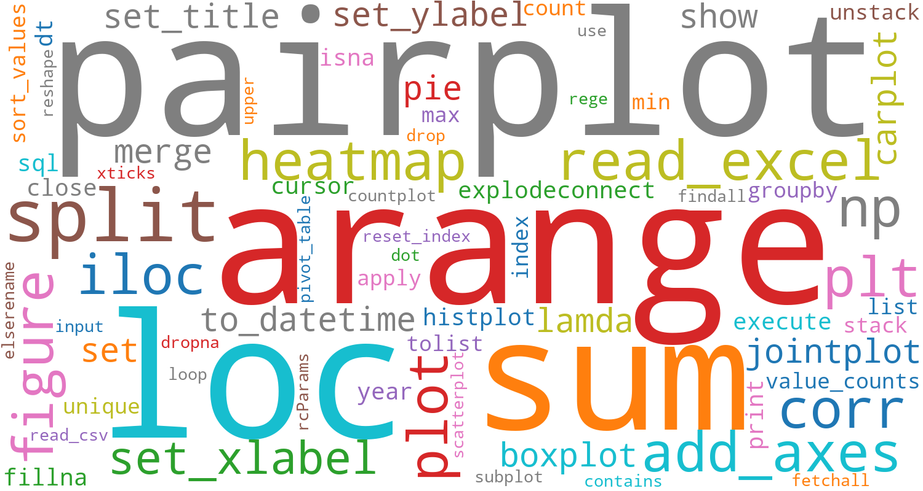
Functions and Libraries Explored
Functions - 83
Libraries -21
Plots - 18
Installed new packages

Slide 6
Learning/Improvements
Optimization of Code
Analysis of Data
Worked on more additional questions
Improving look and feel of charts
Good knowledge on visualizations
Learned new tools like- Jupiter,Git,Git-Desktop

Slide 7
