Slide 1

Bike Store Management System
TERRA BIKES
SQL Weavers

Slide 2
MOTIVATION
Our goal is to provide a solution that optimizes store operations, analyses sales trends, and supports decision-making for bike retailers.

Slide 3
ABOUT PROJECT
Operational Database:
Comprehensive solution for bike store operations and analytics.
Addresses day-to-day operational challenges.
Empowers customers to place orders, submit feedback, and register complaints.
Enables efficient order processing and complaint resolution for employees.
Analytical Database:
Provides managers with insightful metrics.
Offers in-depth insights into sales performance and employee performance.
Examines trends over various time intervals and region
Facilitates data-driven decision-making and strategic choices for store optimization.

Slide 4
Data Sources
Data Sources:
US Cities Name: https://simplemaps.com/data/us-cities
Mockaroo: https://www.mockaroo.com/
Kaggle: https://www.kaggle.com/datasets/dillonmyrick/bike-store-sample-database

Slide 5
APPLICATION DESIGN
Tools Used:
Python, VSCode for coding (IDE), PyQT, MySQL
Python Libraries and SQL queries:
Numpy, pandas, PyQT, Matplotlib, Seaborn, smtp library for email and mysql-python connector

Slide 6
OPERATIONAL MODULE​
Customer Interaction:
Customers register and log in to the system.
Seamless process for submitting feedback, placing orders, and registering complaints against bike store services or products.
Grievance Filing Process:
If a grievance is lodged, customers provide essential details.
Information includes product type and specific issues
Validation and Tracking:
Generates a unique order_ID for each transaction, serving as a reference for tracking the status of orders and grievance.
User-Friendly Interface:
Easy-to-navigate system for customers to track the progress of their orders and complaints in real-time.
Enhances transparency and customer satisfaction within the bike store operational module.

Slide 7
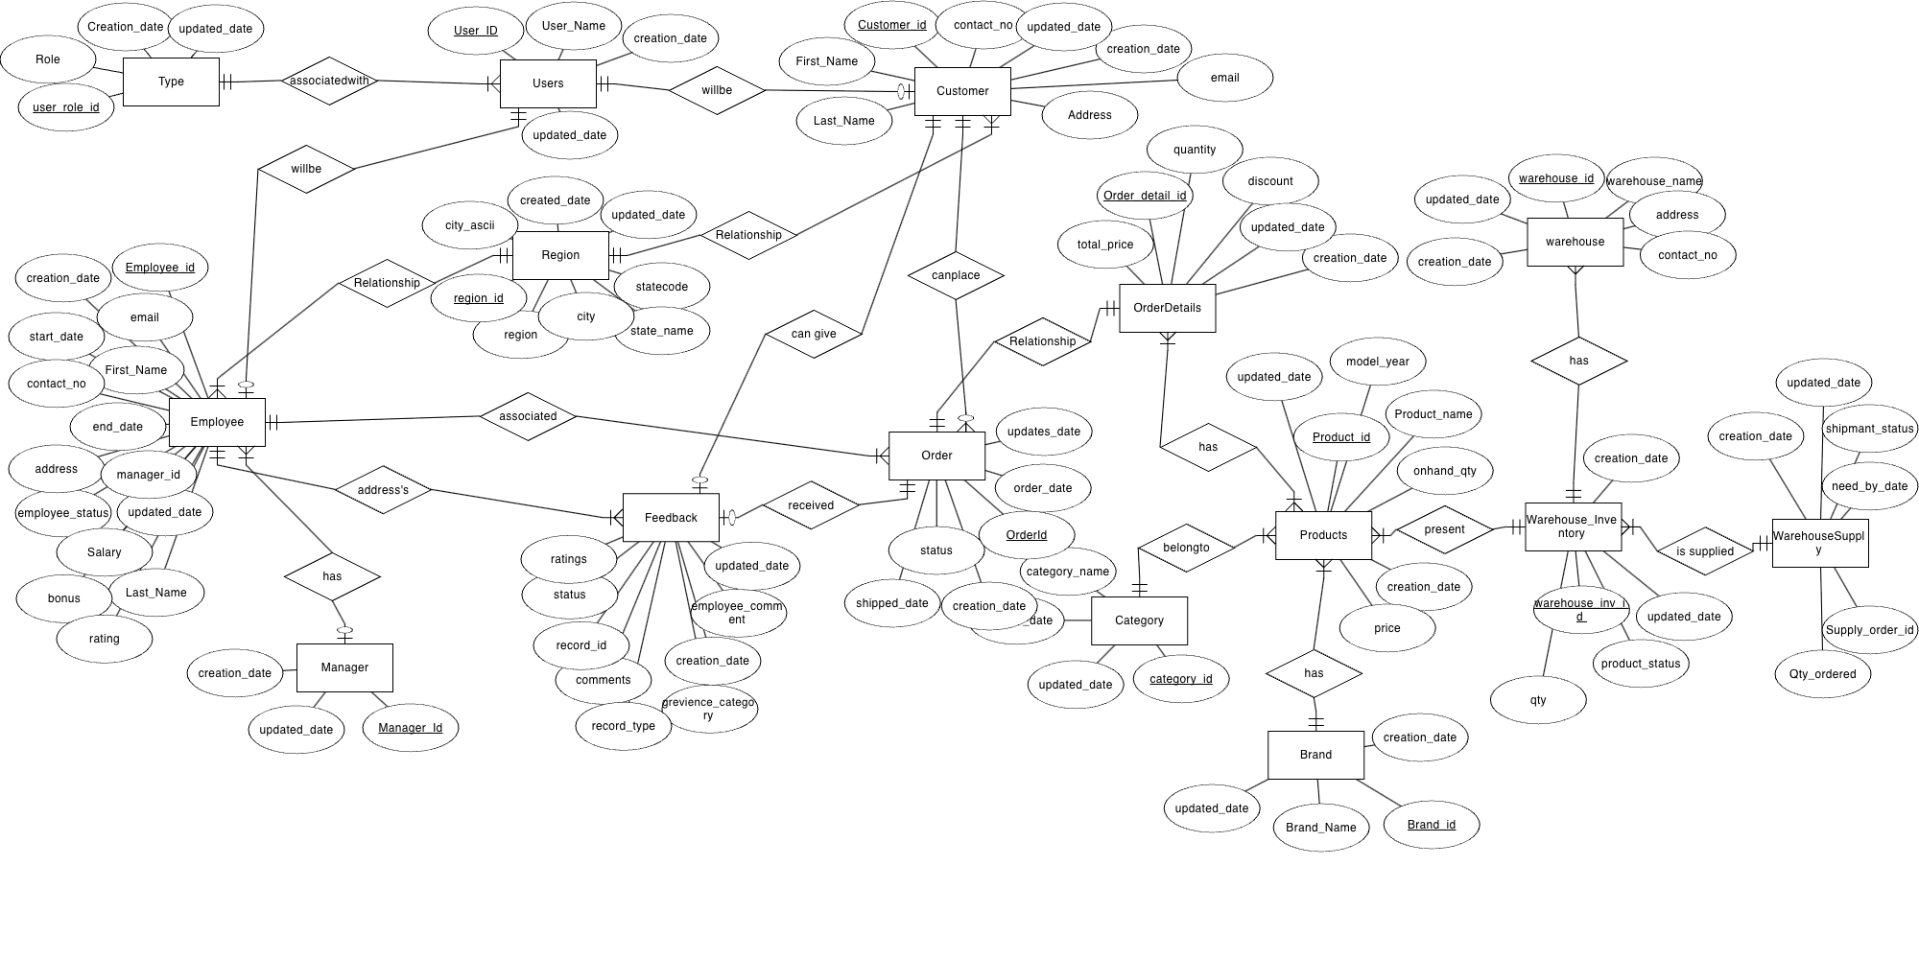
ER DIAGRAM

Slide 8
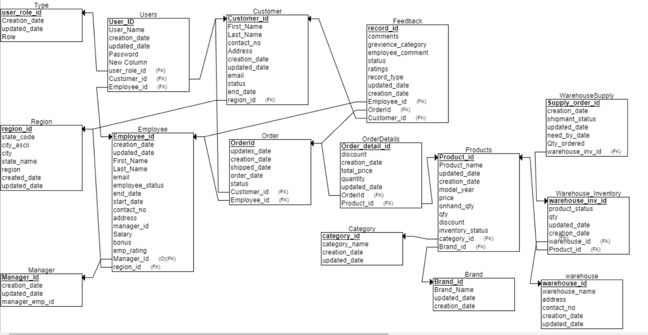
RELATIONAL SCHEMA

Slide 9
ANALYTICAL MODULE
Data Analysis and Integration:
Analyses data from operational module
Integration of diverse datasets to gain comprehensive insights into bike store performance.
Dashboard Insights:
Dynamic dashboard providing a holistic view of company performance, product metrics, sales trends.
We can also see employee performance, performance comparisons

Slide 10
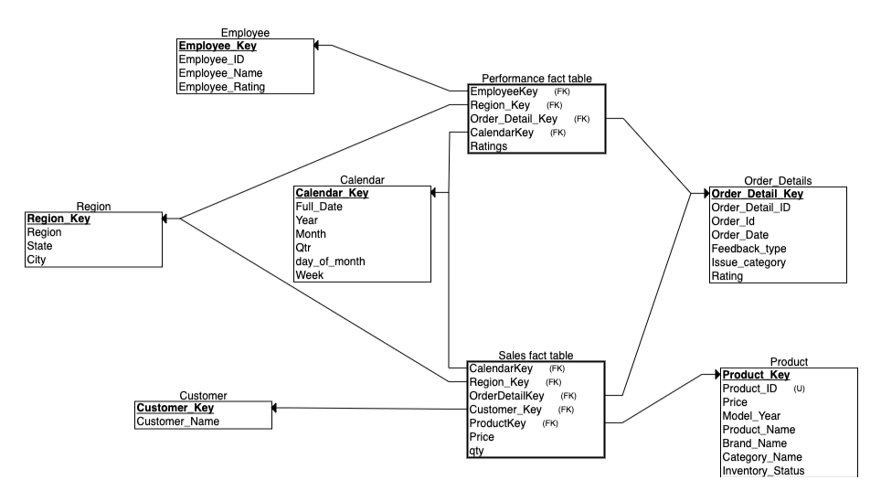
ANALYTICAL DATABASE STAR SCHEMA

Slide 11
ETL
For Operational Database: We have queried on the workbench to insert the data
For Analytical Database: Stored procedure is used to refresh or extract the data from operational database

