Slide 1

Smart Fruit Bowl — Ripeness Monitor
SR No | NAME | USN | ROLL NO
1 | Vinay Matade | 01FE23BEC239 | 508
2 | Spoorti B | 01FE23BEC246 | 513
3 | Shreyas P Wali | 01FE23BEC249 | 515
4 | Kavana Gunga | 01FE23BEC263 | 530

Slide 2
Problem Statement
Design and build a smart fruit bowl that monitors VOC, temperature, and humidity estimate fruit ripeness and indicate whether the fruit is ripening, at peak, or overripe and help increase shelf life by enabling timely consumption.

Slide 3
System Overview
Low-power IoT node for continuous fruit ripeness monitoring via gas sensor analytics
Hardware: XIAO ESP32-S3 microcontroller
Bosch BME680 sensor — Temperature / Humidity / Pressure / Gas Resistance
I2C bus @ 100 kHz, SDA = GPIO5, SCL = GPIO6
Li-ion powered, deep-sleep capable
Software Stack
ESP-IDF + FreeRTOS firmware
Bosch BME68x official sensor API
WiFi STA + MQTT for data streaming, RTC memory for deep-sleep persistence
What It Does
Wakes every 15 min, samples gas resistance, streams via MQTT
Computes linear regression slope every 240 samples (~1 hour window)
Classifies fruit state: EMPTY / FRESH / RIPENING / OVERRIPE
Key Specs: 1 Hz sampling rate, 240-sample window, 12-min deep sleep, 320°C heater 150 ms

Slide 4
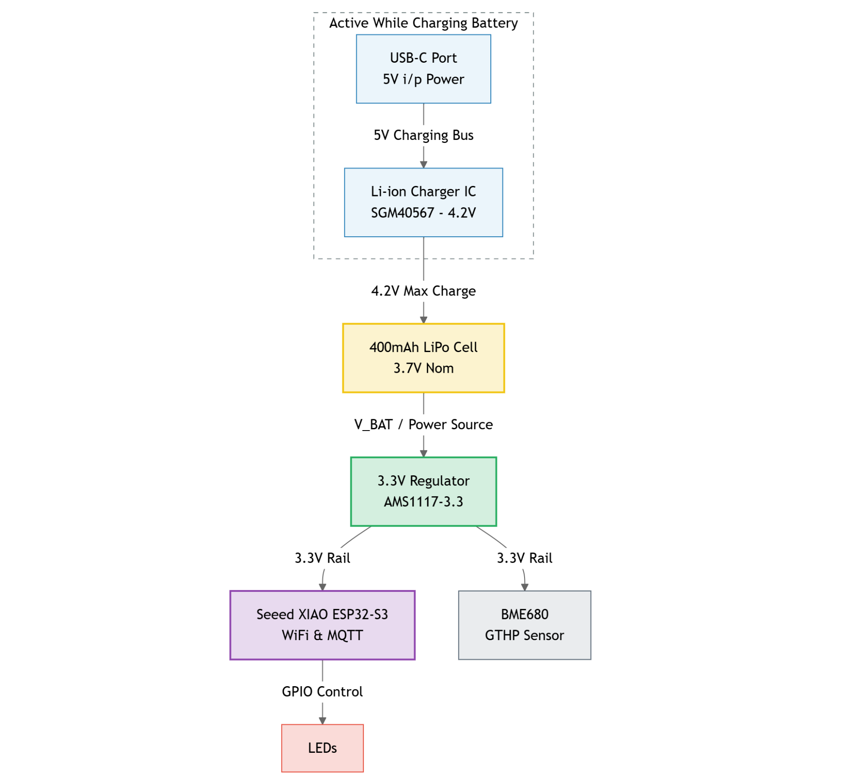
Power Architecture

Slide 5
System Configuration Parameters
I2C & Hardware
SDA_PIN = 5, SCL_PIN = 6, I2C_FREQ_HZ = 100,000
BME_ADDR = 0x76, HEATER_TEMP_C = 320, HEATER_DUR_MS = 150
Timing & Sampling
WARMUP_MS = 120,000 (2 min), SAMPLE_RATE_HZ = 1
SAMPLES_PER_BOOT = 60, RING_BUFFER_SIZE = 240
SLEEP_DURATION_US = 720,000,000 (12 min)
MQTT & Network
Broker: mqtt://broker.emqx.io:1883, QoS = 1, Retain = 0
Topic data: bme680/data (every valid sample)
Topic decision: bme680/decision (every 240 samples ≈ 1 hour)
Memory Layout
sample_t size: 20 bytes; full ring buffer: 4,800 bytes in RTC memory
Decision window: 4 boots × 60 samples = 240 samples ≈ 1 hour of data

Slide 6
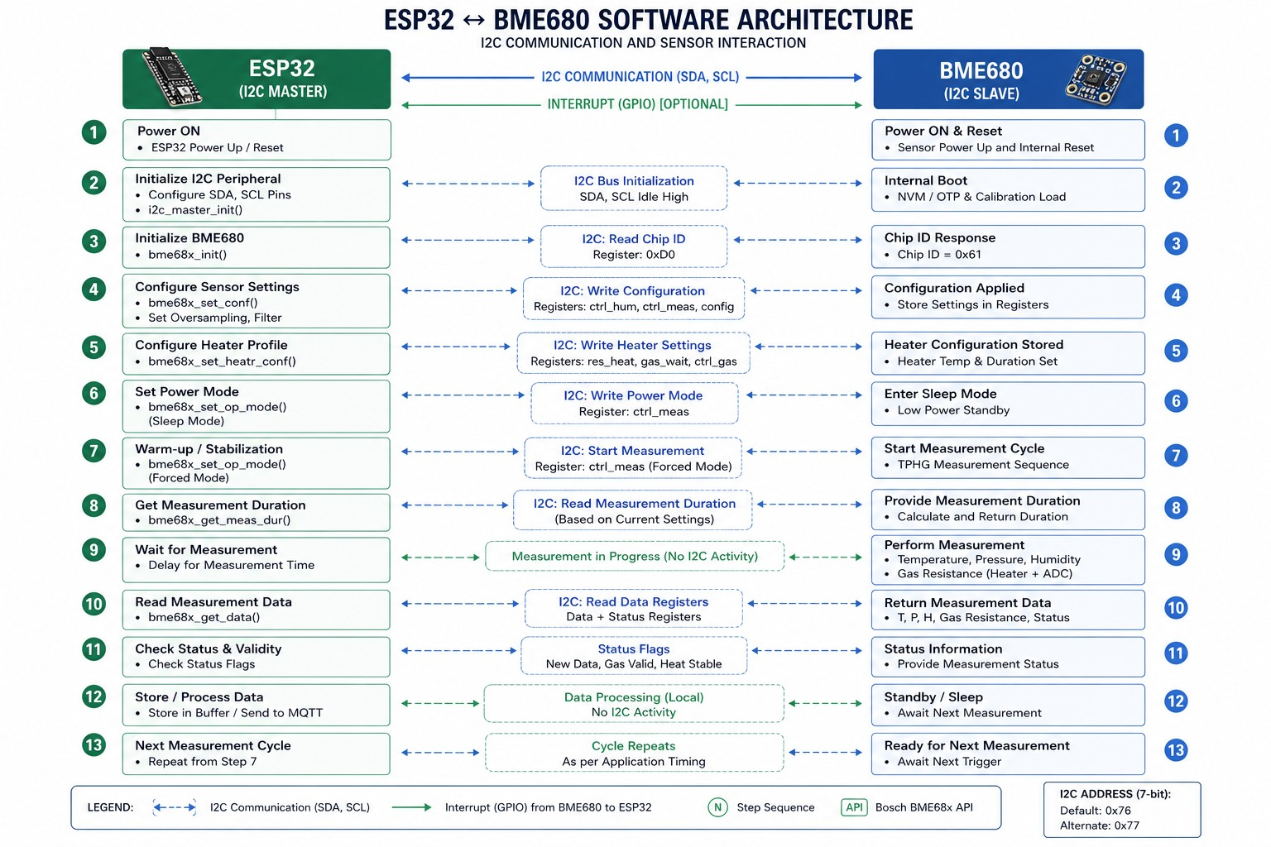
Architecture

Slide 7
Sensor & Hardware Drivers
I2C Master Driver
ESP-IDF I2C_NUM_0 master bus: SDA=GPIO5, SCL=GPIO6 @ 100 kHz
BME680 address: 0x76 (SDO tied to GND), 7-bit; internal pull-ups enabled
Custom bme_i2c_read() / bme_i2c_write() wired to Bosch API callbacks
Bosch BME68x API Initialization
bme68x_init() — reads chip ID, loads calibration data
bme68x_set_conf() — oversampling: T×2, P×1, H×1; IIR filter coeff=3
bme68x_set_heatr_conf() — 320°C, 150 ms, forced mode
bme68x_get_data() — returns status: new_data, gas_valid, heat_stable
Timer & Sync Driver
esp_timer generates 1 Hz periodic interrupt callback
ISR calls xSemaphoreGiveFromISR() — fully ISR-safe design
Main FreeRTOS task blocks on xSemaphoreTake() before each read
Forced mode: single T/H/P/G measurement per trigger, sensor sleeps between reads

Slide 8
Data Structures & Ring Buffer
C Struct: sample_t (20 bytes per node)
Fields: timestamp (uint32, 4B), temperature (float, 4B), humidity (float, 4B), pressure (float, 4B), gas_resistance (float, 4B)
Ring buffer holds 240 nodes = 4,800 bytes stored in RTC memory
RTC_DATA_ATTR Variables (survive deep sleep)
sample_buffer[240] — array of sample_t
head — index of oldest sample; tail — index of next write
count — valid samples in buffer (≤240); sample_count — total ever collected (never reset)
elapsed_seconds — monotonic timestamp across wake cycles
boot_count, decision_counter — boot and decision tracking
Key Ring Buffer Properties
Fixed size 240 → always holds last ~1 hour of data
O(1) insert and oldest-drop; head-to-tail traversal gives time-ordered samples
4 boots × 60 samples/boot = 240 samples → triggers one decision window

Slide 9
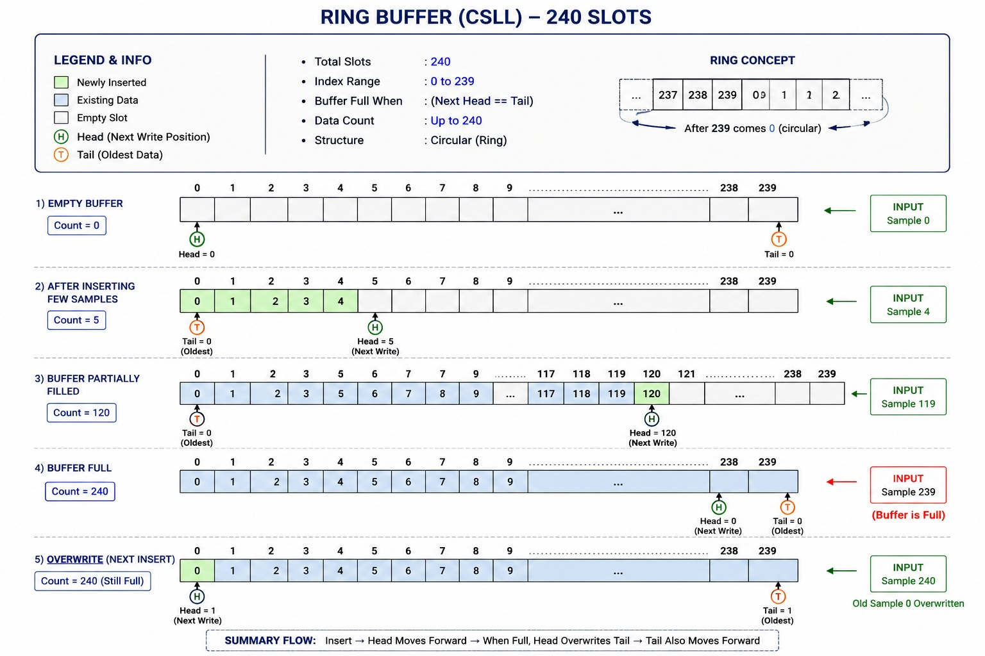
Ring Buffer Implementation

Slide 10
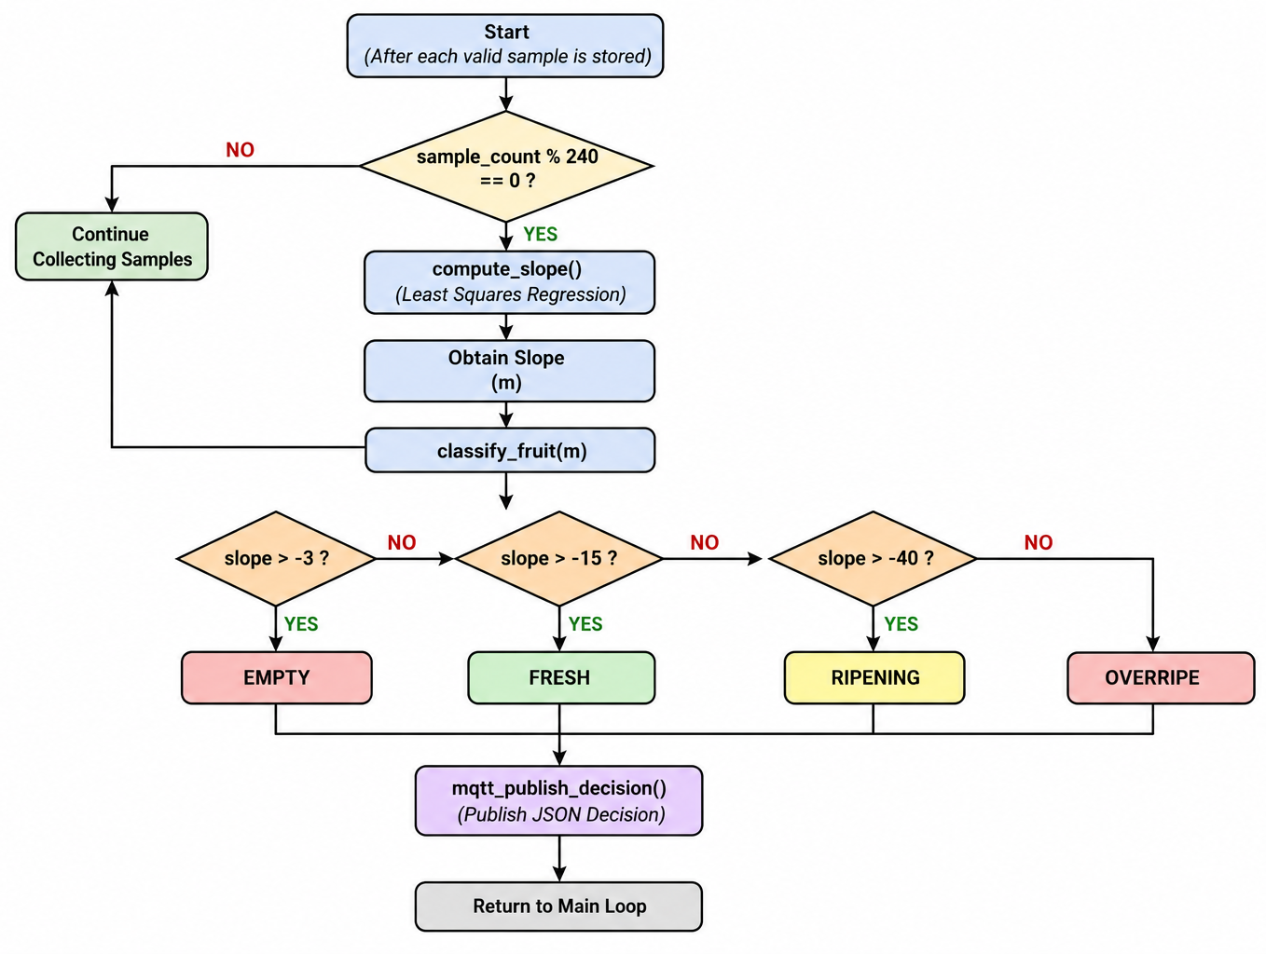
Algorithm Flow — Per Boot Cycle
Step 1: Boot & Initialize
Increment boot_count; add 12-min sleep to elapsed_seconds if boot > 1
Init WiFi (STA) → wait for IP → Init MQTT → wait 2 s → Init I2C + BME680
Step 2: Warm-up Phase — 2 minutes
Run BME680 in forced mode at 1 Hz; discard all readings
Purpose: thermal stabilization of the MOX gas sensor for repeatable resistance values
Step 3: Sampling Phase — 60 valid samples @ 1 Hz
Block on semaphore → forced-mode measurement → reject if !heat_stable || !gas_valid
Build sample_t → push to ring buffer → publish JSON to bme680/data
If sample_count % 240 == 0: compute slope + classify + publish to bme680/decision
Step 4: Deep Sleep — 12 minutes
Put BME680 to sleep mode (mode=00)
Configure RTC timer wakeup: SLEEP_DURATION_US = 720,000,000 µs
Call esp_deep_sleep_start(); MCU resets on wake, RTC variables persist

Slide 11
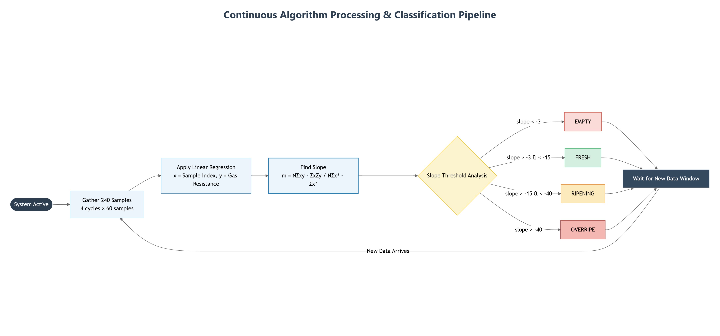
Algorithm Flow

Slide 12
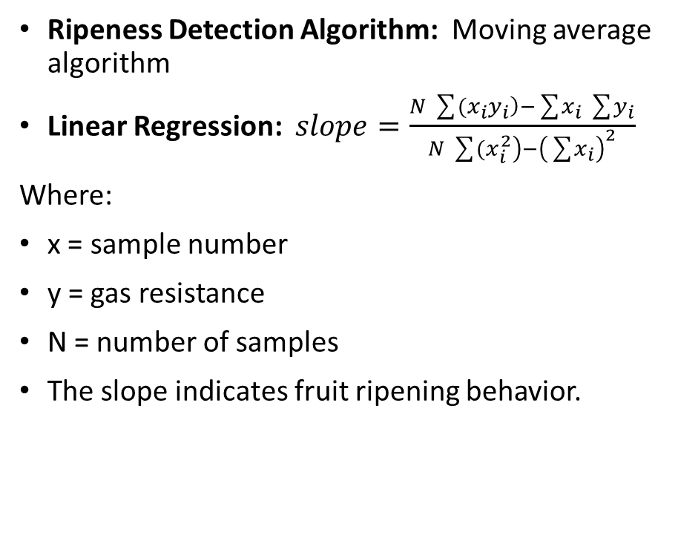
Fruit Ripeness
Ripeness Detection Algorithm: Moving average algorithm
Linear Regression: $slope=\frac{N\sum{(}\left.x_{i}y_{i}\right)−\sum{x_{i}}\sum{y_{i}}}{N\sum{(}\left.x_{i}^{2}\right)−{\left(\sum{x_{i}}\right)}^{2}}$
Where:
x = sample number
y = gas resistance
N = number of samples
The slope indicates fruit ripening behavior.
Fruit Classification
Slope (Ω/s) | Condition
>-3 | Empty
-3 to -15 | Fresh
-15 to -40 | Ripening
< -40 | Overripe

Slide 13
Communication Implementation
WiFi Layer
ESP32-S3 configured as WiFi Station (STA) mode
Connects to SSID, obtains IP via DHCP
Event handler auto-reconnects on STA_DISCONNECTED
15 s timeout on IP acquisition via EventGroup bit
MQTT Layer
Broker: mqtt://broker.emqx.io:1883
esp_mqtt_client_init() + esp_mqtt_client_start(); QoS=1, Retain=0
2 s delay after MQTT start to allow broker handshake
Published Topics
bme680/data — published on every valid BME680 reading: timestamp, temp, humidity, pressure, gas resistance
bme680/decision — published every 240 valid samples (~1 hr): timestamp, sample count, regression slope, condition

Slide 14
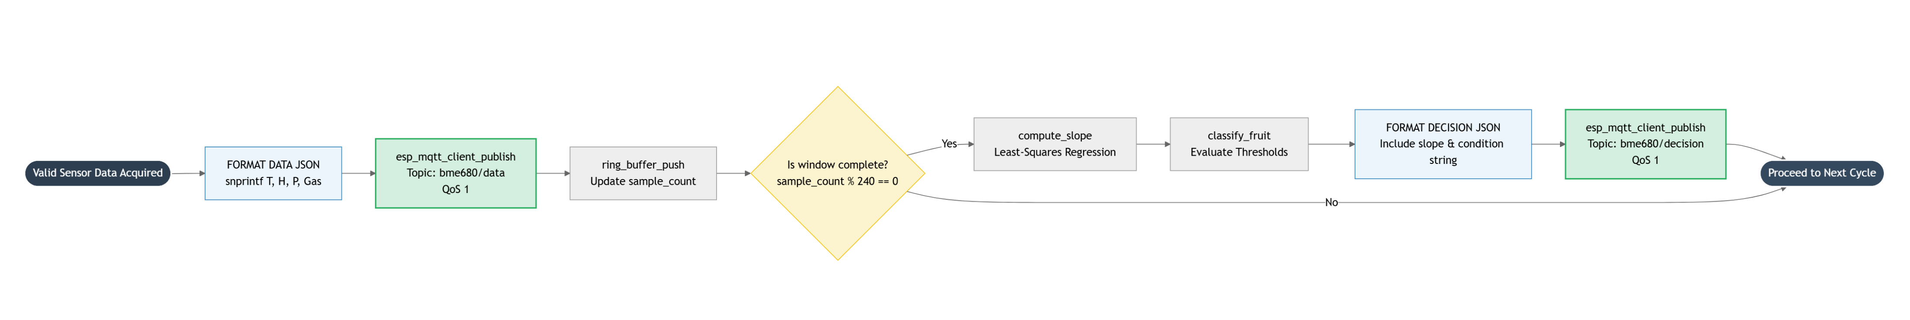
MQTT Publish & Decision Logic Flow

Slide 15
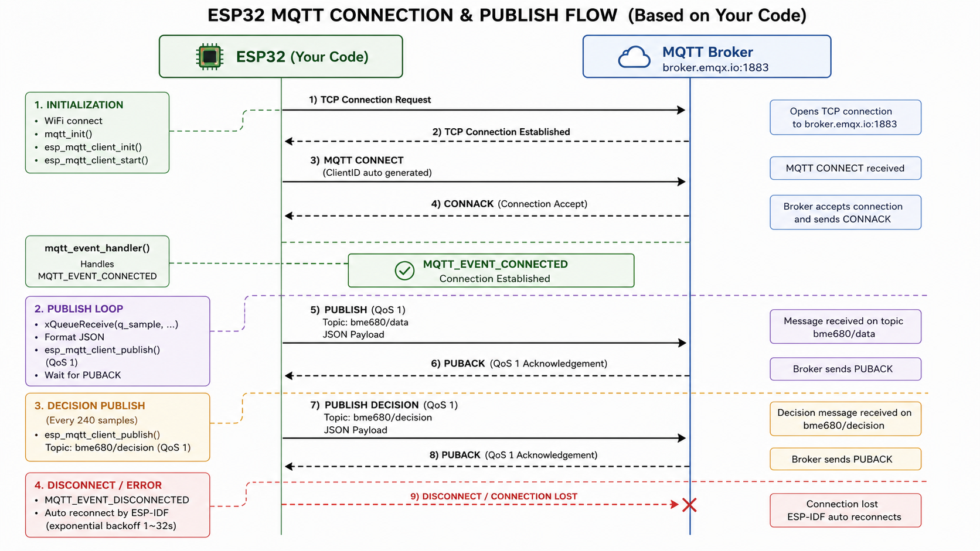
MQTT CONNETION

Slide 16
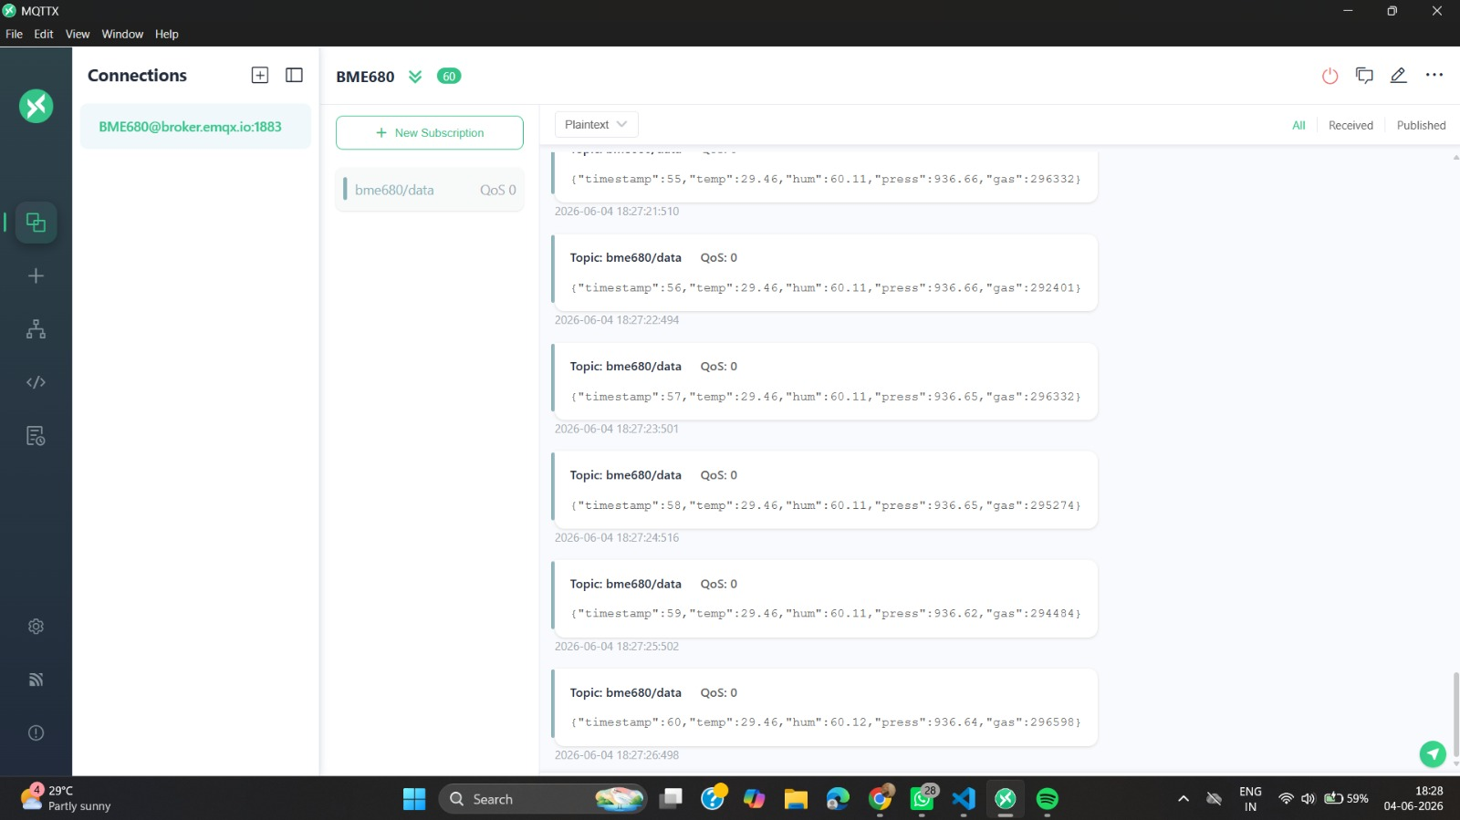
MQTT PUBLISH-RESULT

Slide 17
Power Architecture & Duty Cycle
15-Minute Active Cycle Breakdown
2 min Warm-up: BME680 thermal stabilization; sensor data discarded
1 min Sampling: 60 valid samples @ 1 Hz; MQTT publish active
12 min Deep Sleep: only RTC domain powered; timer wakeup configured
4-Boot Decision Window (~1 Hour)
Boot #1: Samples 1–60 collected & buffered
Boot #2: Samples 61–120 appended to ring buffer
Boot #3: Samples 121–180 appended to ring buffer
Boot #4 ★: Samples 181–240 → Decision triggered (compute slope & classify)
Energy Saving Strategies
BME680 forced mode only — sleeps between measurements
ESP32-S3 deep sleep: only RTC domain + RTC memory powered
WiFi/MQTT active only during the ~3 min active window per cycle
All state in RTC memory — no NVS flash writes needed
Effective duty cycle: ~20% active, ~80% deep sleep per 15-min cycle

Slide 18
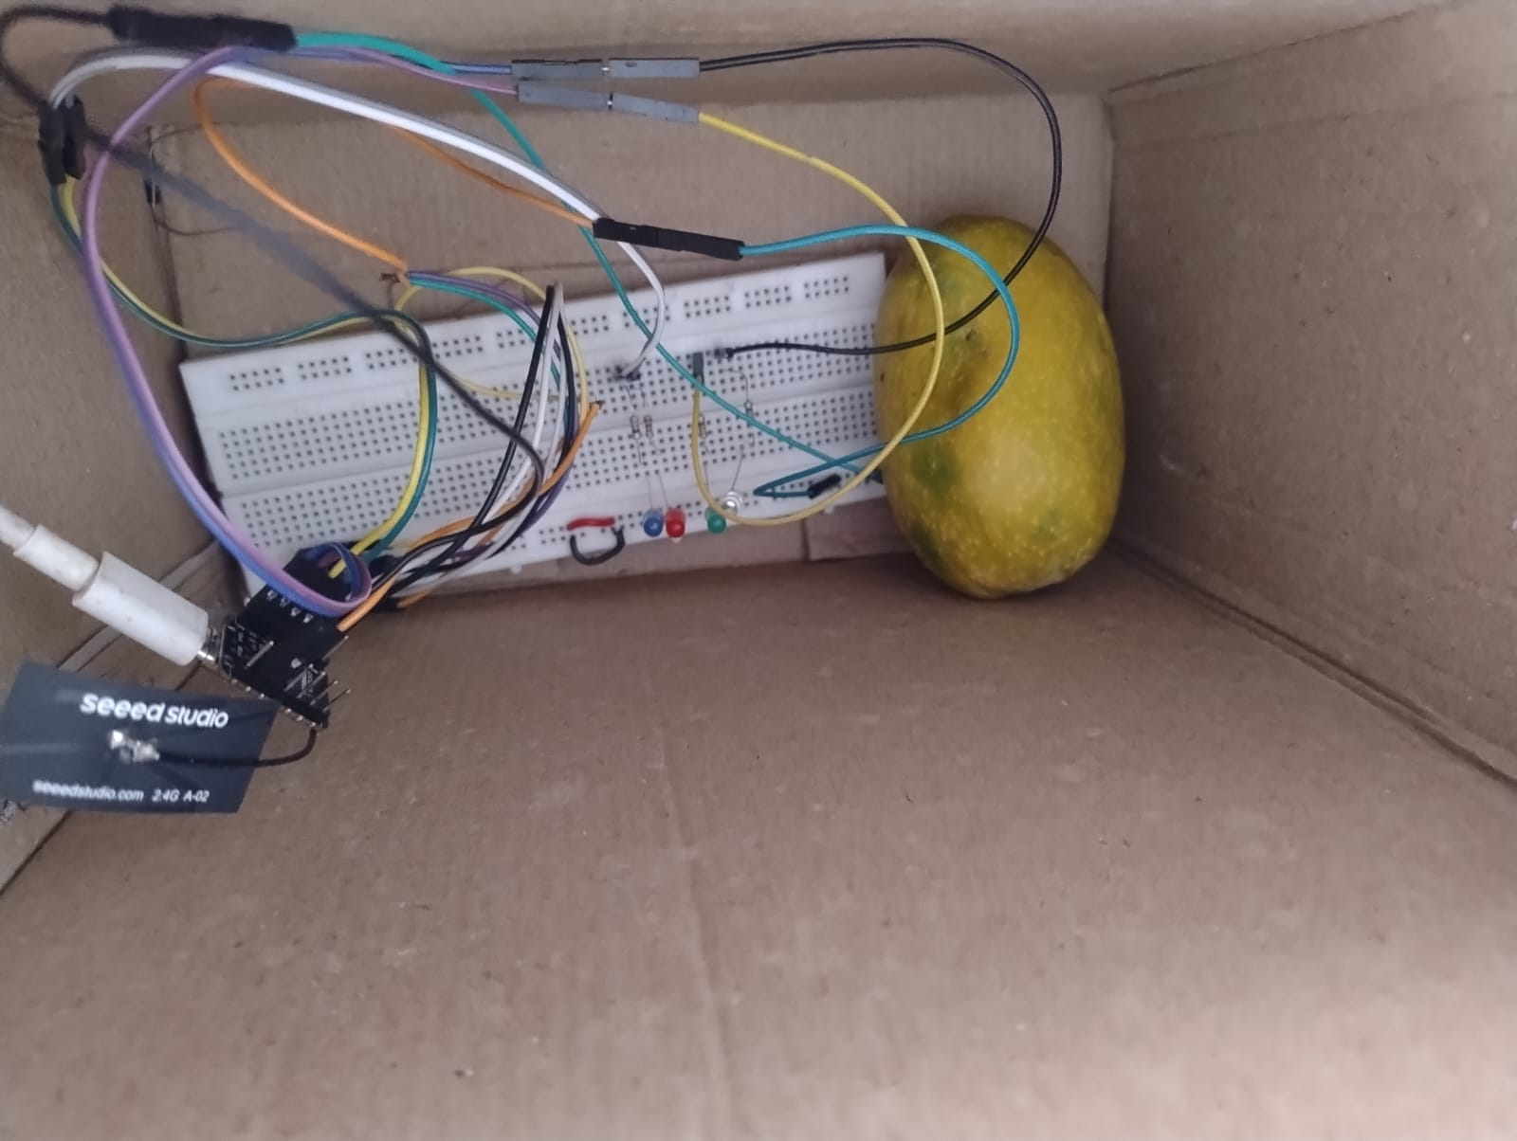
IMPLEMENTAION

