Slide 1
UCS321 — EST PROJECT
Malaria Cell Detection
Using a Custom CNN
PyTorch CNN | Weighted Sampling | Grad-CAM Explainability
Biocon Ltd. — Automated Blood Sample Diagnosis
Team Name | College Name | Student Names
27,558
1
93.3%
0.983
Cell Images
CNN Model
Test Accuracy
ROC AUC

Slide 2
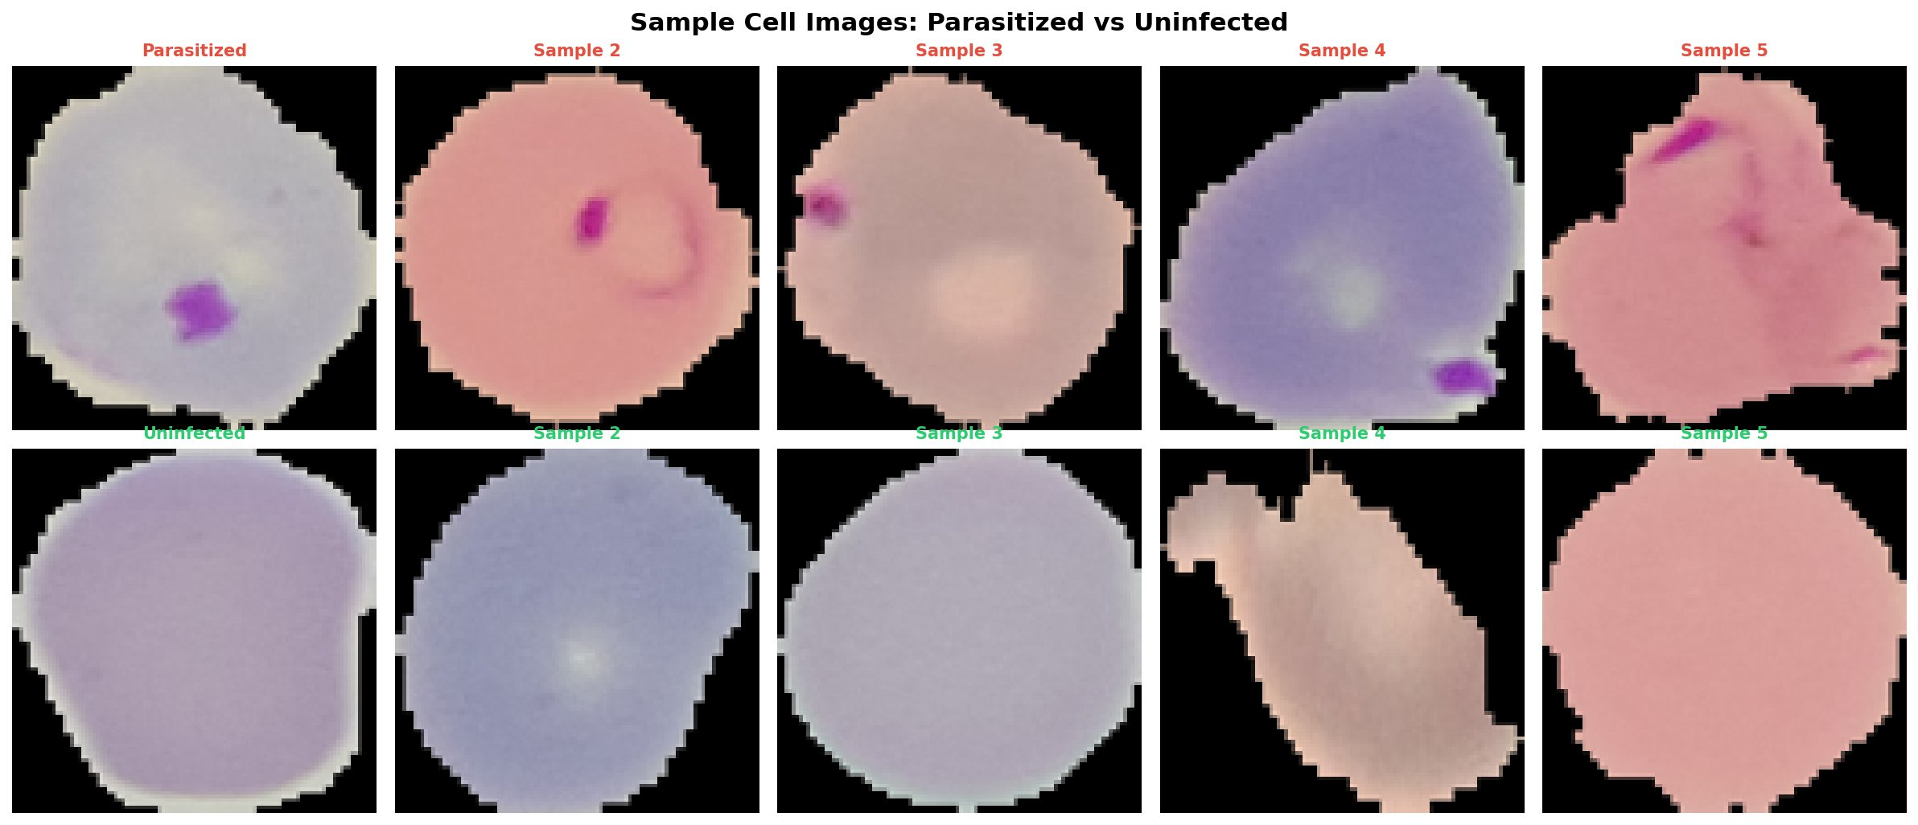
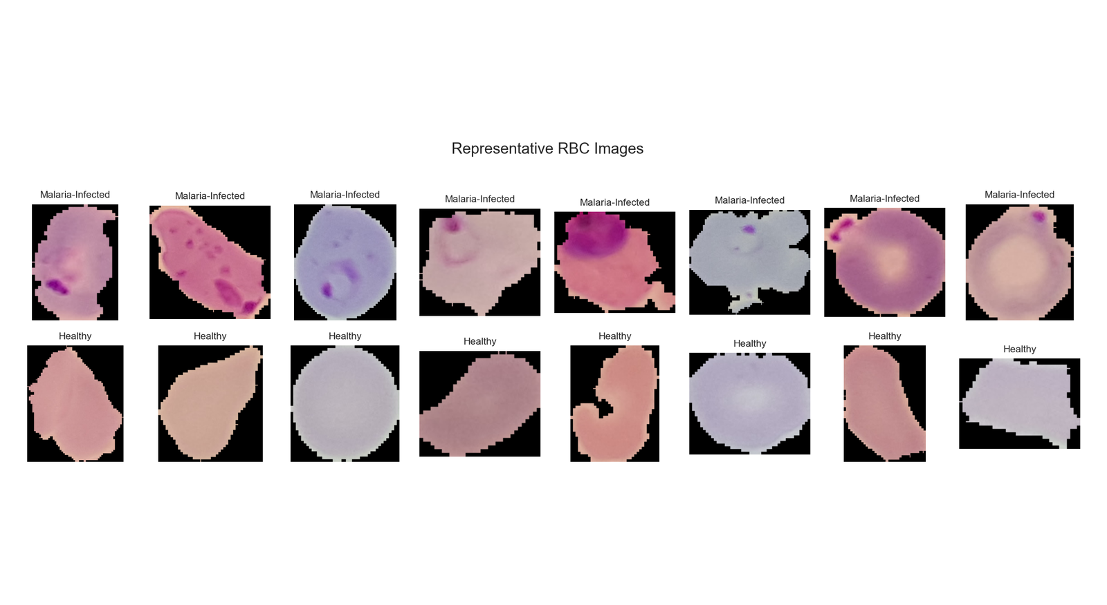
Problem Statement
🌍
Malaria kills 600,000+ people annually — mostly in Africa and South Asia
🔬
Traditional diagnosis requires skilled lab technicians examining blood smears manually
⏱️
Manual diagnosis is slow, error-prone, and unavailable in remote areas
🤖
Deep learning can automate diagnosis with high accuracy and low cost
27,558
50 / 50
64×64 px
🎯
Goal: classify cells as Malaria-Infected or Healthy using the notebook CNN model
Total images
Class balance %
Input resolution

Slide 3
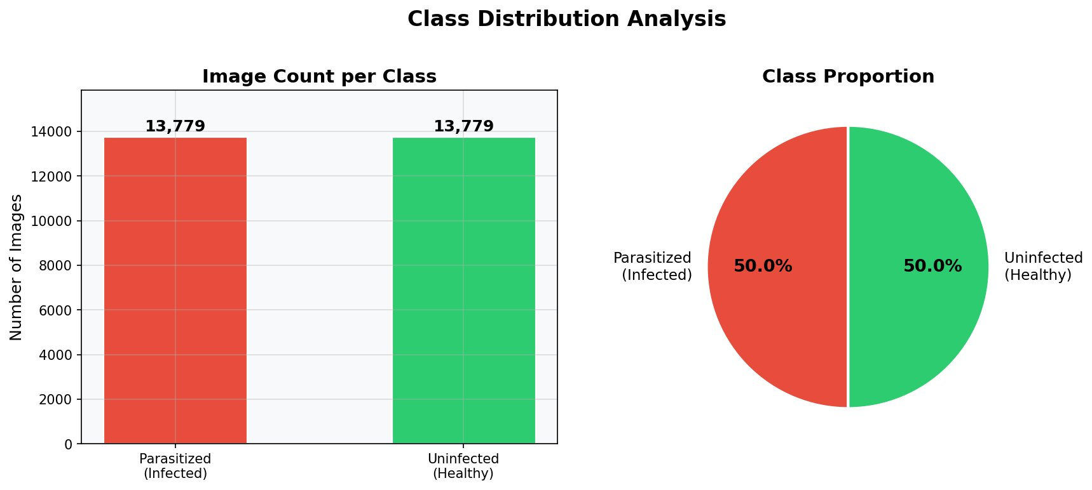
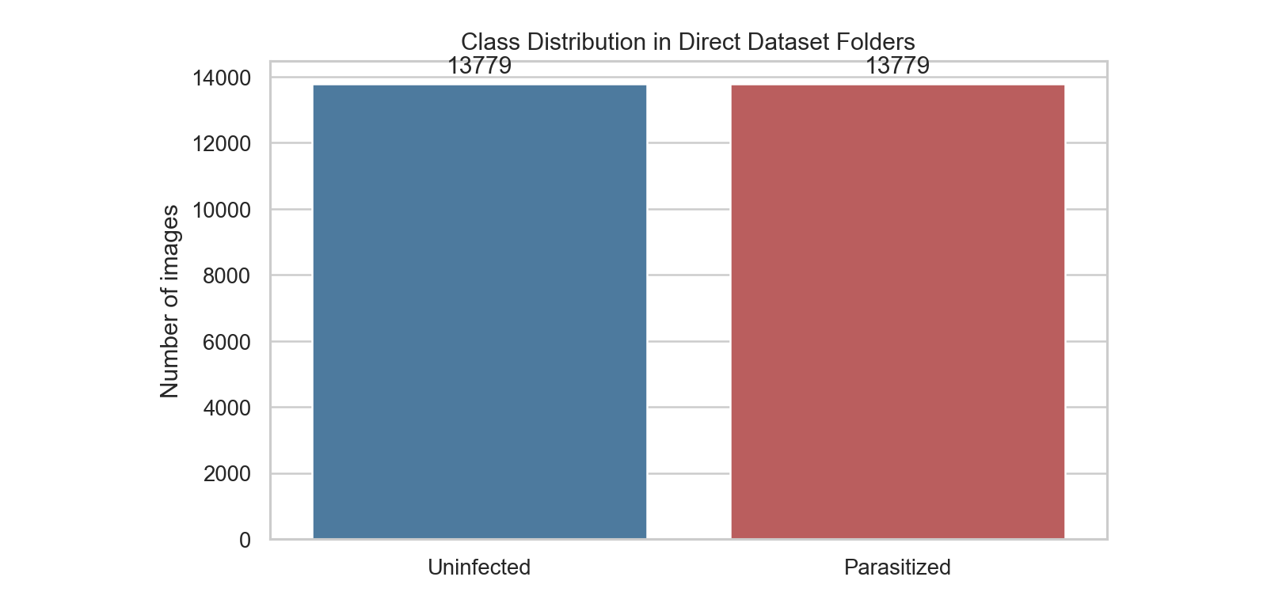
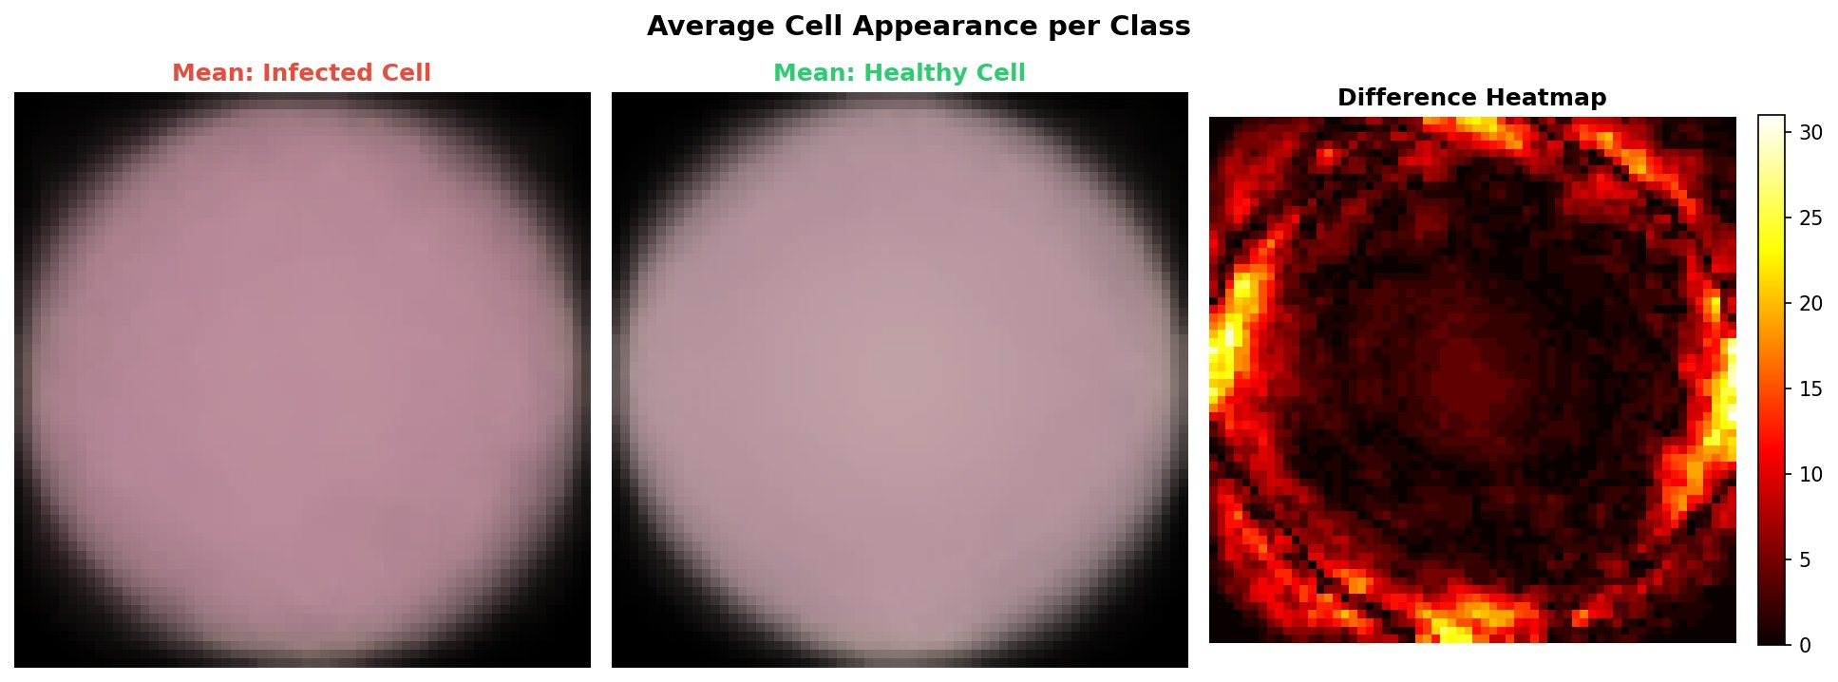
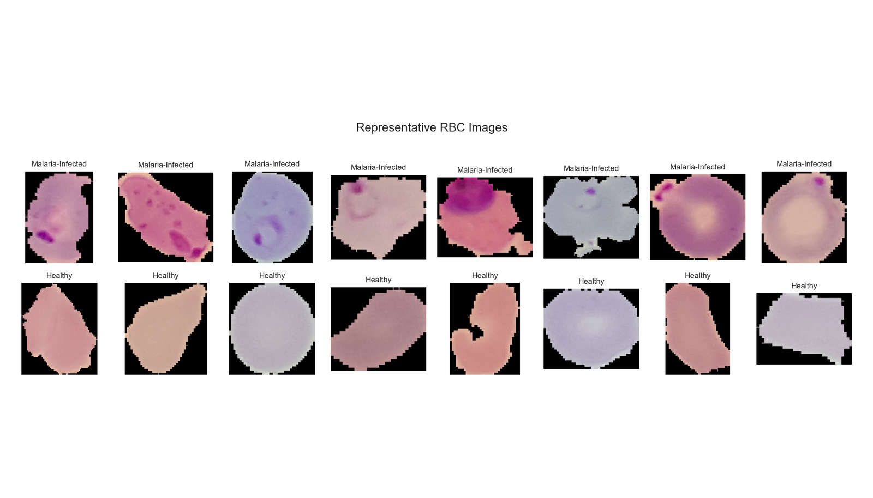
Dataset Overview
cell_images dataset used by the notebook
27,558 total PNG images
13,779 Parasitized + 13,779 Uninfected
Balanced 50/50 class distribution
Images resized to 64×64 for CNN input
Fast-run sample: 1,000 images (500/class)

Slide 4
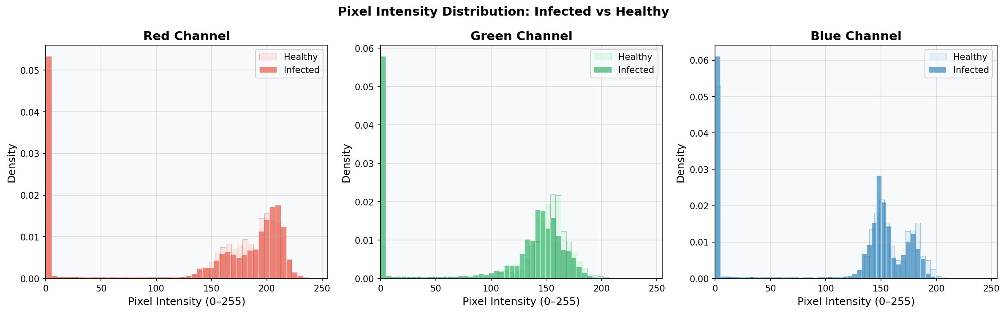
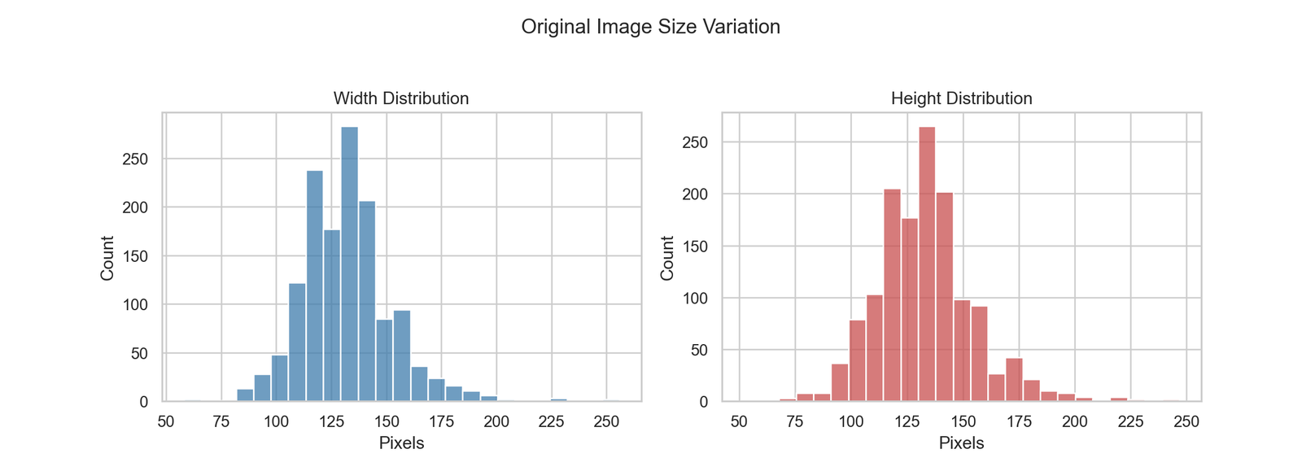
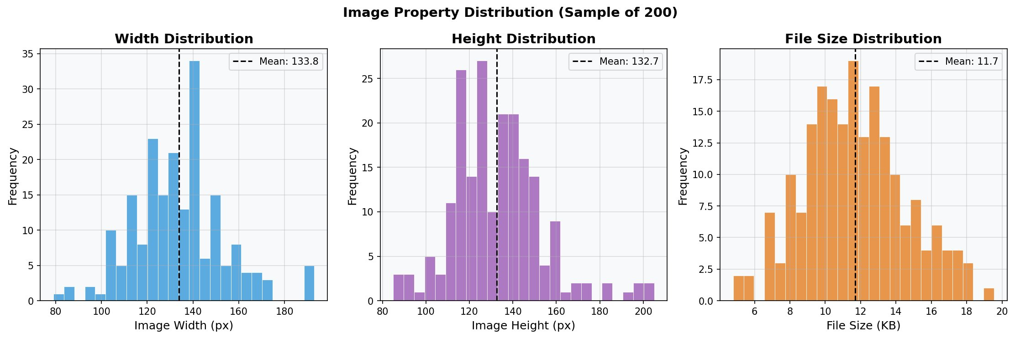
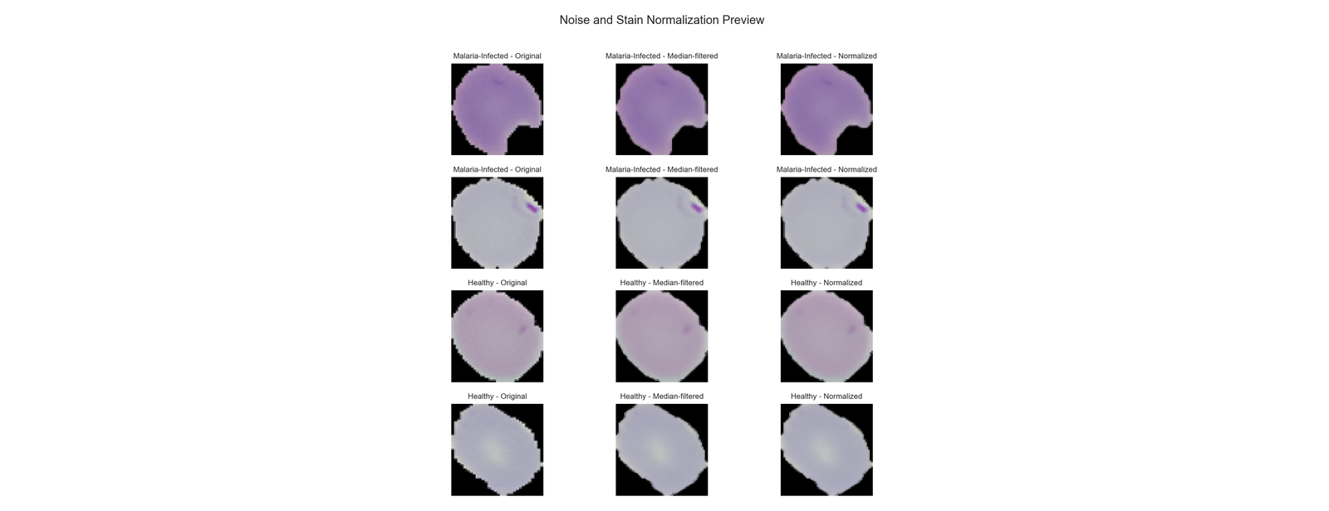
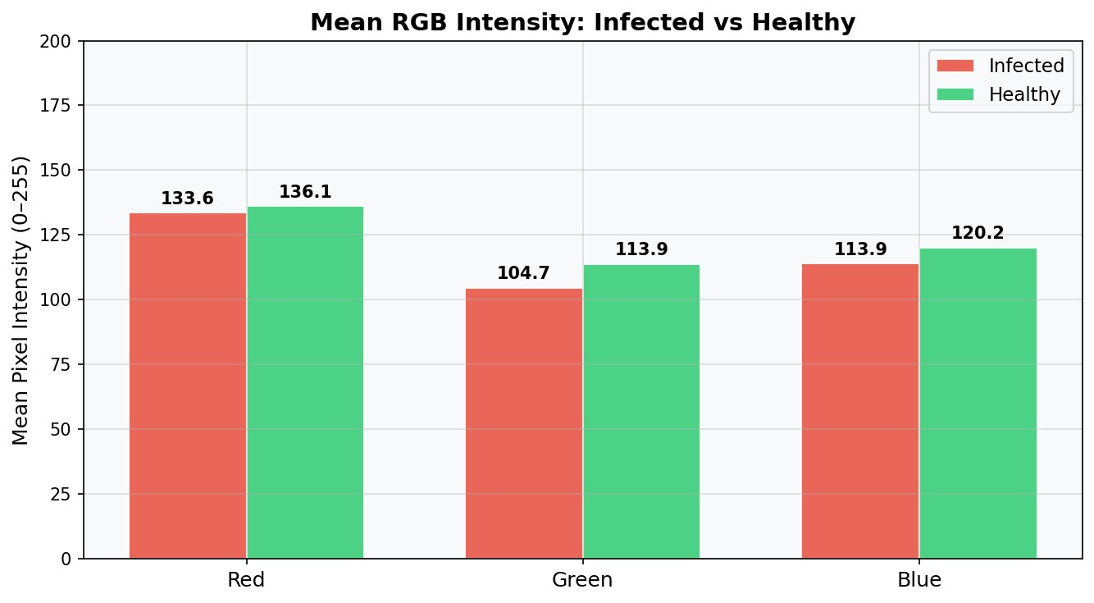
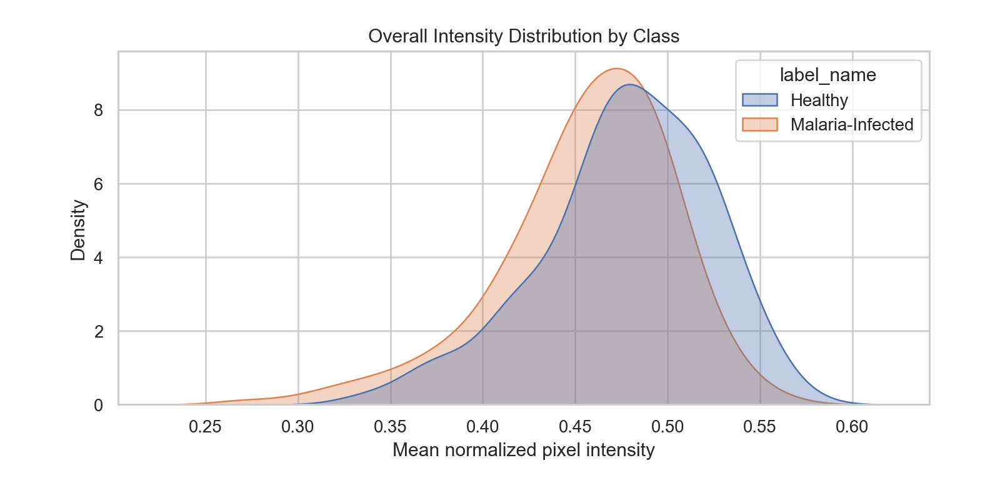
Exploratory Data Analysis
Key EDA Insights
Color and intensity patterns differ between classes
Healthy cells appear more visually uniform in samples
Variable image sizes are standardized to 64×64
Balanced data, with class-weight logic kept in the pipeline
Noise preview supports preprocessing choices before training

Slide 5
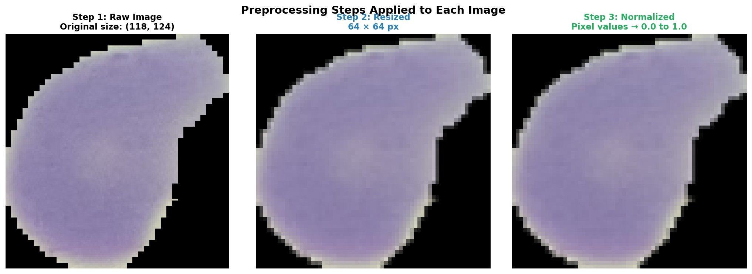
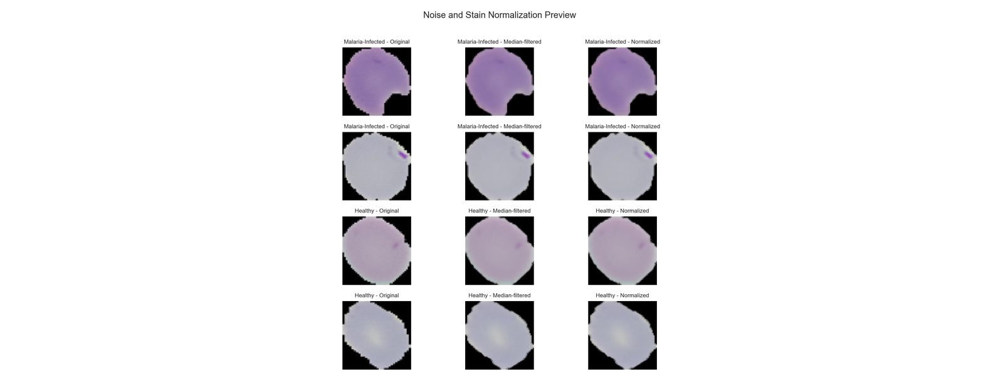
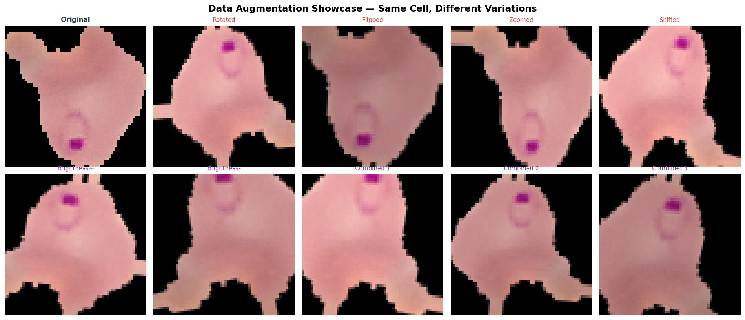

Data Preprocessing & Augmentation
1
2
Resize
Normalize
All images → 64×64 px
Pixels scaled 0.0–1.0
3
4
Split
Augment
70% Train / 15% Val / 15% Test
Flip, rotate, color jitter

Slide 6
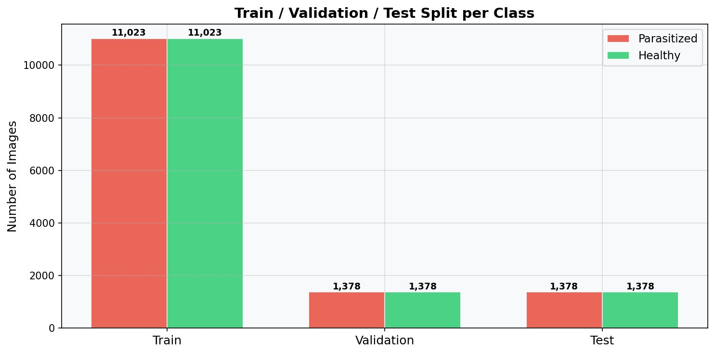
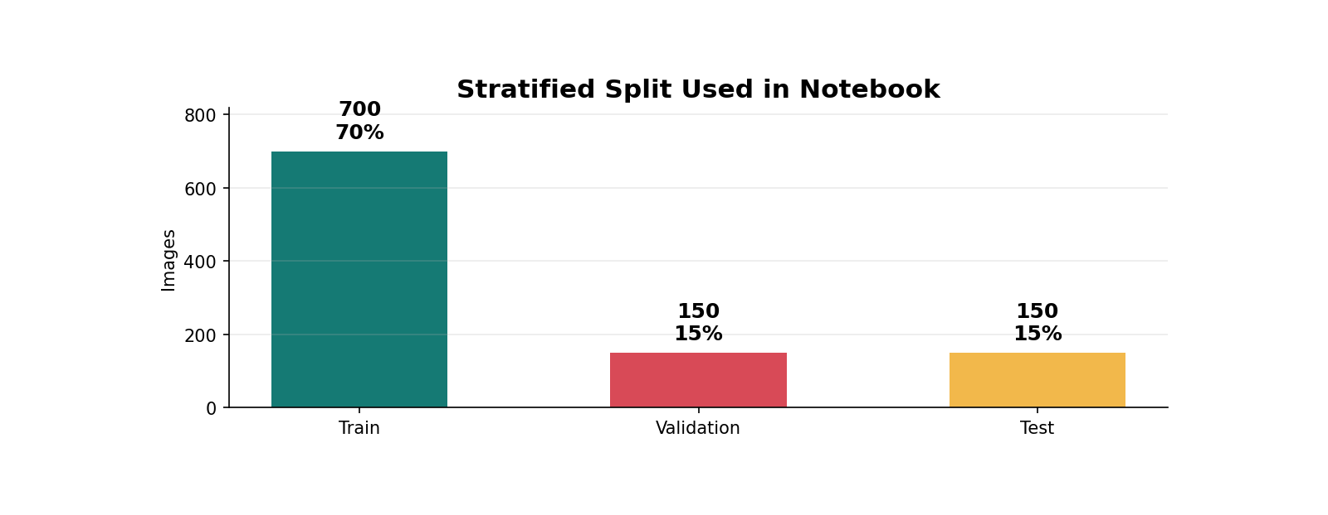
Dataset Split Strategy
Train: 700 (70%)
Validation: 150 (15%)
Test: 150 (15%)

Slide 7
Model Architecture
One reproducible custom CNN trained in the notebook with Grad-CAM support
Custom CNN
Training Controls
Interpretability
Built from scratch
Imbalance-ready setup
Imbalance-ready setup
Conv blocks + BatchNorm + MaxPool
Weighted sampler for balanced batches
Weighted sampler for balanced batches
Dense layer + Dropout regularization
Class weights in BCE loss
Final convolution layer retained
Sigmoid output
Batch size 16, 4 epochs
Heatmaps show focus regions
Optimizer: Adam, LR 0.001
Best weights selected by validation AUC
Expert review before diagnostic use

Slide 8
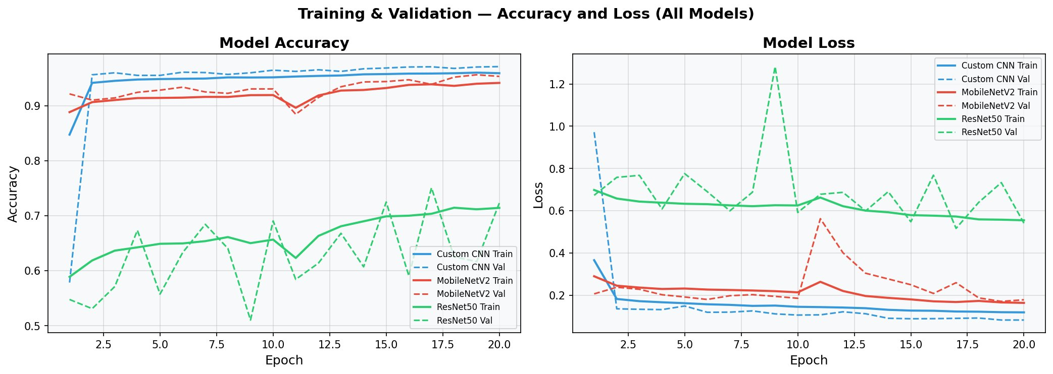
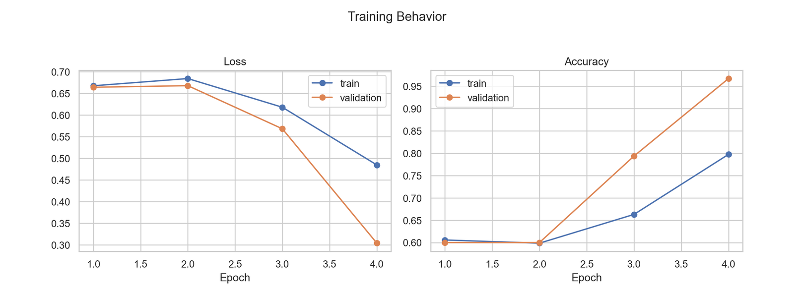
Training Results
Custom CNN
Training Setup
Final Test Result
Final validation accuracy: 96.7%; best validation AUC: 0.9918
4 epochs, Adam 0.001, batch size 16, weighted BCE loss
93.3% accuracy, 94.7% recall, 0.9826 ROC AUC

Slide 9
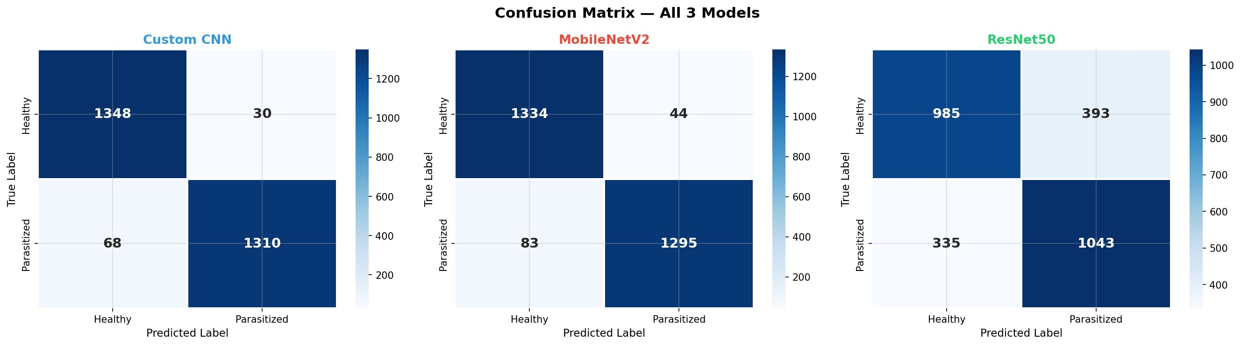
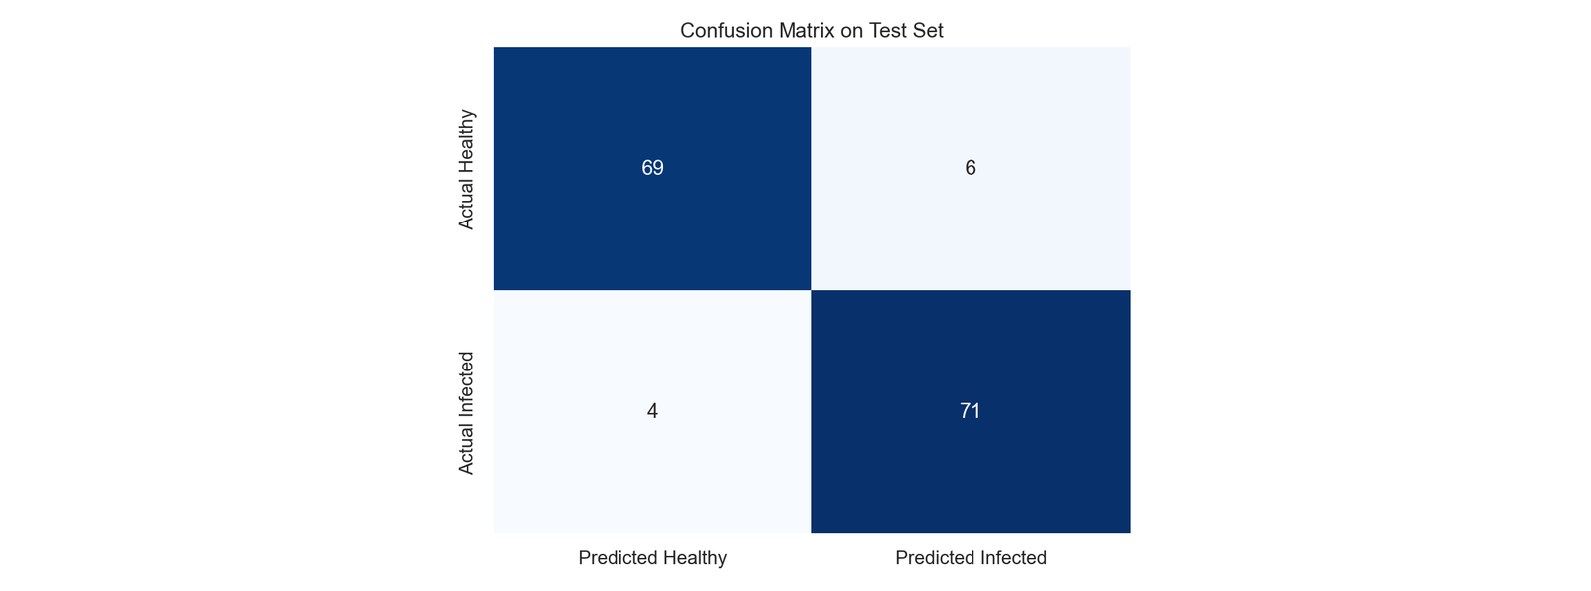
Confusion Matrix — Notebook CNN
Correct predictions
False positives
False negatives
TN: 69 TP: 71
Healthy predicted infected: 6
Infected predicted healthy: 4

Slide 10
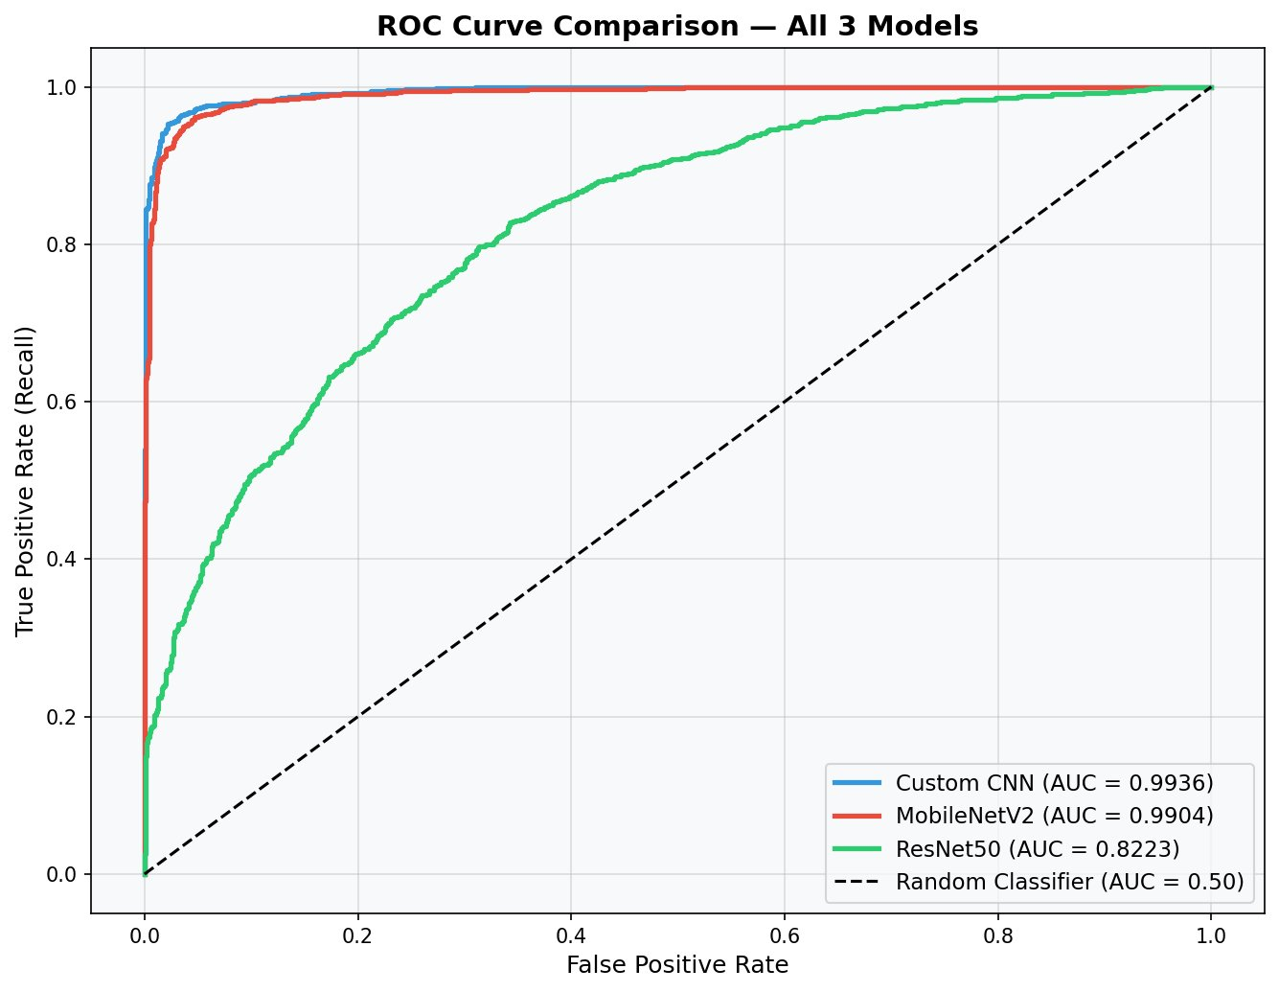
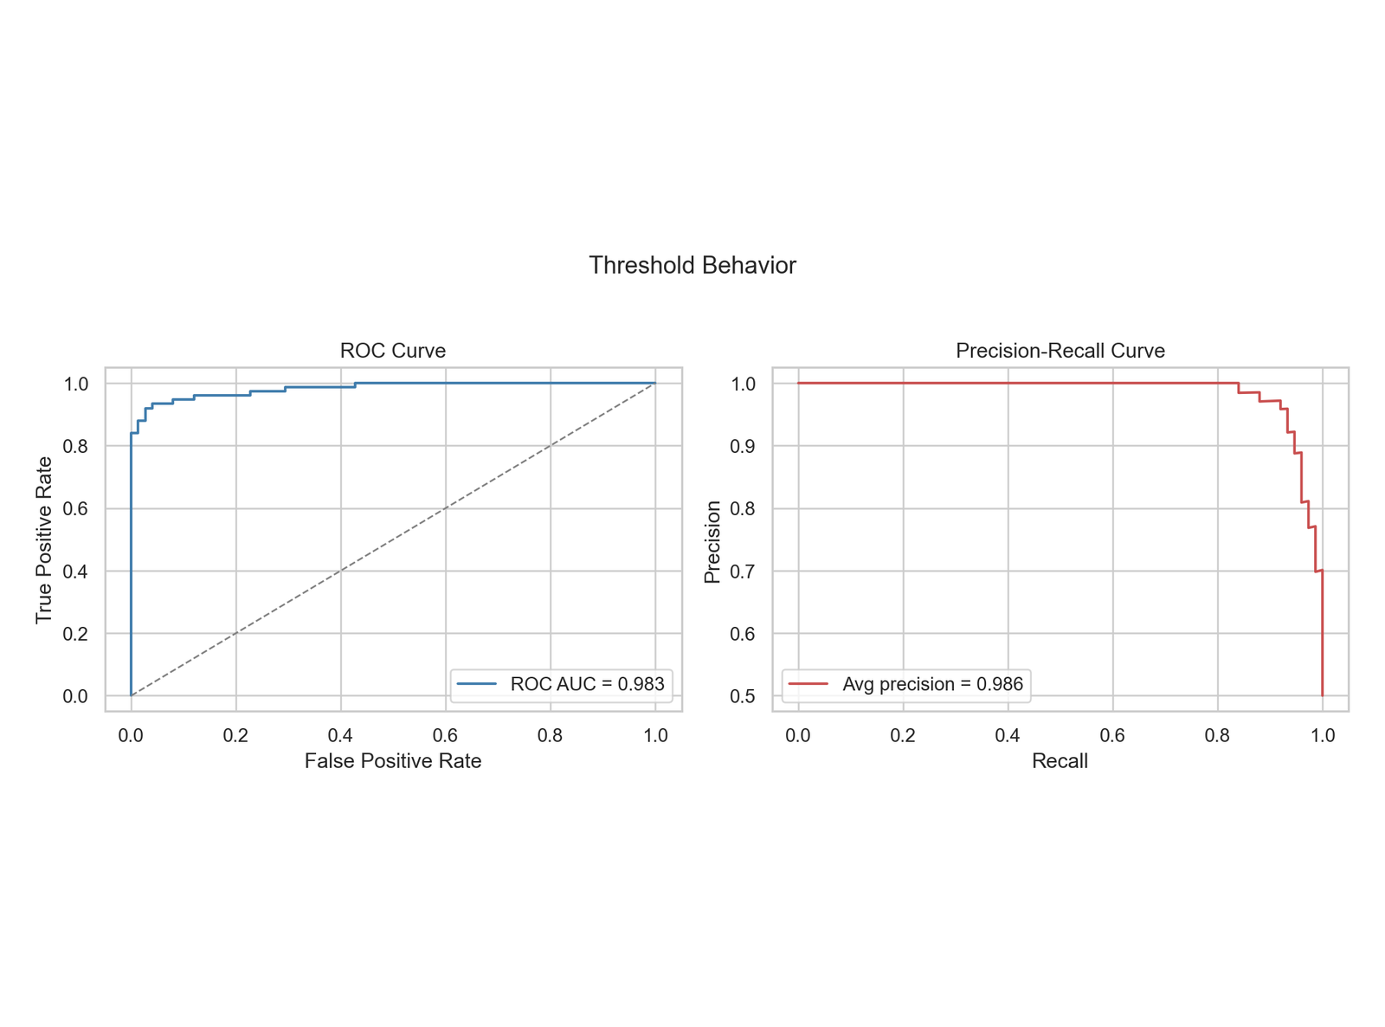
ROC & Precision-Recall Curves
Notebook scores
Custom CNN
ROC AUC = 0.9826
Average precision = 0.9856
Threshold
0.50 cutoff
Recall = 94.7%
Clinical view
Lower threshold can reduce misses
Manual review for uncertain cells
High AUC supports screening, but expert validation is still required

Slide 11
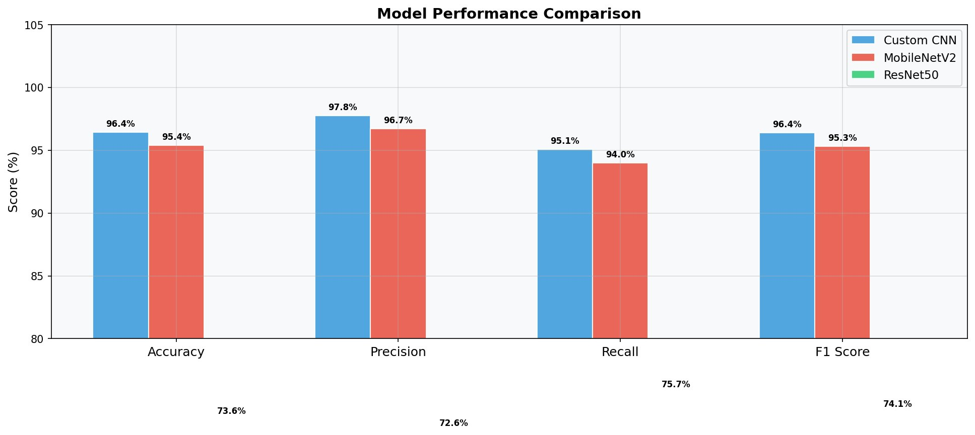
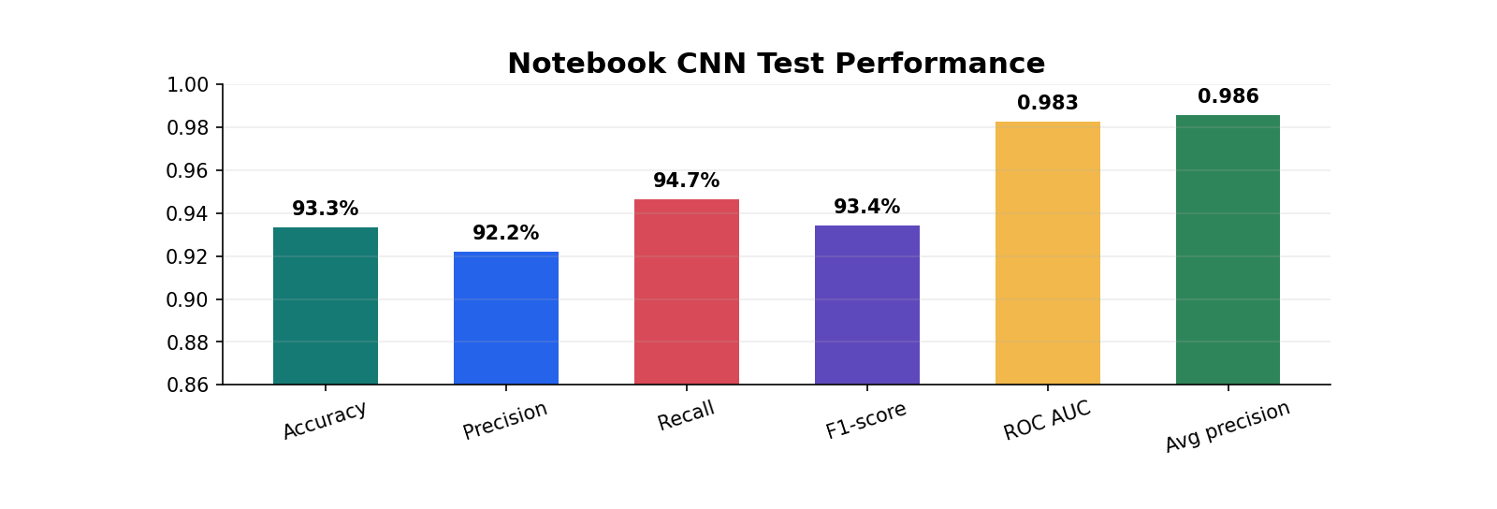
CNN Performance Summary
Metric | Value | Metric | Value | Metric | Value
Accuracy | 93.3% | Precision | 92.2% | Recall | 94.7%
F1-score | 93.4% | ROC AUC | 0.9826 | Avg precision | 0.9856
Test images | 150 | Working images | 1,000 | Threshold | 0.50

Slide 12
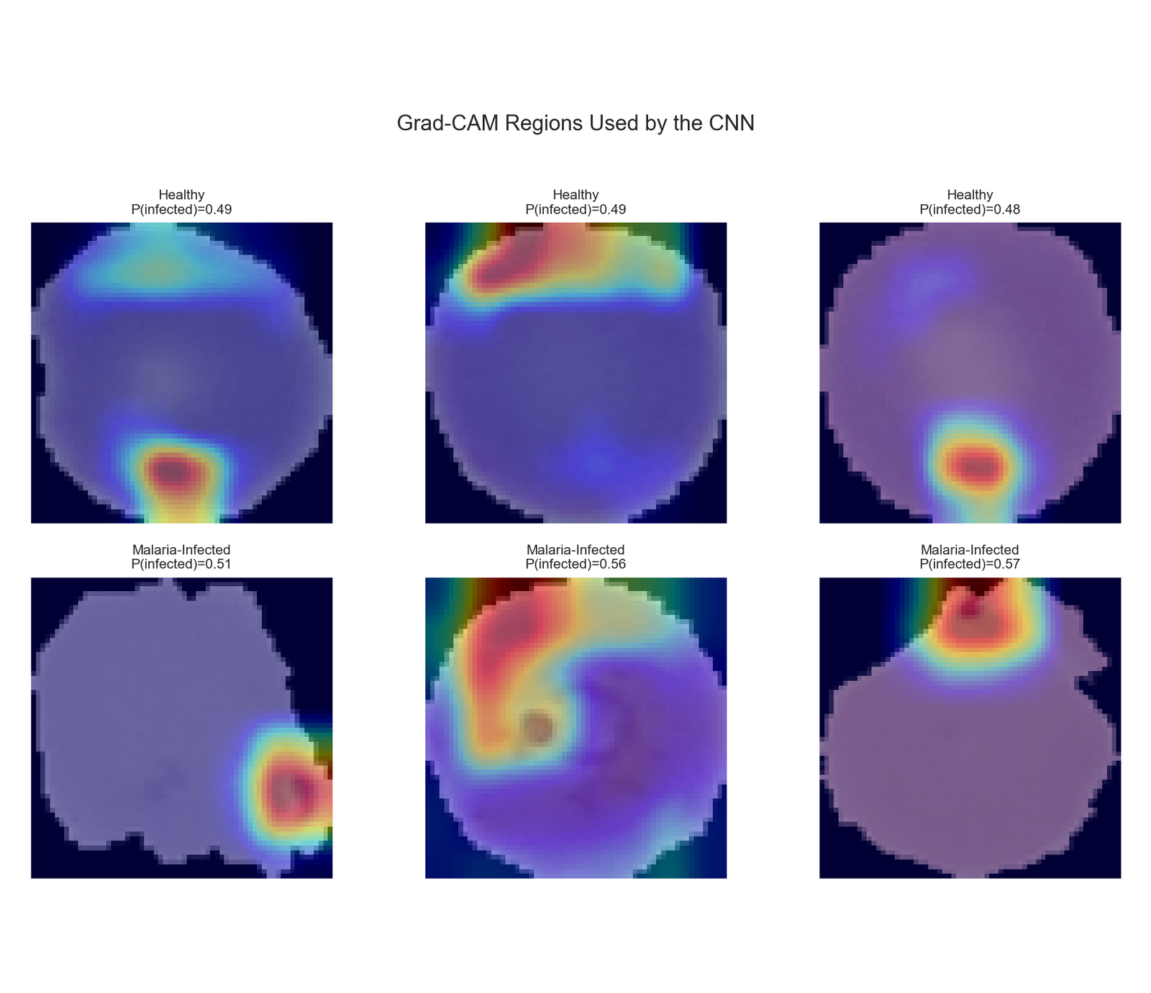
Grad-CAM — Explainable AI
Gradient-weighted Class Activation Mapping — Notebook CNN
What is Grad-CAM?
Generates heatmaps showing WHICH region of the cell the model focused on
Hot colors (red/yellow) = high attention area
Cool colors (blue) = low attention area
For parasitized cells, model highlights the dark parasite spots
Helps medical experts validate and trust predictions
Useful for expert review before clinical use

Slide 13
Notebook Prediction Flow
Run the trained CNN in notebook memory, then review probability, threshold decision, and Grad-CAM evidence
📤
⚙️
🤖
🔥
✅
Step 1
Step 2
Step 3
Step 4
Step 5
Load Image
Preprocess
CNN Predicts
Grad-CAM
Final Label
Test-set RBC image
Resize 64×64 → Normalize
Single PyTorch CNN
Heatmap reviewed
Infected / Healthy
Notebook cell 45:
test_probs, y_true, test_paths_ordered = predict_loader(model, test_loader)
y_pred = (test_probs >= 0.50).astype(int)

Slide 14
Conclusion & Future Work
Key Conclusions
Future Work
Custom CNN achieved 93.3% test accuracy in the notebook run
Run full-dataset training when runtime permits
ROC AUC of 0.9826 shows strong class separation
Use patient-level holdout split for stronger validation
Grad-CAM helps verify that focus stays inside relevant cell regions
Add stain normalization across microscopes and labs
Class weights and weighted sampling make the pipeline imbalance-ready
Calibrate probabilities and tune threshold for screening
Model is a classroom baseline and needs expert validation before clinical use
Ask domain experts to review Grad-CAM overlays
"The model supports medical review; it does not replace diagnostic judgment."

Slide 15
Thank You
Questions & Answers
Dataset: NIH Malaria Cell Images — Kaggle (iarunava)
Model: PyTorch / torchvision — custom CNN baseline
Explainability: Grad-CAM (Selvaraju et al., 2017)
Course: UCS321 — EST Project | Biocon Ltd.
Team Name | College Name | Student Names

