Slide 1

FOLIO
01 / 10
Folio turns document noise into an evidence trail.
A Java-backed prototype for contextual document intelligence, built for the HackTheCore DataOps Innovation Hackathon.
EVIDENCE-DRIVEN ANALYSIS
Notes:
Folio is a Java-backed prototype for contextual document intelligence. It starts with ordinary files and ends with a traceable evidence trail: what was extracted, what conflicted, where it came from, and why the result is review required.

Slide 2

THE AUTHENTICITY GAP
02 / 10
OCR can read a page without proving it is authentic.
Text extraction answers “what characters are present?”
It does not establish who made a claim, whether two documents agree, or whether a page deserves scrutiny.
Folio treats extracted text as evidence to trace and compare, not as a fraud verdict.
READABLE ≠ VERIFIED
Notes:
OCR solves a narrow problem: it turns pixels into characters. That is useful, but insufficient. The investigation begins when extracted claims can be compared, traced to a source location, and stated with the right level of caution.

Slide 3
THE EVIDENCE CHAIN
03 / 10
Folio moves from file intake to explainable investigation.
Each stage preserves context for the next one, so a rule result can be followed back to the document and the exact evidence location.
Ingest
Extract
Classify
Compare
Dossier
Ingest synthetic PDFs and preserve source identity.
Extract the PDF text layer; use local Tesseract only when text is missing or unusable.
Classify documents with deterministic rules.
Cross-check claims, attach page/line evidence IDs, and compare sources.
Assemble the findings into a dossier.
Notes:
Walk left to right. Folio ingests synthetic PDFs, chooses the cleanest extraction path, classifies documents with deterministic rules, compares claims across sources, and assembles the result into a dossier.

Slide 4
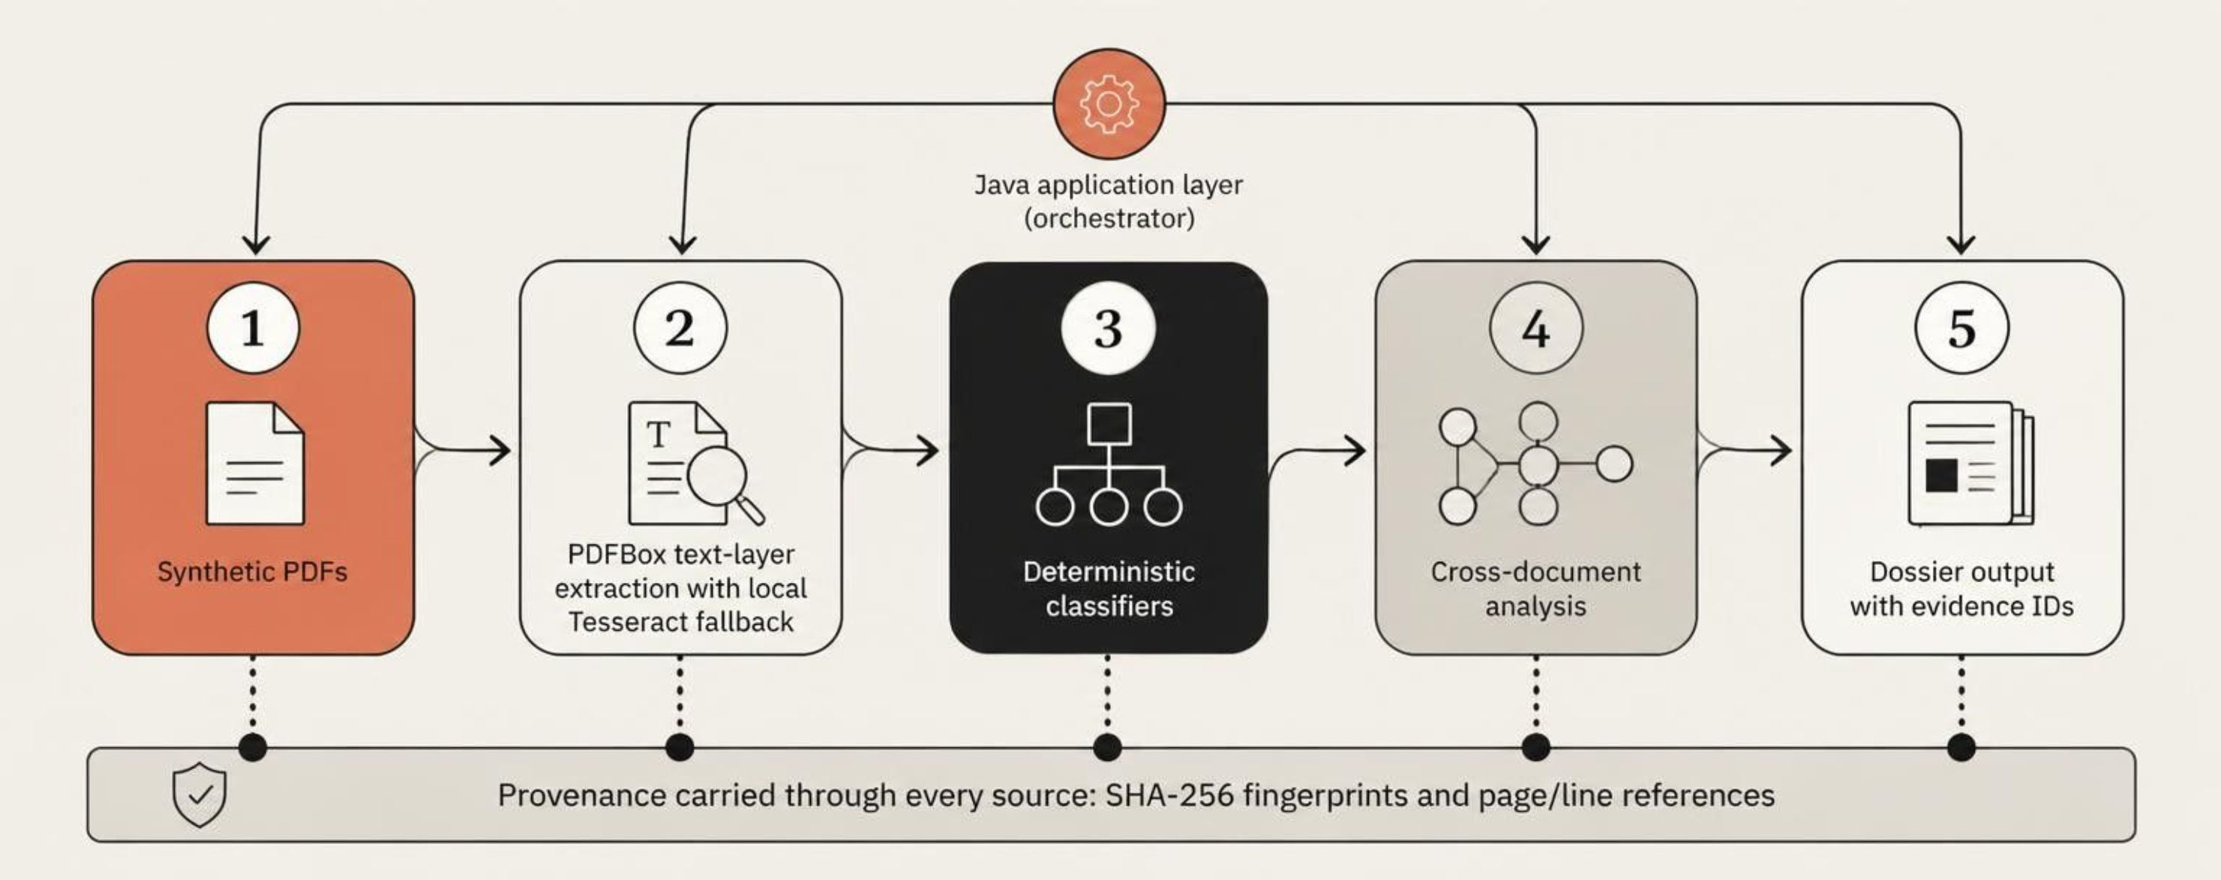
SYSTEM VIEW
04 / 10
One pipeline keeps extraction, fallback, and provenance visible.
Java orchestrates the flow. Every source keeps a SHA-256 fingerprint and page/line evidence references.
Notes:
The architecture makes the important decisions visible. PDFBox is the first extraction path. Tesseract is a local fallback for scanned or image-only pages. Deterministic classifiers and cross-document analysis operate on retained evidence, not on an opaque hosted model.

Slide 5
EXTRACTION STRATEGY
05 / 10
Extraction is pragmatic: use the cleanest available signal.
Folio prefers a transparent path over a clever one. The chosen method remains visible in the investigation record.
PRIMARY PATH
FALLBACK PATH
PDFBox
Local Tesseract
Preserves the native text layer when it exists. The result is direct, inspectable, and tied to the source PDF.
Adds OCR for scanned or image-only pages. Its output remains subject to scan quality and review.
EMBEDDED TEXT LAYER
IMAGE-ONLY PAGE
Deterministic classification
Document type, field patterns, and rule matches stay inspectable.
No hosted LLM required
The workflow does not depend on a hosted language model.
Notes:
The cleanest signal is not always the same signal. PDFBox preserves native text when available. Tesseract is a local fallback when the page is image-only or the text layer is unusable. Classification stays deterministic, and no hosted LLM is required anywhere in the workflow.

Slide 6
CROSS-DOCUMENT SIGNAL
06 / 10
The strongest signal is a contradiction across documents.
Two synthetic claims diverge; Folio surfaces the rule result without declaring fraud.
Source | Claim | Value | Evidence
Synthetic application | Annual income | INR 1,200,000 | application / page 1 / line 12
Synthetic income proof | Annual income | INR 2,100,000 | income proof / page 1 / line 8
INR 900,000
RULE RESULT
Values disagree. Surface the mismatch for review. Folio explains the evidence path; it does not declare fraud.
difference between stated annual incomes
Notes:
The key example is deliberately synthetic. The application states annual income of INR 1,200,000. The income proof states INR 2,100,000. The rule result is a difference of INR 900,000, which becomes review required with both evidence paths intact.

Slide 7

TRACEABILITY
07 / 10
Every observation points back to a source location.
Evidence IDs keep document, page, and line context attached, so a reviewer can re-open the claim.
E-001 · DOCUMENT LOCATION
Application · page 1 · line 12
HASH · SOURCE INSTANCE
SHA-256 fingerprint retained for the inspected file.
OBSERVATION
Page-level font-family outlier — a visual signal only, not proof of tampering.
TRACE THE CLAIM, NOT JUST THE SUMMARY
Notes:
Traceability is the difference between a finding and an assertion. Each evidence ID retains the document, page, and line context. SHA-256 makes the inspected source instance explicit. A font-family outlier can guide review, but it remains an observation.

Slide 8

INVESTIGATION OUTPUT
08 / 10
The investigation dossier makes the reasoning reviewable
INPUTS
FINDINGS
Synthetic documents, source fingerprints, and extraction path.
Classified fields, cross-document mismatches, and evidence IDs.
OBSERVATIONS
DISPOSITION
Page-level visual signals stated with cautious language.
Review required
Never an automated fraud verdict.
INPUTS → FINDINGS → OBSERVATIONS → DISPOSITION
Notes:
The dossier is the handoff artifact. It records the source inputs and extraction path, the classified findings and mismatches, cautious page-level observations, and a disposition of review required. The format makes the reasoning inspectable by another reviewer.

Slide 9
LIVE DEMO
09 / 10
Live demo: follow one mismatch from upload to dossier.
One claim travels through the full chain, so the audience can see both the result and the evidence behind it.
01
02
03
04
05
Load
Extract
Compare
Trace
Review
Load the synthetic application and synthetic income proof.
Show PDFBox extraction, then trigger the local OCR fallback on a scanned page.
Open the comparison: INR 1,200,000 versus INR 2,100,000.
Click the evidence ID to jump to page/line context and show the SHA-256 fingerprint.
End on the dossier’s explainable “review required” outcome.
REVIEW REQUIRED
DEMO THREAD
Upload → extract → compare → trace → dossier
Notes:
The demo follows one mismatch end to end. Start with two synthetic documents, show the primary extraction path and the local OCR fallback, open the comparison, jump from the evidence ID to page and line context, and finish on review required in the dossier.

Slide 10
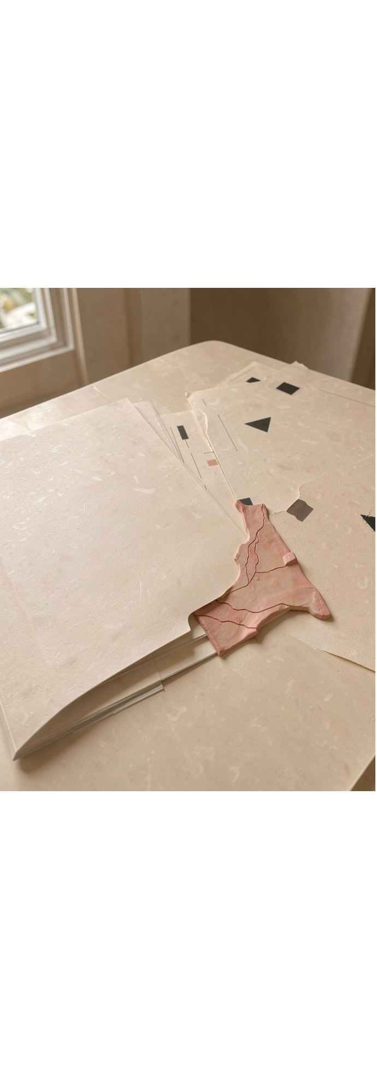
BOUNDARIES & NEXT STEPS
10 / 10
Useful now, deliberately not a compliance system
What needs review
ROADMAP
Make the trail stronger
OCR can misread scans, layouts, or noisy pages.
Rules cover known patterns and can miss new document structures.
A font-family outlier is an observation, not formal tamper detection.
Fictional synthetic documents only; the prototype makes no formal compliance claim.
Richer layout parsing, rule coverage, reviewer feedback loops, regression fixtures, and measured precision/recall on a governed benchmark.
Notes:
Close with the boundary. OCR and deterministic rules are useful, but they carry uncertainty and coverage limits. Folio works with fictional synthetic documents and makes no formal compliance claim. The roadmap is to improve layout parsing, rules, reviewer feedback, regression fixtures, and measured evaluation on a governed benchmark.

