Slide 1





MACHINE LEARNING · NATURAL LANGUAGE PROCESSING · RESEARCH PROJECT
17,790
dataset responses (RAGTruth)
RAG Hallucination Detector
3
ML classifiers compared
A machine learning approach to identifying unsupported claims in retrieval-augmented generation systems
0.800
response-level ROC-AUC (test)
Machine learning
Natural language processing
Retrieval-augmented generation
Human-annotated dataset
Sentence-level detection
1 User query
2 Retrieved documents
3 LLM-generated answer
4 Hallucination detection
5 Verified response
Retrieved context
LLM-generated answer
Hallucination detector
The university was founded in 1998 and has three campuses.
The university was founded in 1998.
Sentence 1 · Supported
It has three campuses.
Sentence 2 · Supported
It serves 75,000 students.
Sentence 3 · Unsupported
No student count anywhere in the evidence.
Answer flagged: likely hallucinated
Figure 1. Every sentence of the answer is scored against the retrieved evidence; the answer inherits the risk of its least-supported sentence. Illustrative input.
STUDENT NAME
UNIVERSITY / COLLEGE
COURSE / SUBJECT
FACULTY GUIDE
ACADEMIC YEAR
[Student name]
[University / college]
[Course / subject]
[Faculty guide]
[2026–27]
Stack · Python · scikit-learn · SQLite · Streamlit · Gemini API · Jupyter Notebook github.com/Kavaykhurana/ml_project
Notes:
Opening. This project detects hallucinations in RAG answers: given the retrieved context and the LLM's response, a trained classifier scores every sentence, flags unsupported ones and gives the answer a risk score equal to its riskiest sentence. It is trained on RAGTruth, 17,790 human-annotated responses. Three classical classifiers were compared; the chosen Gradient Boosting model reaches 0.800 ROC-AUC at the response level on the held-out test split. The figure is an illustrative input; slide 10 shows the real app producing exactly this verdict.

Slide 2

The hallucination problem in retrieval-augmented generation
01 · PROBLEM STATEMENT
Retrieval-augmented generation grounds an LLM in retrieved documents. Grounding is not a guarantee: the model can still add entities, numbers or claims the documents never state, or contradict them outright.
ILLUSTRATIVE EXAMPLE
Retrieved context
The company was established in 2012 and operates in 15 countries.
WHY IT MATTERS
Fluent answers earn trust they have not earned
LLM response, judged sentence by sentence
Retrieved documents do not guarantee factual consistency
The company was established in 2012 and operates in 15 countries.
Evaluation usually scores whole answers, not individual claims
Supported — both facts appear in the context
Human verification is slow and does not scale
It employs 50,000 people worldwide.
Unsupported — the context never states an employee count
One answer can mix correct and hallucinated sentences
“The objective is not merely to generate answers, but to evaluate whether generated answers remain faithful to their evidence.”
GROUNDED
HALLUCINATED
A statement directly supported by the retrieved context.
A statement unsupported by, or in conflict with, the retrieved context.
Example is illustrative. Problem framing: Wu et al., RAGTruth (ACL 2024).
Notes:
RAG is meant to reduce hallucination by grounding answers, but the generator can still introduce unsupported content. The example answer is half right: the first sentence is fully supported, the second invents an employee count. This is why the project works at sentence level rather than scoring answers as a whole. Definitions follow RAGTruth: hallucinated = unsupported by or conflicting with the provided context, regardless of real-world truth.

Slide 3
Why RAGTruth? Selecting the right dataset for hallucination detection
02 · DATASET SELECTION
17,790
2,965
Criterion | Importance | RAGTruth suitability | Why it matters
Problem relevance | Critical | ✓ Directly aligned | Built to study hallucinations in RAG outputs
Human-labelled ground truth | Critical | ✓ Available | Annotators marked hallucinated character spans
Multiple NLP tasks | High | ✓ QA · D2T · Summary | Different response structures test generality
Different LLM families | High | ✓ Six models | GPT, Llama-2 and Mistral: 13.5–65.9 % hallucinating
Source context | Critical | ✓ Available | Every response is paired with its retrieved evidence
Reproducibility | High | ✓ Official splits | Fixed train / test partition, documented labels
generated responses
source instances
14,289
7,664
annotated hallucination spans
responses with ≥ 1 hallucination
6
3
LLMs from 3 model families
task families: QA, data-to-text, summarisation
SELECTION RATIONALE
RAGTruth was selected because it provides human-annotated, context-aware examples that directly match the problem of detecting unsupported RAG-generated claims.
Wu et al., RAGTruth (ACL 2024), MIT licence. All counts re-verified on response.jsonl and source_info.jsonl loaded into the project’s SQLite database.
Notes:
Six reasons drove the choice; three are critical: the corpus is about RAG hallucination specifically, labels are human span annotations rather than model judgements, and every response comes with its context, which is what a context-comparison detector needs. Model diversity matters too: per-model rates range from 13.5% (GPT-3.5) to 65.9% (Mistral-7B), computed directly from the dataset. Answers come from GPT-3.5, GPT-4, Llama-2 7B/13B/70B and Mistral-7B-Instruct.

Slide 4
Understanding the RAGTruth dataset
03 · COMPOSITION AND EXPLORATORY ANALYSIS
17,790
43.1%
14,289
17,617
total responses, full dataset
responses with ≥ 1 hallucination
human-annotated hallucination spans
kept for training after removing 173 refusals / truncations
Task | Sources | Responses | Hallucinated | Rate
Question answering | 989 | 5,934 | 1,724 | 29.1%
Data-to-text | 1,033 | 6,198 | 4,254 | 68.6%
CNN/DM summarisation | 628 | 3,768 | 1,165 | 30.9%
Recent news summarisation | 315 | 1,890 | 521 | 27.6%
Overall | 2,965 | 17,790 | 7,664 | 43.1%
Responses by task
Question answering
5,934
Data-to-text
6,198
CNN/DM summarisation
3,768
Recent news summarisation
1,890
WHAT THE EDA SHOWS
Data-to-text is the outlier: 68.6% of responses hallucinate, more than twice the QA rate (29.1%).
Both summarisation sources sit near QA: 30.9% (CNN/DM) and 27.6% (recent news).
A 2.5× spread across tasks: performance has to be read per task, not from one overall number.
Full RAGTruth release (all splits). The training subset used by the project is smaller — see slide 5. Task-level counts: Wu et al., 2024; totals re-verified on the project database.
Notes:
Composition of the full public release. Each source instance has six responses (one per LLM), so responses = 6 × sources in every row. 43.1% of responses contain at least one hallucinated span. Data-to-text (writing about a business from structured JSON) is by far the hardest task. Important distinction: these are full-dataset statistics. The project trains on a cleaned subset of 17,617 responses after dropping 144 incorrect refusals and 29 truncated answers, and the dataset is not class-balanced.

Slide 5
From human-annotated responses to machine learning samples
04 · ANNOTATION, PREPROCESSING AND SPLITS
Human annotation · 14,289 hallucinated character spans
1
2
3
4
5
6
7
8
9
Raw JSONL
Records
SQLite
Quality filter
Sentences
Span overlap
Labels
Features
Training
response.jsonl · source_info.jsonl
response ↔ context via source_id
sources · responses · runs · predictions
17,790 → 17,617 responses
abbreviation-aware splitter
gold spans ∩ sentence offsets
141,538 sentences, 0 / 1
10 per sentence, vs context
LR · RF · Gradient Boosting
TRAIN / DEV / TEST · CLEANED SUBSET
SENTENCE LABELLING RULE
label(s) = 1 if any gold span overlaps s:
span.start < s.end and span.end > s.start
Split | Responses | Passages | Sentences | Hallucinated sentences
Train | 13,531 | 2,277 | 110,264 | 10.8%
Dev (10% of train) | 1,411 | 238 | 11,092 | 11.7%
Test (official) | 2,675 | 450 | 20,182 | 8.25%
ILLUSTRATIVE
A · “According to the context, the organization was founded in 2012.”
No overlap with a gold span → label 0, grounded
Dev passages: md5(source_id) % 10 == 0. All six LLM answers to one passage share a split, so no passage leaks between train and dev.
Model and threshold are chosen on dev; the official test split is used only for the final report.
B · “The organization employs 50,000 people.”
Overlaps a gold span → label 1, hallucinated
Counts from backend.load_dataset() and backend.sentence_table(), verified on the project database. Labelling rule: backend.sentence_table().
Notes:
RAGTruth labels are character spans; the classifier needs one label per sentence. Each response is split into sentences with character offsets, and a sentence is labelled 1 if it overlaps any gold span. Quality filtering removes 144 incorrect refusals and 29 truncated answers. The dev split is carved from train by hashing source_id, so all six answers to the same passage stay together; otherwise the model could memorise passage-specific vocabulary and inflate dev scores. Note the label imbalance: about 8-12% of sentences are hallucinated, against 43% of responses.

Slide 6
Feature engineering — turning text into evidence-based signals
05 · FEATURE ENGINEERING
A
Lexical novelty
novel_word_ratio · novel_words
WORKED EXAMPLE · REAL FEATURE VALUES
Content words in the sentence that never occur in the context
Context
B
Numeric novelty
novel_numbers · novel_number_ratio
The company was founded in 2012 and operates in 15 countries.
Numbers and dates that are absent from the context
C
Entity novelty
novel_capitals
Sentence 1 · grounded
Capitalised words, likely names, absent from the context
The company was founded in 2012 and operates in 15 countries.
D
Phrase overlap
bigram_overlap · trigram_overlap
Share of 2- and 3-word phrases copied from the context
Sentence 2 · unsupported
The company was founded in 2012 and employs 50,000 workers.
E
Structure
n_words · position · is_last
Sentence length and where it sits in the answer
Feature | Sentence 1 | Sentence 2
novel_word_ratio | 0.00 | 0.57
novel_words | 0 | 4
novel_numbers | 0 | 2 (50, 000)
bigram_overlap | 1.00 | 0.60
trigram_overlap | 1.00 | 0.56
novel_capitals | 0 | 0
The tokenizer splits 50,000 into 50 and 000, so two novel numbers are counted.
Feature code: backend.sentence_features(). Training-set means: notebook §6, 110,264 train sentences. Example values computed by the project code on the illustrative pair.
Notes:
Ten features per sentence, each computed against the retrieved context only. Novelty features count content words, numbers and capitalised words missing from the context; overlap features measure how many bigrams and trigrams are copied verbatim; structural features capture length and position. The chart shows real training-set means: hallucinated sentences have 0.51 novel-word ratio versus 0.30 for grounded ones, and trigram overlap drops from 0.21 to 0.06. The worked example values were computed by the project's own feature code; the model then learns how these signals combine.

Slide 7
System architecture — from dataset to hallucination detection
06 · END-TO-END PIPELINE
01 · DATA INGESTION
02 · DATA MANAGEMENT
03 · PROCESSING
04 · MODEL TRAINING
RAGTruth JSONL from GitHub
response.jsonl: answers + spans
source_info.jsonl: contexts
Downloaded once, ~36 MB
SQLite ragtruth.db
sources · responses
runs · predictions
FK responses → sources
Quality filtering
Sentence segmentation
Annotation span overlap
Feature engineering (10)
LR · RF · Gradient Boosting
Development evaluation
Threshold selection on dev
Best model → model.joblib
model.joblib
DECISION RULE · INSIDE 05
07 · OPTIONAL GENERATION
06 · APPLICATION
05 · INFERENCE
p_i = model(x_i)
flag if p_i ≥ 0.62
risk = max_i p_i
Gemini API
gemini-3.5-flash-lite (default)
gemini-3.8-flash (selectable)
Writes answers only — never judges
Streamlit, 4 tabs
Detector · Dataset
Model performance · History
Logs to predictions table
User context + LLM response
Sentence-level features
Probability per sentence
Flagging + response risk
≥ 0.62 → Likely hallucinated
< 0.62 → Looks grounded
Source: backend.py (data, features, training, inference, Gemini client) and app.py (Streamlit). Decision rule: backend.detect().
Notes:
Seven modules. The top row is offline: download, load into SQLite, build sentence features, train three models and save the best to model.joblib. The bottom row is online: the Streamlit app passes context and response to inference, which scores each sentence, flags those at or above the 0.62 threshold tuned on dev, and returns risk = the maximum sentence probability. Gemini is optional and only generates answers; it never decides whether they are hallucinated. That separation keeps the judge independent of the generator. Every detection is logged to the predictions table.

Slide 8



Comparative model development and selection
07 · CLASSIFIERS
SELECTED
Logistic Regression
Random Forest
Gradient Boosting
LINEAR BASELINE
BAGGED TREE ENSEMBLE
SEQUENTIAL BOOSTING
Linear reference point
One weight per engineered feature
Fast to train, easy to interpret
Averages many independent trees
Learns non-linear feature interactions
More flexible than a linear boundary
Each tree corrects the previous errors
Highest dev-split F1 of the three
Selected for the final detector
StandardScaler → LogisticRegression(
max_iter=1000,
class_weight="balanced")
RandomForestClassifier(
n_estimators=300,
min_samples_leaf=5,
class_weight="balanced")
HistGradientBoostingClassifier(
max_iter=300,
learning_rate=0.05,
class_weight="balanced")
SELECTION PROTOCOL
1
2
3
4
Why this is sound
Fit each model on train
Sweep threshold on dev
Keep the best dev F1
Report once on test
Model choice and threshold are both made on the development split. The test split never influences a decision, so the reported test metrics stay an independent estimate.
13,531 responses
0.05 → 0.95, step 0.01
Gradient Boosting · 0.392
threshold fixed at 0.62
Source: backend.CANDIDATES and backend.train(). Dev F1 and threshold of the selected model: Project_Summary.pdf, latest run.
Notes:
Three classical classifiers on the same ten features, all with balanced class weights because only about 11% of training sentences are hallucinated. Logistic Regression is the linear baseline; Random Forest adds non-linear interactions by bagging trees; HistGradientBoosting builds trees sequentially, each correcting the previous ones. For each model the decision threshold is swept on dev to maximise F1, and the model with the best dev F1 is kept: Gradient Boosting at 0.392, threshold 0.62. These are not deep or transformer models; that is deliberate for a first, interpretable baseline.

Slide 9
Experimental results — measuring hallucination detection performance
08 · HELD-OUT TEST SET
RESPONSE LEVEL · SHOULD THIS ANSWER BE TRUSTED?
Model | Precision | Recall | F1 | ROC-AUC
Logistic Regression | 0.526 | 0.830 | 0.644 | 0.781
Random Forest | 0.539 | 0.806 | 0.646 | 0.793
Gradient Boosting (chosen) | 0.538 | 0.836 | 0.654 | 0.800
SENTENCE LEVEL · WHICH SENTENCE IS UNSUPPORTED?
Model | Precision | Recall | F1 | ROC-AUC
Logistic Regression | 0.211 | 0.522 | 0.301 | 0.771
Random Forest | 0.237 | 0.535 | 0.328 | 0.784
Gradient Boosting (chosen) | 0.235 | 0.582 | 0.334 | 0.797
Sentence level
Response level
Each sentence is classified. Only 1,665 of 20,182 test sentences (8.25%) are hallucinated, which holds down precision and F1.
An answer is flagged when at least one sentence is flagged. This is the practical question a user asks.
A screening tool, not a sentence oracle: it catches 83.6% of hallucinated answers, while only 23.5% of flagged sentences are truly hallucinated.
Held-out RAGTruth test split: 2,675 responses, 20,182 sentences. Metrics from Project_Summary.pdf (latest run); one run throughout. Best value per column in bold cyan.
Notes:
Gradient Boosting leads on response-level F1 (0.654), ROC-AUC (0.800) and recall (0.836); Random Forest has marginally higher precision. Differences between models are small, which suggests the ceiling is set by the features rather than the classifier. Sentence-level F1 is 0.334: with only 8.25% of test sentences hallucinated, even a good ranking (AUC 0.797) produces many false positives at any useful recall. Response-level is the realistic use: should a person double-check this answer? No accuracy figure is headlined because with this class imbalance it would be misleading.

Slide 10
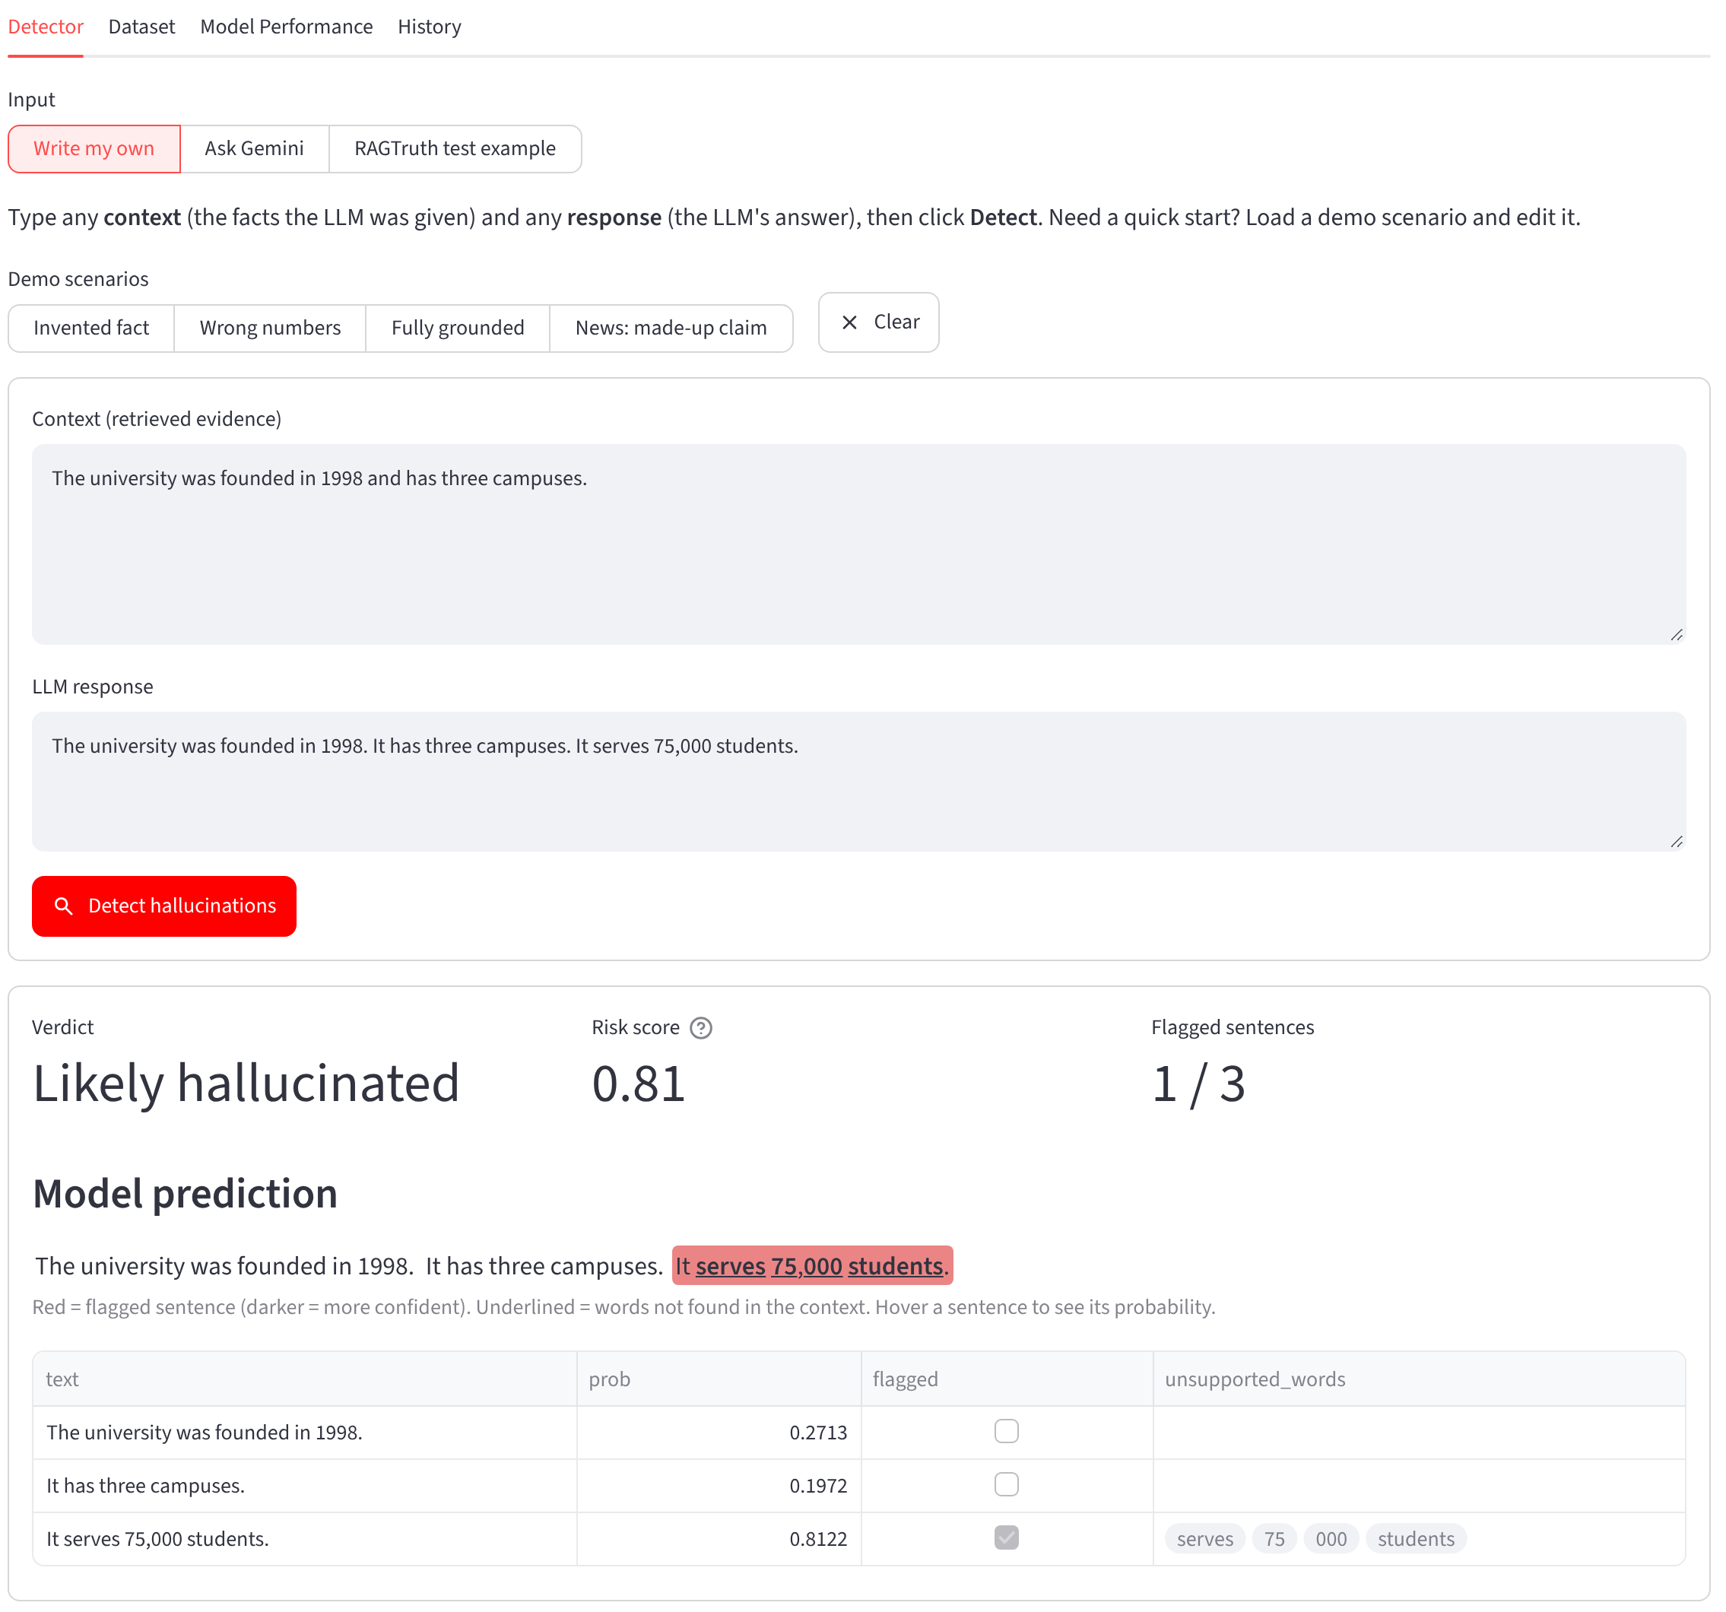



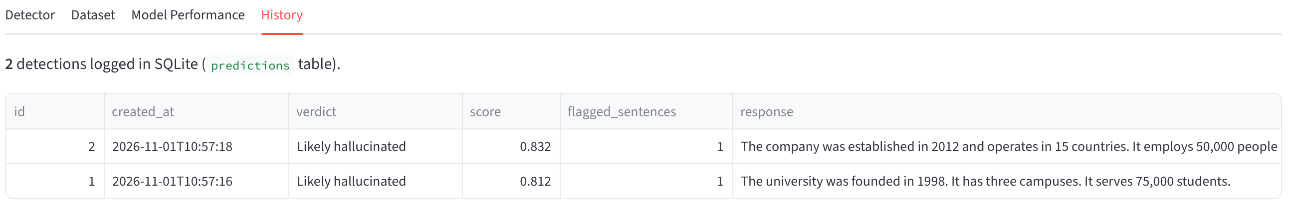


From machine learning model to working application
09 · STREAMLIT APPLICATION
FOUR TABS
Detector
Dataset
Write my own · Ask Gemini · RAGTruth test example compared with gold labels
Live SQLite statistics, EDA charts and a table browser
Model performance
History
All three classifiers at sentence and response level
Every detection: timestamp, risk score, flagged count, verdict
HISTORY TAB · ACTUAL SCREENSHOT
SQLite persistence
Tested
sources · responses · runs · predictions
Backend self-check and 7 end-to-end UI tests
Actual screenshot · Detector tab: only sentence 3 is flagged (p = 0.81).
Screenshots: live local run of app.py with a model trained by the project notebook, Nov 2026. Input text is illustrative; probabilities shown are the model’s real output.
Notes:
The Streamlit app wraps the trained model. The screenshot is a real run: context says the university was founded in 1998 and has three campuses; the answer adds 75,000 students. The detector flags only that sentence and underlines the unsupported words; the answer's risk score is 0.81. The four tabs cover detection (own text, Gemini-generated answers, or real RAGTruth test examples shown against the human gold labels), the dataset, model comparison and the logged history. Seven end-to-end UI tests drive the real app headlessly with Gemini faked.

Slide 11
Critical evaluation — what the model gets right and where it fails
10 · LIMITATIONS AND FUTURE WORK
L1
Lexical, not semantic
IMPLEMENTED
PROPOSED
Features count shared words and phrases. The model never reads meaning.
Lexical detector
Semantic detector
Word novelty
n-gram overlap
Number and entity novelty
Sentence position
Entailment (NLI) score
Contradiction detection
Paraphrase-aware matching
Token-level spans
L2
Paraphrase → false positive
A correct rewording uses new words, so it looks novel and can be flagged.
L3
Contradiction → false negative
Context “Team A defeated Team B.” Response “Team B defeated Team A.” Every word overlaps: the detector returns p = 0.10, looks grounded.
FUTURE IMPROVEMENTS · NOT YET IMPLEMENTED
1
Natural language inference
add an entailment score as a feature
L4 · Task dependence
2
Transformer detector
Data-to-text contexts are JSON, so legitimate rewording looks lexically novel. Its high F1 is driven by flagging almost everything: recall 0.98, precision 0.65.
DeBERTa or ModernBERT on [context] [SEP] [response]
3
Semantic understanding
separate paraphrases from contradictions
4
Task-specific calibration
own threshold for QA, summaries, data-to-text
5
Generalisation
test on other datasets and unseen LLMs
Per-task F1 and Data-to-text precision/recall: project README (test split). Contradiction output: the trained detector run on the shown input.
Notes:
Honest limits. The features are lexical: a correct paraphrase can look novel, and a contradiction that reuses the same words looks grounded. The Team A / Team B example was run through the trained model and it returned 0.10, looks grounded. Performance also depends heavily on task: response-level F1 is 0.78 on data-to-text but that comes from flagging almost everything, 0.53 on QA and 0.39 on summaries. The right column separates what is implemented from what is proposed: an NLI entailment feature and a fine-tuned DeBERTa or ModernBERT classifier are the natural next steps.

Slide 12

Conclusion — towards more trustworthy retrieval-augmented generation
11 · CONTRIBUTIONS AND TAKEAWAYS
KEY CONTRIBUTIONS
17,790
3
0.654
Context-aware hallucination detection pipeline, end to end
Trained on RAGTruth’s human-annotated responses
dataset responses
ML models compared
response-level F1
Character-span annotations turned into sentence labels
0.800
0.836
Ten lexical and structural features against the context
response-level ROC-AUC
response-level recall
Three classical ML classifiers compared on one protocol
Gradient Boosting selected on the development split
“An AI response should not be trusted merely because it sounds convincing. Its claims must be evaluated against the evidence that supports them.”
Streamlit application for practical detection
SQLite-backed tracking of runs and prediction history
Answer generation (Gemini) kept separate from judgement
Lexical matching → semantic entailment → transformer-based detection
This project is an experimental hallucination-screening system. It assists human verification and does not guarantee factual correctness.
NEXT
REFERENCES
1. Wu et al. RAGTruth: A Hallucination Corpus for Developing Trustworthy Retrieval-Augmented Language Models. ACL 2024.
2. RAGTruth repository: github.com/ParticleMedia/RAGTruth
3. Project implementation: github.com/Kavaykhurana/ml_project
4. scikit-learn documentation: scikit-learn.org
5. Streamlit documentation: docs.streamlit.io
Thank you
Questions & answers
Metrics: held-out RAGTruth test split, Project_Summary.pdf (latest run).
Notes:
Summary: a complete pipeline from human-annotated spans to a working, tested application. Headline numbers on the held-out test split: response-level F1 0.654, ROC-AUC 0.800, recall 0.836 with Gradient Boosting. The detector is a screening aid; it does not establish truth, and it inherits the blind spots of lexical features. Likely viva questions: why not accuracy (class imbalance), why max for the risk score (one unsupported sentence is enough to distrust an answer), why group by source_id (leakage), and how a transformer would change the picture.

