Slide 1


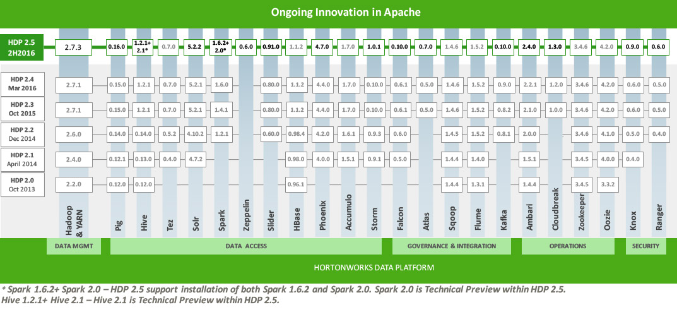
 | ROOT |  | Anaconda (IPy) |  | R |  | Pentaho |  | Gitlabs |  | SonarQube |  | Archiva |  | Jenkins |  | TWiki |  | StormSD |  | HUE |  | MongoDB |  | AppServer |  | Dovecot |  | KaveLanding |  | FreeIPA |  | Ganglia |  | Nagios
3.0-Beta
Oct 2016
6.04
4.1
✗
8.7.1
5.4
2.2.0
1.642
6.0.0
1.0.2
✗
3.2
10.1
2.2-Beta
Sept 2016
5.34.36
2.4
5.4.0
8.7.1
5.4
2.2.0
1.642
6.0.0
0.10.0
3.7.1
3.2
10.1
2.0-Beta
Apr 2016
5.34.36
2.4
5.4.0
8.7.1
5.4
2.2.0
1.642
6.0.0
0.10.0
3.7.1
3.2
7.1.1
1.4-Beta
Jan 2016
5.34.34
2.4
5.2.0
7.6.2
5.0.1
2.2.0
1.624
6.0.0
0.10.0
3.7.1
2.6
7.1.1
1.3-Beta
Aug 2015
5.34.21
2.2
5.2.0
7.6.2
5.0.1
2.2.0
1.624
6.0.0
0.9.3
3.7.1
2.6
7.1.1
1.2-Beta
Jun 2015
5.34.21
2.1
5.2.0
7.6.2
5.0.1
2.2.0
1.598
6.0.0
0.9.3
3.7.1
2.6
7.1.1
1.1-Beta
May 2015
ANALYTICS (KaveToolbox)
DEVELOPMENT & COLLABORATION
LAMBDA STACK
MANAGEMENT
KPMG Analytics and Visualization Platform

