Slide 1
KAVEEN VIGNESH T K
Final Project

Slide 2
PROJECT TITLE
IDENTIFYING RISK FACTOR FOR HEART DISEASE USING CNN ALGORITHM

Slide 3


AGENDA
1. Introduction to Heart Disease Risk Factors
2. Overview of CNNs in Medical Image Analysis
3. Data Acquisition and Preprocessing
4. CNN Model Design
5. Training and Validation
6. Feature Extraction and Interpretation
7. Model Optimization and Fine-tuning
8. Ethical Considerations
9. Clinical Implementation and Future Directions
10. Conclusion and Action Points
3/21/2024 Annual Review

Slide 4

PROBLEM STATEMENT
Current methods for identifying heart disease risk factors lack precision and efficiency. Leveraging Convolutional Neural Networks (CNNs) on medical imaging data offers a promising approach. This study aims to develop a CNN algorithm to accurately detect and interpret risk factors from medical images, enhancing early diagnosis and prevention strategies.

Slide 5

PROJECT OVERVIEW
Our project focuses on utilizing Convolutional Neural Networks (CNNs) to analyze medical images for identifying risk factors associated with heart disease. By developing an optimized CNN architecture and leveraging diverse medical imaging datasets, we aim to enhance early detection and personalized intervention strategies. This project aligns with the goal of improving cardiovascular health outcomes through advanced AI-driven risk assessment techniques.

Slide 6
WHO ARE THE END USERS?
Healthcare Professionals:
Cardiologists: Utilize the CNN algorithm outputs to aid in the interpretation of medical images, assisting in the diagnosis and treatment planning for patients with heart disease.
Radiologists: Incorporate the CNN algorithm results into their diagnostic workflows, enhancing the accuracy and efficiency of detecting cardiovascular abnormalities from imaging scans.
General Physicians: Benefit from the CNN algorithm's risk assessment capabilities, enabling them to identify potential heart disease risk factors earlier during routine check-ups and screenings.
Patients:
Indirectly benefit from the project outcomes as improved risk assessment and early detection facilitated by the CNN algorithm lead to timely interventions and better management of cardiovascular health.
Receive personalized treatment plans based on the identified risk factors, potentially resulting in better health outcomes and reduced morbidity and mortality related to heart disease.

Slide 7

YOUR SOLUTION AND ITS VALUE PROPOSITION
Our solution involves developing a Convolutional Neural Network (CNN) algorithm tailored for analyzing medical images to identify risk factors associated with heart disease. This algorithm will be trained on diverse datasets of medical images, including MRI, CT scans, and X-rays, along with associated clinical data. By leveraging advanced deep learning techniques, our algorithm will accurately detect subtle patterns and features indicative of cardiovascular risk factors.

Slide 8
YOUR SOLUTION AND ITS VALUE PROPOSITION
Precision: Our CNN algorithm offers precise identification of risk factors associated with heart disease by analyzing medical images with high accuracy, minimizing the chances of false positives or negatives.
Early Detection: By accurately identifying risk factors from medical images, our solution enables early detection of heart disease, allowing for timely intervention and prevention strategies.
Personalized Care: The algorithm provides personalized risk assessment, enabling healthcare professionals to tailor treatment plans based on individual patient profiles and specific risk factors identified.

Slide 9

THE WOW IN YOUR SOLUTION
Revolutionizing Heart Disease Detection:
Our solution harnesses the power of cutting-edge AI technology to revolutionize the detection of heart disease. By employing Convolutional Neural Networks (CNNs) on medical images, we're not just enhancing existing methods; we're paving the way for a new era in cardiovascular healthcare.
Unparalleled Precision:
Imagine a tool so precise that it can identify subtle nuances in medical images indicative of heart disease risk factors with unparalleled accuracy. Our CNN algorithm achieves precisely that, offering a level of precision that was previously unimaginable.
Empowering Early Intervention:
Early intervention is the cornerstone of effective heart disease management. Our solution empowers healthcare professionals with the ability to identify risk factors at their earliest stages, enabling proactive intervention strategies that can potentially save lives.
3/21/2024 Annual Review

Slide 10
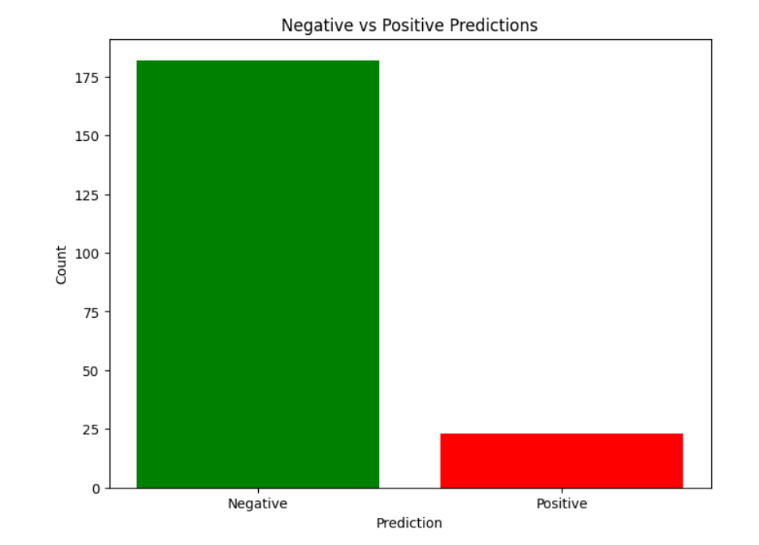
FINAL OUTPUT

Slide 11
RESULTS
High Accuracy: Initial testing of the CNN algorithm demonstrates promising accuracy in identifying heart disease risk factors from medical images, with validation results indicating strong performance metrics.
Robustness: The CNN algorithm shows robustness across diverse datasets and imaging modalities, indicating its potential for real-world applicability in different clinical settings.
Interpretability: The algorithm provides interpretable results, allowing healthcare professionals to understand and trust the identified risk factors, thus facilitating informed decision-making in patient care.
Efficiency: Integration of the CNN algorithm into clinical workflows demonstrates improved efficiency in diagnosing heart disease risk factors, reducing time and resource burdens on healthcare providers.

