Slide 1
Applications
Of Biotechnology
Present by Kaveesha Ramanayake
:SC1172
:INTRODUCTION TO INFORMATION TECHNOLOGY

Slide 2

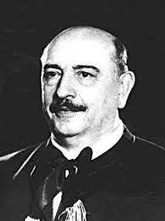
What is biotechnology ?
Biotechnology is a broad area of biology and technology
A technology that uses biological systems or organisms to create or modify products for a particular purpose.
Karl Ereky , the ‘FATHER’ of the biotechnology
Biotechnology relate in different areas
The term biotechnology was coined in 1917,by Hungarian agricultural engineer, Karl Ereky
Notes:
Biotechnology is a broad area of biology and technology, involving the use of living systems and organisms to develop or make products. Depending on the tools and applications, it often overlaps with related scientific fields.

Slide 3
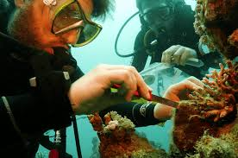
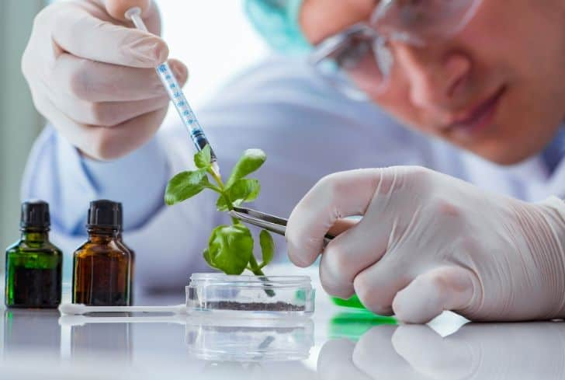
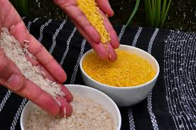
Different areas of biotechnology
MEDICAL
ENVIRONMENTAL
BIOTECHNOLOGY
INDUSTRIAL
FOOD
AGRIULTURAL
BIOINFORMATICS
MARINE
Notes:
There are many areas where we can take biotechnology methods to use different applications for various purposes.

Slide 4
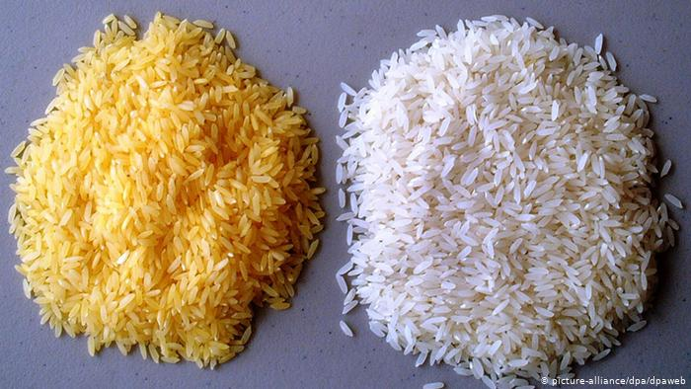
Biotechnology applications in above
Some biotechnology areas
1. in FOOD BIOTECHNOLOGY
Golden rice
Golden rice is a genetically modified, biofortified crop
To produce beta-carotene, which is not normally present in rice
Helps to prevent millions of deaths
Notes:
Technology | nutrition | benefits

Slide 5
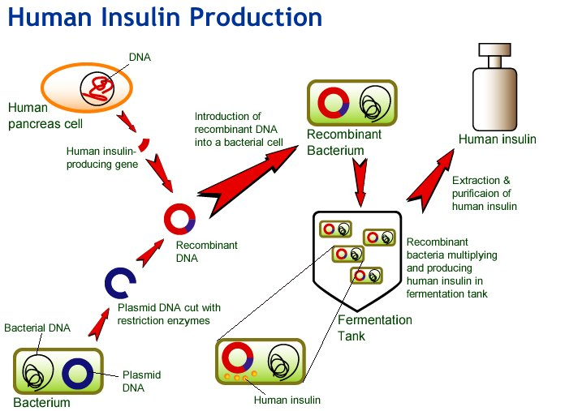
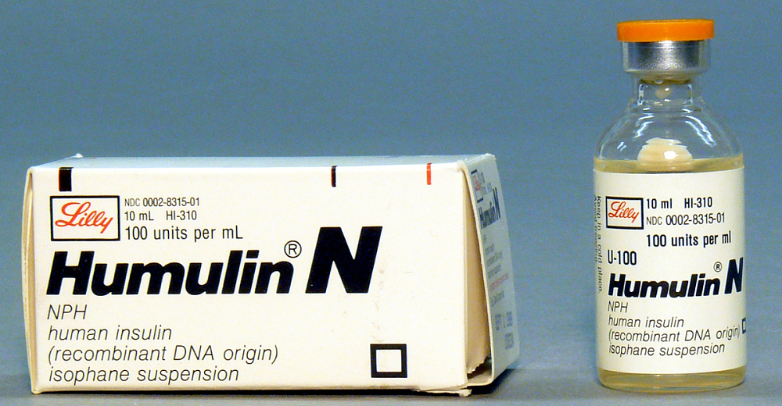
2. In MedicAL BIOTECHNOLOGY
Human insulin
First golden molecule of the biotechnology industry
Produce by recombinant DNA technology
Growes insulin protein within icolai bacteria
Glycemic control in adults and children with type one and type two diabetes mellitus
Notes:
Technology | process |benefits

Slide 6
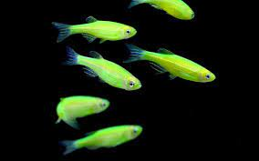
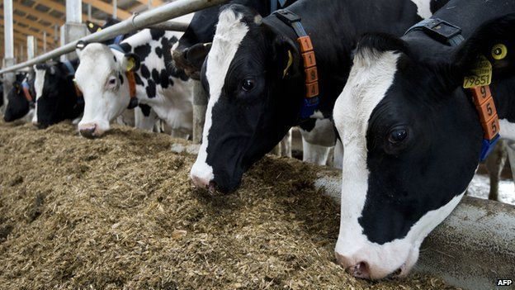
3. In Agricultural BIOTECHNOLOGY
Transgenic animals
Genetically modified animals
Ex: cow, fish, pig, mice
Insert DNA into the embryonic stem cells
To improve breeding and production
Notes:
Who are the transgenic animals | what is the technology we use | benefits

Slide 7
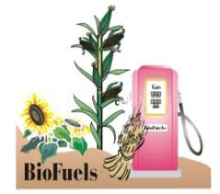
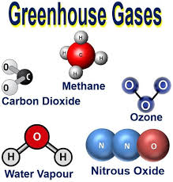
4. In Environmental BIOTECHNOLGY
biofuels
Fuel made from biomass
Through the chemical reactions of transesterification and esterification
Biofuels could help reduce greenhouse gas emissions and our dependency on fossil fuels

Slide 8

references
https://med.nyu.edu/departments-institutes/population-health/divisions-sections-centers/medical-ethics/education/high-school-bioethics-project/learning-scenarios/gmos-the-golden-rice-debate
https://www.onlinebiologynotes.com/human-insulin-production-by-genetic-engineering/
https://www.sciencedirect.com/topics/biochemistry-genetics-and-molecular-biology/transgenic-animal

