Slide 1
Group 13 Teddy’s Brochure
Cecilia Avila, Eugenio Perez, Kaveesha Weerasiri, Adrian Zavala

Slide 2
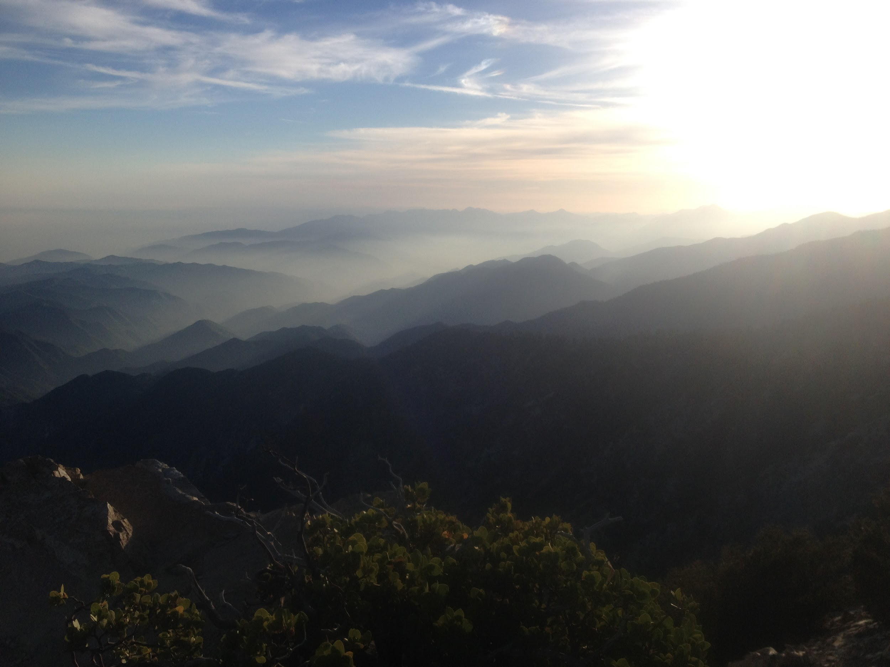
Scenario where Teddy’s Brochure will SAVE YOUR LIFE
← Don’t let this be the last thing you see before getting lost

Slide 3
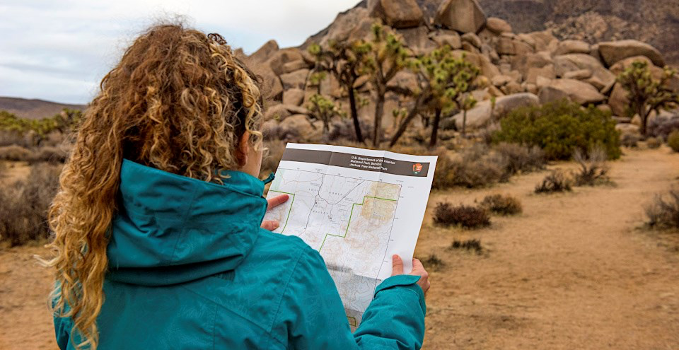
Summary of Teddy’s Brochure
A progressive web application supplementing national parks
Includes:
Walk-through maps
Survival tips
List of volunteer events
Rules
Information
Guides
7 day weather forecast
News

Slide 4
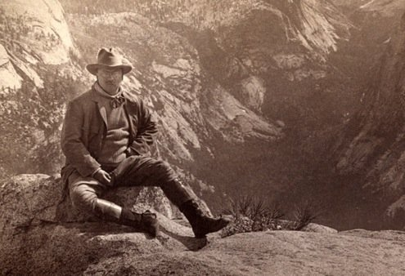
Why Teddy’s Brochure?
You can access information offline
Survival guides and walkthrough maps are helpful
Increases interest
Make groups feel safer with more resources
Reduces paper waste
Reduces the number of resource management organizations
It will be up to date

Slide 5
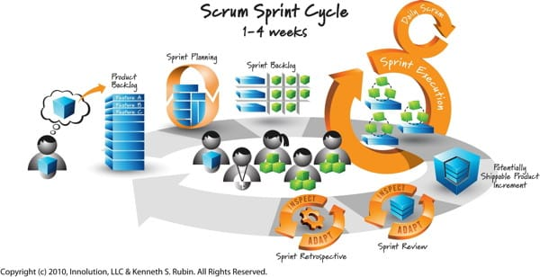
Development schedule
10 weeks of agile development
3 weeks of testing
Available between spring and summer
Continued app support after first release

Slide 6
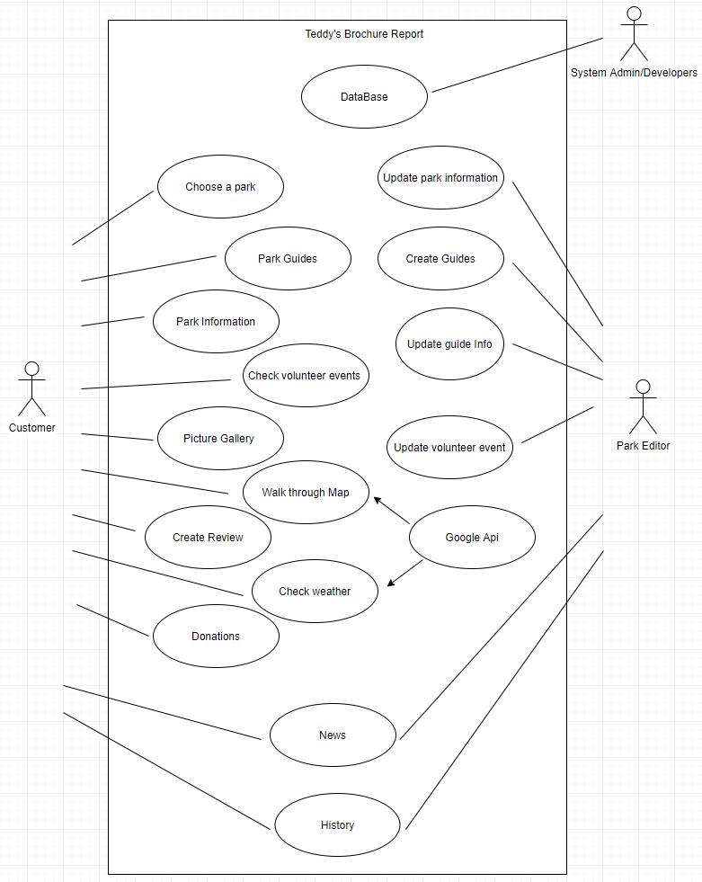
Use cases
System designers
Usability experts
General public
Employees
People maintaining brochure

Slide 7

Who does it affect?
Stakeholders: The National Park Service U.S. Departmental of the Interior, park employees, testers, system designers, and usability experts
Customer: The National Park Service
Client: Park visitors

Slide 8

Assumptions
Api retrieval, parsing, and display work
Volunteer organizations exist
User has a smartphone or smart device

Slide 9
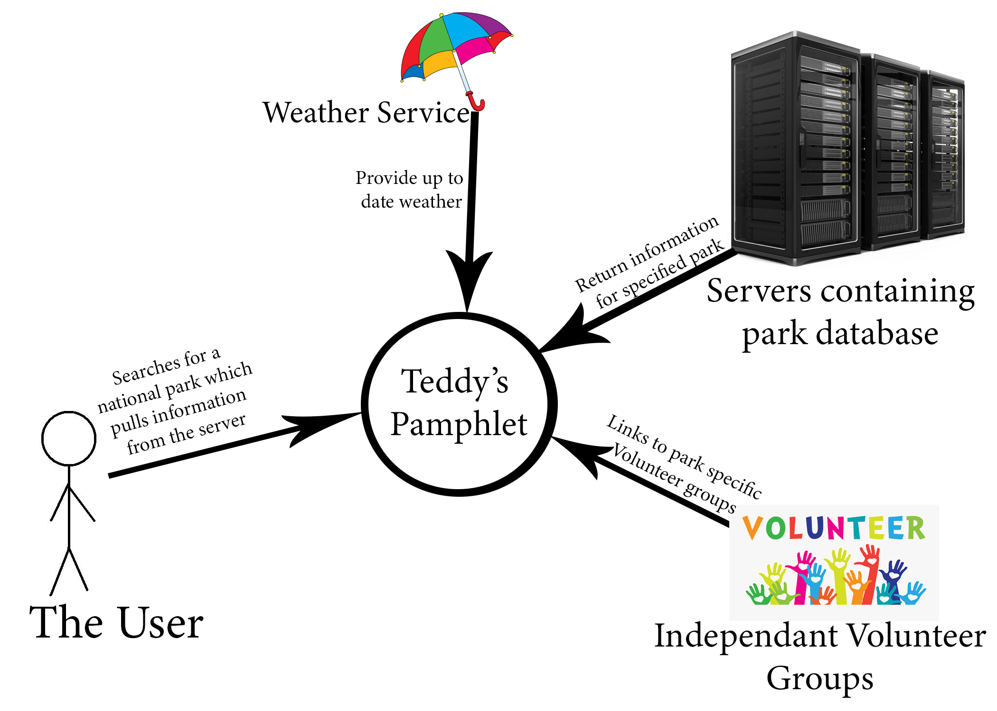
Data storage
Objects to store developer and editor information
List component to display volunteering groups
Ability to store jpegs, pngs, and PDFs
Provides a framework that is modular

Slide 10
Thank you!

