Slide 1
Teddy’s Brochure
Cecilia Avila, Eugenio Perez, Kaveesha Weerasiri, Adrian Zavala

Slide 2
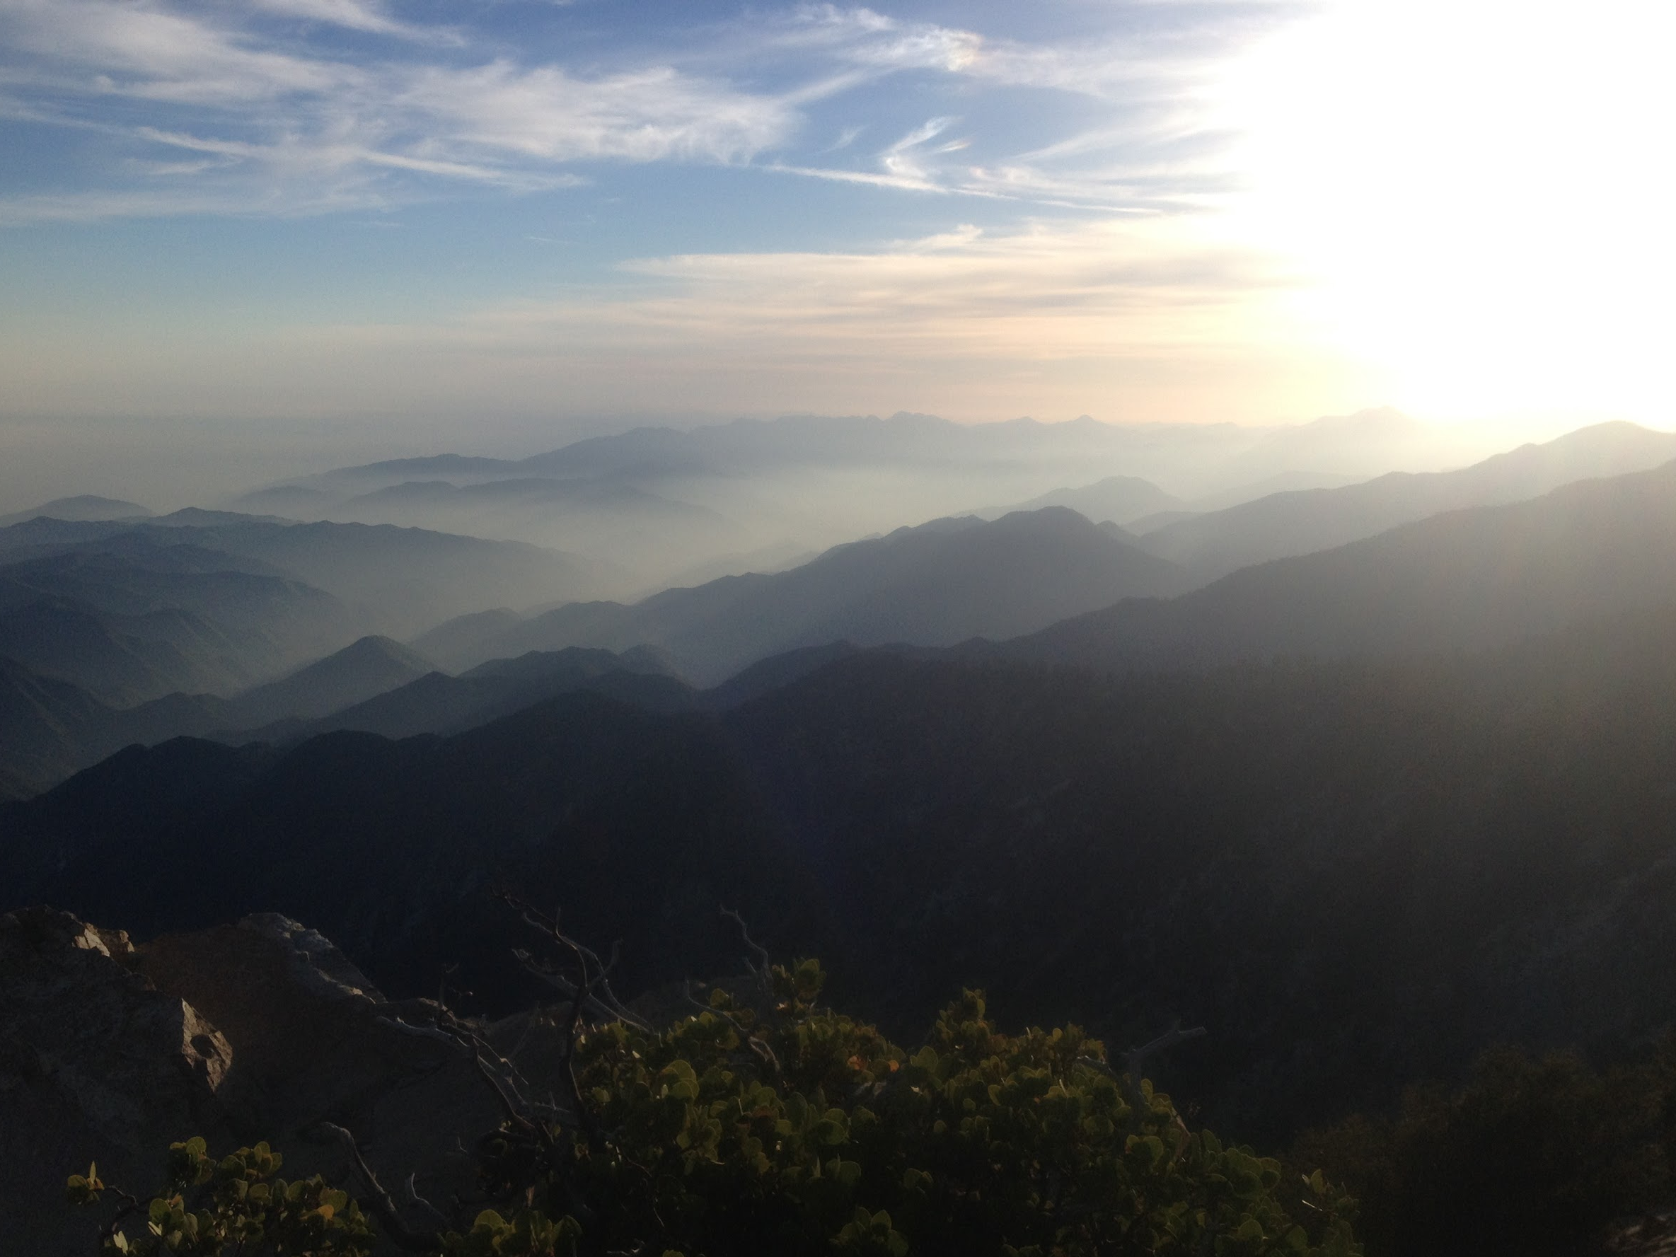
Teddy’s Brochure is a one stop for every National Park in the US
It is an app for your phone or tablet
Contains information for any given National Park
Guides
General Park Info
Virtual Maps
Weather
Volunteer Groups
Rates
History
Works Offline

Slide 3
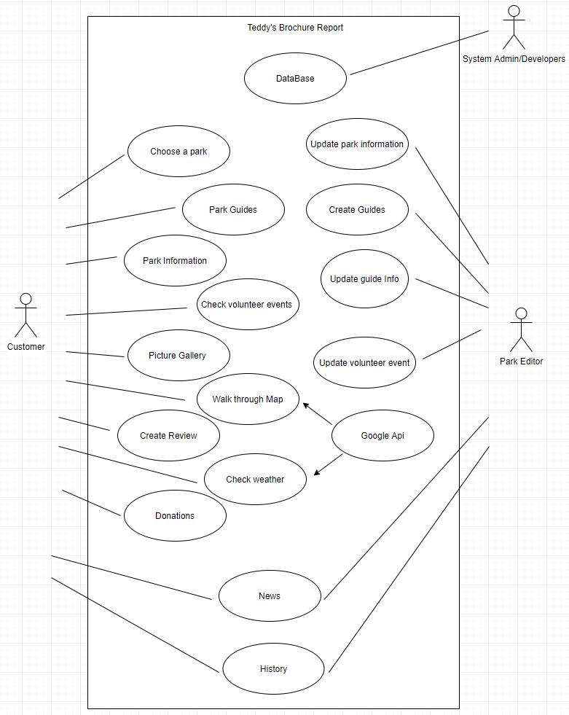
Requirements
We want a clean and intuitive UI
We want all information delivered in a lightweight format (SQL, low battery consumption)

Slide 4
Requirements
(continued)
Every national park should be in our database, (62 areas)
We want all the information to be displayed to the user in a easily digestible format
We want this information to be accessible without an internet connection

Slide 5
Design Goals
Enhance models that parks currently use
Make it easy for people to choose different parks
Have access to the different tabs of the application from the home screen
The format the information is stored should be reusable

Slide 6
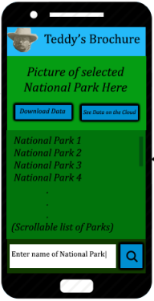
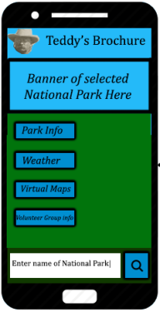
Mock-up

Slide 7
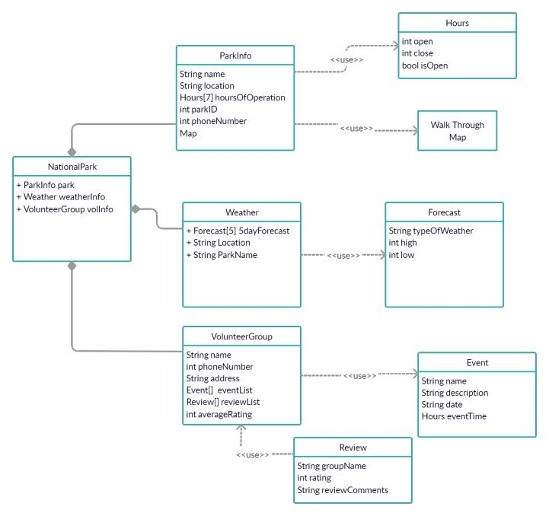
Classes

Slide 8
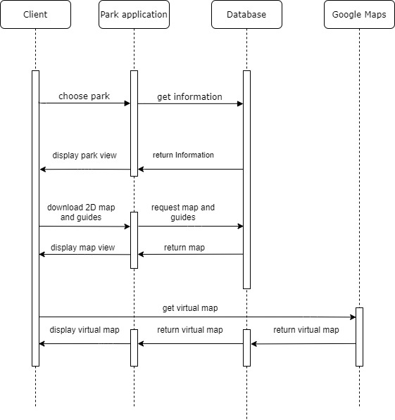
Sequence Diagram
Downloading maps
And guides

Slide 9
Testing
We acknowledge that what needs to be tested will change over the course of development
All 62 National Parks must display accurate and up to date information
Ideally, due to the scale of the application, regression testing should be employed at the end of each sprint.

