Slide 1

DreamBridge
Bridging Your Dreams and Education...
University Course Enrollment System
Presented by: Kaveesha Senarathne
Date: September 22, 2026

Slide 2

Introduction
Java-based system for managing student course enrollment.
Prioritizes registration for high-demand courses.
Built from scratch without Java Collection Framework.
Data Structures: Doubly Linked List, Priority Queue & Hash Table.
Algorithms: Binary Search & Quick Sort.
Provides fast searching, sorting, and data management.
Supports to efficient and cost-effective software development.

Slide 3


Content
01. System Features
02. Technologies Used
03. System Design
04. Live Demo
05. Testing Strategy
07. Final System Results
06. Data Structures & Algorithms

Slide 4

01. System Features
“Architecture isn't about building the perfect system; it's about making trade-offs.” — Martin Fowler

Slide 5
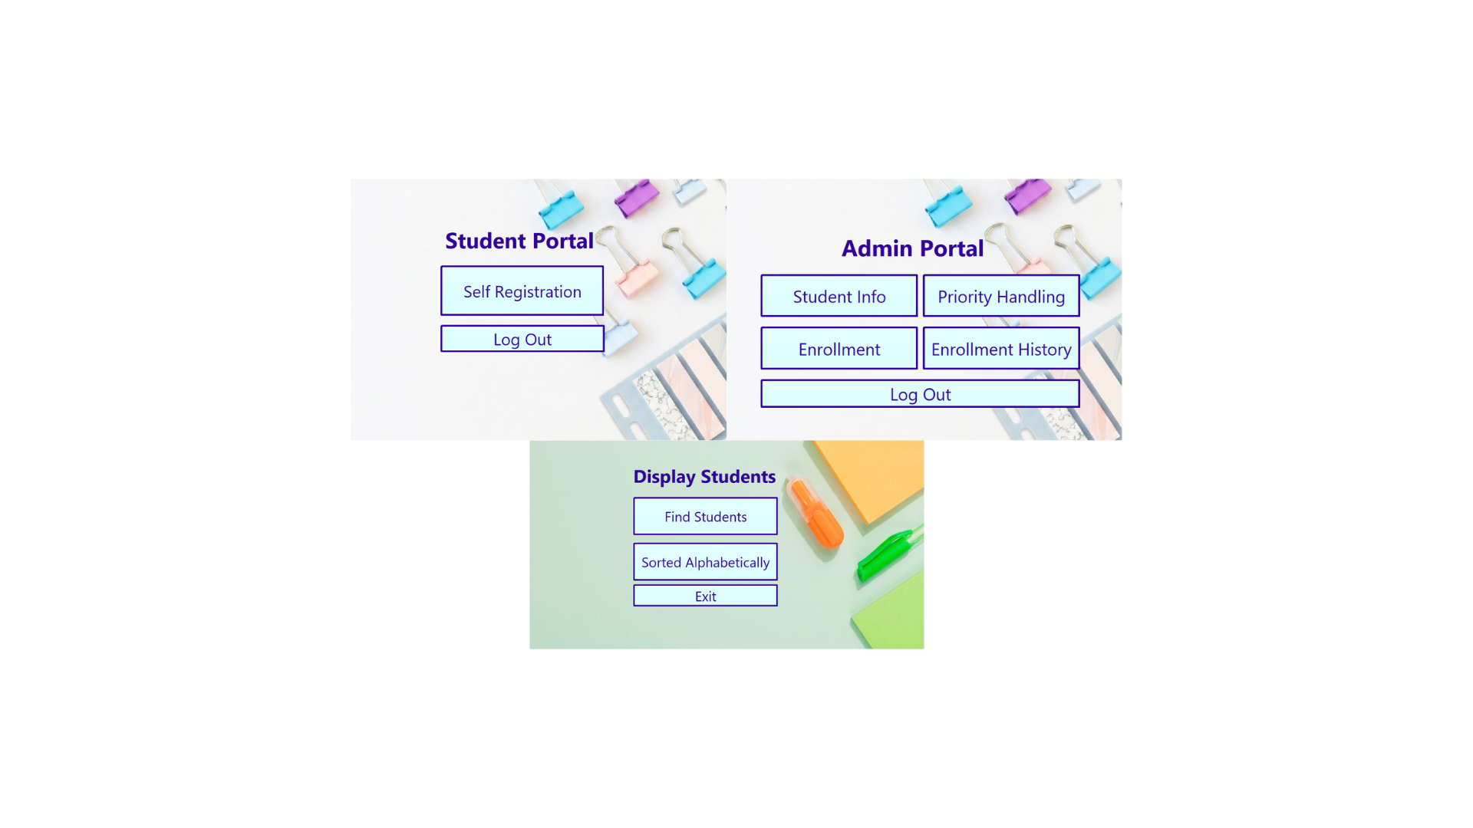
Functional Features
Self-Students Registration
Review Registered Students
Sort Registered Students Alphabetically
Priority Handling
Student Enrollment
Review Enrolled Students

Slide 6
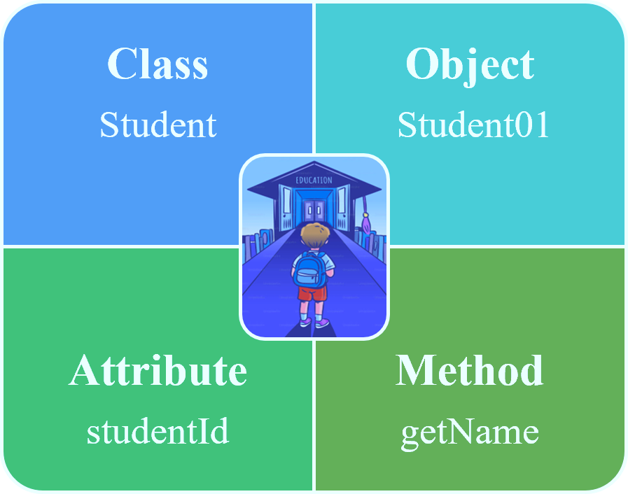
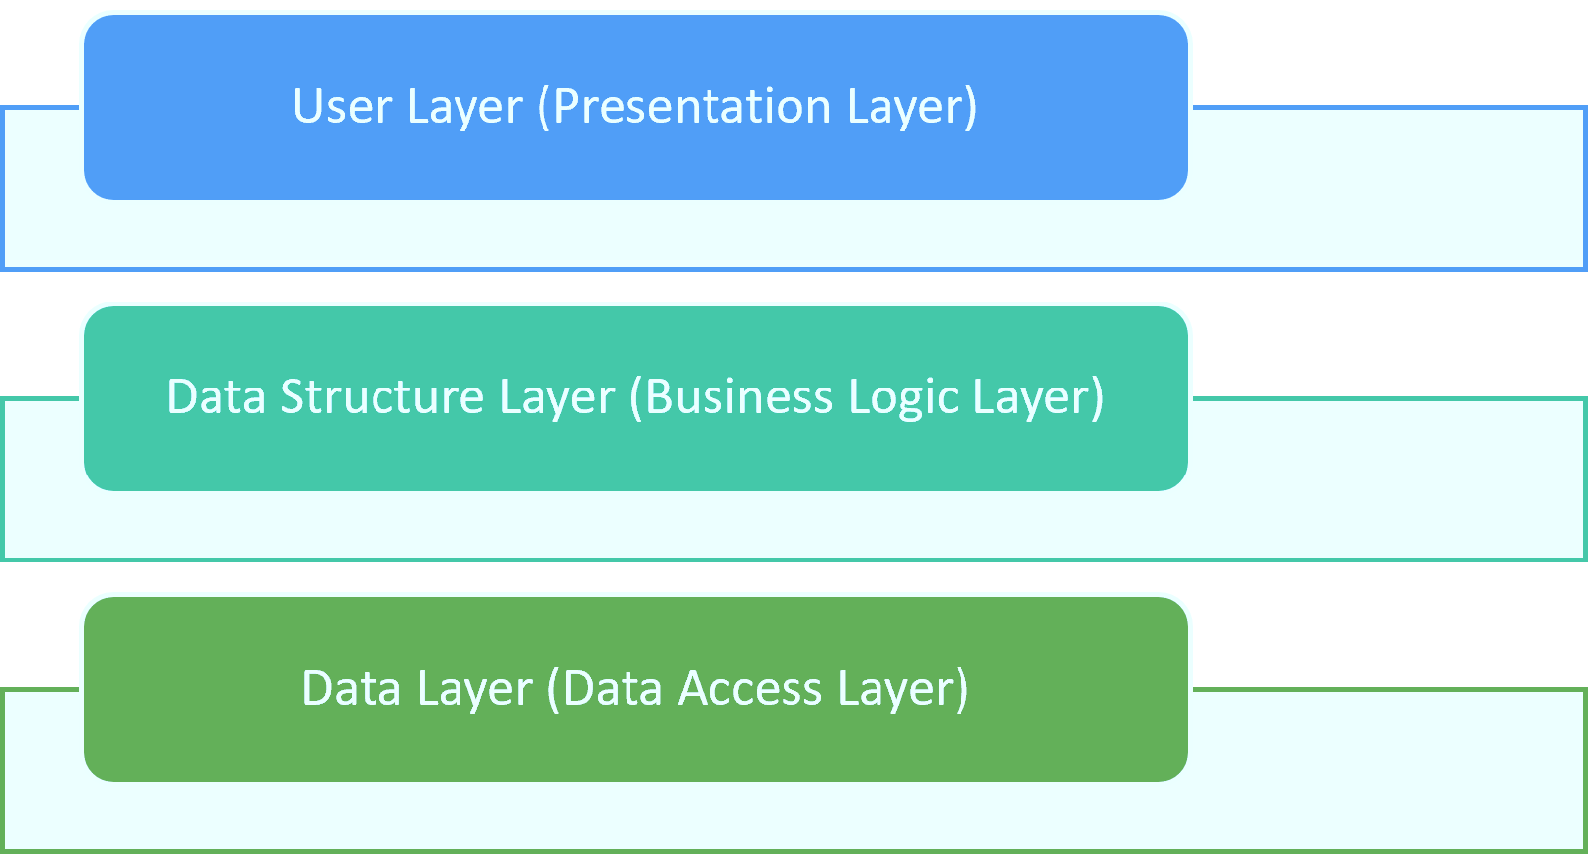
Non-Functional Features
Efficiency
Reliability
Usability
Scalability
Maintainability
Security
Persistence
Performance
OOP
3-Tier Architecture

Slide 7
02. Technologies Used
Technology | Purpose
Java | Programming language
NetBeans IDE | Development Environment
Object-oriented programming (OOP) | Software Design
File Handling | Permanent data Storage
Exception Handling | Efficient error handling
Custom Data Structure | Efficient data management

Slide 8

03. System Design
Highlight the hidden costs, complexities, and design choices behind adding system capabilities……

Slide 9
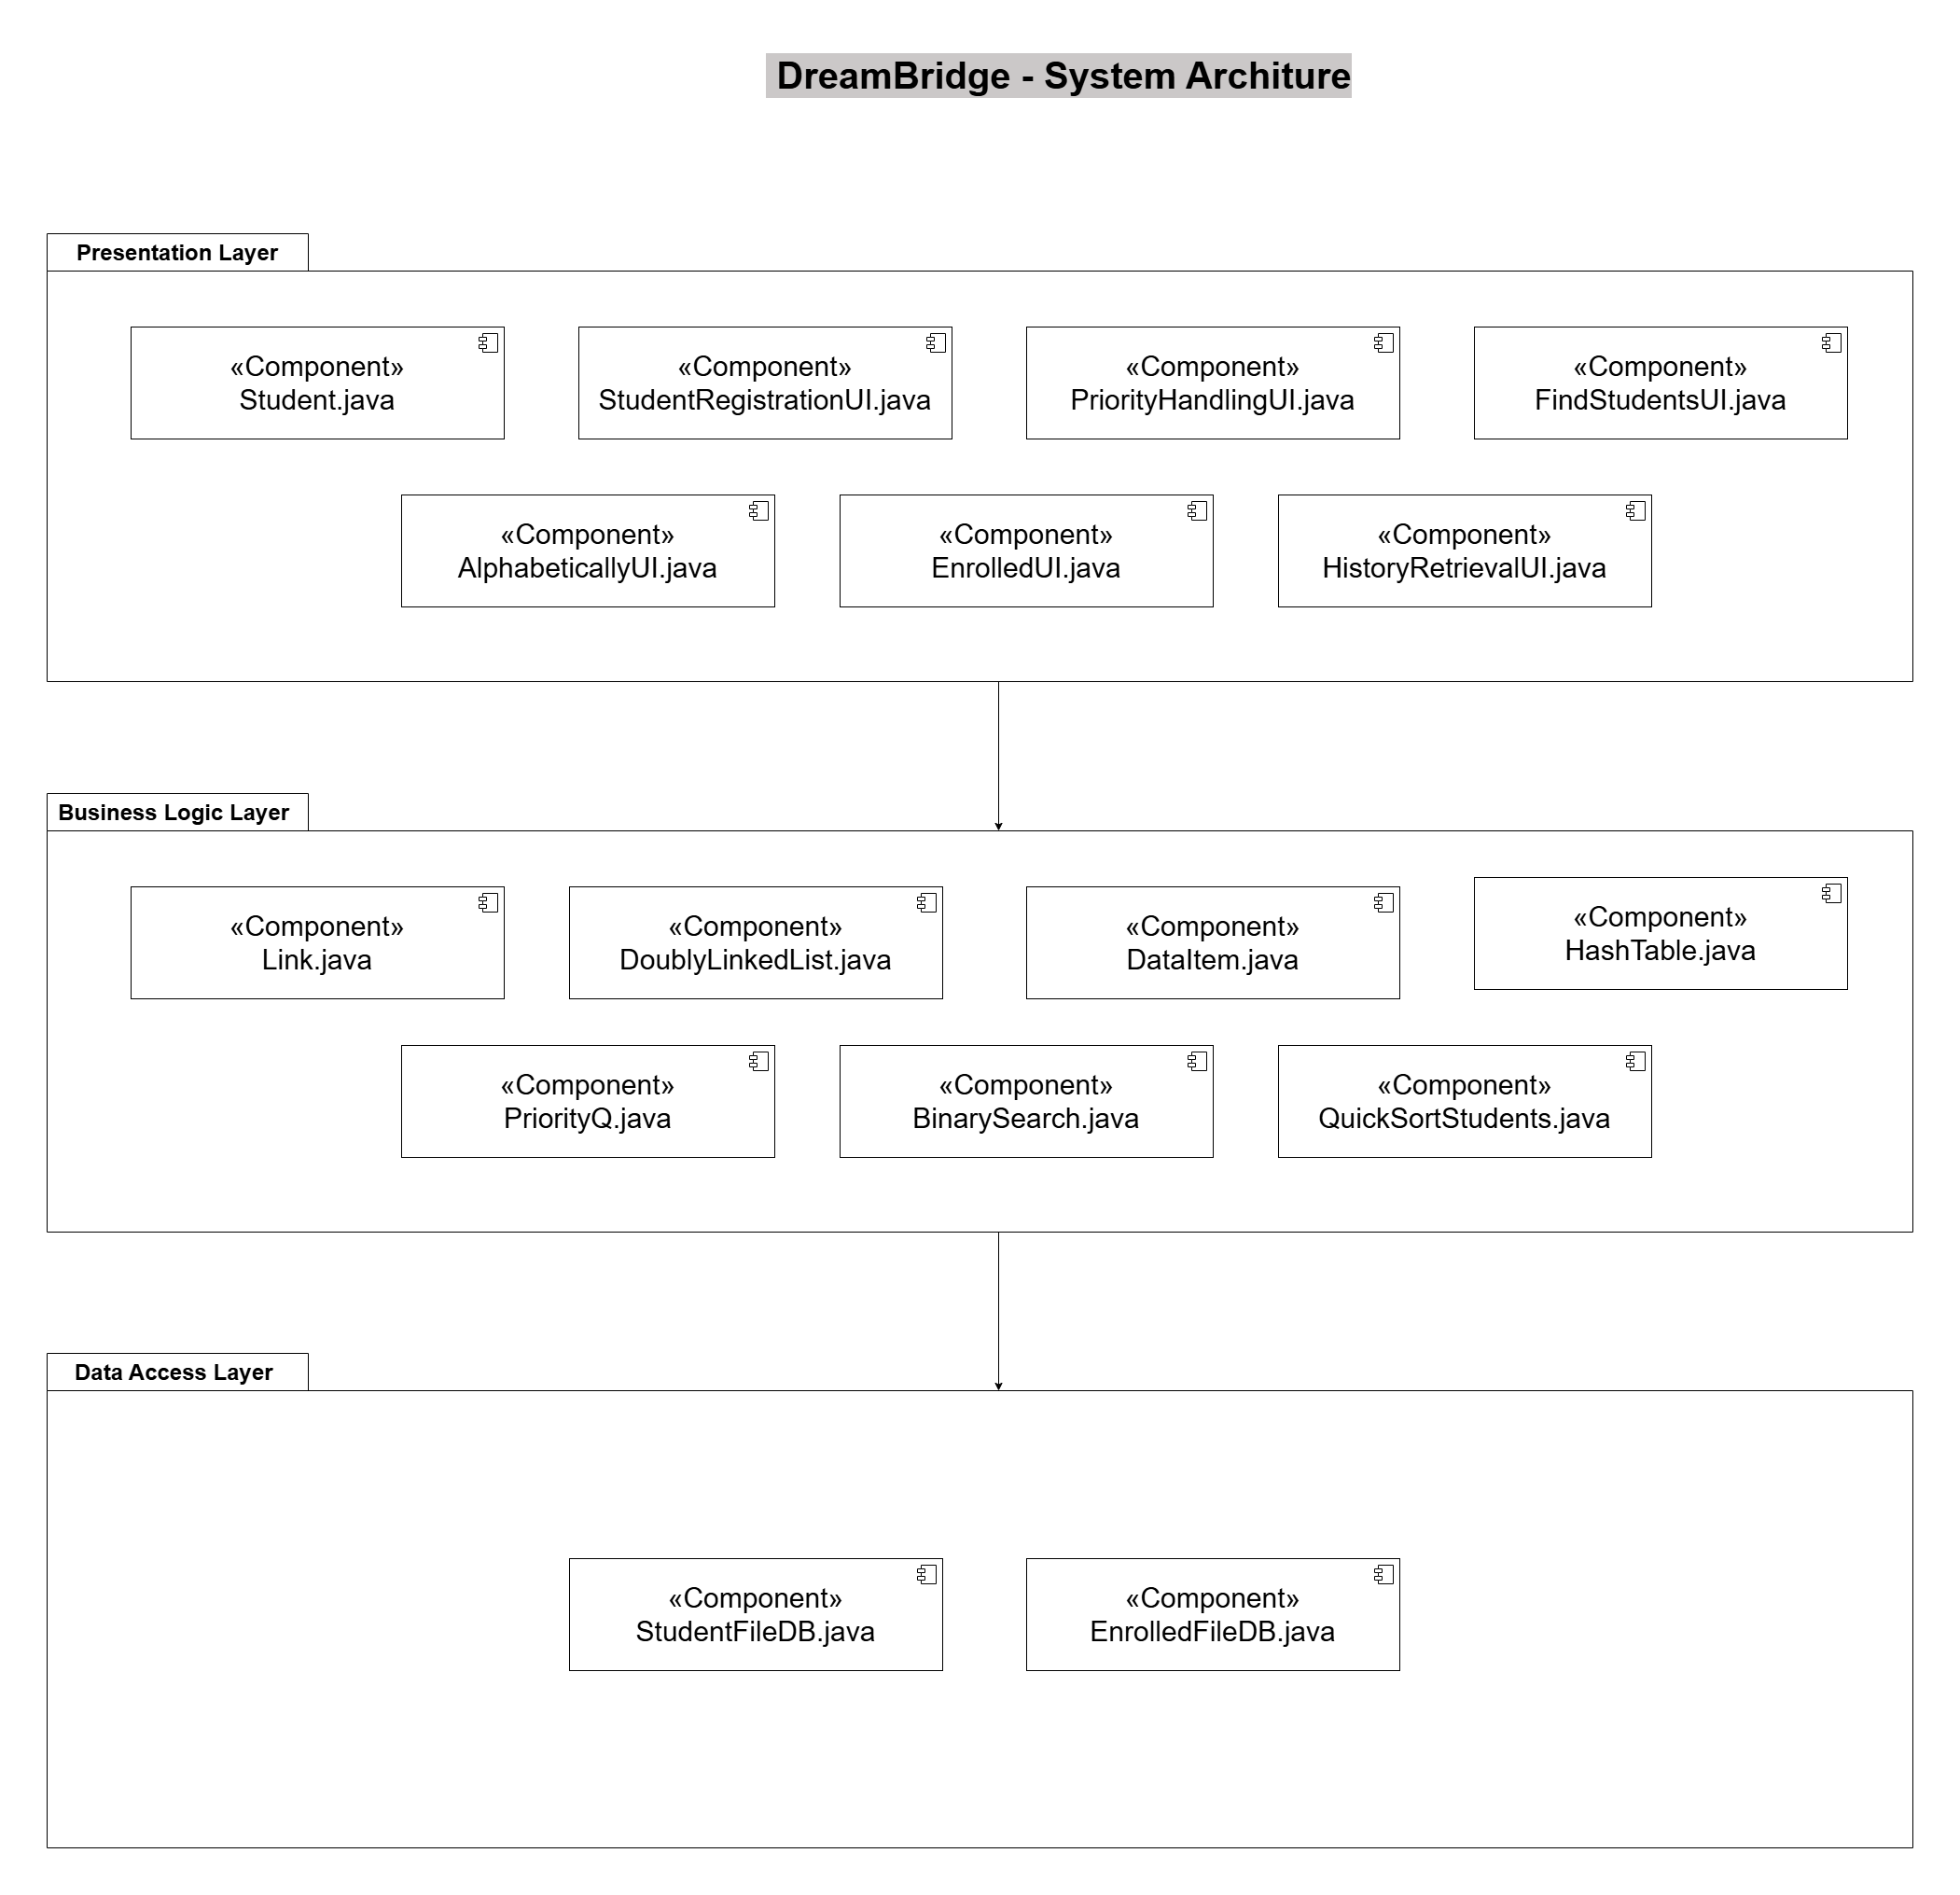
System Architecture
3-Tier Architecture

Slide 10
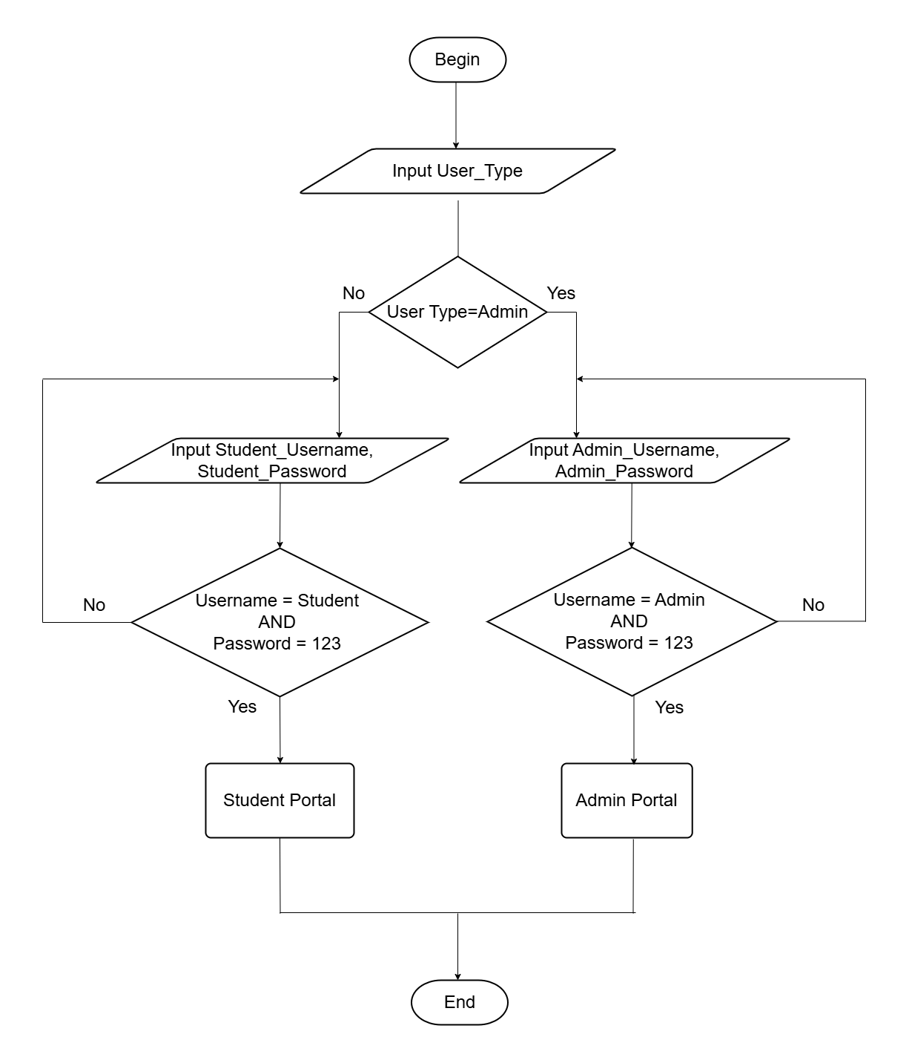
System Workflow
System Login
User Portals

Slide 11
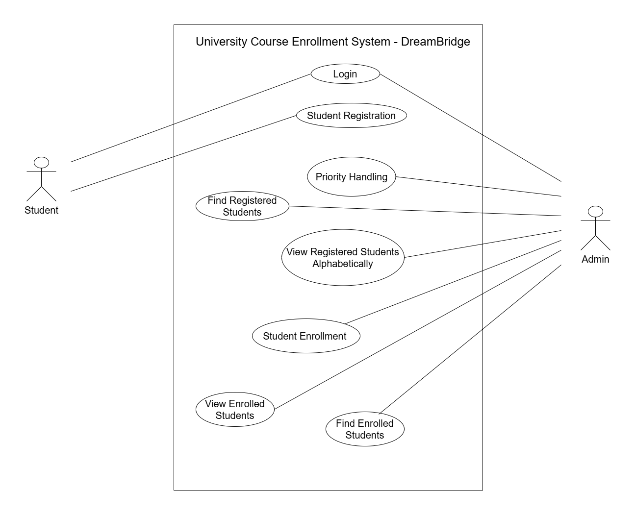
Use Case Diagram
Actors
Student
Admin

Slide 12
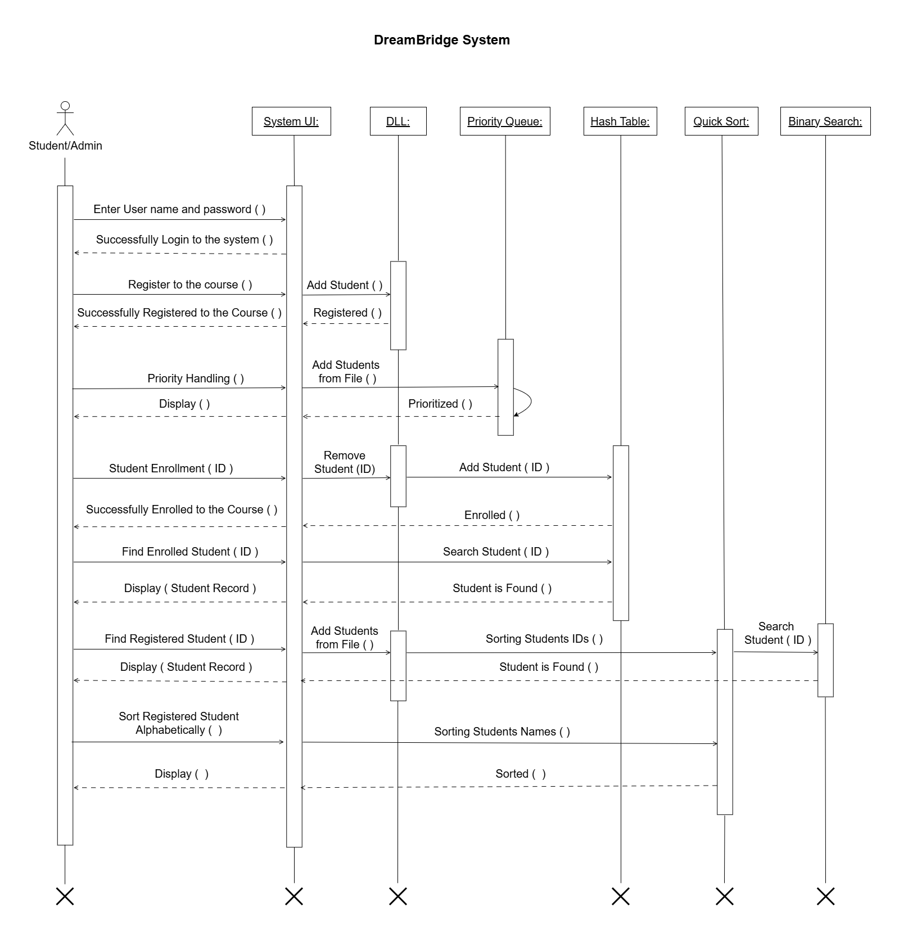
Sequence Diagram
User logs into the system
Doubly Linked List
Priority Queue
Hash Table
Quick Sort
Binary Search

Slide 13

04. Live Demo
DreamBridge
Bridging Your Dreams and Education...

Slide 14

05. Testing Strategy
Testing shows the presence, not the absence, of bugs….

Slide 15

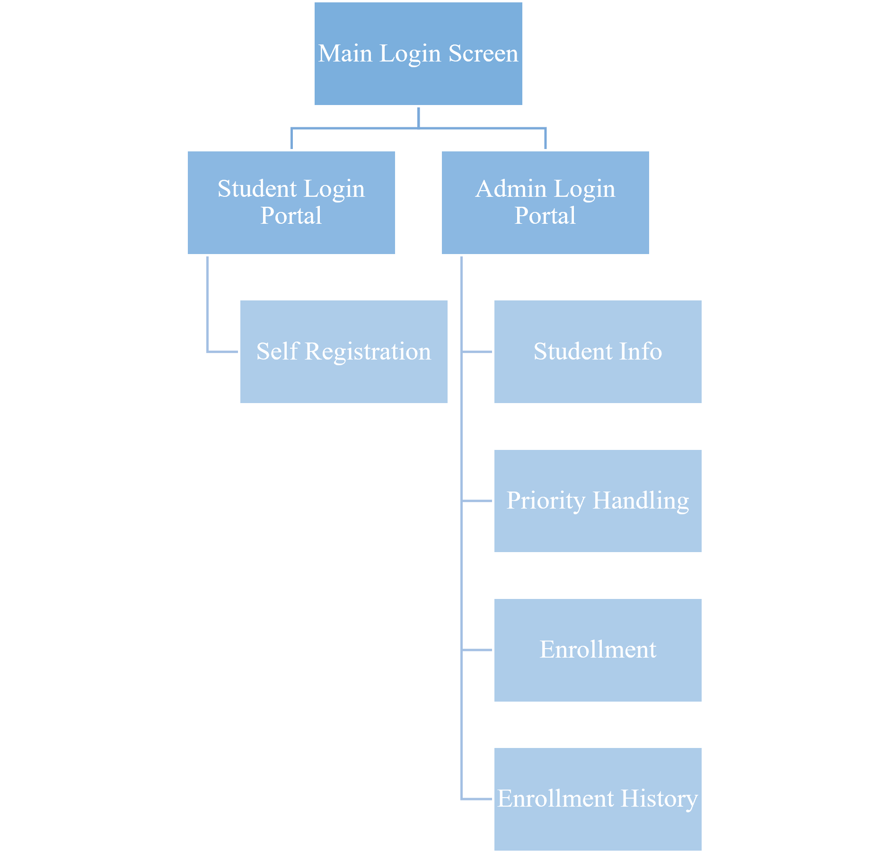
Testing Approach
Top-Down approach

Slide 16
Testing Methods
Normal Cases
Unit Testing
Integration Testing
Regression Testing
System Testing
Performance Testing
Boundary Cases
Edge Cases

Slide 17
Test Conclusion
Total Test Cases | Passed | Failed
15 | 14 | 01

Slide 18
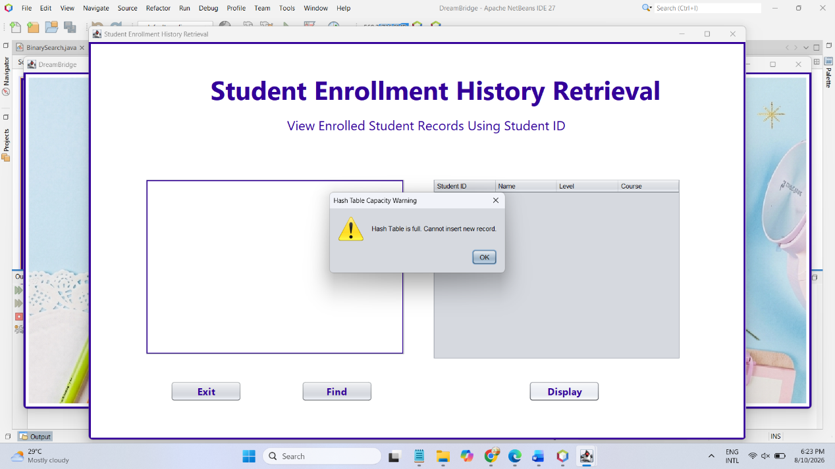
What went wrong

Slide 19
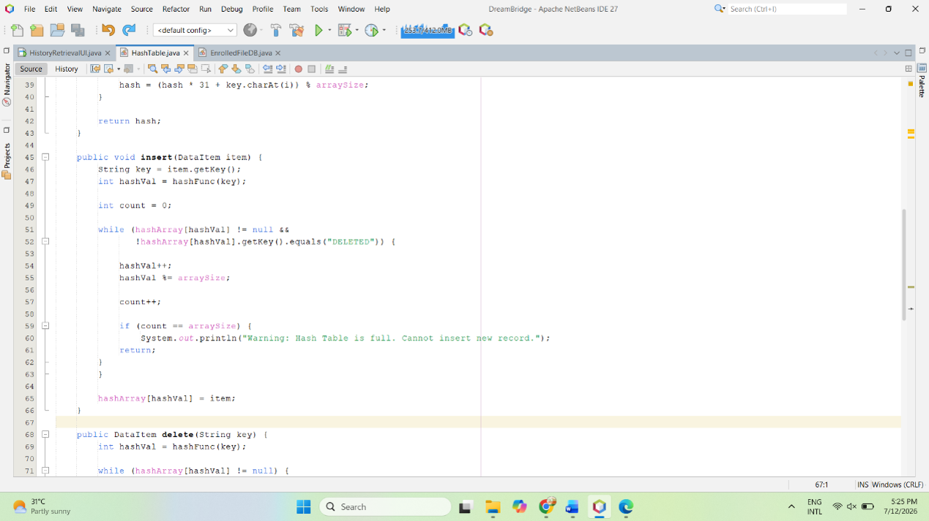
What went wrong

Slide 20
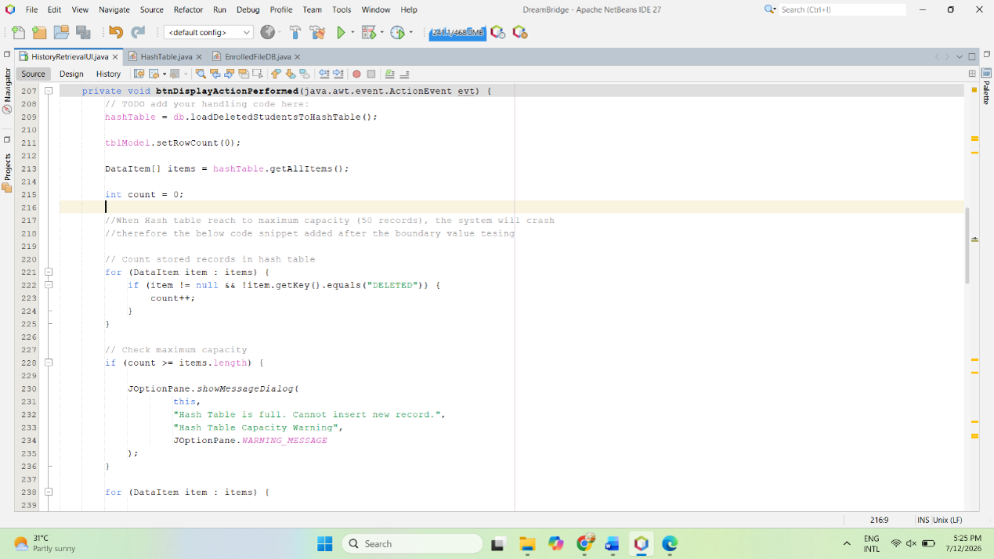
What went wrong

Slide 21

06. Data Structures & Algorithms
Nuts and Bolts used by programmers……

Slide 22
Doubly Linked List (DLL)
Insertion
Store student registration records
Previous and Next nodes
Inserted at the end of the list
Has no direct reference to the last node
Accessed by traversing all elements
DLL takes O(n) time complexity for insertion
Deletion
Deleted from the DLL by searching for the node that is relevant to the given student ID
DLL takes O(n) time complexity for deletion

Slide 23
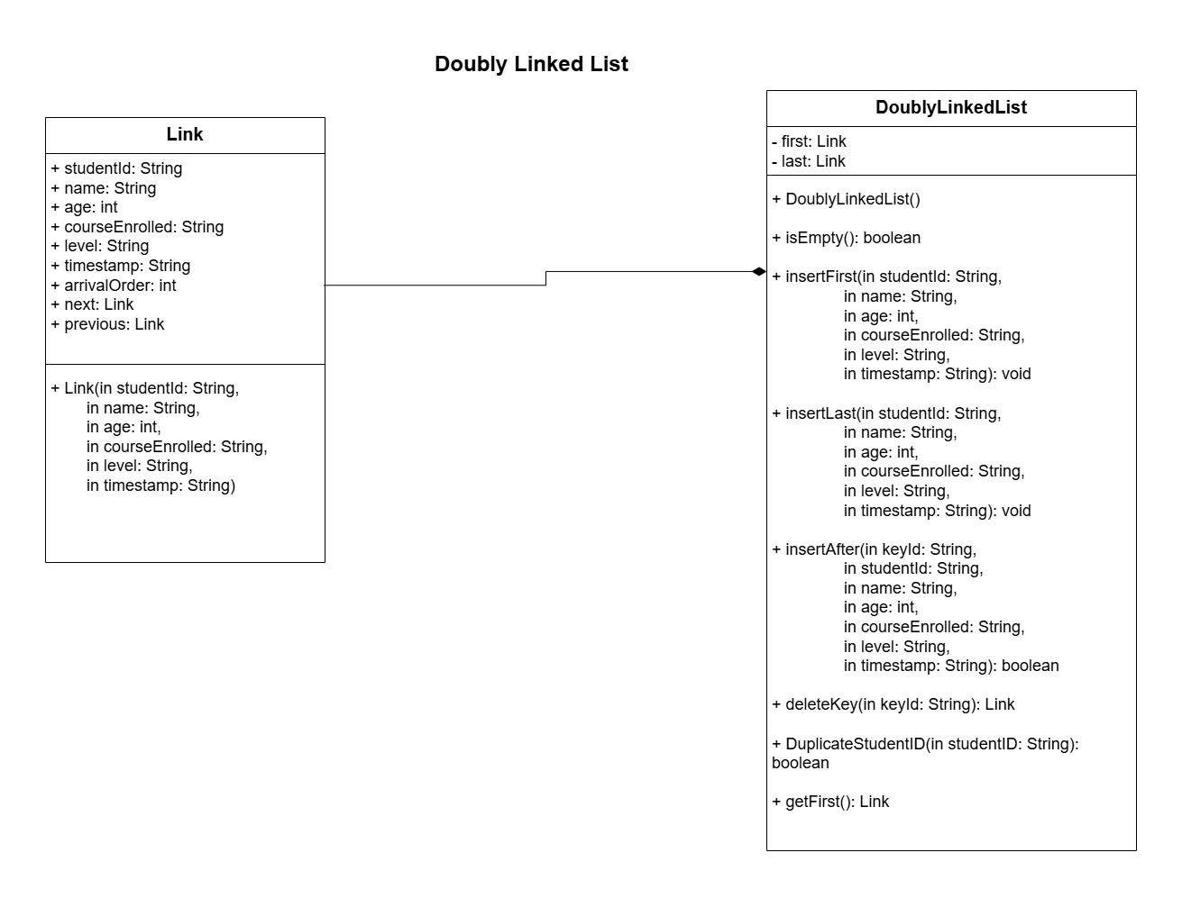

Slide 24
Priority Queue
Insertion
Displayed in the table based on their academic status (Senior, Junior, Fresher)
The priority queue is implemented using a sorted array
The highest-priority student can remain at the beginning of the array
To insert a new element, the elements should be shifted to get the correct position
As a result, the time complexity becomes O(n)
Deletion
Remove the student at the front of the sorted array
The remaining elements should be shifted to the left
The time complexity of the deletion becomes O(n)

Slide 25
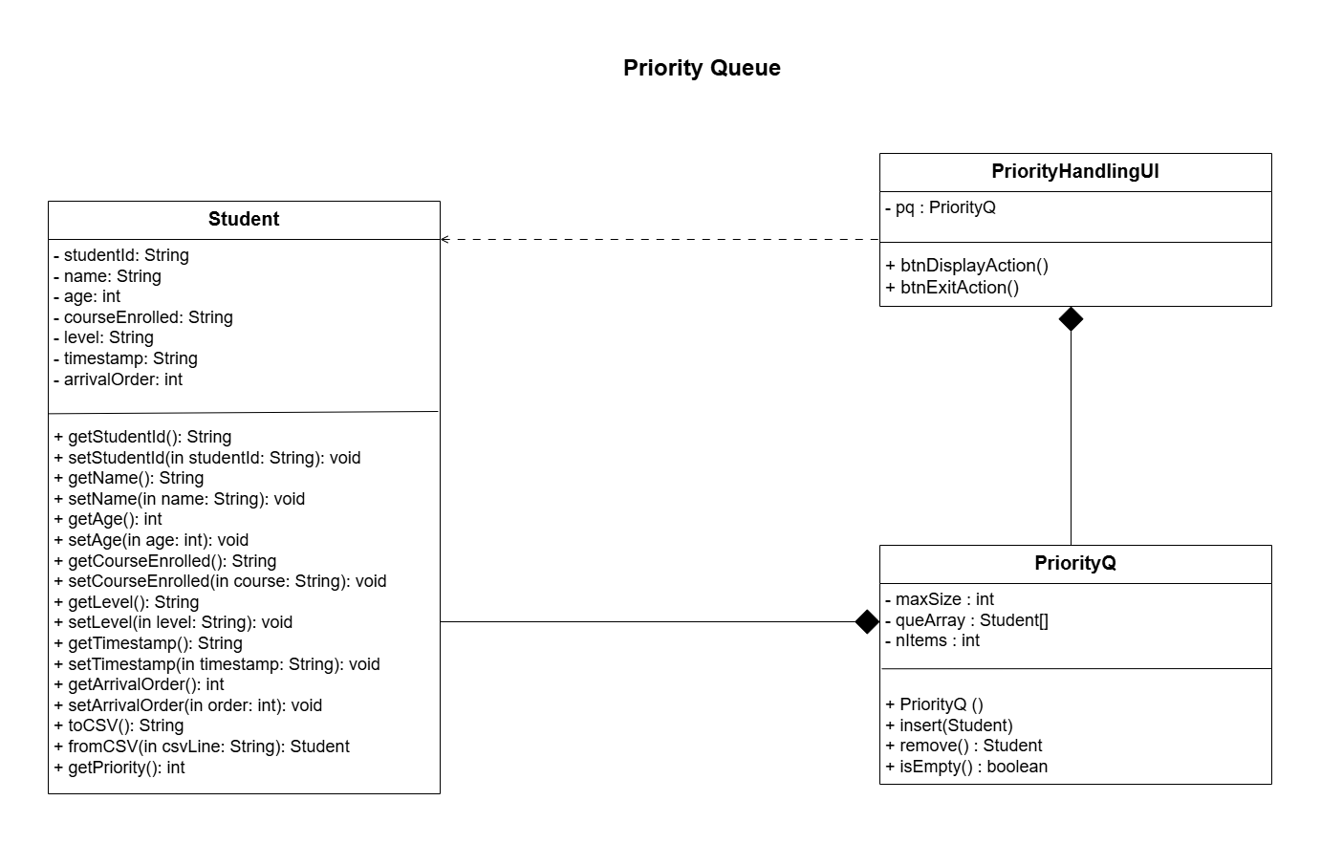

Slide 26
Hash Table
Insertion
Used for Enrollment History Retrieval
Enrolled students are inserted from the text file into the hash table
A collision happens when two elements produce the same position
With collision: insertion takes O(1)
Without collision: insertion takes O(n)
Search
A student can be found without searching all elements in the hash table
Then, the time complexity becomes O(1)
If the student is not found in that position, the system checks the next positions one by one
Then, the time complexity becomes O(n)

Slide 27
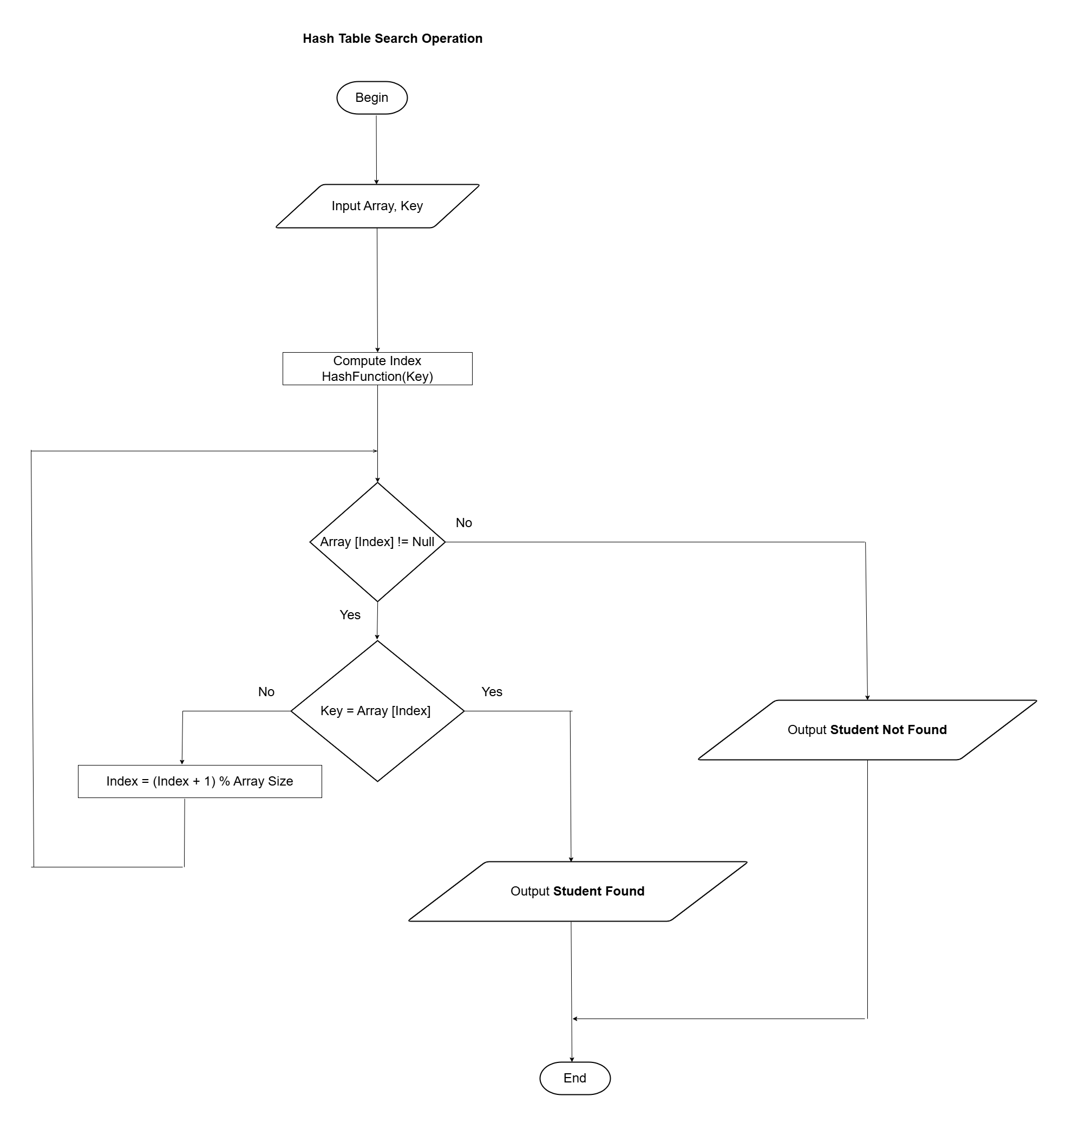
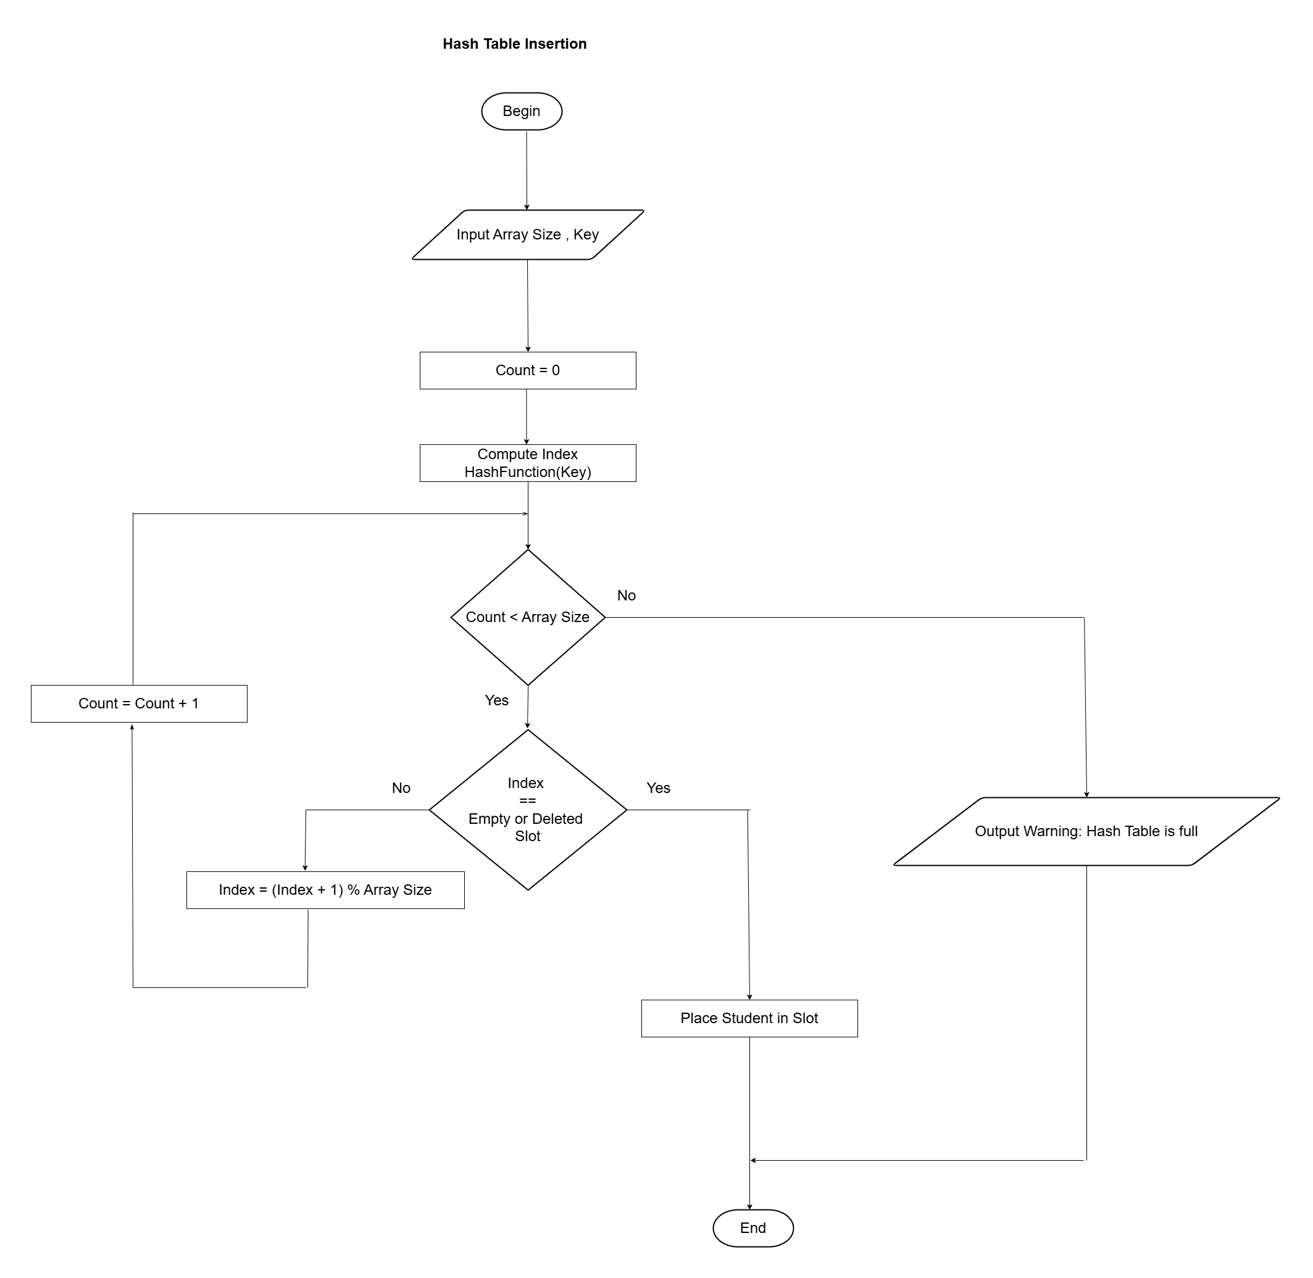

Slide 28
Binary Search
Used to find registered students
Quick sort is used to sort the array
Divides the sorted array into two equal parts and compares the middle element.
When a student is found in the first comparison, time complexity becomes O(1)
Otherwise, time complexity becomes O(log n)

Slide 29
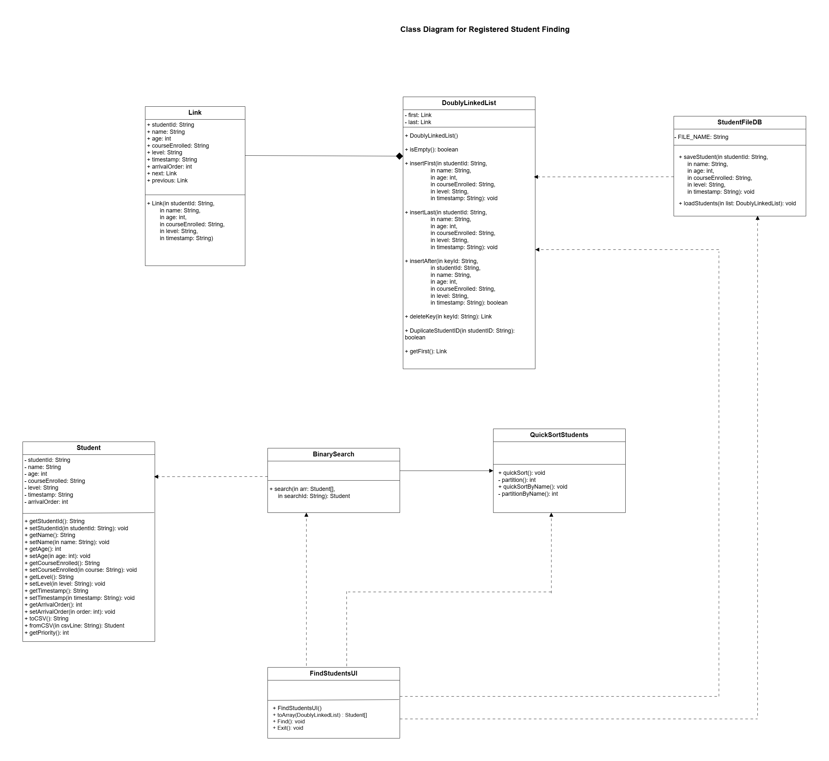

Slide 30
Quicksort
The Find Students and Sorted Alphabetically function are used Quicksort algorithm
Divides the array into smaller partitions using a pivot element and recursively sorts each partition
In the best and average cases, Quick Sort divides the array into balanced partitions. Then, the sorting time complexity becomes O(n log n)
space complexity becomes O(n) in the worst case, due to recursive function calls.

Slide 31
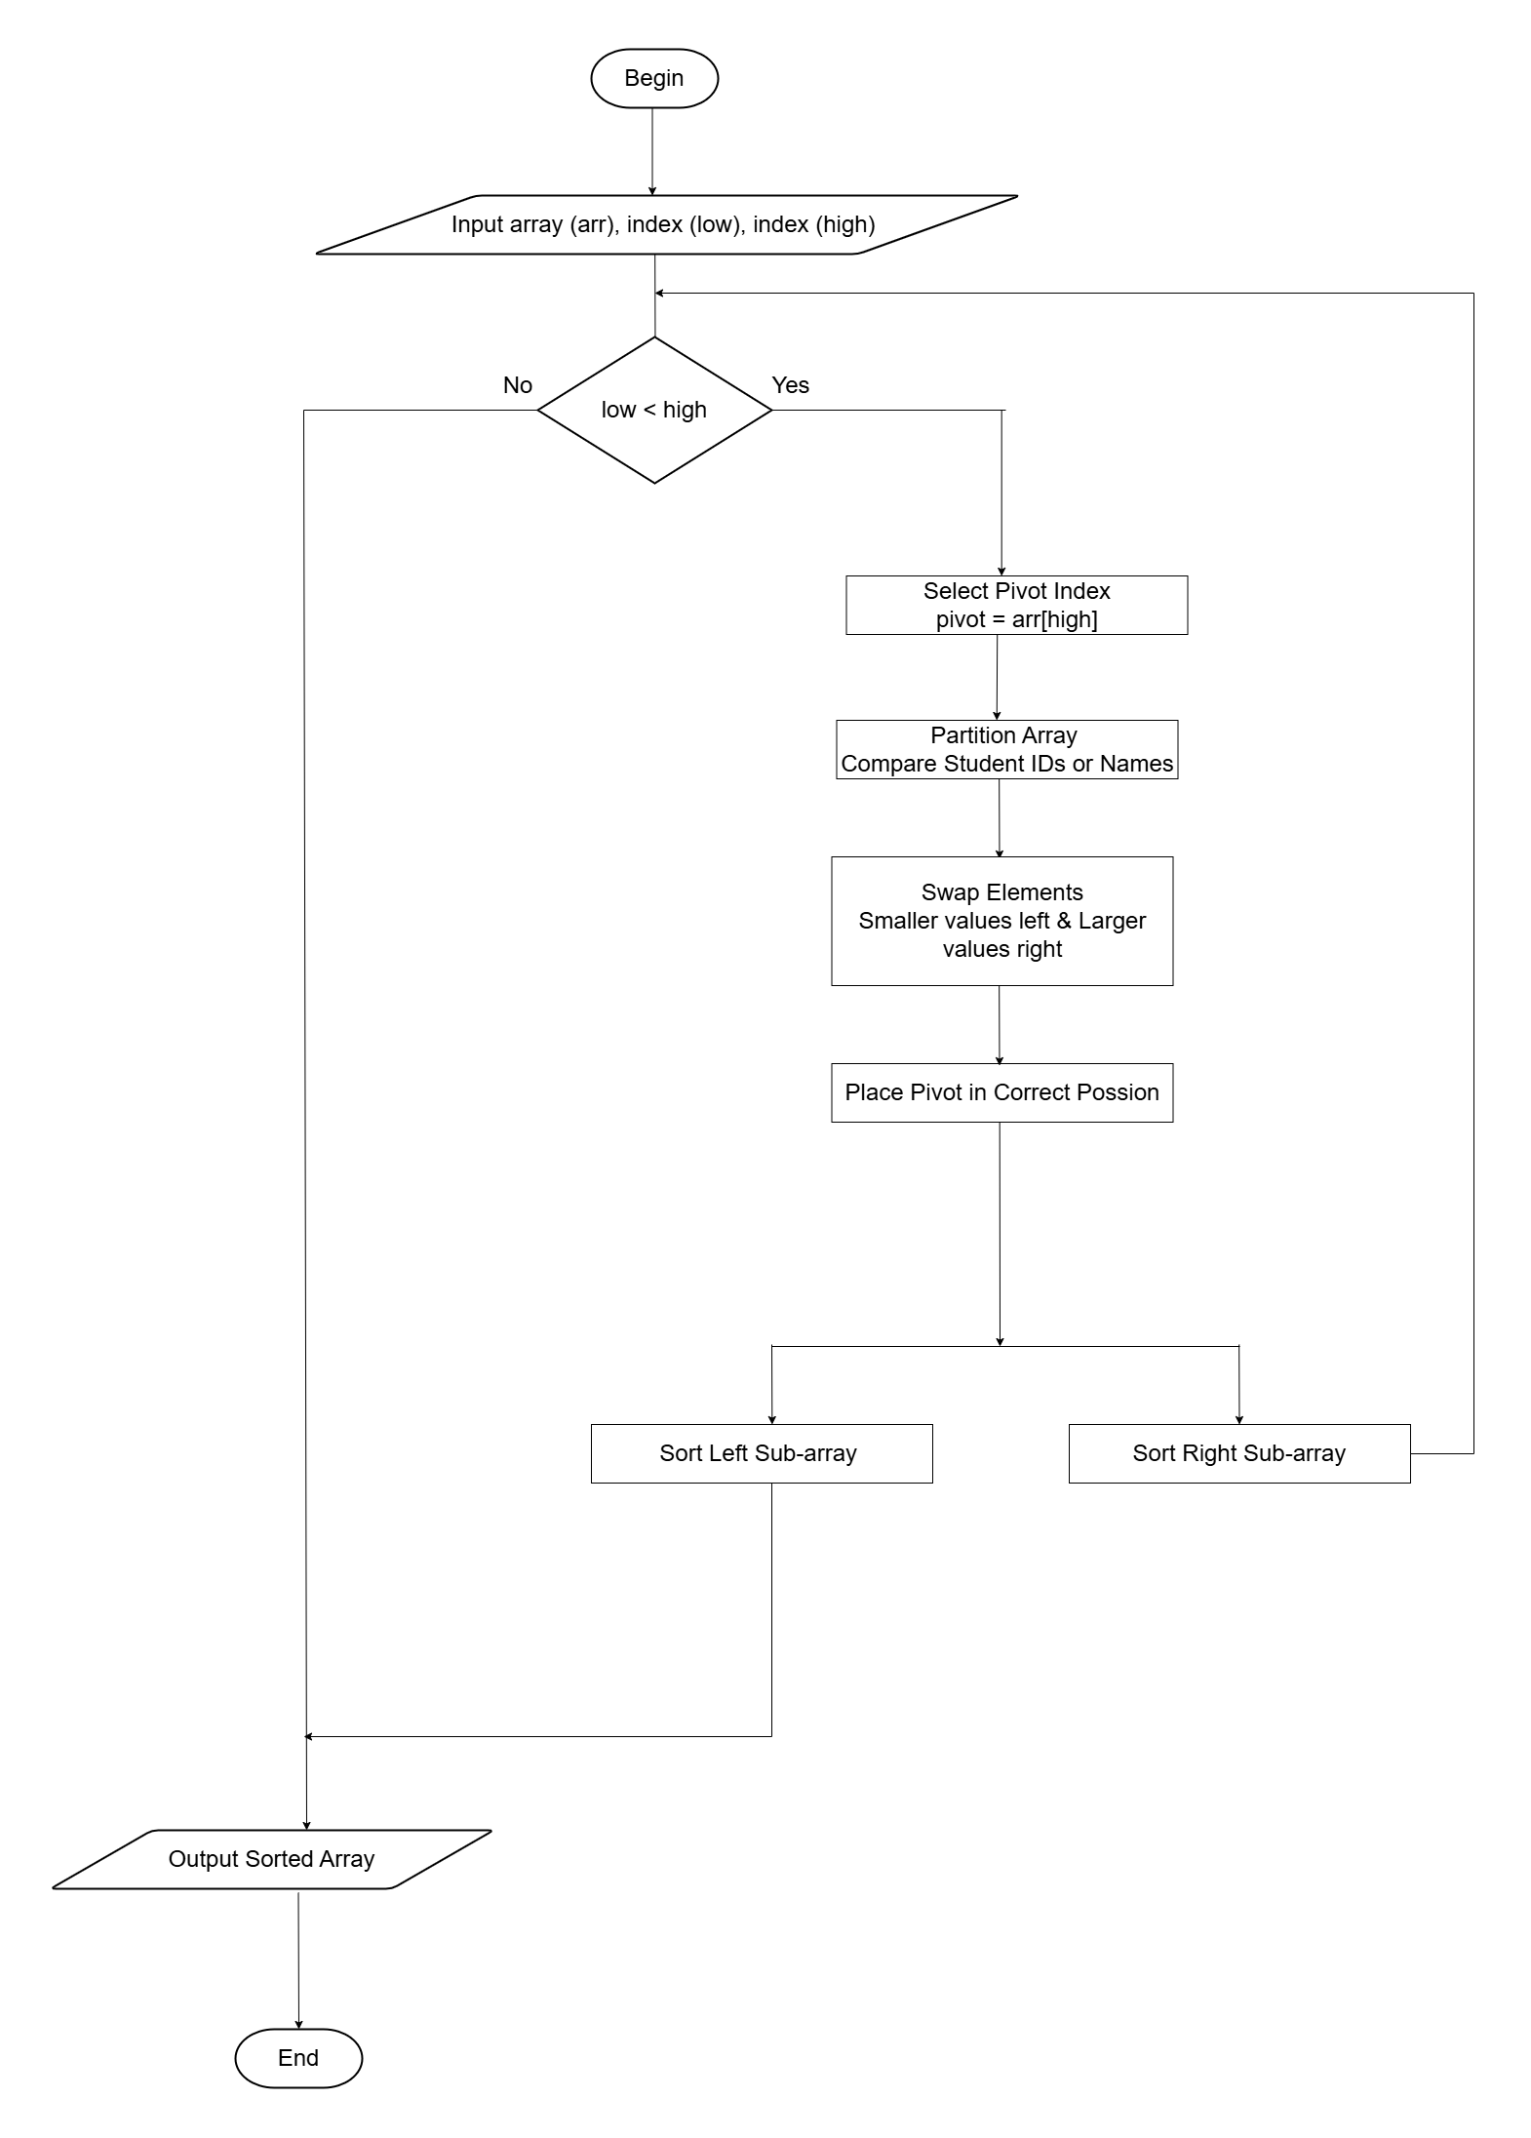

Slide 32
07. Final System Results
"Correctness is clearly the prime quality...“ - Bertrand Meyer

Slide 33
Requirements Traceability Matrix
Requirement No | Functional Requirement | Implementation Techniques | Test Evidence | Status
01 | Student Registration & Queueing | Doubly Linked List | TC02 TC11 TC14 | Implemented
02 | High-Demand Course Handling | Priority Queue | TC04 TC06 TC07 | Implemented
03 | Enrollment History Retrieval | Hash Table | TC03 TC08 TC09 | Implemented
04 | Searching | Binary Search | TC12 TC13 TC15 | Implemented
 | Sorting | Quick Sort | TC05 TC10 | Implemented

Slide 34
Reflection on Limitations
Hash table is implemented with a fixed size of 50 records. If the number of records exceeds 50, Java source code modification is needed.
Student data is stored in a text file instead of a database.

Slide 35
Improvements
Hash table can be enhanced by implementing dynamic resizing
Replace text files with a relational database such as MySQL
System can be improved by adding more pairs of User Names and Passwords by using a Hash Table.
Generate separate files for each student and course.
Enrollment confirmation SMS or email to a patient using APIs.
Develop a web application using Spring Boot for the back-end framework and React.js for the front-end framework.

Slide 36
Thank You !
Bridging Your Dreams and Education...

