Slide 1

ML6 – Senior AI Engineer Use Case Solutions
Presented by Kaveh Kasaee Roodsari

Slide 2

Agenda
Use Case 1: Sensor Data
Use Case 2: Sports Analytics
Roadmap
Conclusion

Slide 3
Use Case 1 Overview: Sensor Data
Problem
Solution overview
Approach
Results & Insights
Business value
Deployment

Slide 4

Problem: Limited Labels, Large Data Volume
1600 machine breakdown events recorded via sensors
Only 40 cases labeled by experts (~2.5%)
Manual labeling is time-consuming and not scalable
Key question: How can we leverage the small labeled dataset to extract meaningful insights from the remaining 1560 cases?

Slide 5

Solution Overview
Use a hybrid semi-supervised learning approach to combine labeled and unlabeled data
Identify the most informative sensors to reduce noise
Learn patterns from labeled data using a machine learning model
Assign labels to a large portion of the unlabeled data (~54%)
Validate the reliability of these predictions
Use clustering to analyze the remaining data and uncover hidden patterns

Slide 6
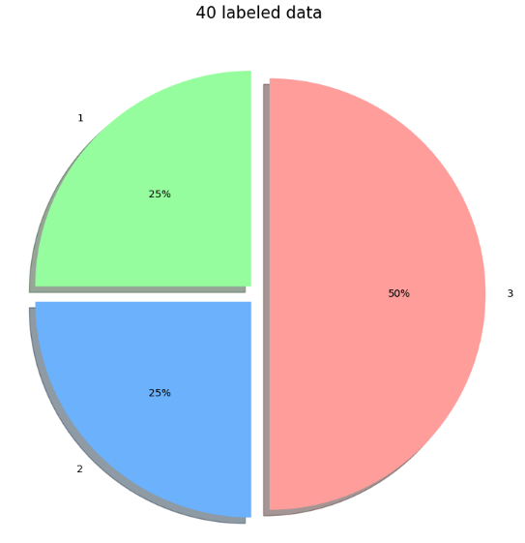
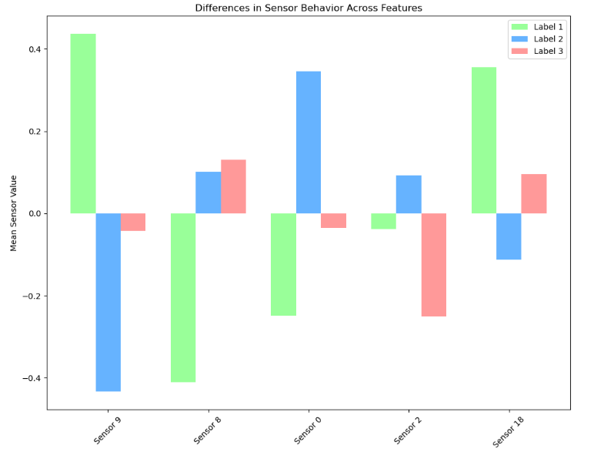
Approach
Data understanding & feature selection
Analyzed labeled data to identify differences in sensor behavior
Selected the most informative sensors using statistical testing (ANOVA)
Reduced to top 5 sensors to focus on key patterns
Verified consistency across full dataset (KS test)
Modeling & pseudo-labeling
Trained a Random Forest model on labeled data
Used robust validation (LOOCV) due to small dataset
Assigned labels to unlabeled data using confidence-based predictions
Clustering the remaining part
Applied KMeans clustering on remaining unlabeled data
Grouped similar breakdowns based on sensor patterns
Compared clusters with known labels to interpret their meaning

Slide 7
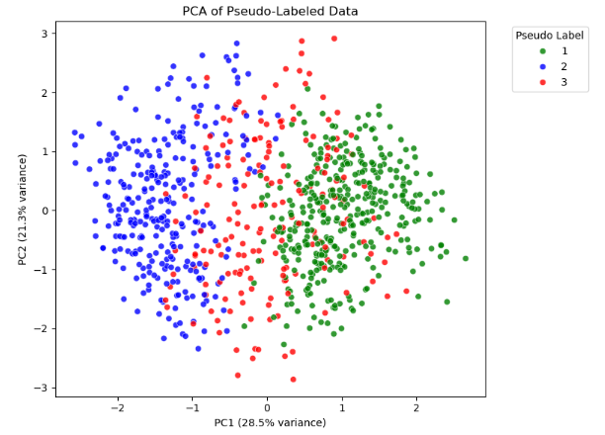
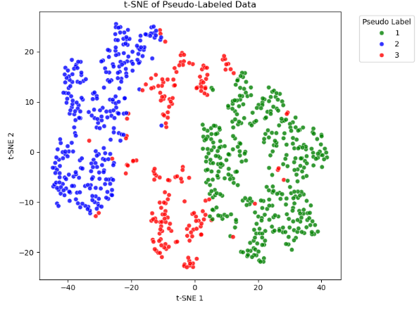
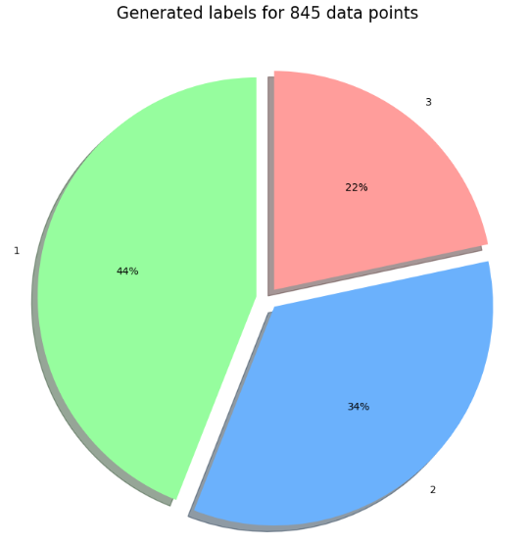
Results & Insights
~54% of unlabeled data automatically labeled
Validation Step
High consistency with similarity validation (~86%)
Randomized test confirms non-random structure (~36%)

Slide 8
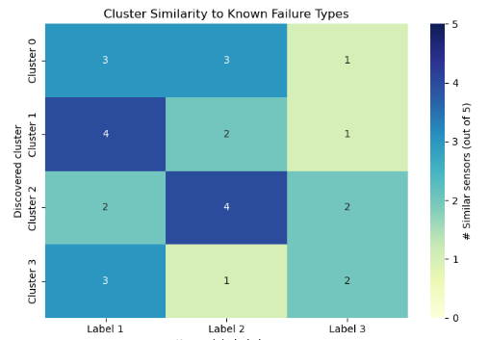
Results & Insights
Remaining data (~43%) forms 4 meaningful clusters
Clusters correspond to variations of known failure types
Failure Type 1 → multiple subtypes
Failure Type 2 → also has subtypes
Some cases are in between two failure types.
Failure Type 3 is less represented in uncertain data

Slide 9
Business value
1. Reduced manual effort
Automatically label ~54% of breakdowns
Significantly reduces expert workload
2. Faster root cause analysis
Immediate insights into likely failure types
Enables quicker troubleshooting and response
3. Better understanding of machine behavior
Identifies subtypes within failure types
Reveals overlapping and ambiguous cases
4. Continuous improvement
Uncertain cases can be reviewed by experts
New labels improve the model over time
5. Scalable solution
Can be applied across multiple machines or sites
Enables standardized and data-driven diagnostics

Slide 10

Deployment
Sensor data is ingested and stored in BigQuery / Cloud Storage
The trained model is deployed as a scalable API using Cloud Run
New data is processed in real-time or batch mode to generate predictions
Results are stored and visualized in a dashboard (Looker Studio)
A feedback loop enables continuous learning through expert validation

Slide 11
Use Case 2 Overview: Sports Analytics
Problem
Solution overview
Approach
Results & Insights
Business value
Deployment

Slide 12
Problem
video data of soccer games
Count how many players from each team are visible on screen at any moment
Challenges
Dynamic video (players moving, occlusions)
Different team colors in each match
Presence of referees and non-players
No predefined labels for teams
Goal
Develop an automated system that:
Detects players in video frames
Assigns them to the correct team
Provides real-time or batch player counts per team

Slide 13

Solution Overview
Offline video analysis to learn team appearance profiles from the match
Person detection to localize players in each frame
Feature extraction using jersey color and screen position
Clustering to identify the two dominant team groups
Frame-by-frame assignment of visible persons to Team A / Team B / Other
Live count overlay showing the number of visible players per team

Slide 14
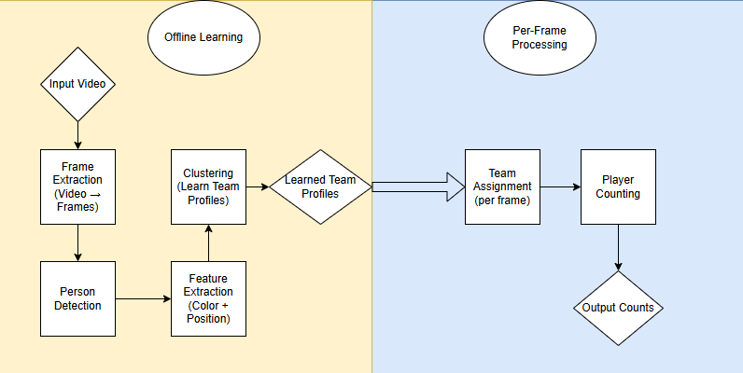
Approach
Detect persons in each frame
Extract player features (color + position)
Cluster players to identify teams
Assign players per frame
Count players per team

Slide 15

Results & Insights
Expected Output
Real-time or batch counts of visible players per team
Example:
Team A: 6 players
Team B: 5 players
Insights
Enables quick understanding of player distribution on screen
Can support further analytics (e.g. formations, coverage)
Works without predefined team labels
Limitations
Sensitive to lighting and color variations
Difficult cases:
overlapping players
similar jersey colors
Goalkeeper and referee detection requires additional logic

Slide 16
Business value
Faster Video Analysis
Automatically counts players on screen
No need to manually review video
Save Time & Effort
Reduces manual work for analysts
Can process many matches quickly
Better Insights
Shows how players are distributed on the field
Helps understand team behavior during the game
Future Potential
Can be extended to:
track players
analyze formations
detect important events

Slide 17

Deployment
Store match videos in Cloud Storage
Run the pipeline in batch mode for the MVP
Use Vertex AI for model training
Use Cloud Run for a simple processing service or API
Save player counts and summaries to a file or dashboard (Looker)
Start with offline processing, then move to near real-time if needed

Slide 18
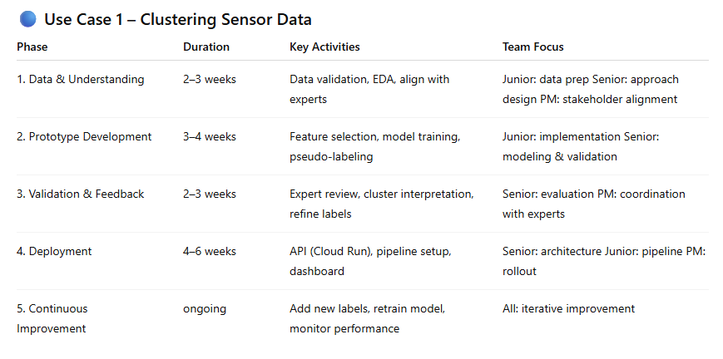
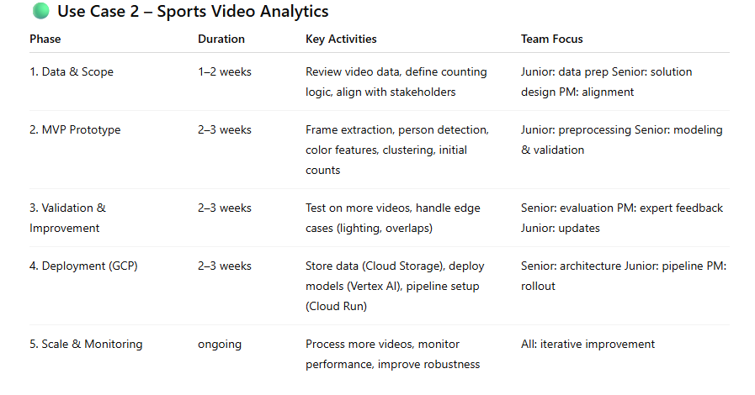
Roadmap

Slide 19
Conclusion
Two different ML problems:
Sensor data (Use Case 1)
Video analytics (Use Case 2)
Focus on simple, practical MVP solutions
Clear path from prototype → deployment → scaling
Accelerating Project Kickoff
Start with a simple baseline (e.g. RF + clustering)
Focus on high-impact problems first
Use iterative development with fast feedback
Integrate expert feedback early (human-in-the-loop)
Reuse components for scalability

