Slide 1
UK Road Safty : Developing A Binary Classifier to Predict Accident Severity in UK
Kaveh Vasei
Springboard Cap2
Summer 2023

Slide 2

Traffic Analysis and Severity Prediction
Capstone2
Kaveh Vasei

Slide 3
Background
The UK government collects and publishes (usually on an annual basis) detailed information about traffic accidents across the country. This information includes, but is not limited to, geographical locations, weather conditions, type of vehicles, number of casualties and vehicle maneuvers, making this a very interesting and comprehensive dataset for analysis and research.
The full dataset for this project is available at : https://www.data.gov.uk/dataset/cb7ae6f0-4be6-4935-9277-47e5ce24a11f/road-safety-data

Slide 4
Importance of Analyzing Traffic Accidents
Accurately analyzing accidents can help governments to better the safety of their roads and highways.
Identifying high areas of accidents and high areas of accident severity can highlight areas of concern.
It can also be beneficial to insurance companies looking to change their rates in different areas.

Slide 5
Objective
Develop machine learning model that can accurately classify accidents in UK as Major and Minor accidents.
Accurately predict whether an accident will be classified as "minor" or "major".
to identify high-risk areas, improve emergency response, and implement targeted interventions. (What features can cause serious accidents)
Enhance road safety by making informed decisions and allocating resources effectively.
Major Accidents: Are the ones that was fatal or resulted on serious Hospitalization
Minor Accidents: Roadside medical help or just a quick emergency room visit
No fender Bender in Dataset (we always have at least one casualty)

Slide 6
Data
Accidents
main data set contains information about accident severity, weather, location, date, hour, day of week, road type…
Vehicles
contains information about vehicle type, vehicle model, engine size, driver sex, driver age, car age, car status after accidents
Casualty
contains information about casualty severity, age, sex social class, casualty type, pedestrian or car passenger…
Data guide file
contains the text description of all variable code in the three files

Slide 7
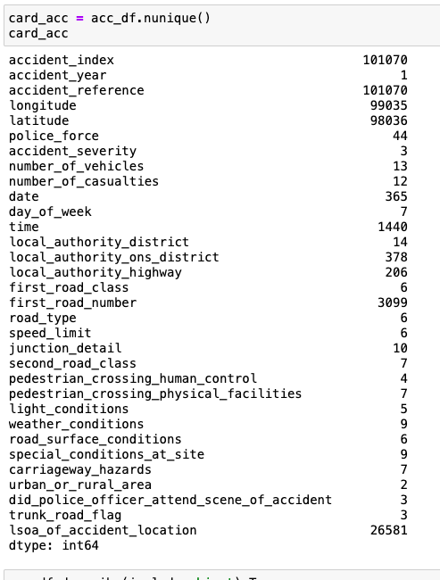
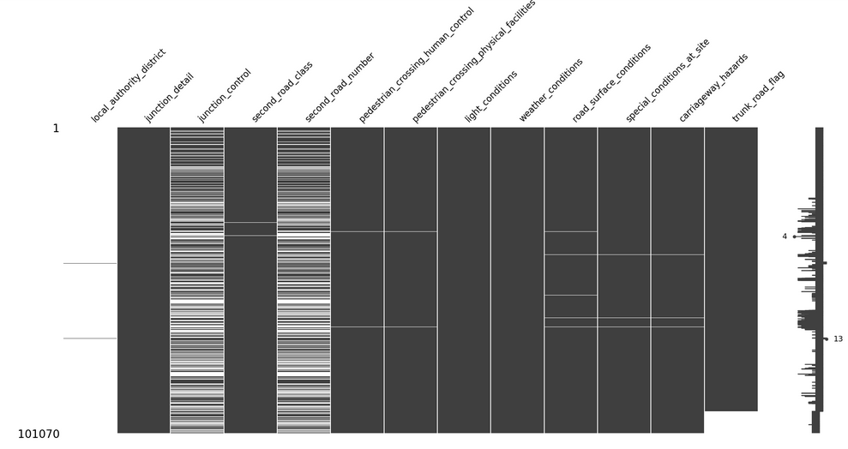
Data Wrangling

Slide 8
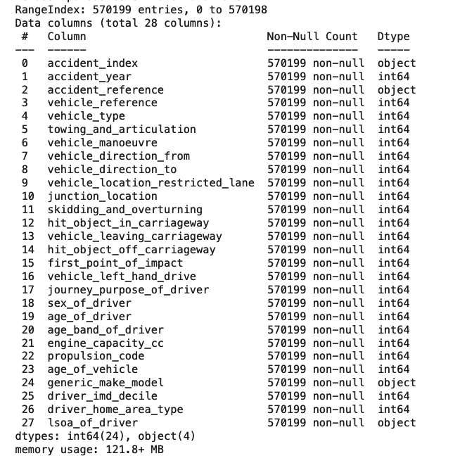
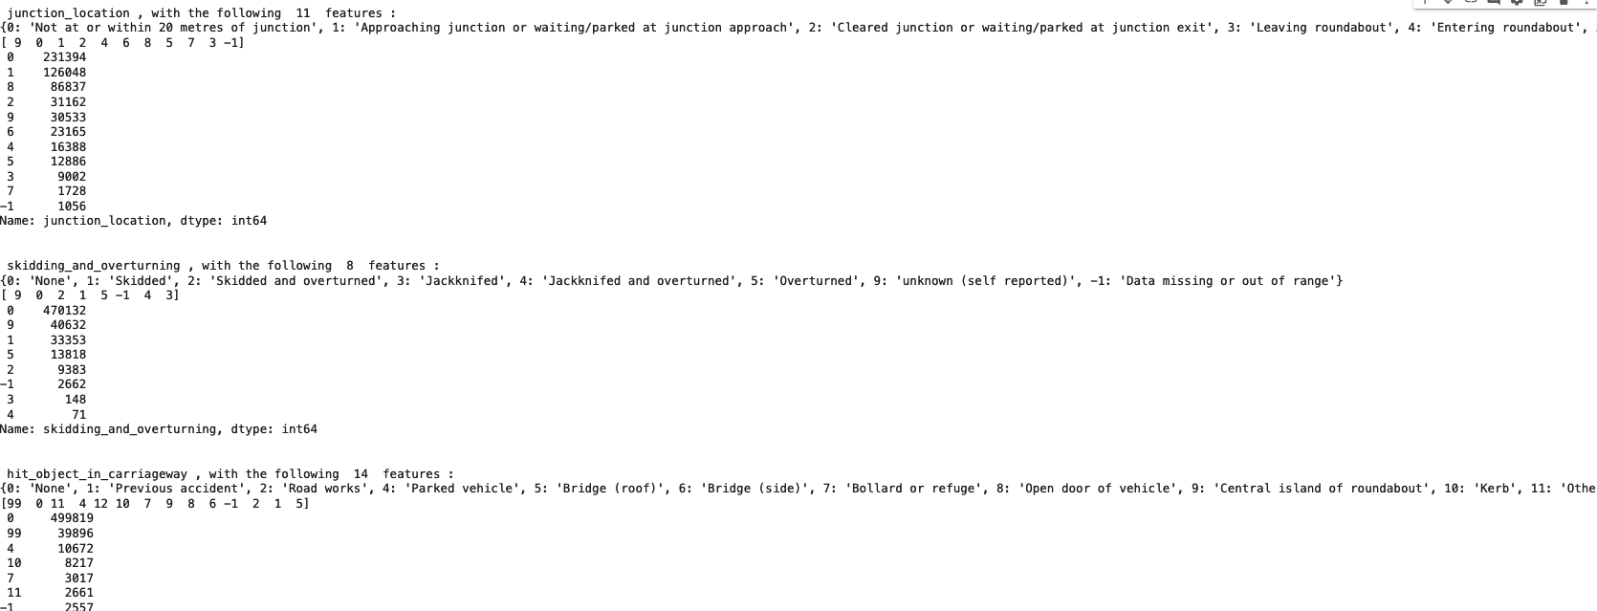
Mostly Nominal Categorical data type

Slide 9
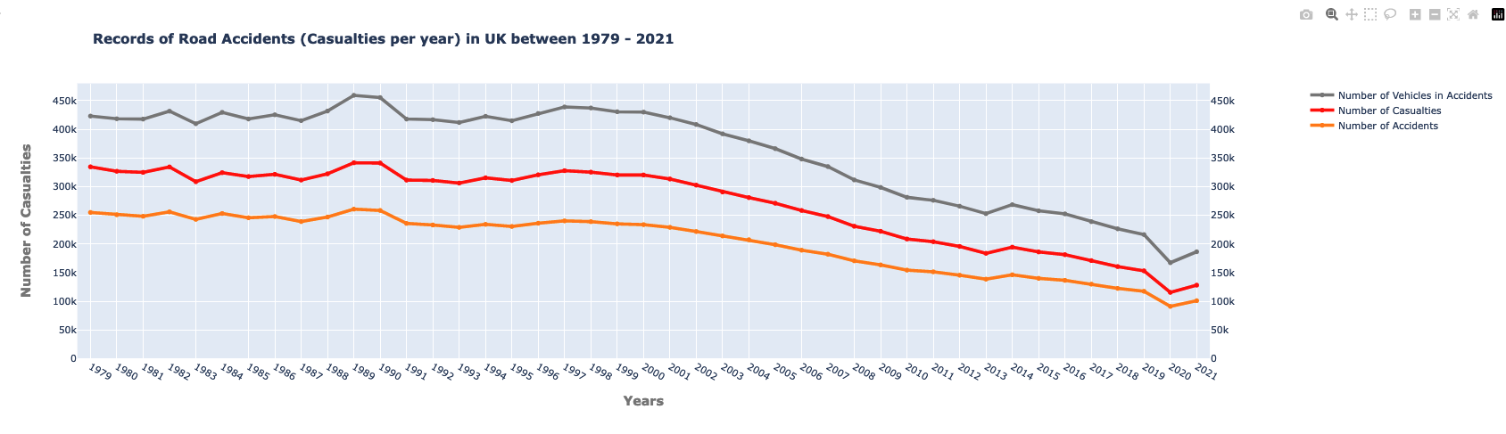
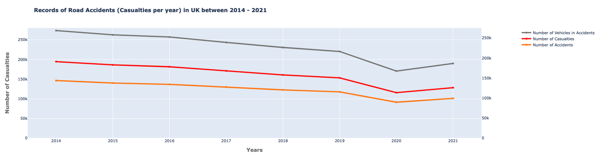

Slide 10
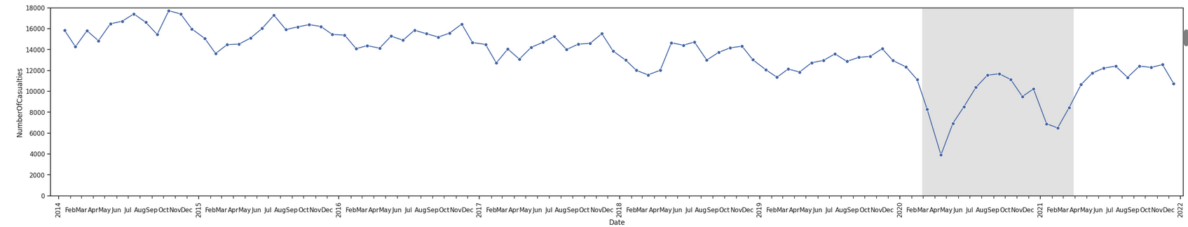
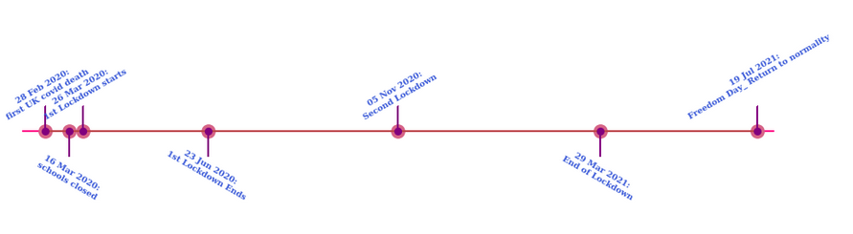
Covid

Slide 11
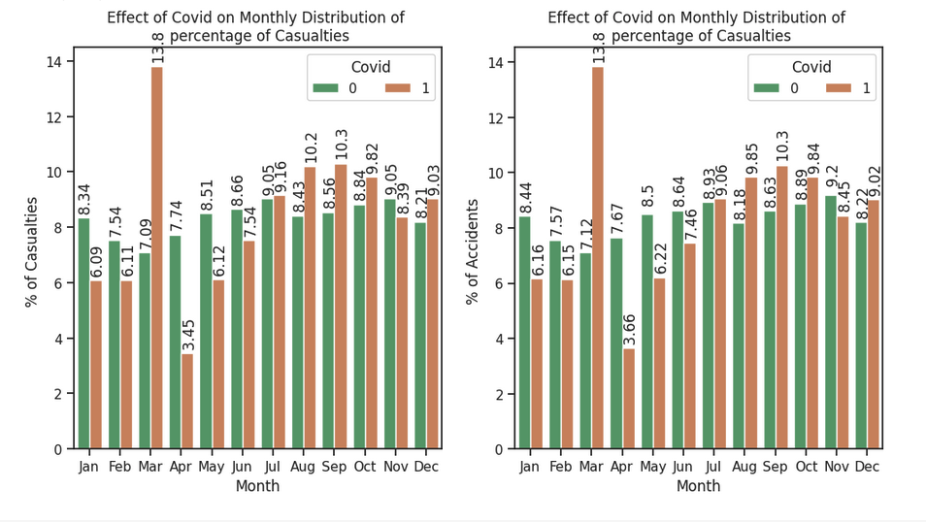
EDR

Slide 12
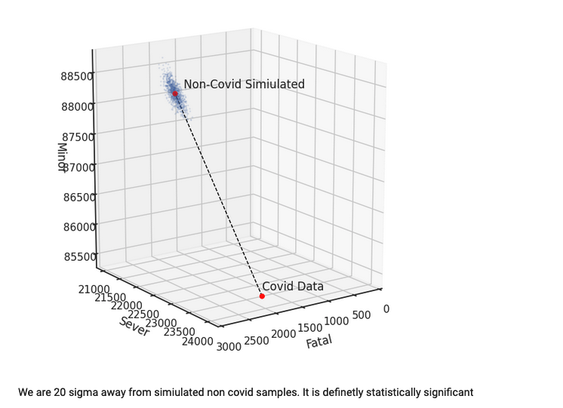
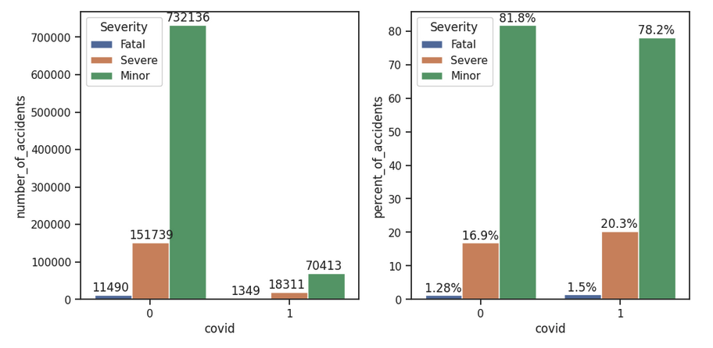
Effect of covid on target value

Slide 13
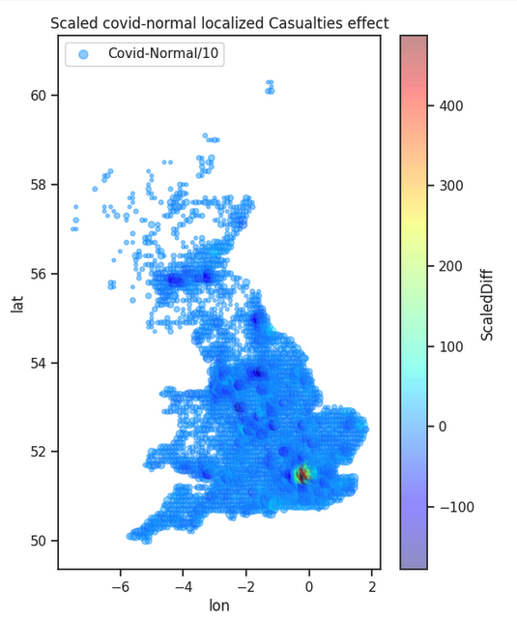
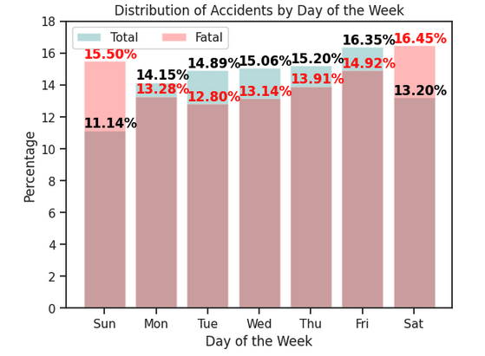
Majority of accidents occurred in 30 speed limit zones. It would have been beneficial to have actual data on the speeds of the vehicles involved or at least if they were speeding.

Slide 14
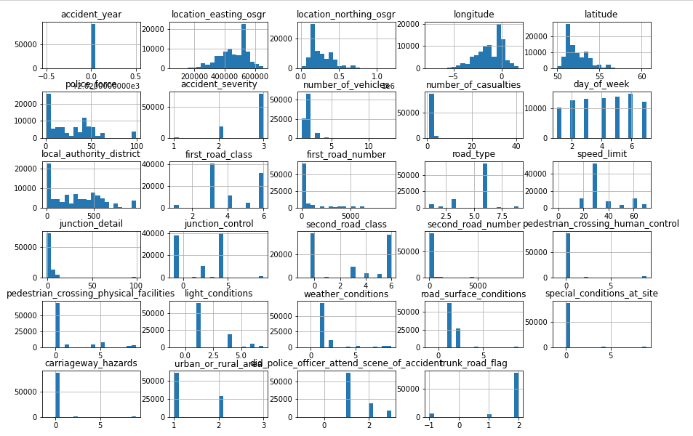
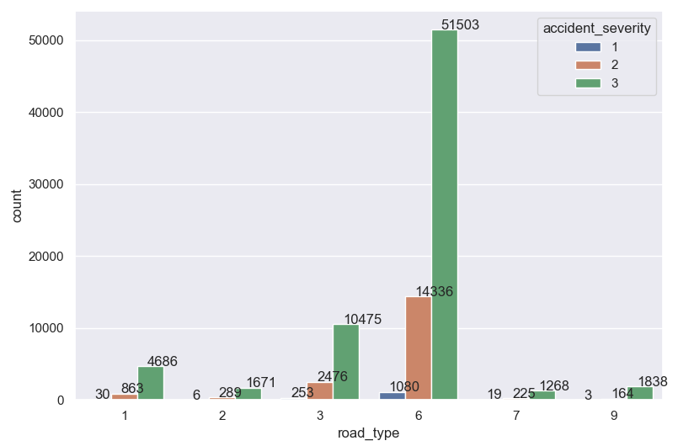
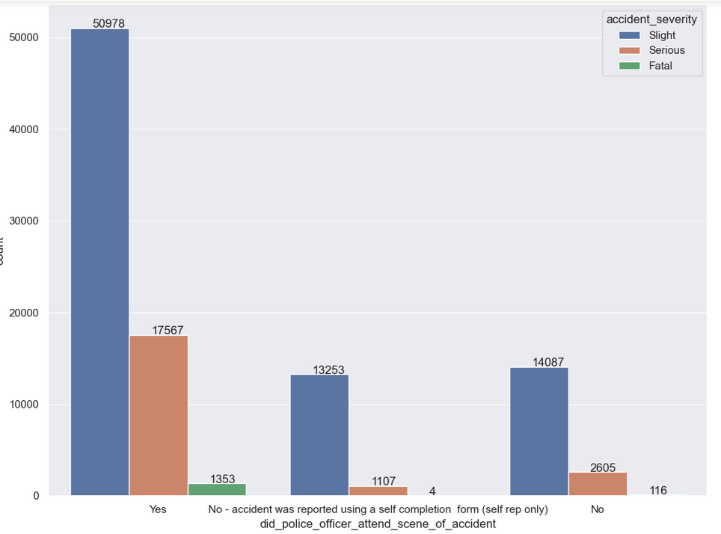
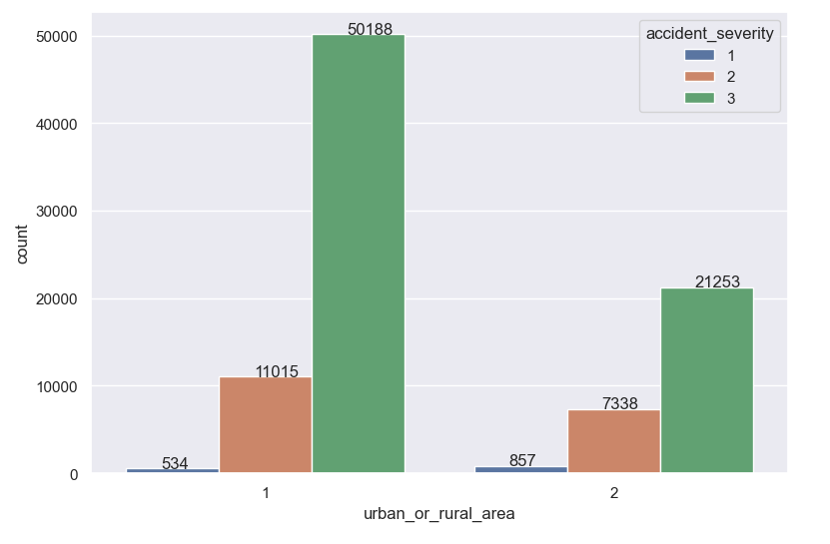
EDR

Slide 15
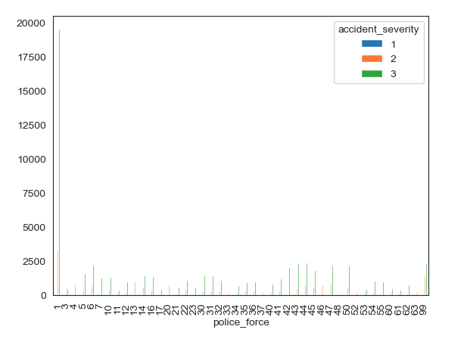
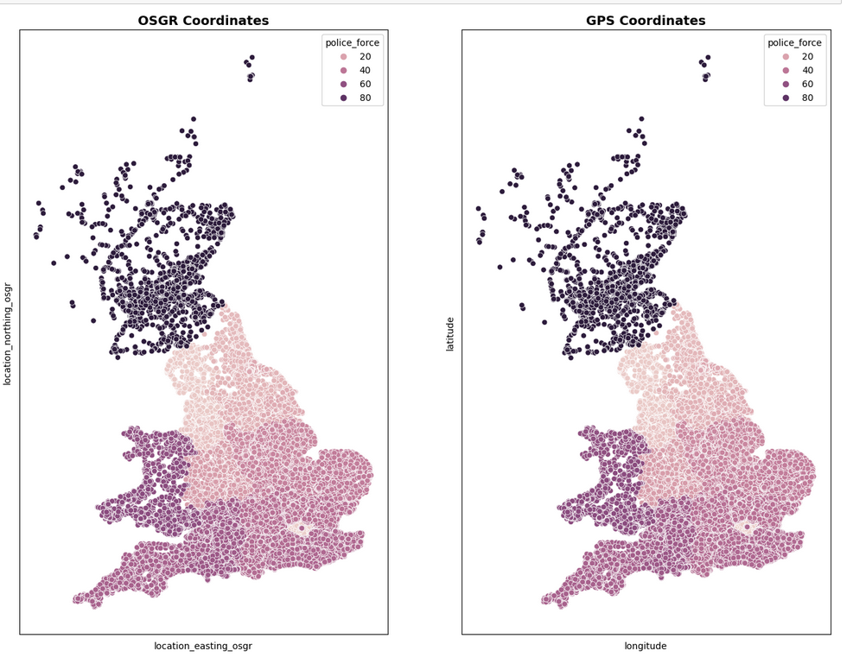
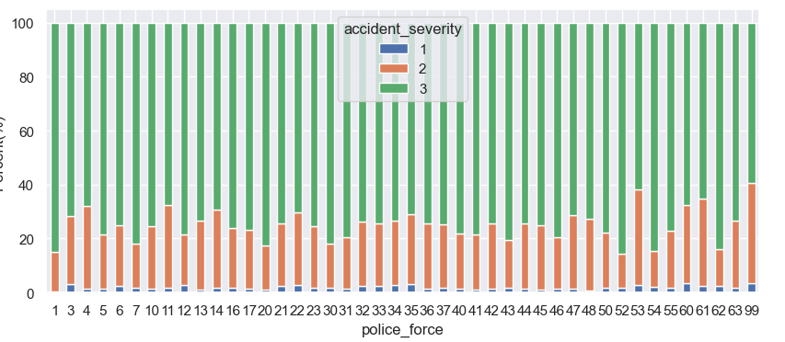
EDR

Slide 16
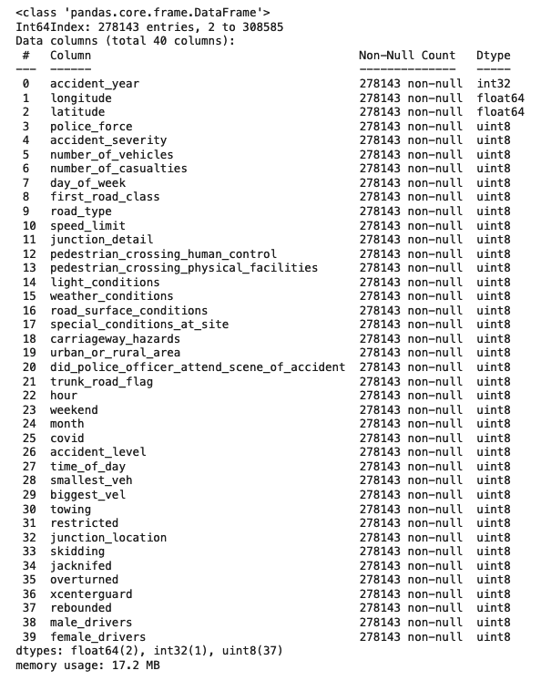
Feature engineering & Data PreProcessing
Relation of many to one from veh_df to acc_df
(groupby, aggregate)
Train Vlidation and test sets (stratify)
15% test
15% of rest validation
Rest train ~200k
OHE (one hot encode nominals)

Slide 17

Imbalance
Using algorithms with ability to define class weights
Undersampling
Oversampling (SMOTE)

Slide 18
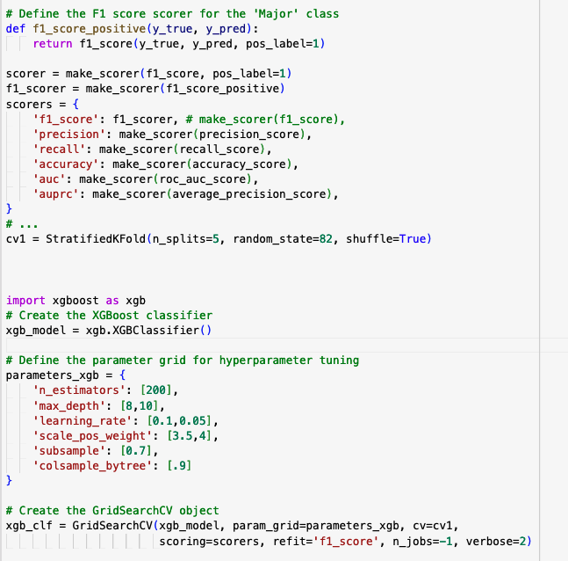
Models
Random Forest Classifier
Balanced Random Forest
XGBOOST
Naïve-Base
Logistic regression

Slide 19
Cross validation
Hyper parameter tuning:
Grid search
Random search
Various imbalance approach
The best models where RFC and XGB very similar results after tuning

Slide 20
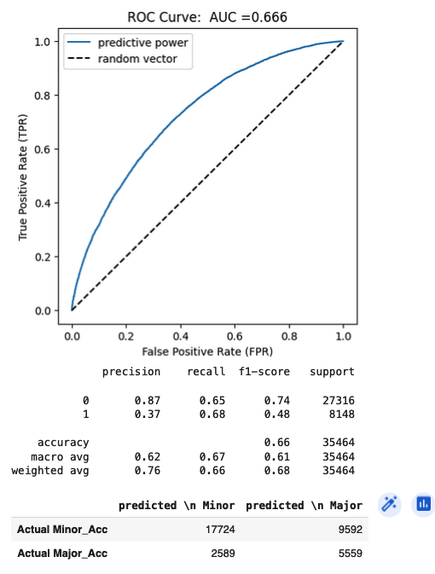
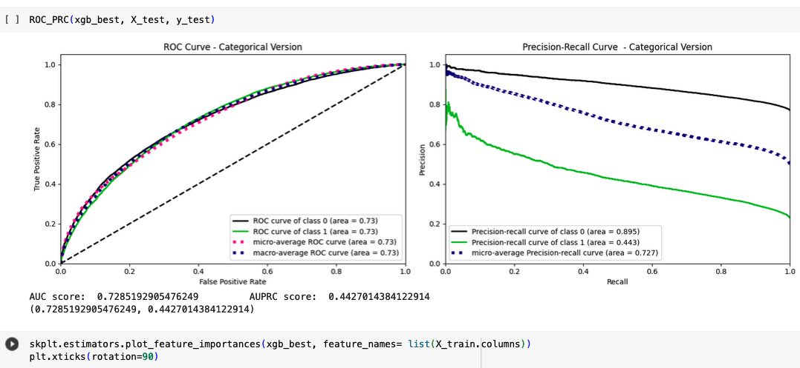

Slide 21
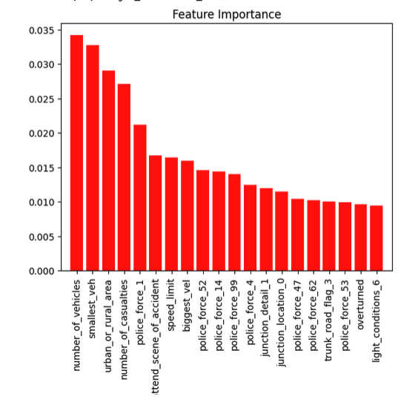
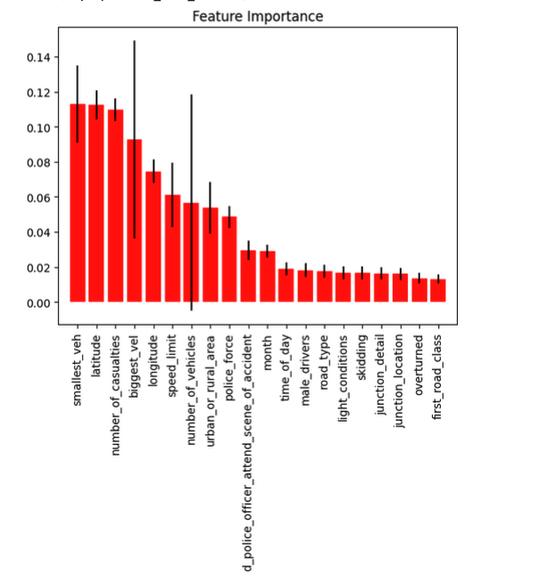

Slide 22
Next Steps:
Maybe instead of projecting veh_df to acc_df it is better to run the model for each vehicle involved in the accident and then chose the severity of the accident and urgency of sending resources to accident.
Using more data that is going to be soon released to decrease the effect of covid
Using a neural network as well to find the patterns

