Slide 1
Image Classification using Convolusional Neural Network computer vision : Fashion MNIST
Kaveh Vasei

Slide 2
Objective
Develop machine learning model that can accurately classify the images into their respective fashion categories

Slide 3
Dataset
Fashion MNIST is a dataset of Zalando's article images
Fashion MNIST contains of a training set of 60,000 examples and a test set of 10,000 examples.
Each example is a 28x28 grayscale image, associated with a label from 10 classes.
The intensity of the image, ranging from 0 (black) to 255 (white).

Slide 4
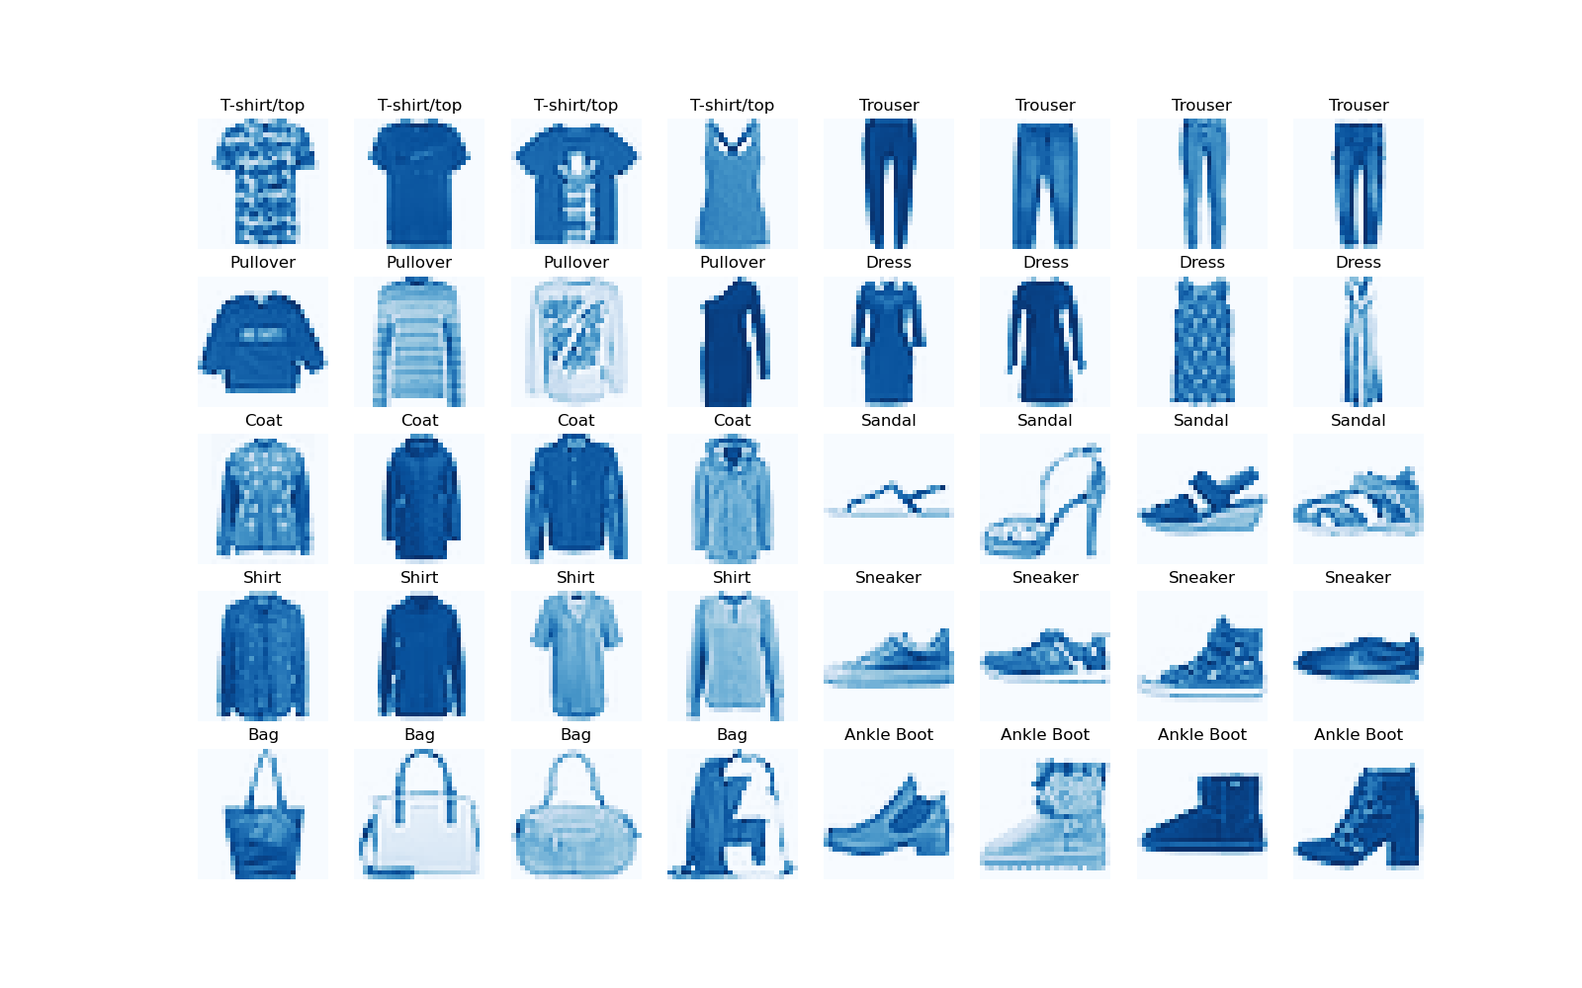
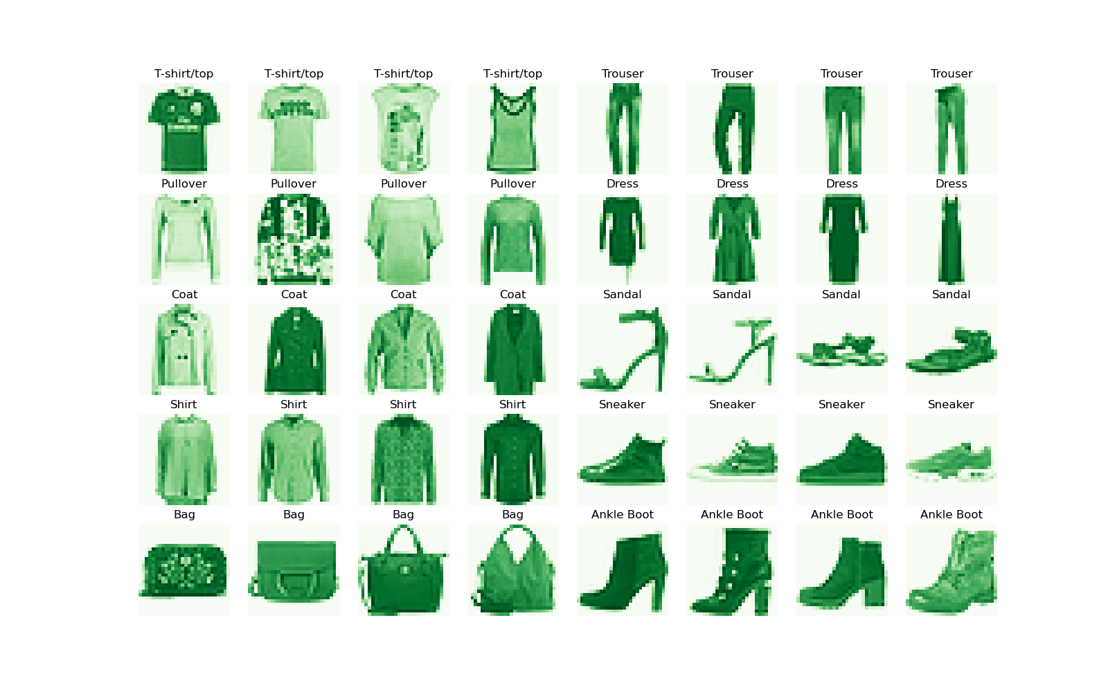
Train & Test Sets Examples
Labels:
0 - T-shirt/top
1 - Trouser
2 - Pullover
3 - Dress
4 - Coat
5 - Sandal
6 - Shirt
7 - Sneaker
8 - Bag
9 - Ankle boot
Train Set
Test Set

Slide 5
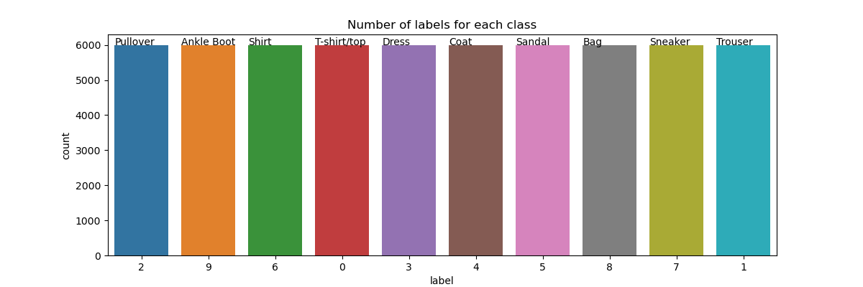
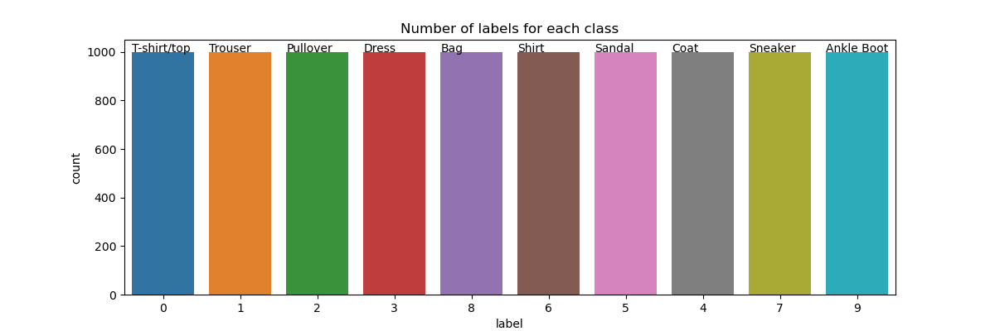
Balanced Datasets
Train Set
Test Set

Slide 6
Data Wrangling
Each row is a separate image.
Column 1 is the class label.
Remaining columns are pixel numbers (784 total).
Each value is the darkness of the pixel (1 to 255).

Slide 7
Data Pre-processing
1- Conversion to Categorical Metrics
Labels are converted to one-hot encoded categorical metrics
2- Feature Extraction and Reshaping
The pixel values (feature columns) are extracted and reshaped to the dimensions of the input images
The feature array is converted into a 4-dimensional array, suitable for image data
3- Normalization
The pixel values are normalized by dividing them by 255, bringing them within the range of 0 to 1
4- split training data into 80% training and 20% validation.

Slide 8
Methodology
For this project we will be going to use deep learning concepts like artificial neural networks and convolutional neural networks to build an image classification model which will learn to distinguish 10 different item images into their respective categories.

Slide 9
Modelling
For building an image classifier here we use deep convolutional neural networks (CNN).
Model Architecture:
Convolution Layer: The primary purpose of Convolution in case of a CNN is to extract features from the input image.
Max Pooling Layer: Pooling reduces the dimensionality of each feature map but retaining the most important information.
Fully Connected Layer/Dense Layer: “Fully Connected” implies that every neuron in the previous layer is connected to every neuron on the next layer.

Slide 10
Convolutional Network
Training process in a Convolution Network:
We initialize all filters and parameters / weights with random values.
The network takes a training image as input, goes through the forward propagation step (convolution, ReLU and pooling operations along with forward propagation in the Fully Connected layer) and finds the output probabilities for each class.
Calculate the total error at the output layer (summation over all 10 classes).
Use Backpropagation to calculate the gradients of the error with respect to all weights in the network and use gradient descent to update all filter values / weights and parameter values to minimize the output error.

Slide 11
Evaluation Metric
Evaluation metrics explain the performance of a model.
Categorical Cross-Entropy & Accuracy are our metrics in this project.
Categorical Cross-Entropy: Cross-entropy loss, or log loss, measures the performance of a classification model whose output is a probability value between 0 and 1. Cross-entropy loss increases as the predicted probability diverges from the actual label.

Slide 12
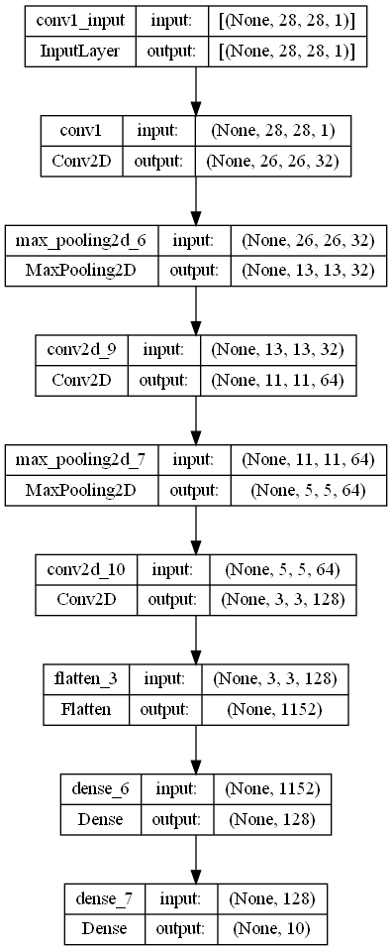
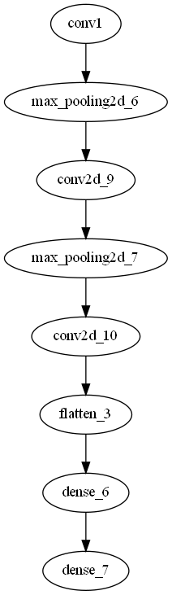
Model Architecture

Slide 13
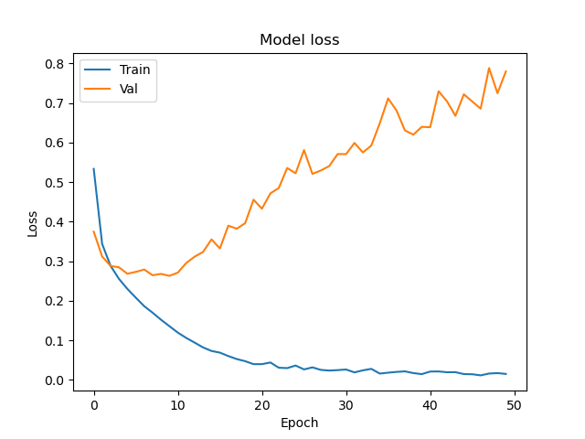
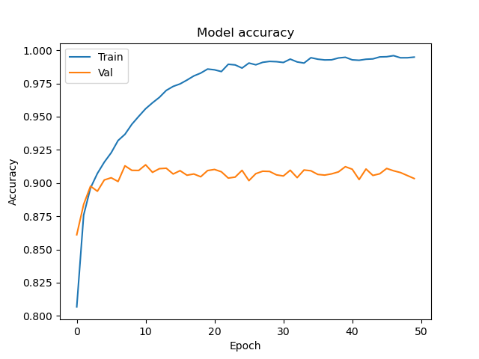
Loss and Accuracy plots

Slide 14
Generalization & Regularization
Generalization refers to how well the concepts learned by the model apply to new unseen data.
Overfitting happens when the models learns too well the details and the noise from training data, but it doesn’t generalize well, so the performance is poor for testing data.
Regularization is a key component in preventing overfitting.
Regularization techniques:
Dropout.
Batch Normalization.

Slide 15
Hyper Parameters
Hyper parameters are the variables which determines the network structure and the variables which determine how the network is trained.
Hyper parameters related to Network structure:
Number of Hidden-Layers & Units
Dropout
Hyper parameters related to Training Algorithm:
Number of Epochs
Batch size

Slide 16
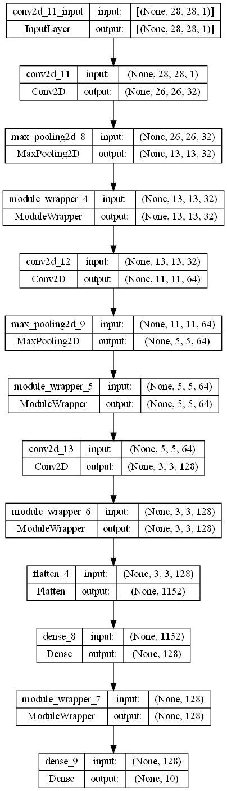
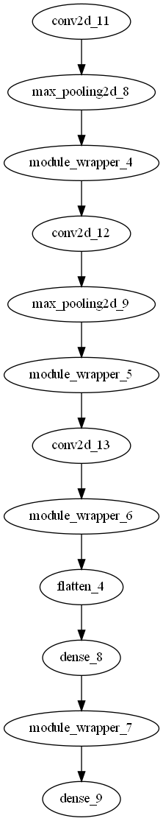
Modified Model Architecture
This is how the final model is layered:
Three Convolution Layers with 32, 64, 128 filters with a 3x3 kernel and padding.
Three Max Pooling Layer with 2x2 pooling size.
Four Dropouts layers with 0.25, 0.25, 0.4 and 0.3 rates.
Flatten Layer.
Two Fully Connected Layer with 128 and 10 neurons.
Output Layer with 10 neurons.

Slide 17
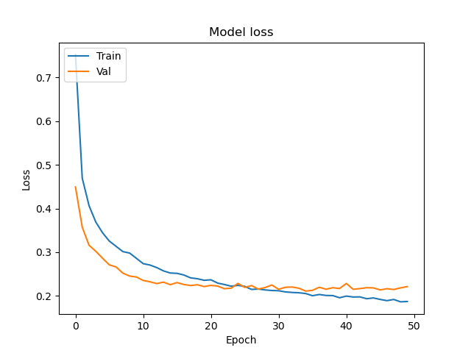
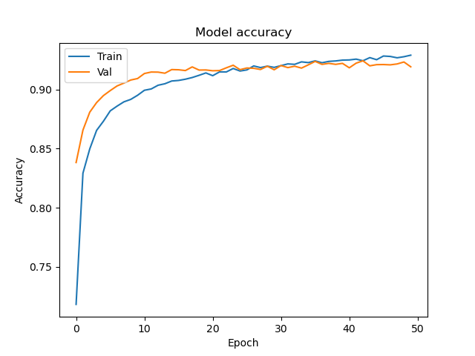
Loss and Accuracy plots

Slide 18
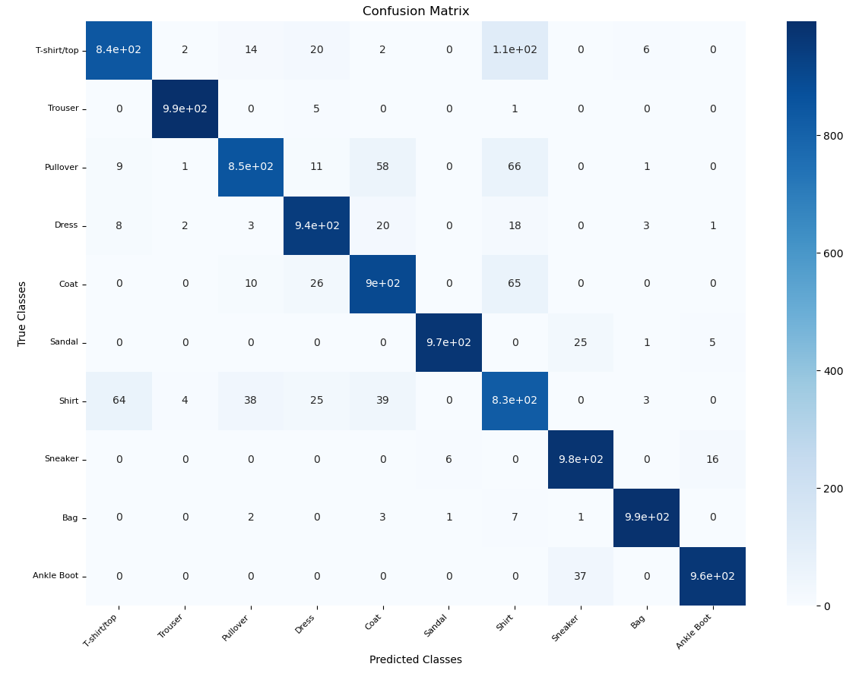
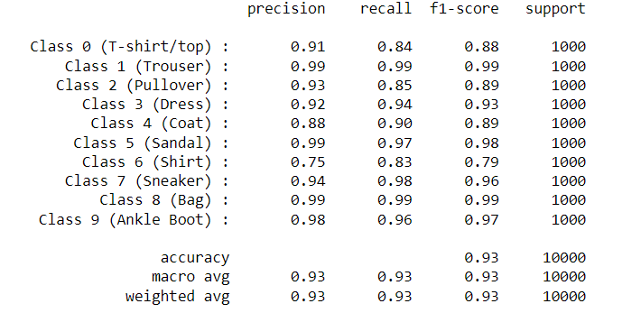
Test Set Results
Test Loss: 0.2088
Test Accuracy: 0.9258

Slide 19
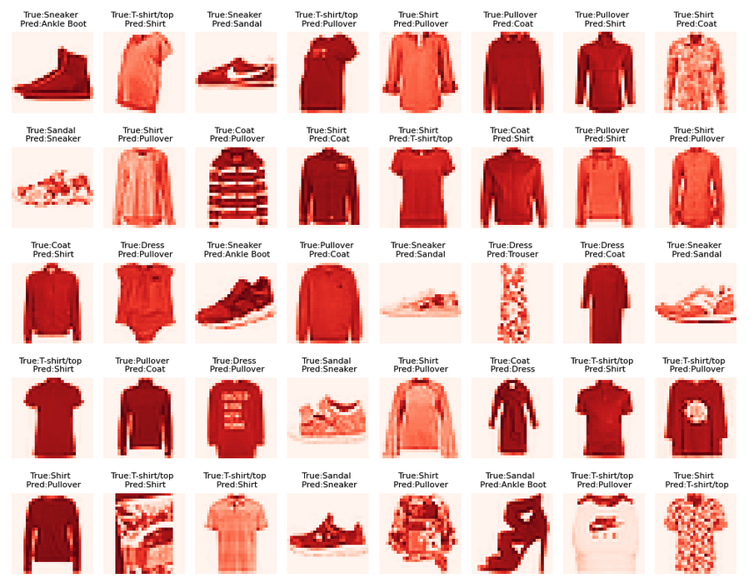
Misclassified Examples

Slide 20
Strength
The model achieved a high accuracy of 92.58% on the test set, indicating its ability to classify fashion items accurately.
The addition of dropout layers helped mitigate overfitting and improve generalization, resulting in better performance on the validation set.
The model demonstrated good precision, recall, and F1-score across most classes, indicating its ability to correctly classify different fashion items.
The confusion matrix provided insights into the performance of the model, highlighting areas where misclassifications occurred.

Slide 21
Limitations
Despite achieving good overall accuracy, the model struggled with certain classes, such as shirts and pullovers, where precision and recall were relatively lower. This suggests that the model may have difficulty distinguishing between similar clothing items.
The model's performance plateaued after reaching an accuracy of around 0.9, indicating a potential limitation in its ability to further improve accuracy on the validation set.
The model may be sensitive to variations in image quality, lighting conditions, or other factors that could impact the visual appearance of fashion items.
The dataset itself may have limitations, such as class imbalance or inconsistencies in labeling, which could affect the model's performance.

Slide 22
Business Impact
Product Categorization and Recommendations
Putting images of new products
Personalized recommendations based on preferences and browsing history
Quality Control and Defect Detection
Detect anomalies or deviation from the expected standards
Trend Analysis and Market Insight
Inform decision-making processes, like designing new collections
Tailoring marketing campaigns to align with fashion trends

