Slide 1
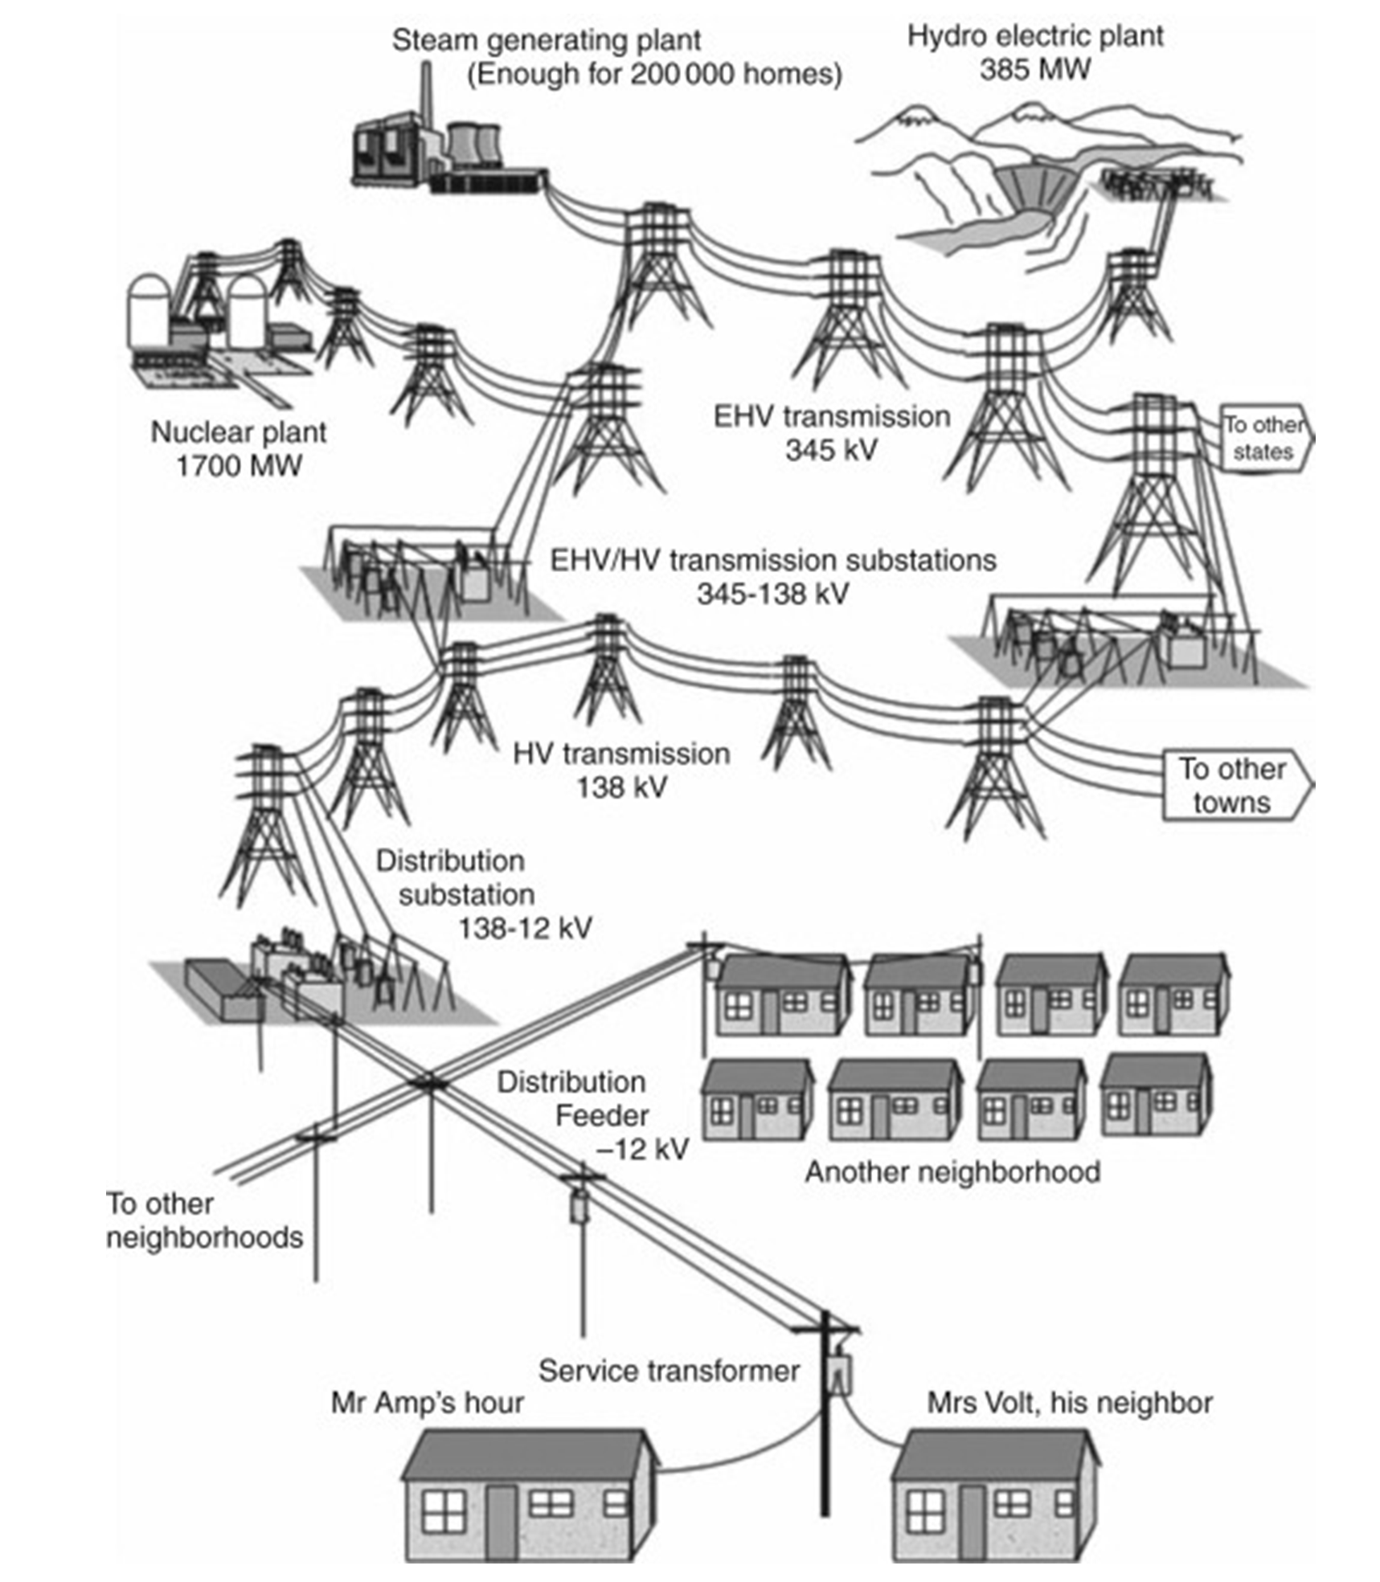
Generation
Transmission
Grid
Distribution
Grid

