Slide 1
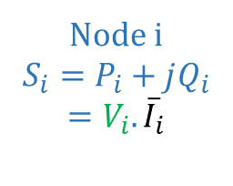
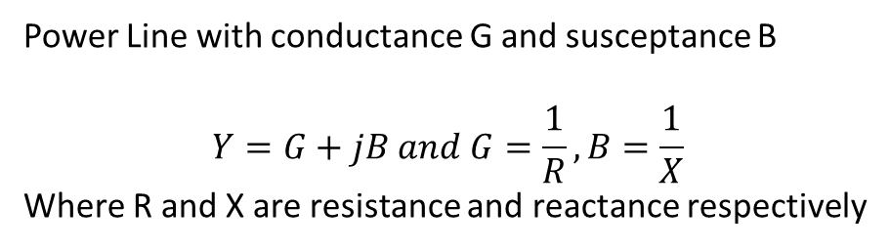
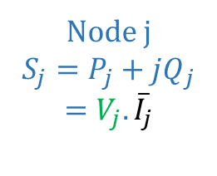
Power Line with conductance G and susceptance B
$$Y=G+jB and G=\frac{1}{R}, B=\frac{1}{X}$$
Where R and X are resistance and reactance respectively
Node j
$$S_{j}=P_{j}+jQ_{j}$$
$$=V_{j}.{\overline{I}}_{j}$$
Node i
$$S_{i}=P_{i}+jQ_{i}$$
$$=V_{i}.{\overline{I}}_{i}$$

