Slide 1
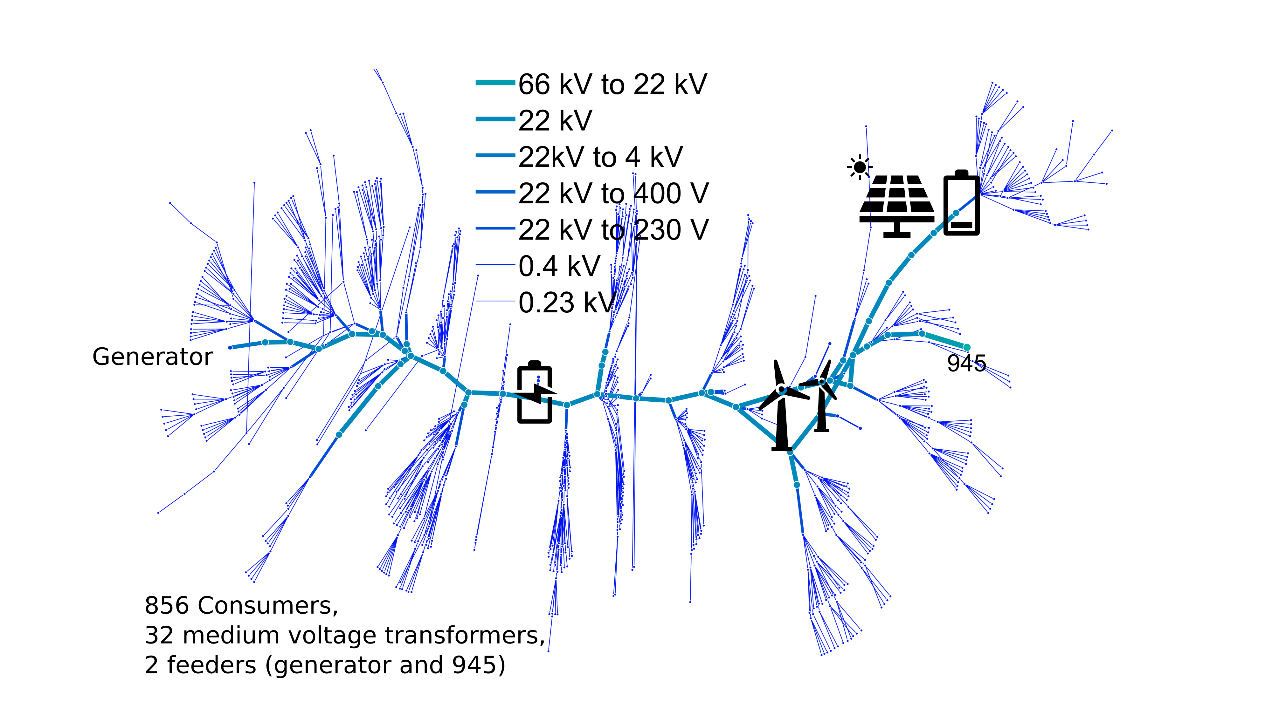
Operate?
Charge?
disharge?
Discharge?
charge?
Operate?
Charge?
disharge?
Discharge?
charge?

Slide 2






Operate?
Charge?
disharge?
Discharge?
charge?
$$t_{1}$$
$$cost$$
Operate?
$$t_{1}$$
$$P$$
$$cost$$
Charge?
disharge?
Discharge?
charge?
$$P$$

Slide 3


























$$t_{4}$$
$$cost$$
$$t_{4}$$
$$t_{3}$$
Operate?
$$cost$$
$$cost$$
$$P$$
$$P$$
$$P$$
$$t_{3}$$
$$t_{2}$$
$$cost$$
$$cost$$
disharge?
Charge?
$$t_{2}$$
$$P$$
$$P$$
Discharge?
charge?
$$t_{1}$$
$$cost$$
$$cost$$
Operate?
$$t_{1}$$
$$P$$
$$P$$
$$cost$$
Charge?
discharge?
Discharge?
charge?
$$P$$
$$t_{3}$$
$$t_{4}$$
$$t_{1}$$
$$t_{2}$$

Slide 4





$$t_{4}$$
$$cost$$
$$t_{4}$$
$$t_{3}$$
Operate?
$$cost$$
$$cost$$
$$P$$
$$P$$
$$P$$
$$t_{3}$$
$$t_{2}$$
$$cost$$
$$cost$$
disharge?
Charge?
$$t_{2}$$
$$P$$
$$P$$
Discharge?
charge?
$$t_{1}$$
$$cost$$
$$cost$$
Operate?
$$t_{1}$$
$$P$$
$$P$$
$$cost$$
Charge?
discharge?
Discharge?
charge?
$$P$$
$$t_{3}$$
$$t_{4}$$
$$t_{1}$$
$$t_{2}$$

