Slide 1
REPTRAK churn prediction
Shisi Wang
05/25/2022

Slide 2
1. List of Assumptions
All responders in the dataset are considered as existing clients
Whether a responder used or purchased product in the past 12 months is used as an engagement indicator
Churn prediction is analyzed at record level, assuming they have autonomy when making final purchase decision
Churn trend doesn’t drift much in the future when run prediction.
Survey data is reliable

Slide 3
2. Approach
1. Exploratory analysis:
Feature Distribution
Correlation among features
Define and Build label
2. Modeling:
Feature Engineering
Model Selection
Feature Importance
Iterate all above steps
Ensemble from List of Classifier
Enable Calibration
3. Prediction

Slide 4
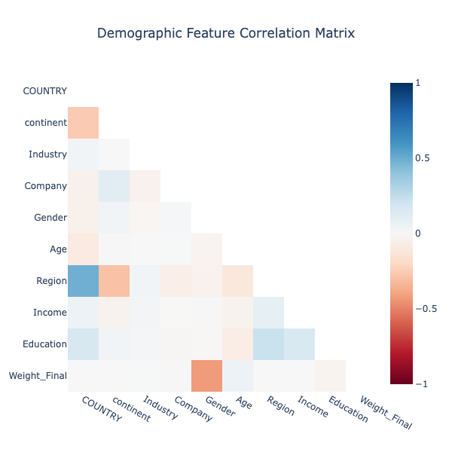
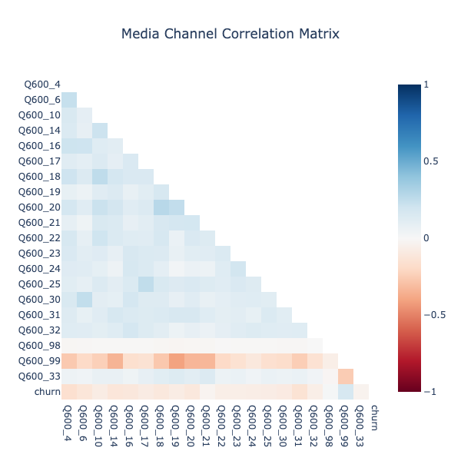
3. Data Exploration Correlation Heap Among Feature Sets

Slide 5
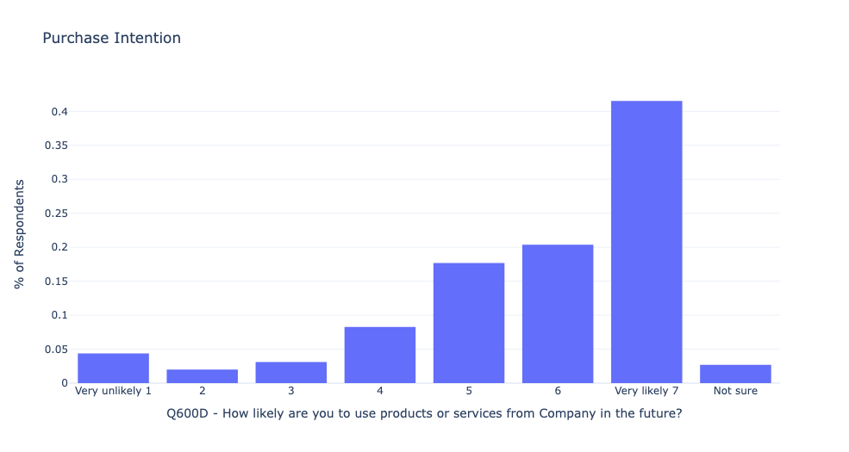
4. Define Label Churn if user declare no intention to continue

Slide 6
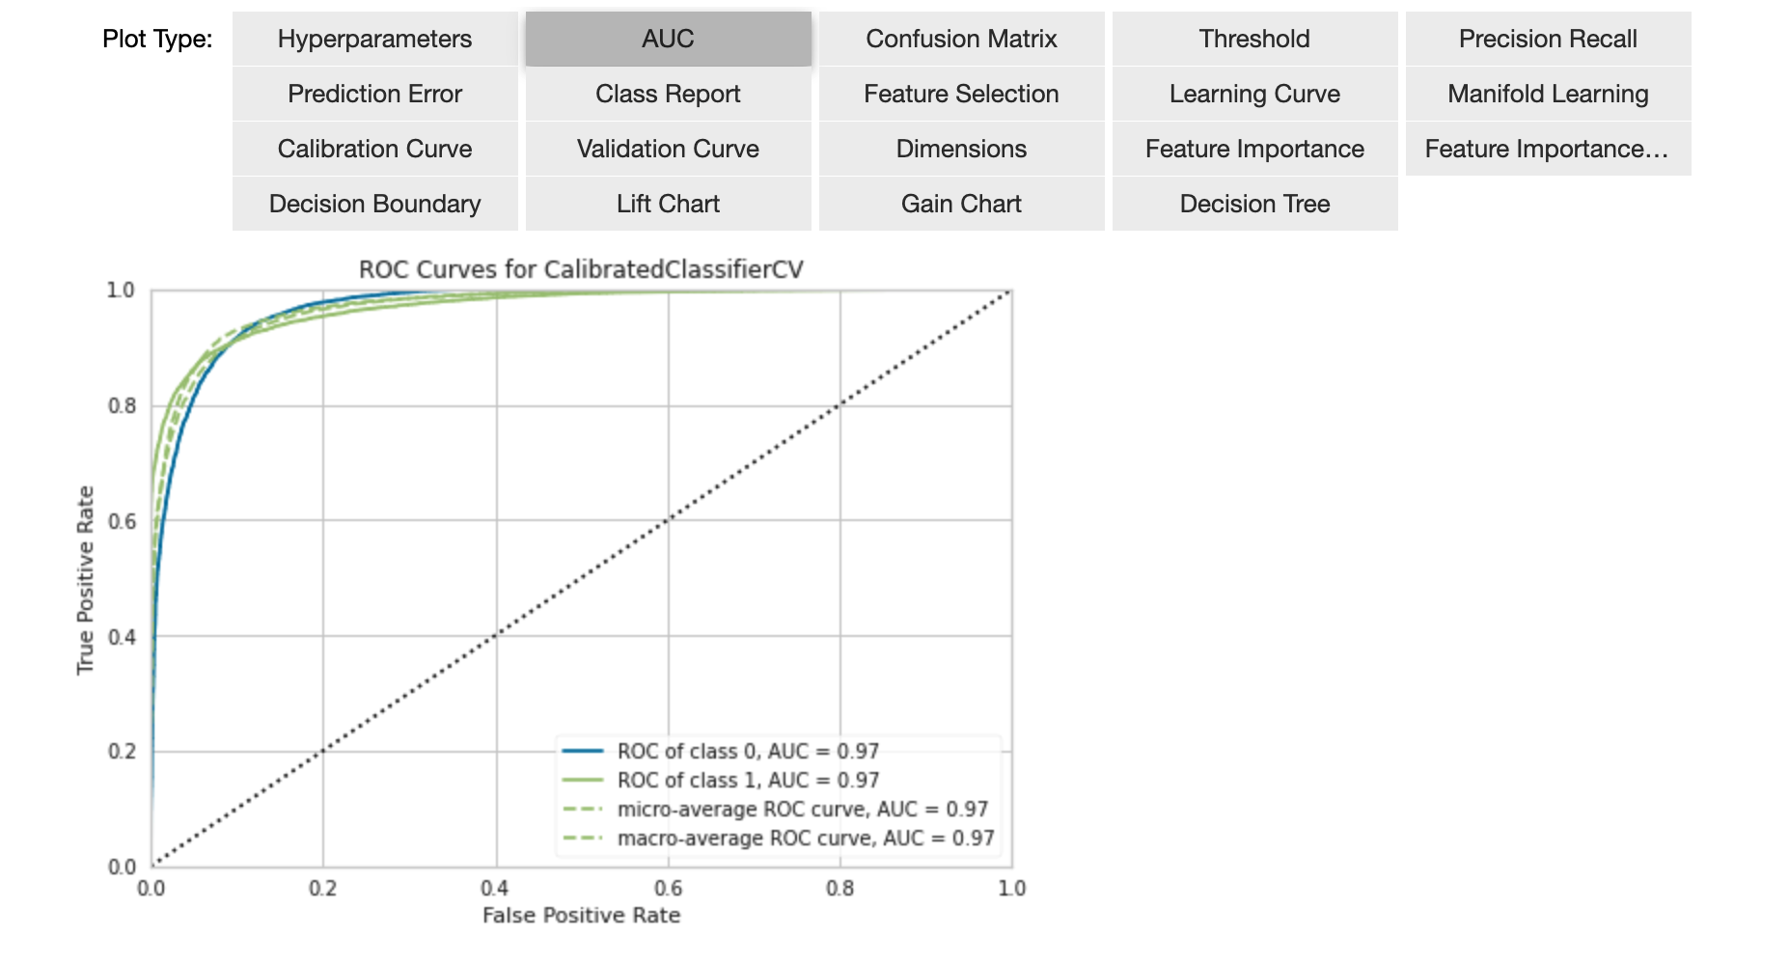
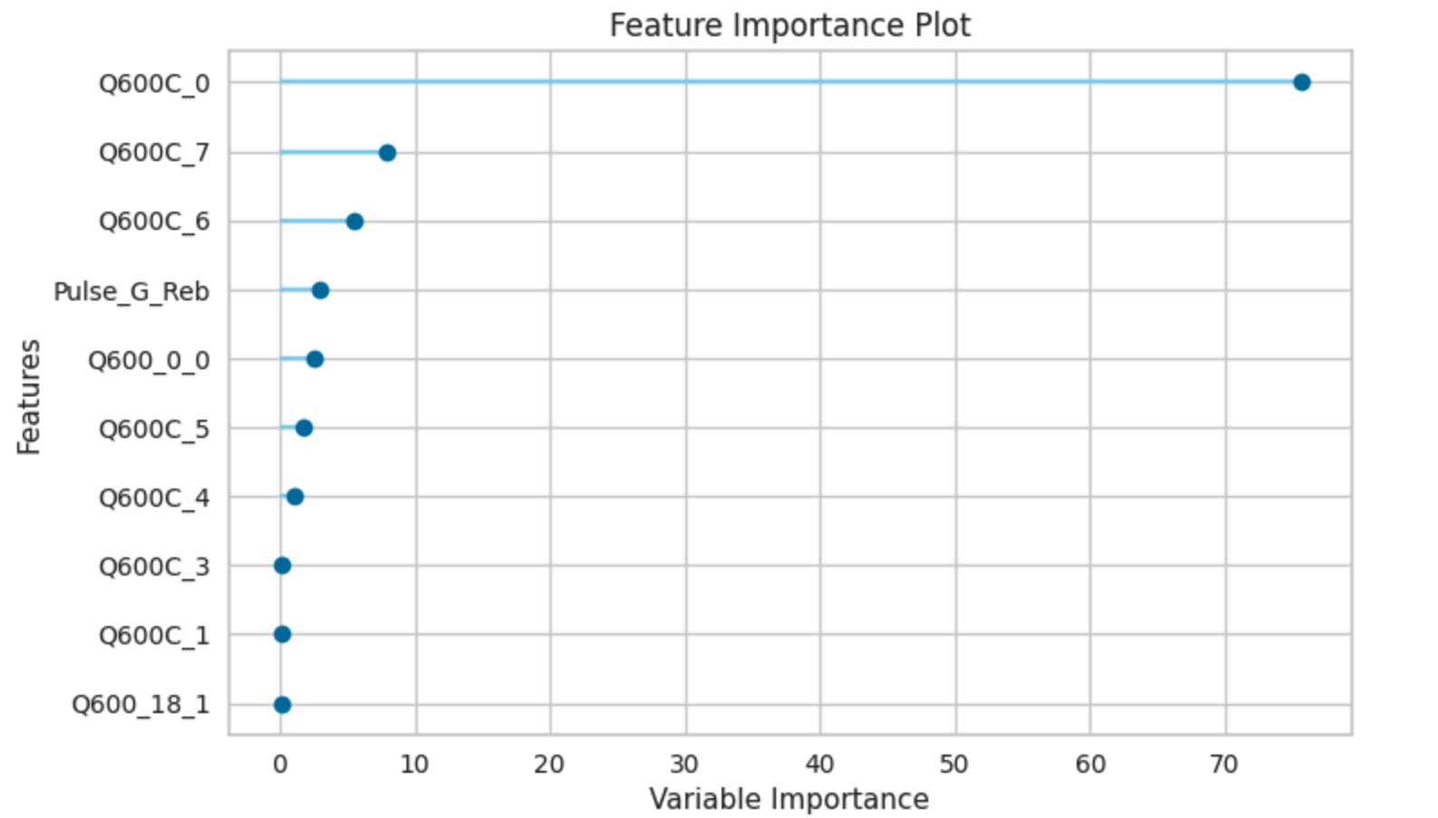
5. AutoML Model Performance Evaluation

Slide 7
6. Data-driven Conclusion
Based on Demographic Attributes:
Aware of gender difference in product design and marketing strategy
Different strategy at targeting customer from distinct RepTrak score group
Apply localization strategy when run marketing campaign or services at target geo
Based on feature importance:
Customer with high satisfaction with product will be more likely to stay. e.g. Invest in customer onboarding and boost life span
Encourage user to share their user experience with family and friends via social media
Work on improving the client company’s RepTrak® Pulse

Slide 8
7. What to implement beyond 3-6 hours
More In-depth data exploration
Iterate on feature engineering, including dimension reduction and data transformation on feature set
Fine-tune best performing models before ensemble
Interpret model and model results
Out-of-time test if additional test data is provided
Add unit test and integration test
Add version control

