Slide 1
Subject:- Hydraulics and Pneumatics
Semester : 4th
Branch :- Mechanical Engg.
Prepared by:- Sunny Brar

Slide 2
Pumps and water turbines
Hydraulic Pump
Rotary Pumps
Reciprocating Pumps
Centrifugal Pumps
Water Turbines
Pelton Wheel Turbine
Francis Turbine
Kaplan Turbine

Slide 3
Hydraulic Pump and turbine
Pumps are the Hydraulic machines which convert mechanical energy into Hydraulic energy( Pressure Energy). Pumps are used to lift liquid to lift it from lower level to higher level. Examples of Pumps are Centrifugal, Reciprocating Pumps and Rotary Pumps etc.
Whereas Hydraulic Turbines converts Hydraulic energy into Mechanical Energy. The mechanical energy is further converted to electrical energy. Hydraulic Turbine is the most important part of Hydro-electric power plant.

Slide 4
Reciprocating pump
A Reciprocating Pump sucks and lifts the liquid by actually displacing it with the help of piston reciprocating in a cylinder. It is a positive displacement pump.
Components
Cylinder
Piston
Suction & Delivery Valves
Suction and Delivery Pipes

Slide 5
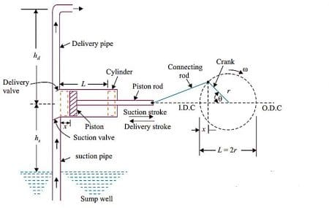
Single Acting reciprocating pump

Slide 6
Centrifugal pump
It is that hydraulic machine which converts mechanical energy into pressure energy by means of centrifugal force acting on the liquid .
Components
Impeller
Casing
Suction Pipe
Delivery pipe

Slide 7
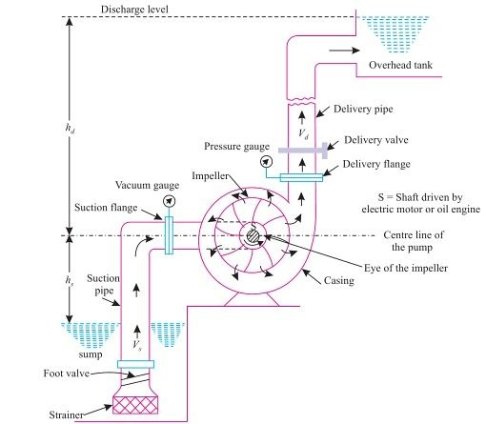
Centrifugal pump

Slide 8
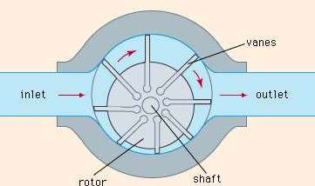
Rotary pumps:- Vane pump

Slide 9
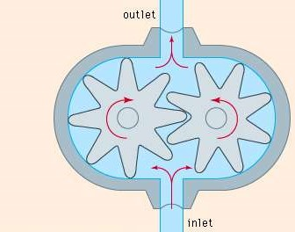
Rotary pumps:- gear pump

Slide 10
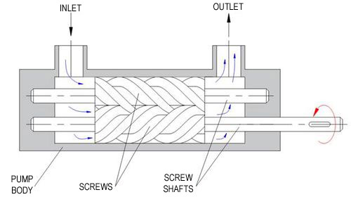
Rotary pumps:- Screw pump

Slide 11
Important terms
Cavitation:- It is the formation of vapour bubbles in a flowing liquid in the region where the pressure of liquid falls below its vaopur pressure and then sudden collapsing of these bubbles in high pressure region.
Pitting:- The erosion of pump material on the inside surface due to repeated hammering action caused by collapsing vapour bubbles at high pressure region is called pitting.
Priming:- In this operation the suction pipe, casing and a portion of delivery pipe of a centrifugal pump is filled with liquid from outside source for removing air .

Slide 12
Comparison of reciprocating and centrifugal pump
Centrifugal pump
Reciprocating pump
Its operation is steady.
Delivery is continuous and smooth.
Used for large discharge and small heads.
Operating speed is high
Low maintenance cost
Initial cost is less.
More viscous fluids can be lifted
Its operation is intermittent.
Delivery is fluctuating and pulsating.
Used for high head and low discharge
Operating speed is low
Maintenance cost is more
High Initial cost
Used for lifting less viscous fluids

Slide 13
Turbine
Hydraulic Turbines are the machines which use the energy of water and converts it (Hydraulic energy) into Mechanical Energy. The mechanical energy developed by a turbine is further converted to electrical energy by running an electric generator coupled directly to the shaft of Turbine. Hydraulic Turbine is the most important part of Hydro-electric power plant.

Slide 14
Classification of hydraulic turbines
According to the type of energy at inlet
Impulse Turbine (b) Reaction Turbine
According to the direction of flow through runner
Tangential Flow Turbine (b) Radial Flow Turbine
(c) Axial Flow Turbine (d) Mixed Flow Turbine
3. According to Head at the inlet of turbine
High Head Turbine
Medium Head Turbine
Low Head Turbine
4. According to Specific speed of turbine
Low Specific speed turbine
Medium specific speed turbine
High Specific speed turbine

Slide 15
Impulse turbine vs reaction turbine
Impulse turbine
Reaction turbine
The energy available at the inlet of the turbine is Kinetic energy only
The pressure in the turbine from inlet to outlet is atmospheric pressure
These turbines works on high head (above 250 m)
The wheel does not run full so that the air has free access between the vanes.
Casing has no hydraulic function
Flow through the turbine is tangential.
Draft tube is not required.
Flow regulation is done by the needle valve fitted into the nozzle
Examples : Pelton Wheel Turbine, Gurard Turbine, Banki Turbine etc.
The energy available at the inlet of turbine is kinetic as well as pressure energy.
As the water flows from inlet to outlet pressure decreases and at outlet of turbine pressure is below atmospheric pressure.
These turbines works on medium head (60 m to 250 m) and low head ( Below 60 m).
The wheel always run full.
Casing has hydraulic function.
Flow of water is axial, radial or mixed .
Draft tube is required.
Guide vanes are required to control the supply of water to runner.
Examples: Francis Turbine, Kaplan Turbine, Propeller Turbine etc.

Slide 16
Selection of turbines
The hydraulic turbine is always selected to match the specific conditions under which it had to operate and attain maximum possible efficiency. Following factors are considered while selecting a suitable turbine for a particular power plant.
Rotational Speed
Specific Turbine
Head Available
Runaway speed
Availability of water
Number of units
Cavitation
Part load efficiency
Maximum Efficiency
Overall cost of plant

Slide 17
Pelton Wheel turbine
Pelton wheel Turbine is an impulse turbine, tangential flow, high head and low specific speed turbine Designed by L.A. Pelton, an American engineer.
Water from the reservoir flows through the penstock and at the Nozzle fitted at outlet of it coverts available head into Kinetic Energy.
A high velocity jet of water through the nozzle is made to strike the series of Buckets ( Vanes) mounted over the periphery of the runner making the runner revolving freely and consequently the shaft rotate keyed to the runner.
Generator is coupled with the shaft for generating electricity.
Important Parts are as follows:-
Nozzle and Spear
Runner with Buckets
Casing
Brake Nozzle

Slide 18
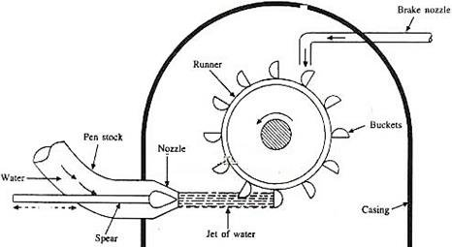
Pelton wheel turbine

Slide 19
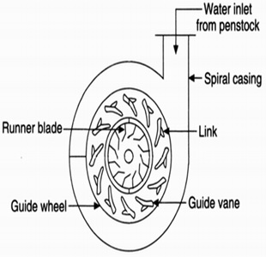
Francis turbine

Slide 20
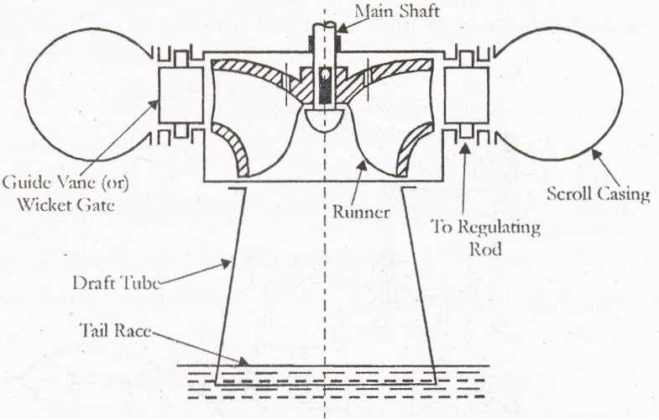
Francis Turbine

Slide 21
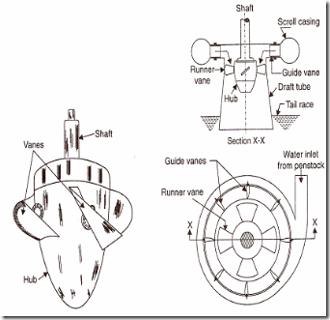
Kaplan turbine

Slide 22
Oil power hydraulic and pneumatic systems
Hydraulics System: Definition, components, merits and demerits and applications
Pneumatic System: Definition, components , merits and demerits and applications
Comparison of Hydraulic and Pneumatic Systems.
Hydraulic oil, Seals

Slide 23
Oil power hydraulics & Pneumatics
Oil Power hydraulics is that branch of fluid mechanics in hydraulic oil is used as working medium.
Pneumatics is tht branch of engineering in which compressed air or any other is used as working medium inoperating machines and equipments.

Slide 24
Merits & Demerits of hydraulic system
Merit
As oil has more resistance to shear than water, it can transmit more shearing force.
Oil absorbs vibrations and shock load, if any, in a machine.
Speed of moving parts of a machine can be controlled easily.
Oil powered machines are self lubricating.
Oil powered machines need less maintenance.
Transmission of motion by oil is not easy.
Demeitr:-
Leakage of oil causes problems in maintenance work and makes the working arae dirty.
Chances of fire hazards are there.
At high temperature oil looses its viscosity and therefore needs to replaced under such conditions.
Oil powered machinery is costlier than water powered.

Slide 25
Application of oil power hydraulics
Operation of shaping machine
In Press Hammering
Hydraulic Vice
Earth moving machines
In drilling operation during oil exploration.

Slide 26
Merits and Demerits of pneumatic system
Merits:-
Air is freely available in nature without any cost.
Wear and tear of the parts using air as the working medium is less resulting in lower maintenance.
More effective gripping as compared to hydraulic system
As chances of fire hazards are not there, making thses system suitable for use in coal mines and other fire prone areas of manufacturing.
Demerits:-
Storage vessel is required to store the compressed air, hence additional equipment is required in thses system.
Chances of leakage of air from pressure side to low pressure side.
It is not economical to use pneumatic system for small scale production unit.

Slide 27
Applications of pneumatic system
The following are the applications of pneumatic system:-
Pneumatic tools
Pneumatic drills and chucks
Operating air motor
Operating spray paint gun
Operating the blower.
Pneumatic brakes in locomotives.

Slide 28
Basic components of hydraulic system
Oil reservoir
Pump
Valves
Filters
Seals
Pipe
Actuators

Slide 29
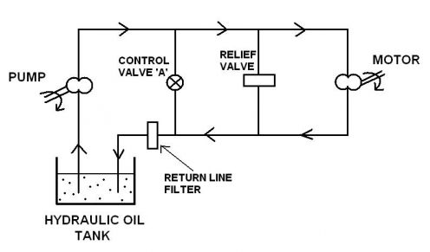
Basic components of hydraulic system

Slide 30
Hydraulic oil
The major function of hydraulic oil is to provide energy transmission through the system.
The most common oil used is petroleum based mineral oil.
Besides transmitting energy, it performs various functions which are as follows:-
Lubrication
Cooling
Sealing
Removal of contamination

Slide 31
Types of minerals
1. Mineral oils
2. Emulsions:-
Oil-in-Water Emusions
Water-in-oil Emulsion
3. Vegetable Oils

Slide 32
Properties of an ideal hydraulic oil
Viscosity should be ideal
Lubricating properties should be good.
Should be chemically and environmentally stable.
Should be in incompressible
Should be fire resistant.
Low flammability.
Foam resitance.
Volatility should be low.
Heat Dissipation ability should be good.
Density should be low.

Slide 33
Seals
Seal is a material which is used in the hydraulic system to prevent leakage of oil.
Use of seals increases efficiency.
Prevent loss of power.
Prevent failure of components such as valves etc

Slide 34
Classification of seals
Positive and non-positive seals:- Positive seals do not permit any leakage of oil and non-positivve seals permit a small amount of leakage of oil to the extent of providing lubricating film on the rotating parts.
Static and Dynamic seals:- Static seals prevent leakage of oil through stationey surfaces. Dynamic seals prevent leakage of oil around rotating or moving parts.

Slide 35
Types of oil seals
Gaskets
O-rings
Packing
Wiperrings
Piston rings

Slide 36
Commonly used seal material
Leather
Metal
Asbestos
Rubber, Elastomers and Plastics

Slide 37
Requirement of good sealing materials
Should resist wear and abrasion
Should recover from deformation quickly.
Should resist harmful effects such as deterioration, excessive swelling and shrinkage caused by acids
Should withstand system temperature and pressure without leakage.

Slide 38
Common faults in hydraulic system
Sharp noise in the system
High rate of seal failure.
Excessive leakage in the system
Excessive loss of system pressure
Sharp rise in oil temperature.
Reduced speed of machine tool elements.
Cavitaion of pump.
Poor oil life.

Slide 39
Simple visual checks of oil
Visual Appearance
Smelling
Viscosity
Tardiness
Oxidation
Acidity
Foaming
Water content
Solid content

Slide 40
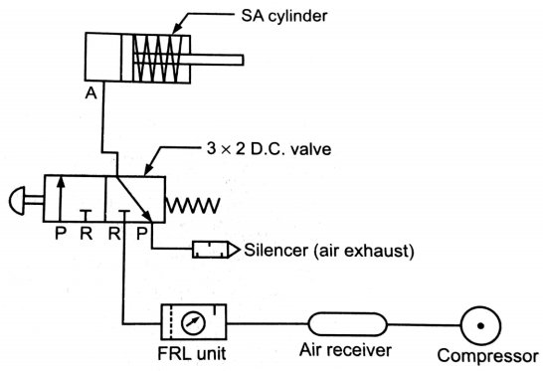
Basic components of pneumatic system

Slide 41
Basic components of pneumatic system
Air Copressor
Relief Valve
Air Filter
Air Pressure regulator
Lubricator
Direction control valve
Cylinder
Functional control

