Slide 1
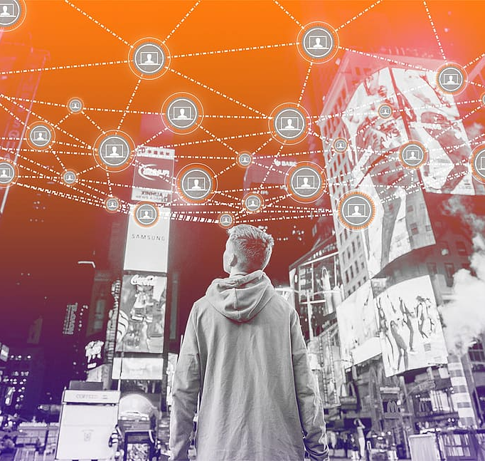
Internet of Things
MINI PROJECT #2
DATA-ENGINEERING-IN-IOT-PIPELINE
GROUP 07
SHALIKA DULAJ
KAVINDA RATHNAYAKE

Slide 2

Overview
Introduction
Objective
Process Flow Chart
Technologies
Data Processing
Prediction
Visualization

Slide 3
Introduction
This project, part of the IoT course at the University of Oulu, aims to develop an IoT data pipeline focused on data engineering. It involves extracting, preprocessing, visualizing, and storing data from temperature and pressure sensors across three remote locations.
Each site has three temperature sensors, offering a comprehensive dataset that is processed and visualized for detailed environmental analysis and stored in the cloud for efficient management

Slide 4
Objective -
Developing and implementing an IoT pipeline focused on data engineering
Key Themes:
Extraction: Collecting data from temperature and pressure sensors across three remote locations.
Pre-processing: Refining sensor data for accuracy and usability.
Visualization: Transforming data into understandable visual formats.
Storage: Efficiently storing large volumes of sensor data.
Outcome: A comprehensive dataset from nine temperature sensors, enabling insightful analysis and smart decision-making.

Slide 5
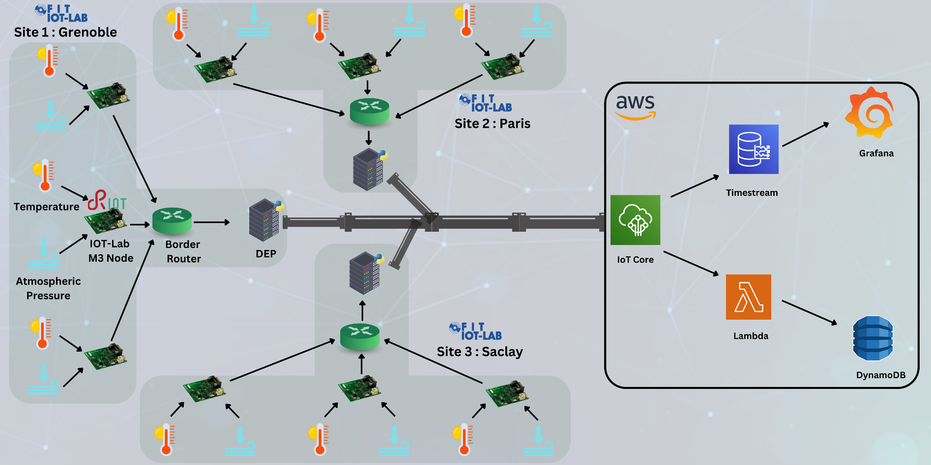
Process Flow

Slide 6
Technologies
Sensor Nodes - Read Sensor Data
Board: IoT-LAB M3
Firmware Language - C/C++
Communication - embedded-MQTT
DEP Station + Bridge - Data Processing and Forwarding
Board: IoT-LAB A8-M3
Language - Python + AWS SDK + Scikit-learn
Communication with endpoint - MQTT

Slide 7
Data Processing
Detect Outliers/Anomalies in the incoming data
Check for missing values
Implements Z-score calculation to identify outliers in temperature and pressure data
Utilize median imputation to deal with missing values
Utilize a median filter to smooth & average data further
A linear regression model is created and trained using this data for prediction.
After training, the model predicts the next temperature or pressure value in case of a communication error event with the nodes.
AWS Lambda

Slide 8
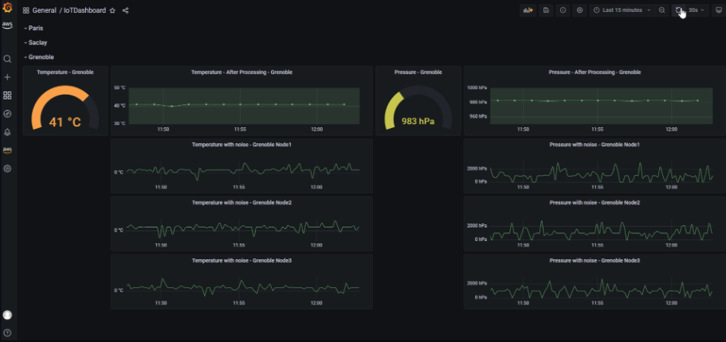
Data Visualization and Store

Slide 9
Demo
https://www.youtube.com/watch?v=rnzVh7fzxgE

Slide 10
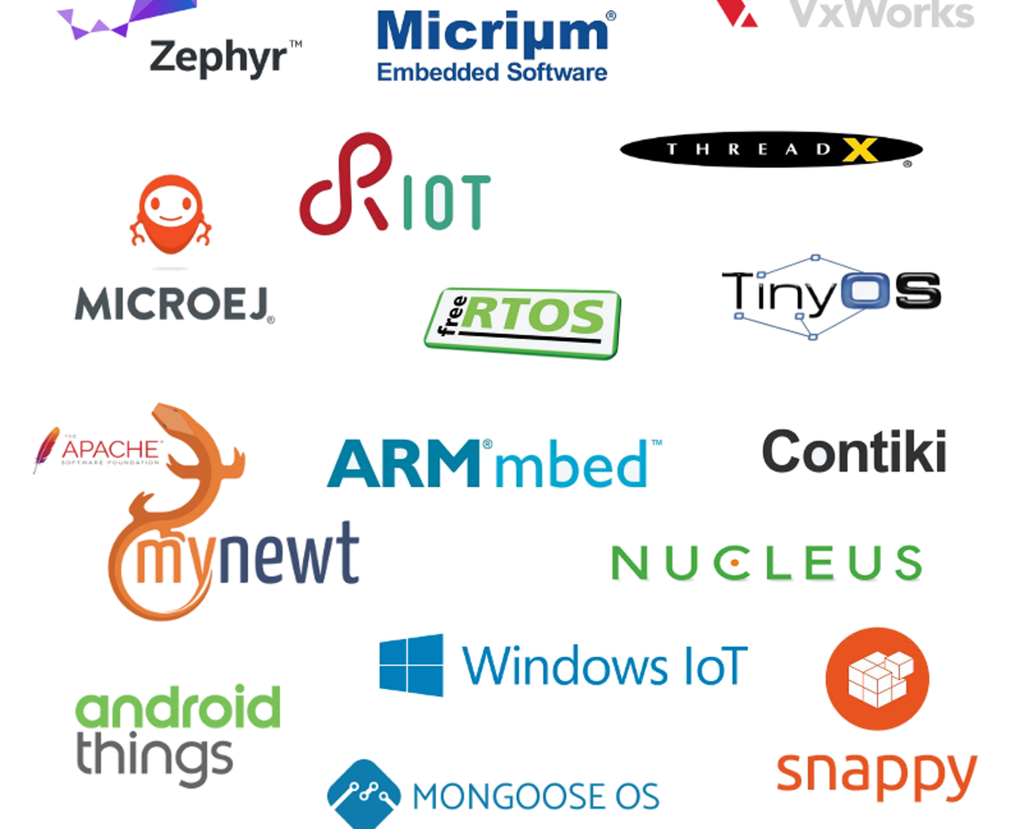
Thank You

