Slide 1

EMPLOYEE PAYROLL MANAGEMENT
Baljeet Singh, Team Lead

Slide 2
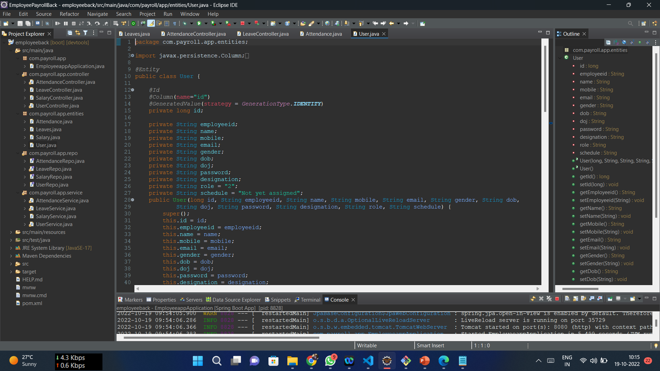
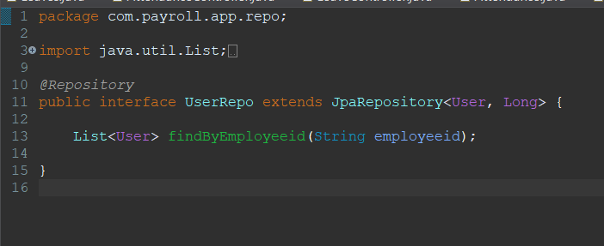
Backend User :

Slide 3
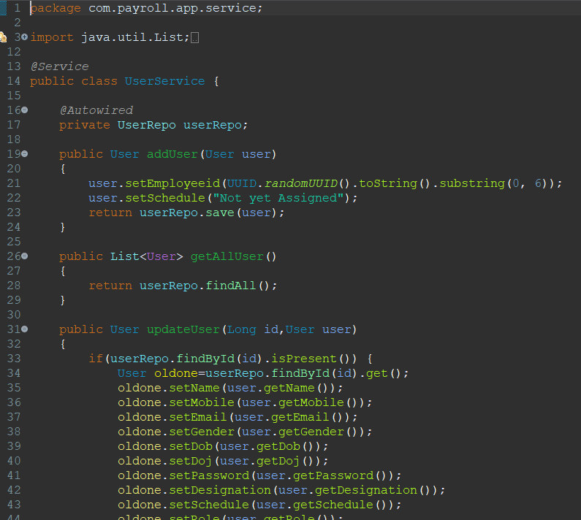
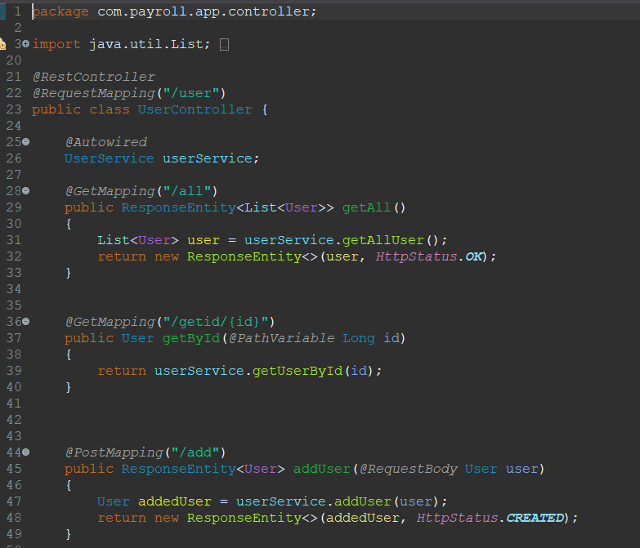
Backend User :

Slide 4
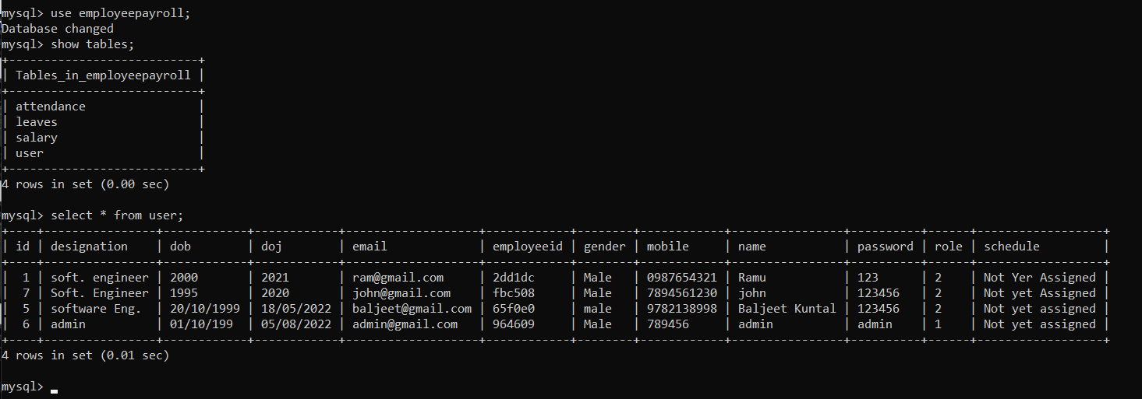
Backend User :
User Table:

Slide 5
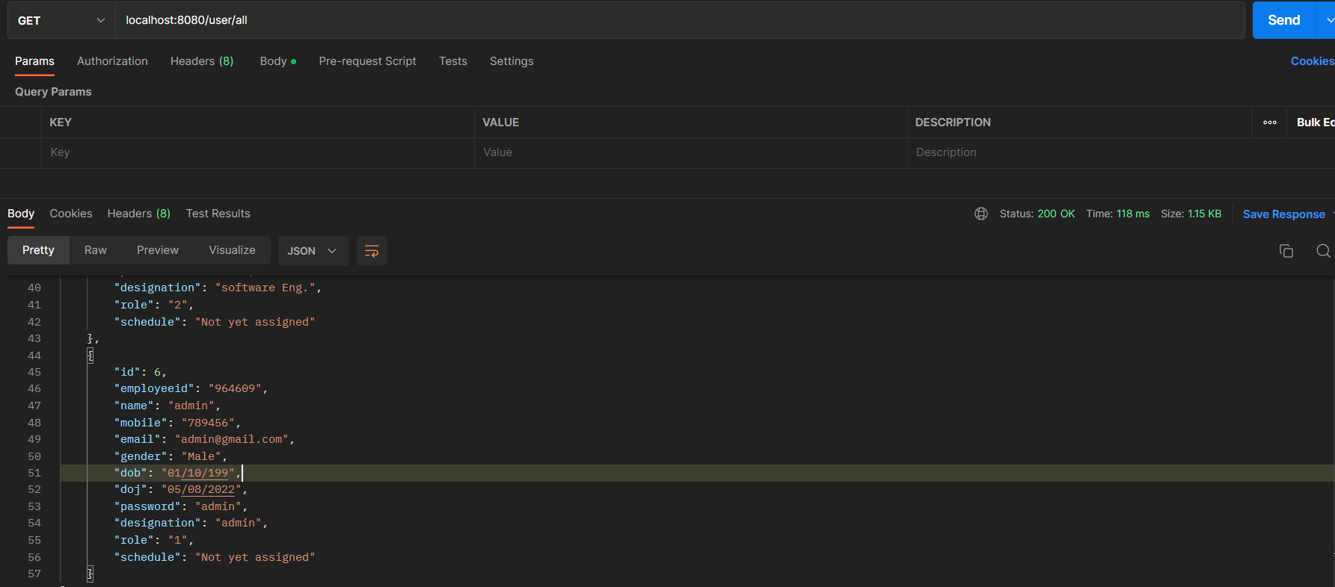
Backend User :
Postman:

Slide 6
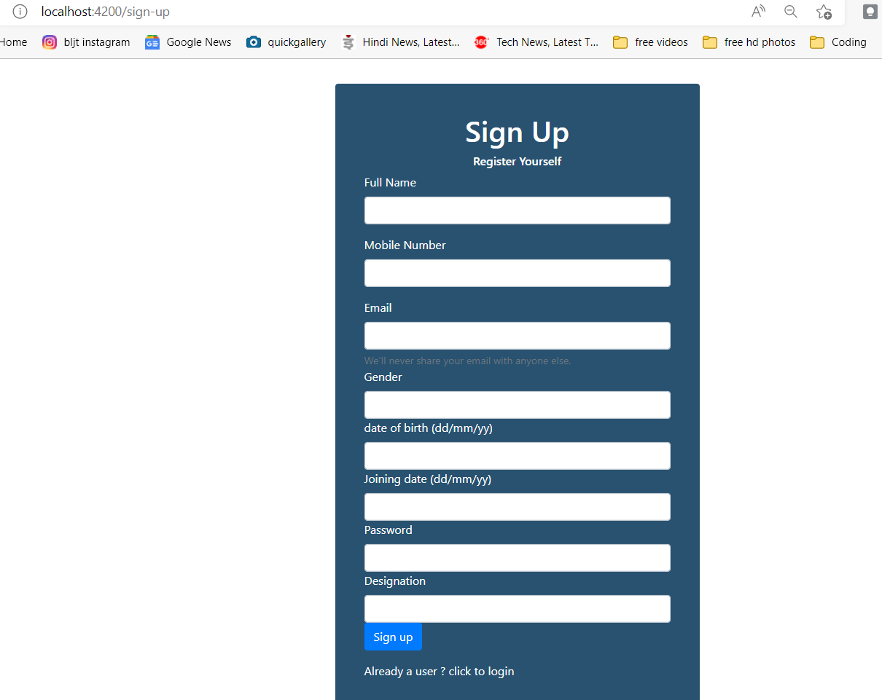
New user registration :

Slide 7
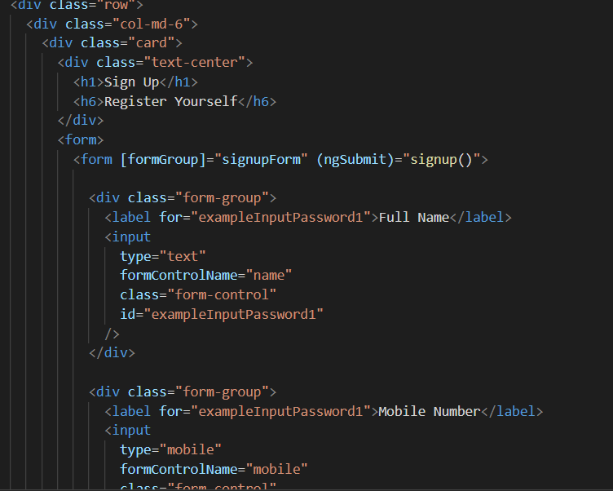
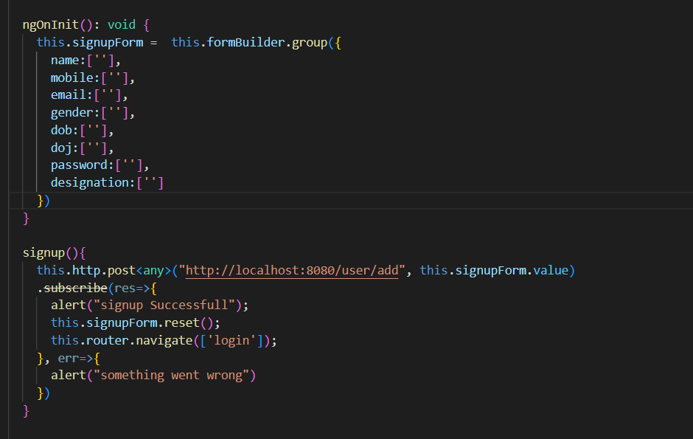
Regsitration Front end :

Slide 8
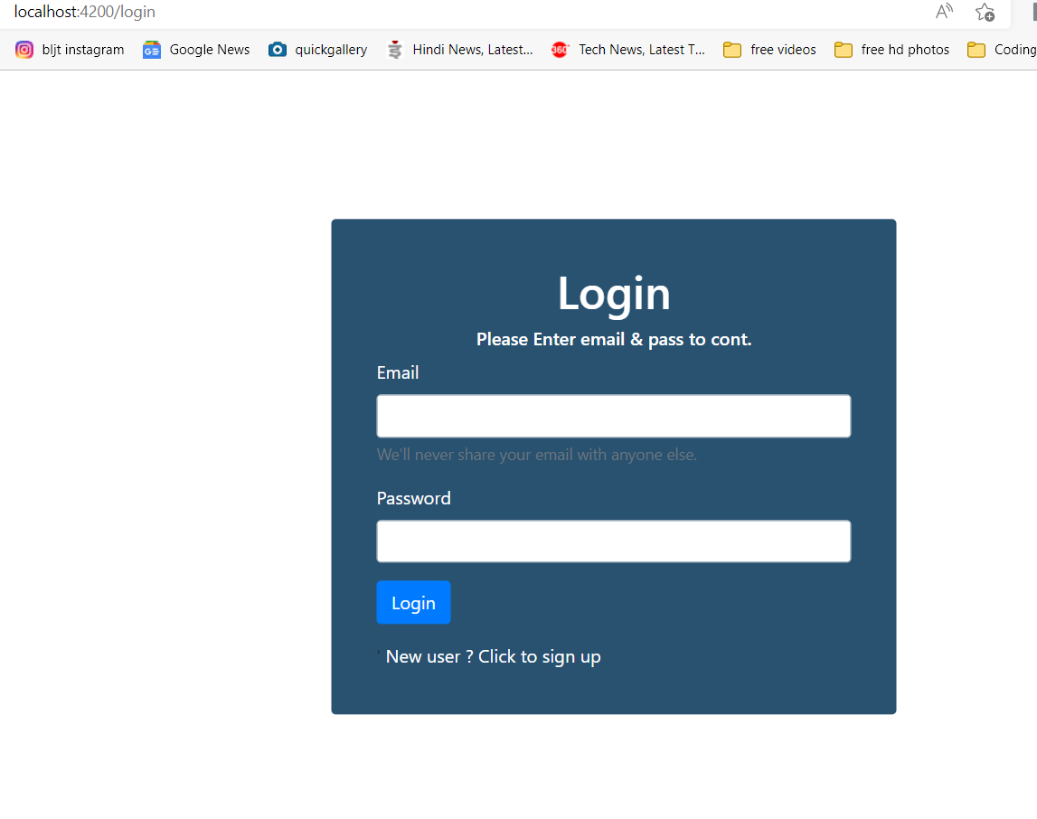
User login on the basis of admin or user:

Slide 9
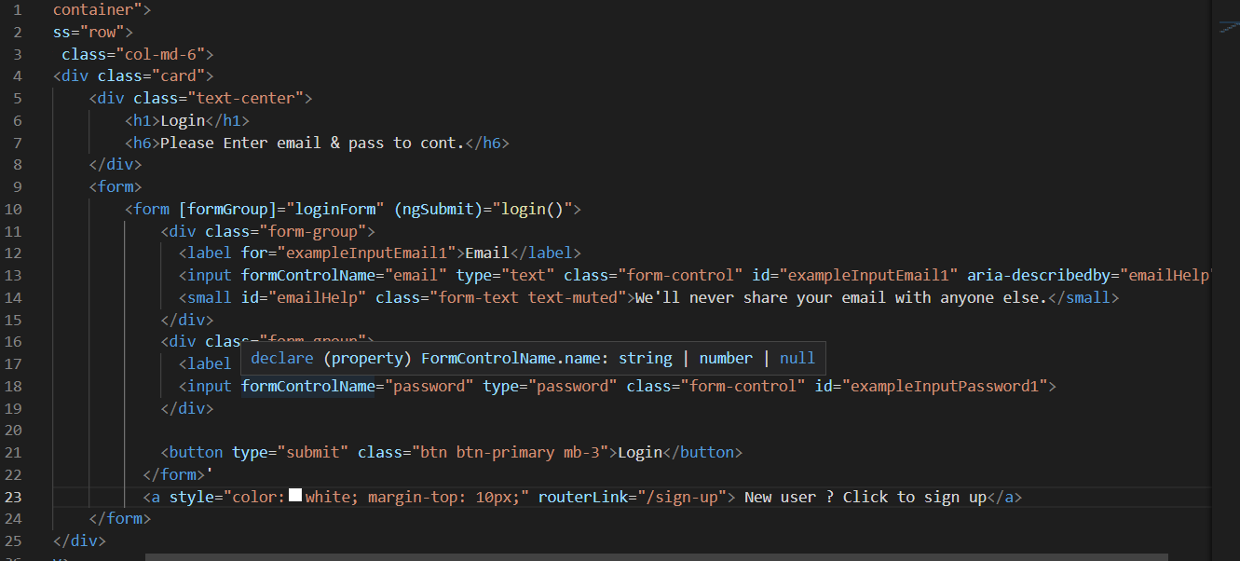
Login Front-end :

Slide 10
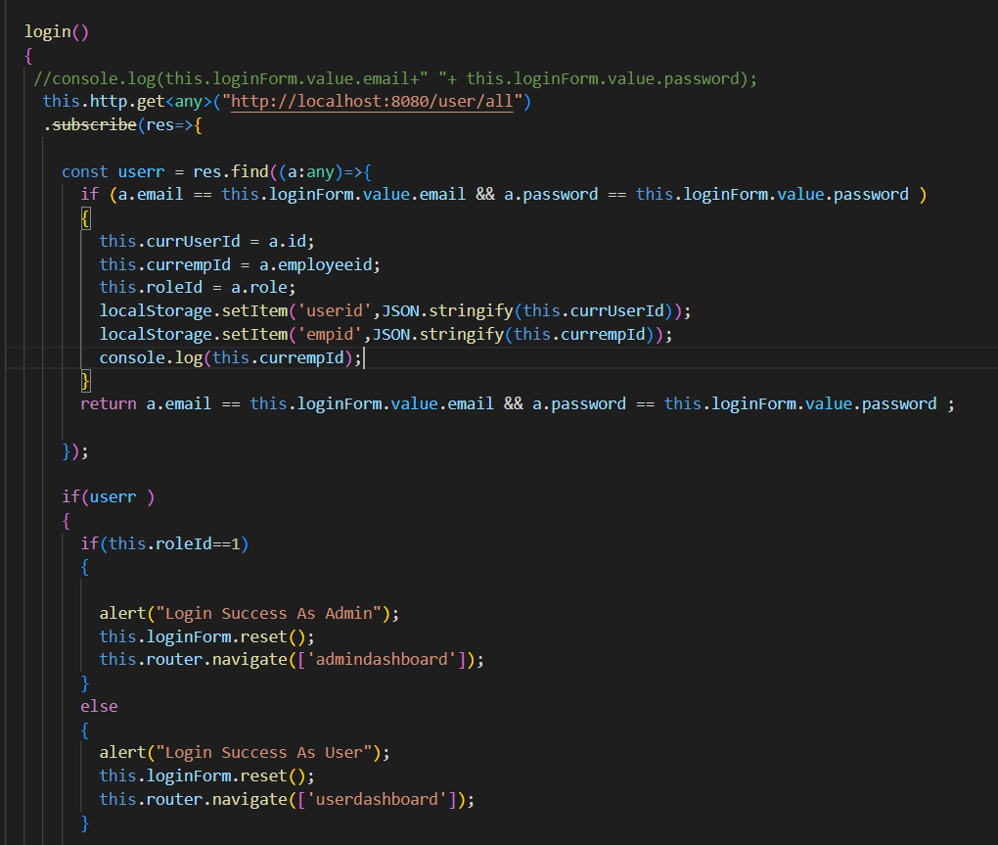
Login Front-end :

Slide 11
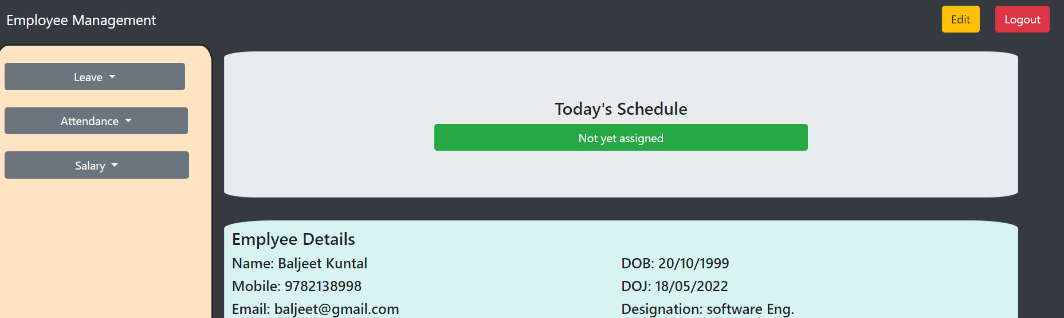
Edit and Logout Button User dashboard :

Slide 12
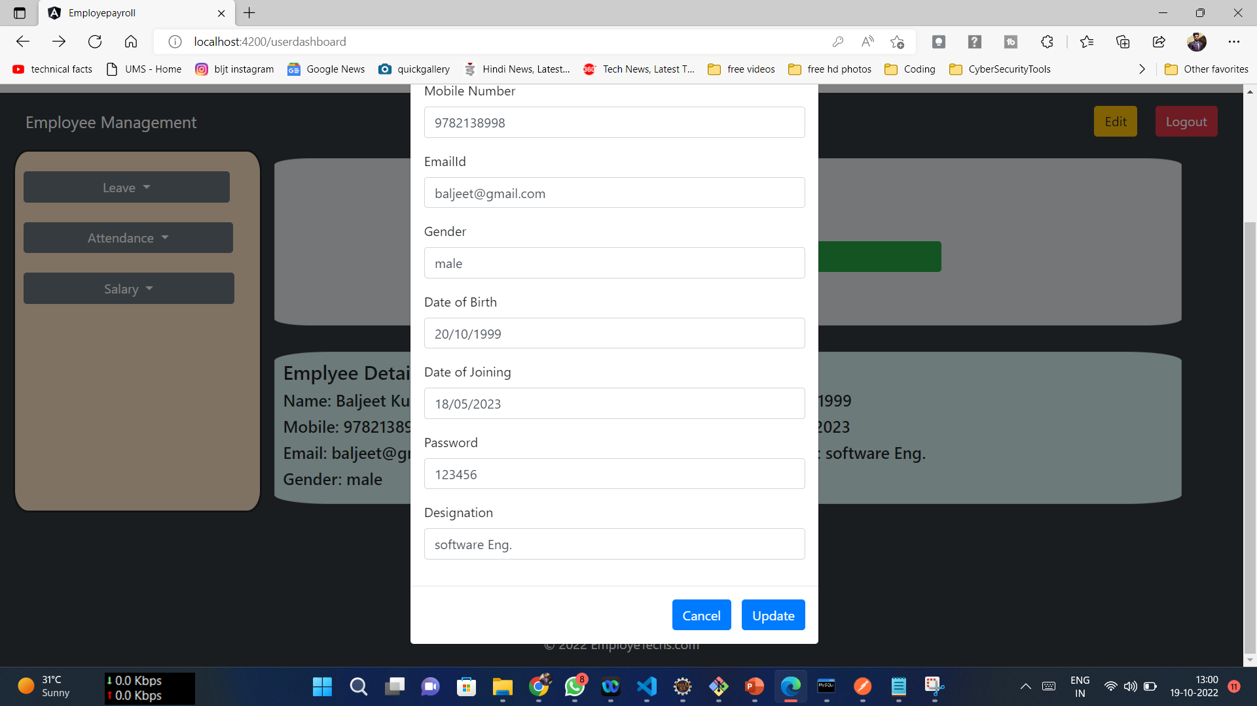
Edit and Logout Button User dashboard :

Slide 13
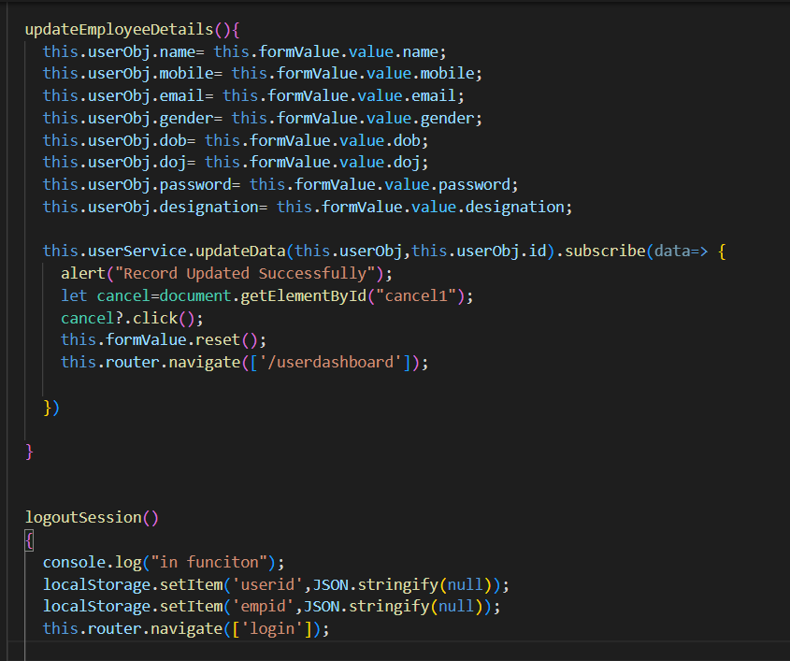
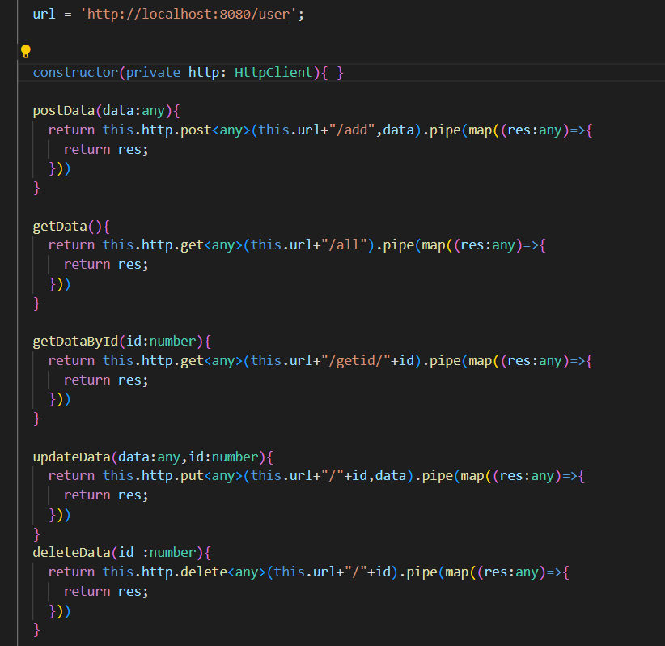
Code:

Slide 14
Integrated the whole software and fixed minor bugs
edit attendance ( data and posting issue (fixed))
admin leave not working [fixed leave working fine]
added edit functionality in user dashboard
Fixed edit functionality in admin dashboard (role issue)

Slide 15



THANK YOU
Baljeet Singh
Baljeet.singh@mphasis.com

