Slide 1
Employee Data Analysis using Excel
STUDENT NAME : KAVIDHARASHINI K
REGISTER NO : 312215019
DEPARTMENT : COMMERCE
COLLEGE : SOKA IKEDA COLLEGE OF ARTS AND SCIENCE FOR WOMEN

Slide 2
PROJECT TITLE
Employee Performance Analysis using Excel

Slide 3


AGENDA
Problem Statement
Project Overview
End Users
Our Solution and Proposition
Dataset Description
Modelling Approach
Results and Discussion
Conclusion
3/21/2024 Annual Review

Slide 4

PROBLEM STATEMENT
It is made for company Profitable growth and success and also Employee personal growth too…

Slide 5

PROJECT OVERVIEW
The primary purpose of an employee data base is to store and organize employee related information for administrative , operational and analytical purposes
.

Slide 6


WHO ARE THE END USERS?
Company management
Employee

Slide 7

OUR SOLUTION AND ITS VALUE PROPOSITION
Conditional formatting – missing
Filter – remove
Formula – performance
Pivot – summary
Graph – data visualization

Slide 8

Dataset Description
Employee=-Kaggle
26-features
9-features
Emp id – number
Name-text
Emp type
Performance level
Gender- male female
Employee rating-num

Slide 9

THE "WOW" IN OUR SOLUTION
Performance level=IFS(Z8>=5,”VERY HIGH”,Z8>=4,”HIGH”,Z8>=3,”MED”,TRUE,”LOW”)
3/21/2024 Annual Review
9

Slide 10
MODELLING
Data set : Kaggle, Employee dataset
Data Cleaning : Missing Values , Irrelevant
Formulae : Performance Calculation , Low , Medium , High
Pivot Table : Summary , Business Unit ,Gender , Employment Type , Employee ID , Performance
Chart : Report
10

Slide 11

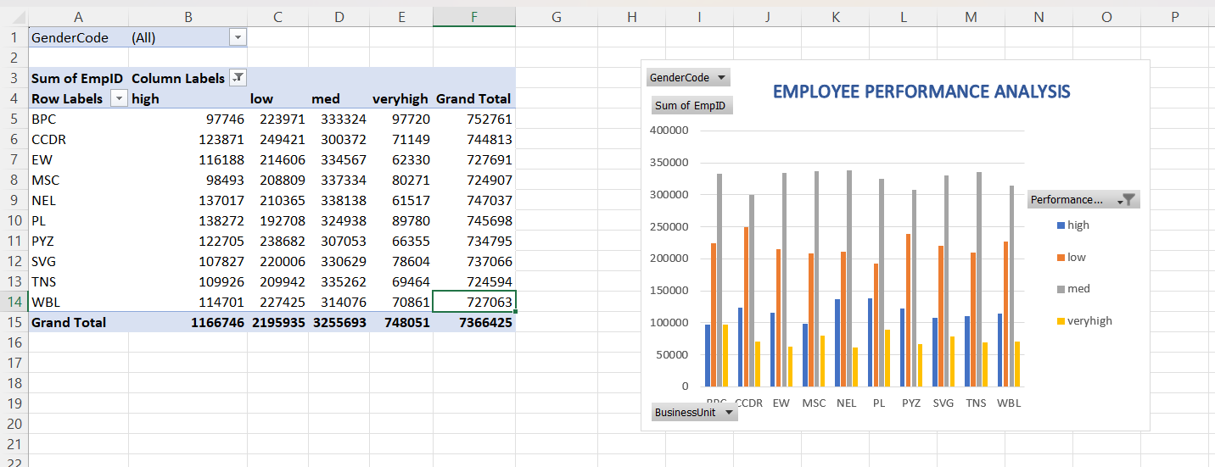
RESULTS
11

Slide 12

conclusion
Highlight key findings from the data.
Making generalized comparisonsAssess the right strength of the claim.
Are hypotheses supported? To what extent? To what extent do generalizations hold

