Slide 1

department of chemistry, ceg campus, Anna university.
Topic
Meerwein–Ponndorf–Verley reduction
By
V Sai Ram

Slide 2
INTRODUCTION
MPV Reduction is the reduction of aldehydes and ketones to corresponding alcohols using Aluminium oxide catalysis in the presence sacrificial alcohol.
The MPV reduction was discovered by Albert Verley and the team of Hans Meerwein and Rudolf Schmidt in 1925. They found that a mixture of aluminium ethoxide and ethanol could reduce aldehydes to their alcohols.
Ponndorf applied the reaction to ketones and upgraded the catalyst to aluminium isopropoxide in isopropanol.

Slide 3
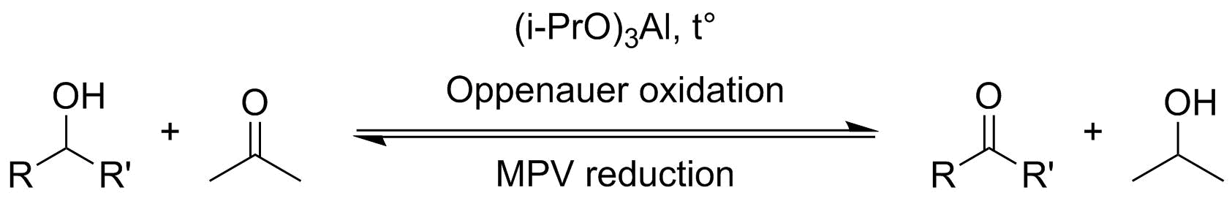
GENERAL REACTION
Conversion of aldehyde or ketone in to corresponding alcohol by treatment with Aluminium isopropoxide in isopropanol solution.
This reaction is reversible and is called Oppenauer oxidation

Slide 4
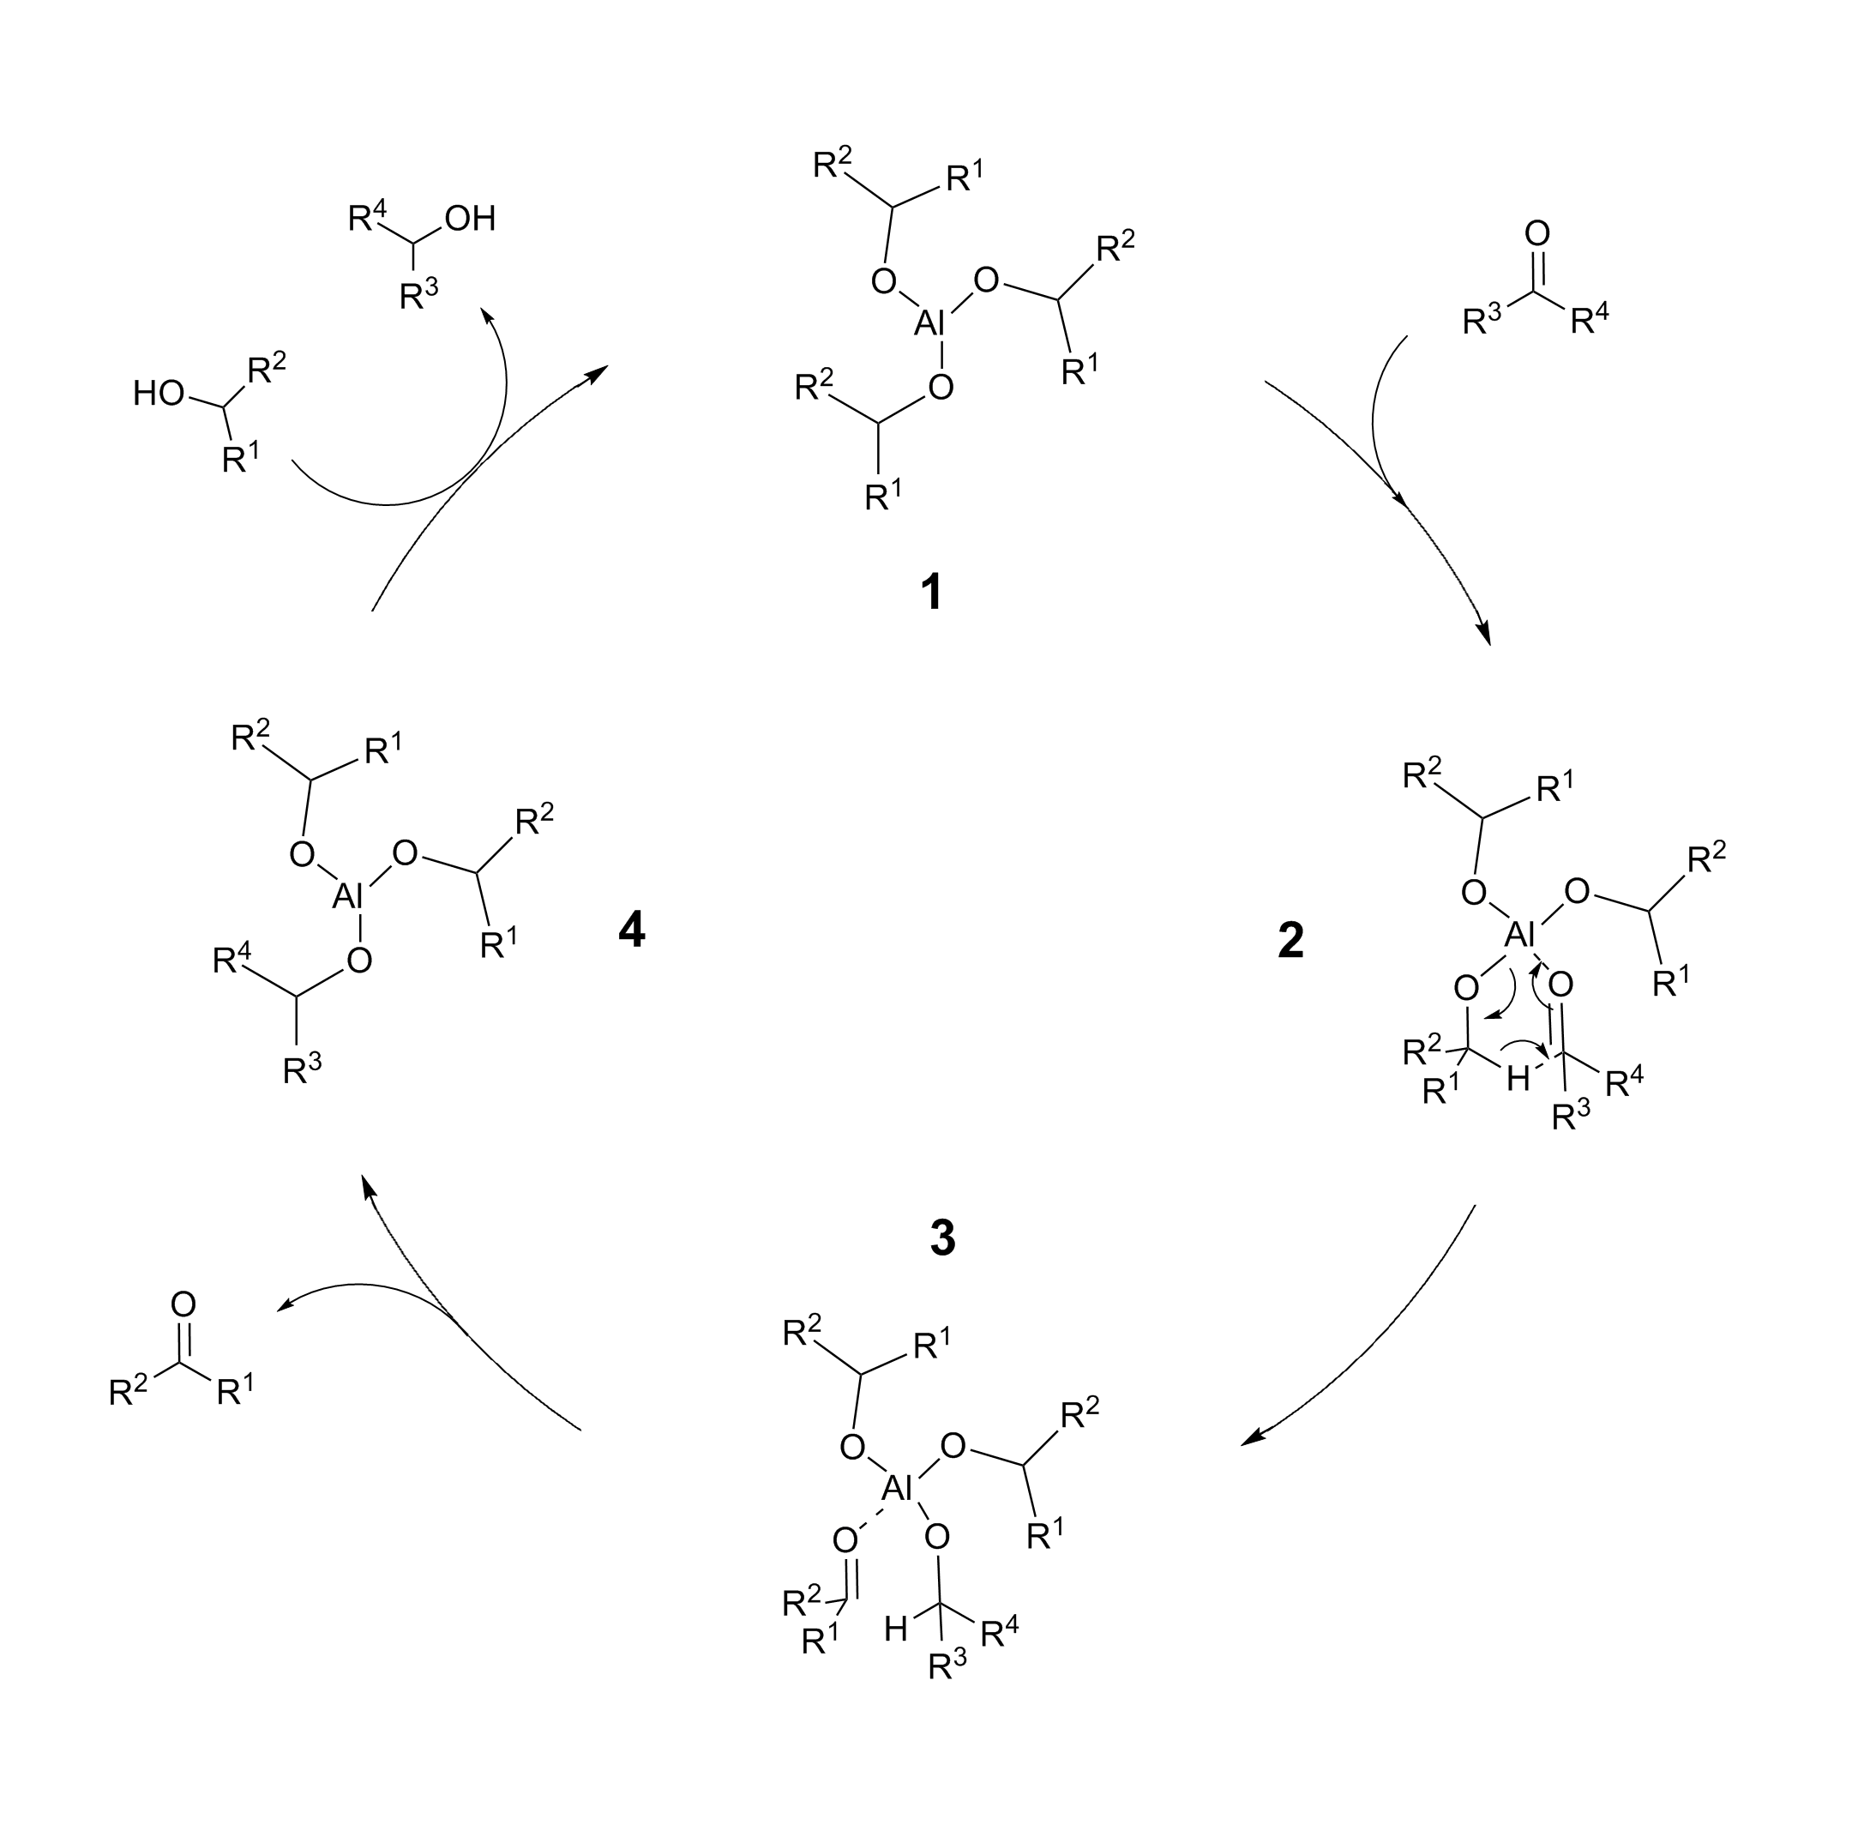
Mechanism

Slide 5
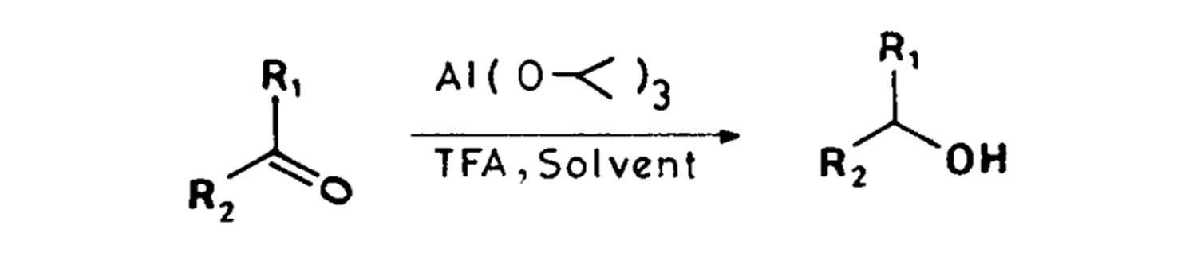
MODIFICATION
Aldehydes and ketones have been reduced very rapidly in good yields at room temperature by addition of trifluoroacetic acid (TFA) to aluminium isopropoxide (AIP) in MPC reduction.
A modified Meerwein-Ponndorf-Verley reduction system has been developed which results in extremely rapid reduction of aldehydes and ketones to carbinols at room temperature in good conversions.

Slide 6
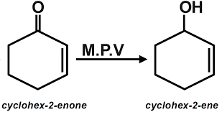
APPLICATIONS
This method of reduction is specific for carbonyl group and therefore it can be used for reducing aldehydes and ketones containing some other reducible group, such as, a double bond, a nitro or an ester group, which are not reduced under these conditions.

Slide 7
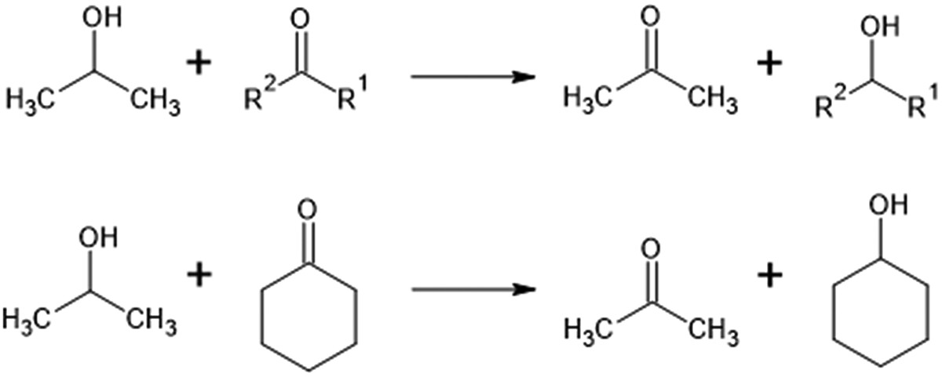
APPLICATIONS

Slide 8
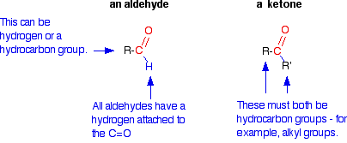
Chemoselectivity
One of the great draws of the Meerwein–Ponndorf–Verley reduction is its chemoselectivity.
Aldehydes are reduced before ketones allowing for a measure of control over the reaction.

Slide 9
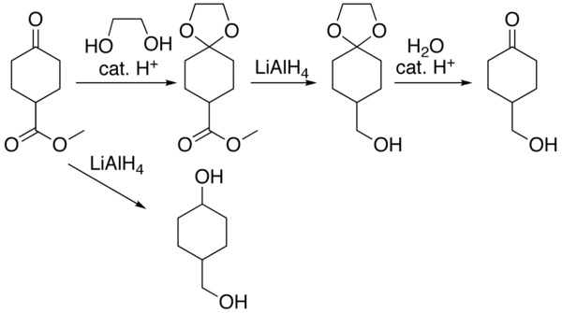
Chemoselectivity
If it is necessary to reduce one carbonyl in the presence of another, the common carbonyl protecting groups may be employed. Groups, such as alkenes and alkynes, that normally pose a problem for reduction by other means have no reactivity under these conditions

Slide 10
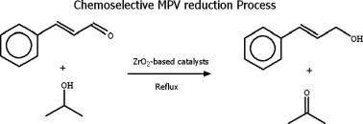
Chemoselectivity

Slide 11
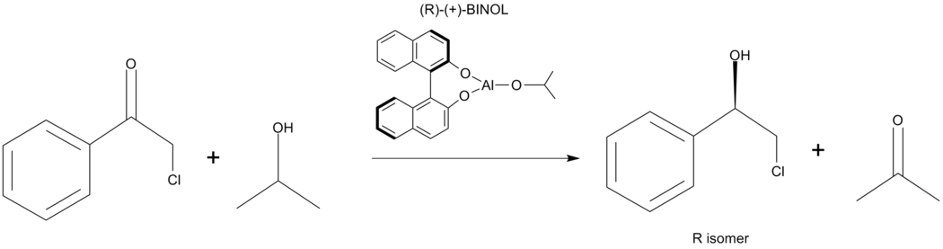
Stereoselectivity
The aluminium based Meerwein–Ponndorf–Verley reduction can be performed on prochiral ketones leading to chiralalcohols. The three main ways to achieve the asymmetric reduction is by use of a chiral alcohol hydride source, use of an intramolecular MPV reduction, or use of a chiral ligand on the aluminium alkoxide

Slide 12
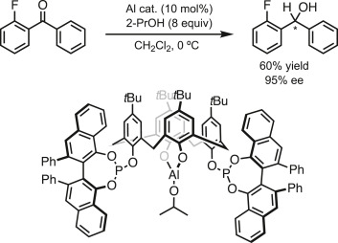
Variations Asymmetric Oxidation and Reductions
Al and Y Catalyzed ATH of C=O Bond
Asymmetric Meerwein–Ponndorf–Verley reduction using Al-calix[4]arene complex as a catalyst.

Slide 13
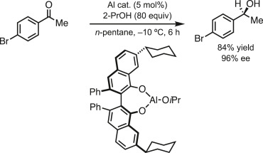
Variations Chiral Al-catalyst for MPV reduction bearing (S)-VANOL derivative

Slide 14
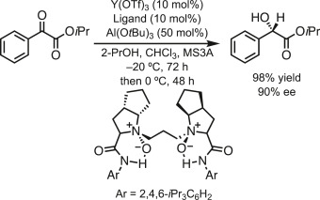
Variations Chiral Al-catalyst for MPV reduction bearing (S)-VANOL derivative.

