Slide 1
CPSC 323: Compilers and Languages Epsilon - NFA
Mr. Kavil Jain
Teaching Associate
Mail: kjain@fullerton.edu
Reference : Prof Doina Bein & Prof James Choi

Slide 2
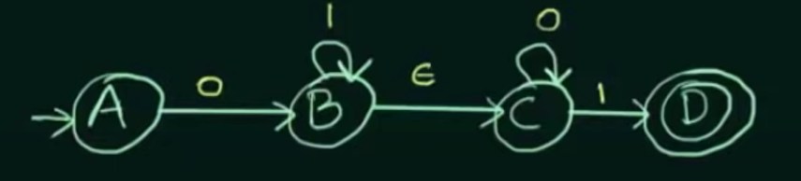

Epsilon(ε)- NFA
Epsilon represent empty input symbol or null input.
5 Tuples in ε-NFA:
{Q, Σ, $q_{0}$, δ, F}
Σ: Σ ∪ {ε} -> ${\text{Σ}}^{∗}$
δ: Q x ${\text{Σ}}^{∗}$ ∪ ε -> $2^{Q}$
Example:

Slide 3
Why Epsilon NFA?
Purely for convenience.
For instance, when converting a regular expression to an NFA, we use the transition to connect the small parts of the automata. But if there is no symbol to be read there, an epsilon transition is a simple way to do this.
They are, however, not necessary, it makes the construction of NFA simpler.

Slide 4
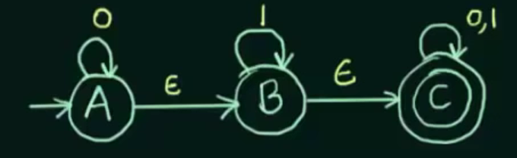
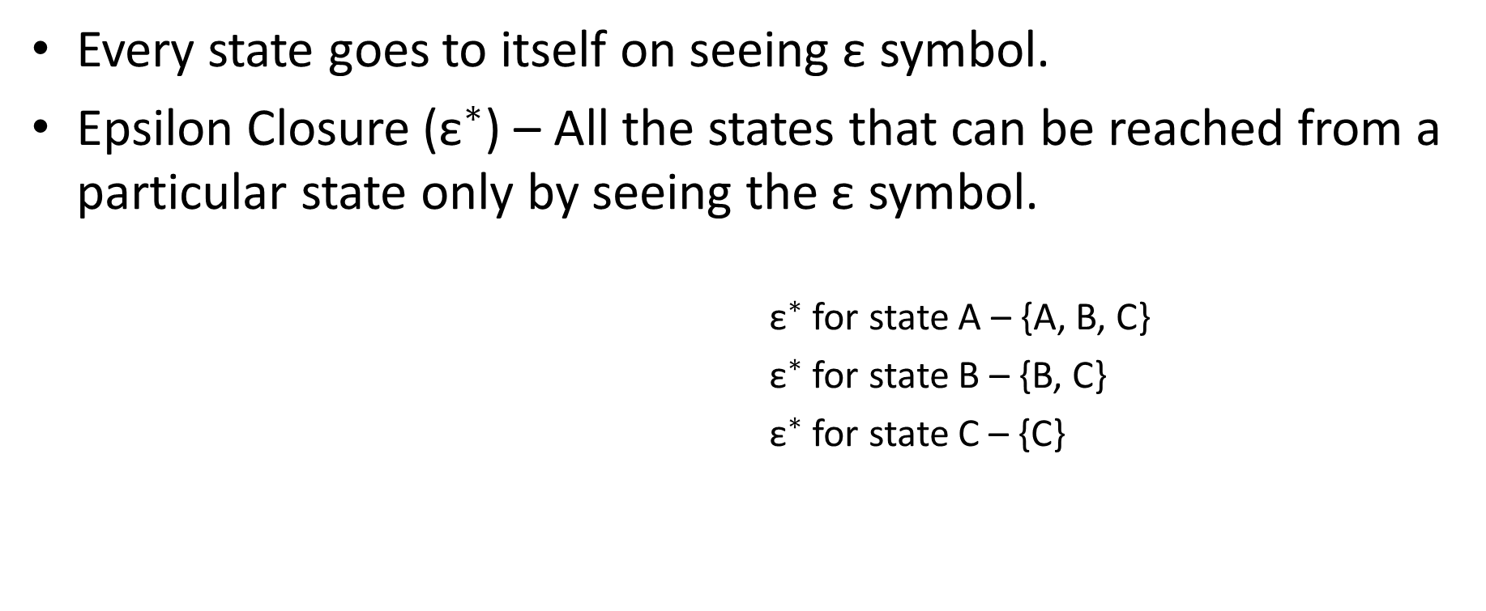
Every state goes to itself on seeing ε symbol.
Epsilon Closure (${\text{ε}}^{∗}$) – All the states that can be reached from a particular state only by seeing the ε symbol.
${\text{ε}}^{∗}$ for state A – {A, B, C}
${\text{ε}}^{∗}$ for state B – {B, C}
${\text{ε}}^{∗}$ for state C – {C}

Slide 5
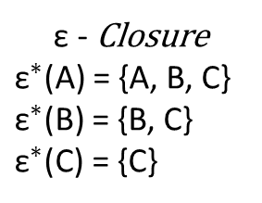
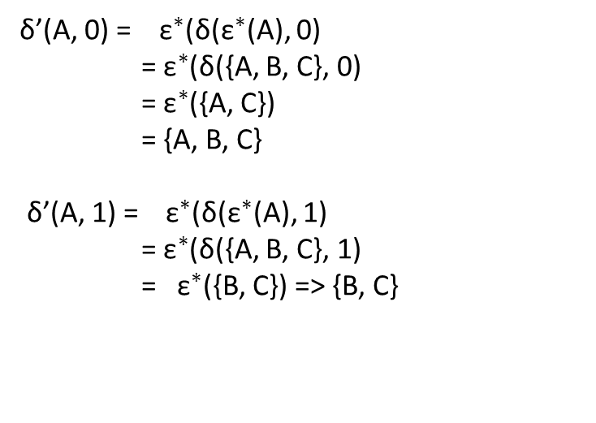
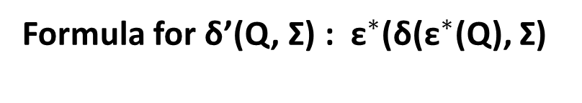
Convert ε-NFA to NFA
ε - NFA
 | 0 | 1 | ε
A | {A} | φ | {B}
B | φ | B | C
C | {C} | {C} | φ
ε - Closure
${\text{ε}}^{∗}$(A) = {A, B, C}
${\text{ε}}^{∗}$(B) = {B, C}
${\text{ε}}^{∗}$(C) = {C}
δ’(A, 0) = ${ \text{ε}}^{∗}$(δ(${\text{ε}}^{∗}$(A), 0)
= ${\text{ε}}^{∗}$(δ({A, B, C}, 0)
= ${\text{ε}}^{∗}$({A, C}) = {A, B, C} δ’(A, 1) = ${ \text{ε}}^{∗}$(δ(${\text{ε}}^{∗}$(A), 1)
= ${\text{ε}}^{∗}$(δ({A, B, C}, 1)
= ${ \text{ε}}^{∗}$({B, C}) => {B, C}
Formula for δ’(Q, Σ) : ${\text{ε}}^{∗}$(δ(${\text{ε}}^{∗}$(Q), Σ)

Slide 6
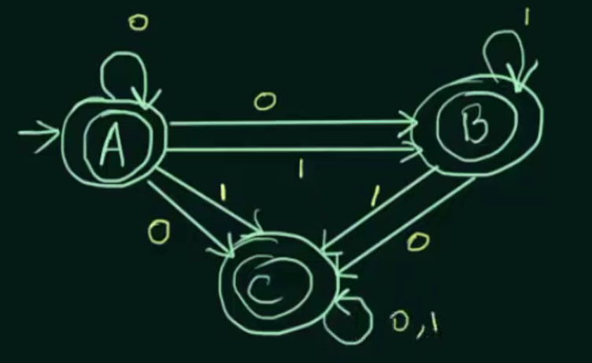

To find final states -> if ${\text{ε}}^{∗}$ of the state has final state in ε - NFA
 | 0 | 1
A | {A, B, C} | {B, C}
B | {C} | {B, C}
C | {C} | {C}

Slide 7
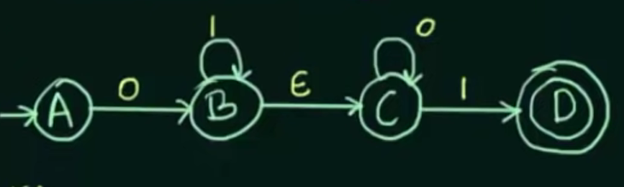
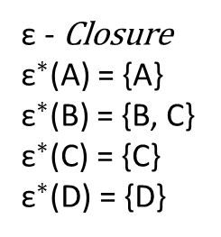
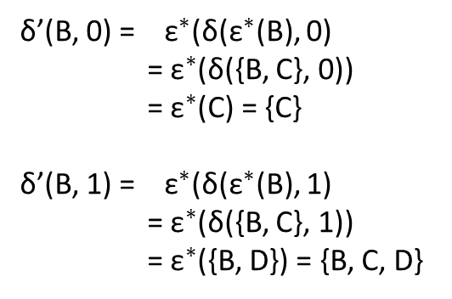
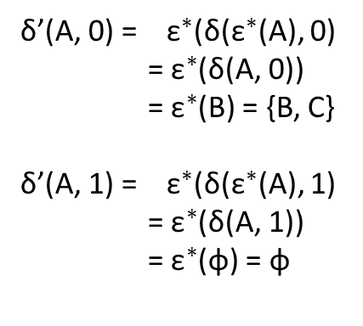
Example
 | 0 | 1 | ε
A | B | φ | φ
B | φ | B | C
C | C | D | φ
D | φ | φ | φ
ε - Closure
${\text{ε}}^{∗}$(A) = {A}
${\text{ε}}^{∗}$(B) = {B, C}
${\text{ε}}^{∗}$(C) = {C}
${\text{ε}}^{∗}$(D) = {D}
δ’(A, 0) = ${ \text{ε}}^{∗}$(δ(${\text{ε}}^{∗}$(A), 0)
= ${\text{ε}}^{∗}$(δ(A, 0))
= ${\text{ε}}^{∗}$(B) = {B, C} δ’(A, 1) = ${ \text{ε}}^{∗}$(δ(${\text{ε}}^{∗}$(A), 1)
= ${\text{ε}}^{∗}$(δ(A, 1))
= ${\text{ε}}^{∗}$(φ) = φ
δ’(B, 0) = ${ \text{ε}}^{∗}$(δ(${\text{ε}}^{∗}$(B), 0)
= ${\text{ε}}^{∗}$(δ({B, C}, 0))
= ${\text{ε}}^{∗}$(C) = {C} δ’(B, 1) = ${ \text{ε}}^{∗}$(δ(${\text{ε}}^{∗}$(B), 1)
= ${\text{ε}}^{∗}$(δ({B, C}, 1))
= ${\text{ε}}^{∗}$({B, D}) = {B, C, D}
……….

Slide 8
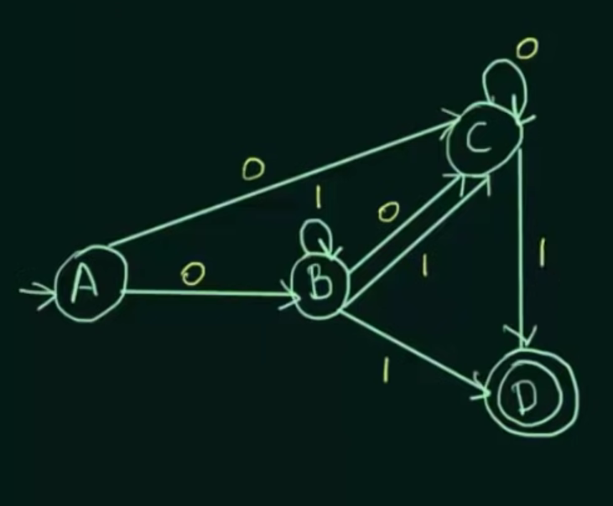
 | 0 | 1
A | {B, C} | φ
B | C | {B, C, D}
C | C | D
D | φ | φ

Slide 9
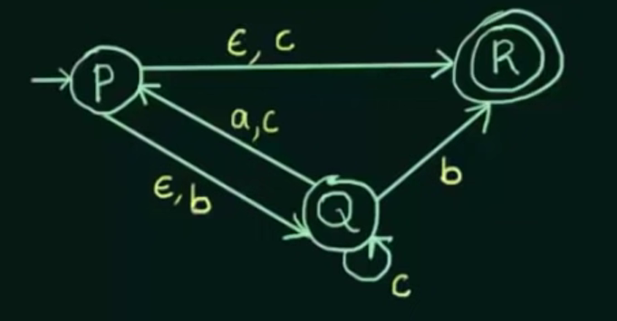
Classwork
Convert the following ε-NFA to its equivalent NFA

