Slide 1
CPSC 323: Compilers and Languages Compiler Design - Architecture
Mr. Kavil Jain
Teaching Associate
Mail: kjain@fullerton.edu
Reference : Prof Doina Bein & Prof James Choi

Slide 2
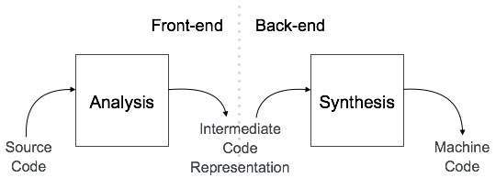
Phases of Compiler
Reference: Tutorials Point

Slide 3
Analysis Phase
Analysis phase is the first three phases of compiler also called as front-end of the compiler – [Lexical Analysis, Syntax Analysis, Semantic Analysis].
The analysis phase of the compiler reads the source program, divides it into core parts and then checks for lexical, grammar and syntax errors.
The analysis phase generates an intermediate representation of the source program and symbol table, which should be fed to the Synthesis phase as input.

Slide 4
Synthesis Phase
Synthesis phase is also called the back-end of the compiler which contains intermediate code generator, code optimization, and Code generation.
The synthesis phase generates the target program with the help of intermediate source code representation and symbol table.

Slide 5
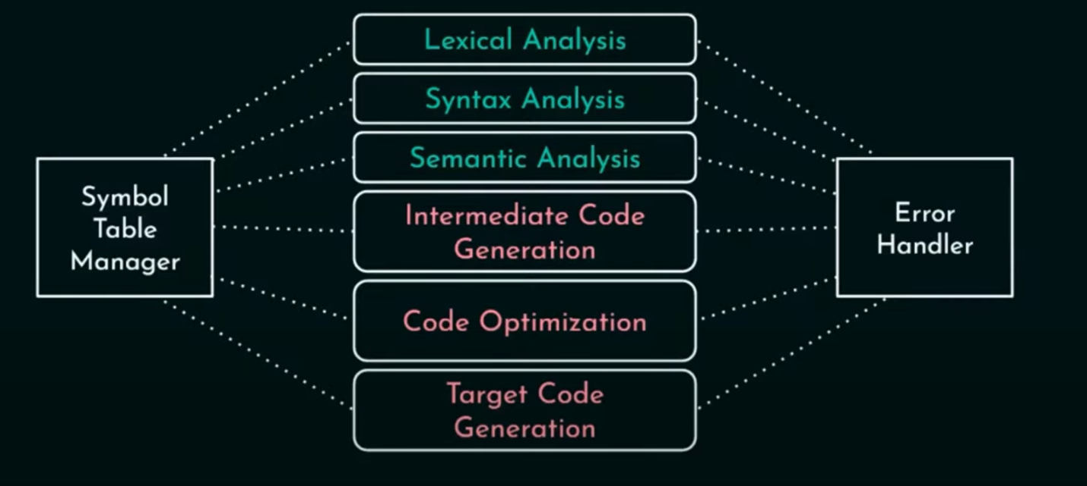

Slide 6
Lexical Analysis (Scanner)
Lexical analysis or Lexical analyzer is the initial stage or phase of the compiler. This phase scans the source code and transforms the input program into a series of a token.
A token is basically the arrangement of characters that defines a unit of information in the source code.
Roles and Responsibilities of Lexical Analyzer
It is accountable for terminating the comments and white spaces from the source program.
It helps in identifying the tokens.
Categorization of lexical units.

Slide 7
Syntax Analysis (Parser)
Analyzes the structure of the source code based on the grammar rules of the programming language.
It accepts tokens as input and provides a parse tree as output. It is also known as parsing in a compiler.
Roles and Responsibilities of Syntax Analyzer
Note syntax errors.
Helps in building a parse tree.
Acquire tokens from the lexical analyzer.
Scan the syntax errors, if any.

Slide 8
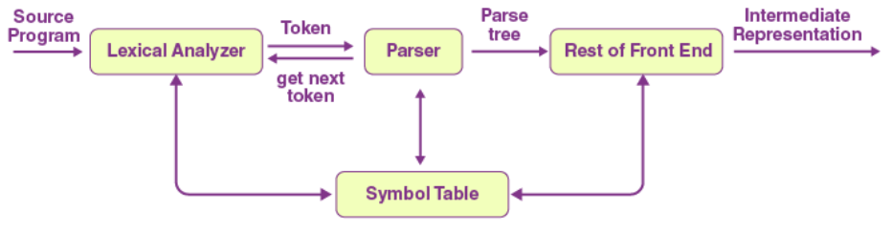

Slide 9
Semantic Analysis
Semantic analyzer defines the validity of the parse tree, and the annotated syntax tree comes as an output.
Checks the meaning of the code, ensuring it adheres to the semantics of the programming language.
Generates a symbol table that keeps track of variables, their types, and their scopes.
Roles and Responsibilities of Semantic Analyzer:
Saving collected data to symbol tables or syntax trees.
It notifies semantic errors.
Scanning for semantic errors.

Slide 10
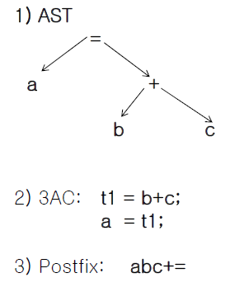
Intermediate Code Generation
It is a phase where an internal representation of the source code is created that reflects the information uncovered during the syntax analysis phase.
Examples of Internal representation:
Source code: a = b + c
Abstract Syntax Tree
Three Address Code

Slide 11
Code Optimization
Enhances the intermediate code to improve the efficiency of the generated machine code.
Techniques include constant folding, common subexpression elimination, and loop optimization.
The goal is to produce code that runs faster and uses fewer resources.

Slide 12
Code Generation
Translates the optimized intermediate code into machine code or assembly code for the target architecture.
Involves choosing appropriate instructions and registers to implement the high-level code efficiently.

Slide 13
Symbol Table
The symbol table is mainly known as the data structure of the compiler. It helps in storing the identifiers with their name and types. It makes it very easy to operate the searching and fetching process.
The symbol table connects or interacts with all phases of the compiler and error handler for updates. It is also accountable for scope management.

Slide 14
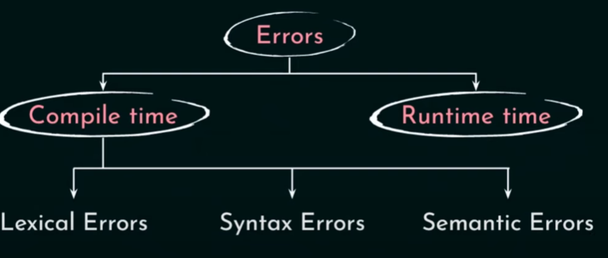
Error Handler
Detects and reports errors at various stages of compilation.
Provides meaningful error messages to help programmers identify and correct issues in their code.

