Slide 1
CPSC 323: Compilers and Languages DFA & NFA
Mr. Kavil Jain
Teaching Associate
Mail: kjain@fullerton.edu
Reference : Prof Doina Bein & Prof James Choi

Slide 2
Finite Automata
Finite Automata, or Finite State Machines (FSMs), are theoretical models of computation used to recognize patterns in strings.
A finite automaton has five elements or tuples:
States (Q):
Finite set of states representing the different situations the automaton can be in.
Alphabet (Σ):
A finite set of input symbols.
Transition Function (δ):
Defines how the automaton transitions from one state to another based on the current state and input symbol. Q x Σ -> Q
Start State (q₀):
The initial state where the automaton begins processing.
Accepting States (F):
Set of states that, if reached, signify the input is accepted.

Slide 3
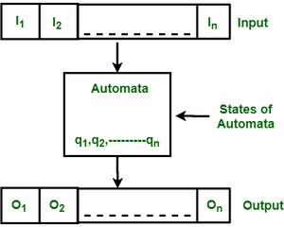
Basically, it is an abstract model of a digital computer which reads an input string and changes its internal state depending on the current input symbol.
Reference: GeeksForGeeks

Slide 4
Deterministic Finite Automaton (DFA)
A DFA is a type of finite automaton where, for each state and input symbol, there is exactly one next state. It's deterministic because there is no ambiguity in the transition from one state to another.
Null (or epsilon(ε)) move is not allowed, i.e., DFA cannot change state without any input character.

Slide 5
Example 1
For example, construct a DFA which accept a language of all strings ending with ‘a’.
Given: Σ = {a,b}, q = {q0}, F={q1}, Q = {q0, q1} List of acceptable strings
L = {a, aa, aaa, aaaa, aaaaa, ba, bba, bbbaa, aba, abba, aaba, abaa}
Strings not accepted are,
ab, bb, aab, abbb, etc.
_{State}\^{Symbol?} | a | b
q₀ | q₁ | q₀
q₁ | q₁ | q₀

Slide 6
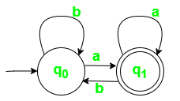
State Transition Diagram for DFA with ? = {a, b}

Slide 7
Example 2
DFA for Strings with an Odd Number of 0s and 1s:
Alphabet (Σ): {0, 1}
States (Q): {q₀, q₁, q₂}
Transition Function (δ):
δ(q₀, 0) = q₁
δ(q₀, 1) = q₁
δ(q₁, 0) = q₂
δ(q₁, 1) = q₂
δ(q₂, 0) = q₀
δ(q₂, 1) = q₀
Start State (q₀): q₀
Accepting States (F): {q₁, q₂}

Slide 8
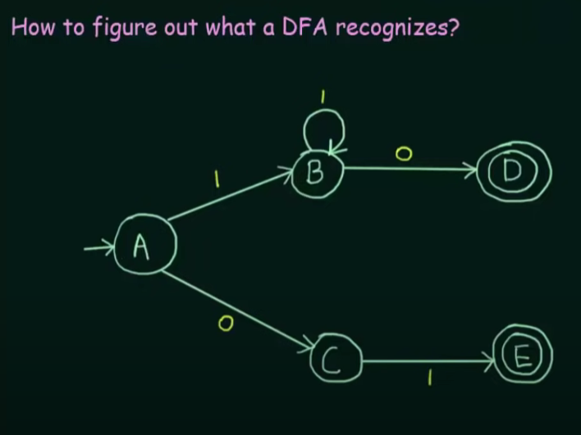
Classwork
Set of all strings that start with ‘0’
Set of all string over {0, 1} of length 2.
Set of all strings over {a, b} that does not contain ‘aabb’ in it.

Slide 9
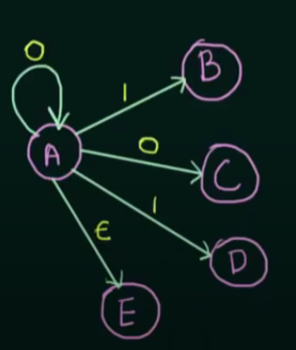
Nondeterministic Finite Automata(NFA)
NFA is similar to DFA except following additional features:
Null (or ε) move is allowed i.e., it can move forward without reading symbols.
Ability to transmit to any number of states for a particular input.
The next state may be chosen at random or all the next states may be chosen in parallel

Slide 10
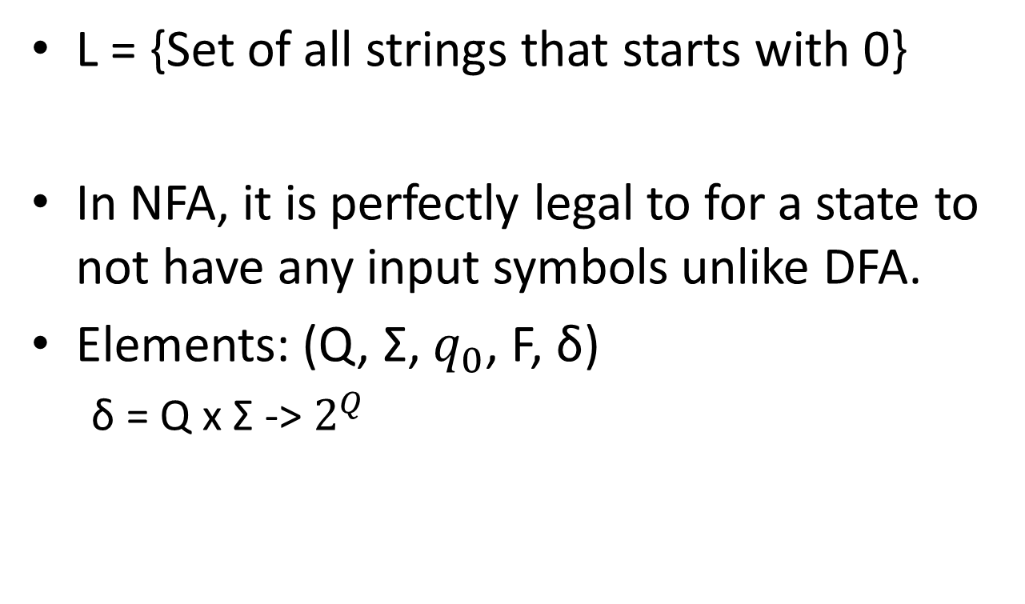
0,1
L = {Set of all strings that starts with 0}
In NFA, it is perfectly legal to for a state to not have any input symbols unlike DFA.
Elements: (Q, Σ, $q_{0}$, F, δ)
δ = Q x Σ -> $2^{Q}$
A
0
B

Slide 11
Examples
0,1
L = {Set of all strings that starts with 0}
{0, 00, 000, 01, 010, 011 …… }
L = {Set of all strings over {0,1} of length 2}
Σ = {0, 1}
L = {00, 01, 10, 11}
A
0
B
A
0, 1
B
0, 1
C

Slide 12
Classwork
L1 = {Set of all strings that contains ‘0’}
L2 = {Set of all strings that starts with ’10’}
L3 = {Set of all strings that contains ‘01’}
L4 = {Set of all strings that ends with ’11’}

Slide 13

Conversion of NFA to DFA
Transition Function in DFA δ = Q x Σ -> Q
NFA δ = Q x Σ -> $2^{Q}$
Example: L={Set of all string over {0, 1} that starts with ‘0’}
Σ = {0, 1}
NFA =>
DFA =>
0,1
 | 0 | 1
A | B | φ
B | B | B
A
0
B
0,1
 | 0 | 1
A | B | C
B | B | B
C | C | C
A
0
B
1
C
0,1
C is a Dead State

Slide 14
Example 1
L = {Set of all strings over {0, 1} that ends with ‘1’}
Σ = 0, 1
NFA =>
DFA =>
0,1
 | 0 | 1
A | {A} | {A, B}
B | φ | φ
A
1
B
0
 | 0 | 1
A | A | AB
AB | A | AB
A
1
AB
AB – Single State

Slide 15
Example 2
Find the equivalent DFA for the NFA given by M = [{A, B, C}, (a,b), δ, A, {C}] where δ is given by:
 | a | b
A | A, B | C
B | A | B
C | - | A, B
 | a | b
A | AB | C
AB | AB | CB
CB | A | AB
C | D | AB
D | D | D
A
a
b
CB
a
b
a
AB
b
a, b
b
C
D
a

Slide 16
Classwork
L = {Set of all strings over (0,1) that ends with ‘01’}
L = {Set of all strings over {0,1} in which the second last symbol is ‘1’}
 | 0 | 1
A | A, B | A
B | - | C
 | - | -
C

