Slide 1
Quantum
Search Lab
An application-driven implementation and evaluation of Grover’s search algorithm
Quantum Computing · Course project
Kavin-JS.github.io/GrovX
Notes:
Introduce the project in one sentence: I implemented Grover’s search algorithm as a real quantum circuit on a simulator, compared it with ordinary classical search, and measured what it would cost on real hardware. The website is live at the address on the slide and everything I show today comes from it. The bars on the right are the idea of the whole talk: many equal items, and one marked item whose amplitude gets pushed up.

Slide 2
The problem: one item among N
You have N = 2ⁿ candidates and a yes/no check. Nothing else: no order, no structure to exploit.
≈ N / 2
checks on average with classical linear search
Unlock code
the lock says open or denied
≈ 0.785·√N
Database record
does record x match the query?
oracle queries with Grover’s algorithm
Cipher key
A quadratic reduction. Not exponential.
does this key decrypt correctly?
Notes:
Explain the problem without any quantum words first. Imagine a lock that only says open or denied. If you have N possible codes and no clue, you try them one by one, which takes about N over 2 attempts on average. The same shape appears for finding a record in an unsorted table or a key of a cipher. Grover’s algorithm needs only about 0.785 times the square root of N queries. That is a quadratic improvement, and it is important to say it is not exponential, because examiners often ask.

Slide 3
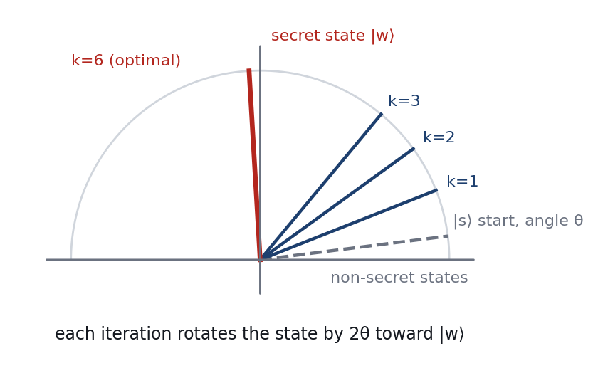
How Grover’s algorithm works
01
Superpose
Hadamard on every qubit: all N items get equal amplitude.
02
Oracle
Flip the sign of the secret item’s amplitude.
03
Diffuse
Reflect all amplitudes about their mean: the secret grows, others shrink.
04
Repeat, then measure
Each iteration rotates the state by 2θ toward the secret. P = sin²((2k+1)θ).
About (π/4)√N rounds, then read out all qubits.
Notes:
Walk through the four steps. One: Hadamard gates put the register in an equal superposition, so every item has the same tiny amplitude. Two: the oracle marks the secret by flipping the sign of its amplitude; nothing is measurable yet. Three: the diffusion step reflects every amplitude about the average; because the secret is now below average, it ends far above it. Repeat about pi over four times root N. The picture on the right is the geometric reason it works: two reflections make a rotation by 2 theta, so the state turns steadily toward the secret. If you rotate too far it turns past the secret, so you must stop at the right time.

Slide 4
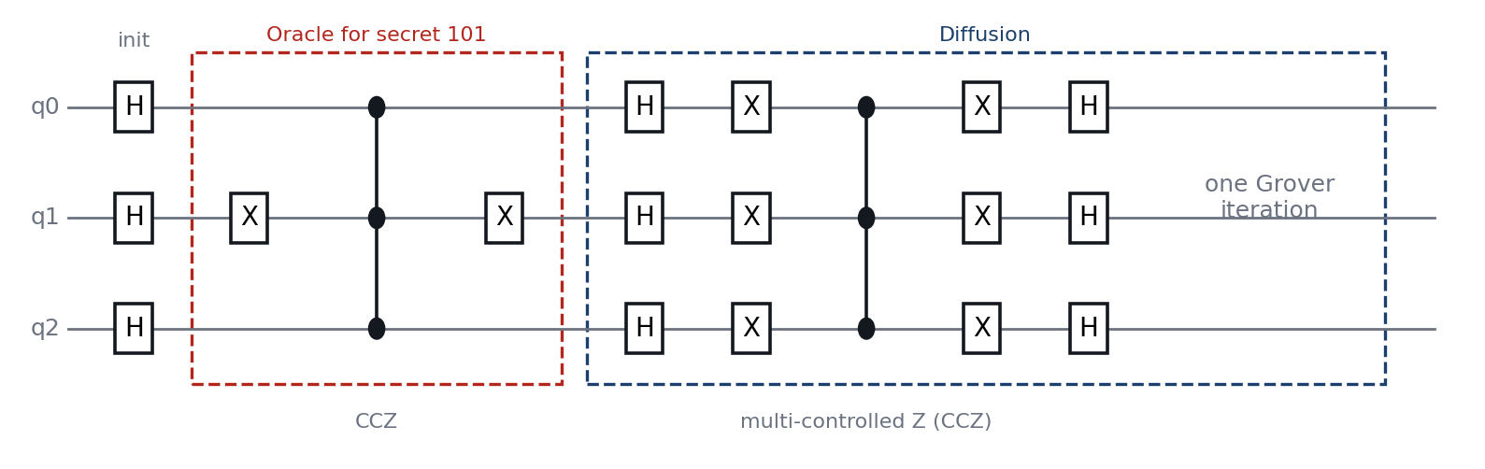
The circuit I implemented
Only three gates
Oracle = X, MCZ, X
Diffusion = H, X, MCZ, X, H
Hadamard, Pauli-X and multi-controlled Z. All real-valued, so the simulation is exact.
X gates select which bit pattern is marked; the MCZ flips its sign.
At n = 14: 100 iterations, 2,814 H, 4,200 X and 200 MCZ gates.
Notes:
This is the actual circuit for three qubits with the secret 101. The red box is the oracle: an X gate on the qubit where the secret has a zero, then a multi-controlled Z, then the X again. That flips the sign of exactly one state. The blue box is the diffusion step: H, X, multi-controlled Z, X, H on all qubits. Repeat those two boxes. In my code these are literally lists of gates that the simulator executes one by one, so it is a real circuit simulation and not a shortcut formula.

Slide 5
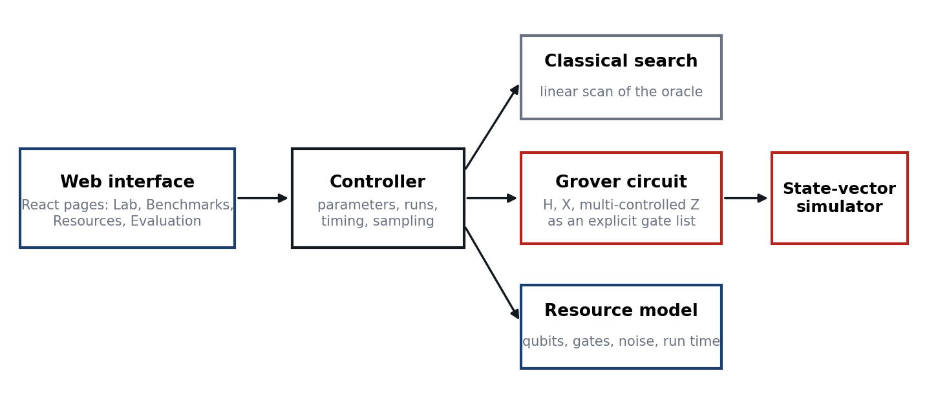
System and verification
12 tests
automated unit tests, all passing
9 decimals
simulation matches sin²((2k+1)θ) at every iteration
Everything runs in the browser: React + Vite, hosted on GitHub Pages. No backend, no database, no API keys.
Notes:
The site has six pages: Home, Algorithm, Lab, Benchmarks, Resources and Evaluation. The Lab runs classical search and Grover side by side. A controller in the browser runs both, times them, samples measurements and draws charts. To be sure the circuit is right I wrote twelve automated tests. The key one runs the full circuit for several sizes and compares the success probability after every iteration with the theoretical formula; they agree to nine decimal places. So the results I show are trustworthy.

Slide 6
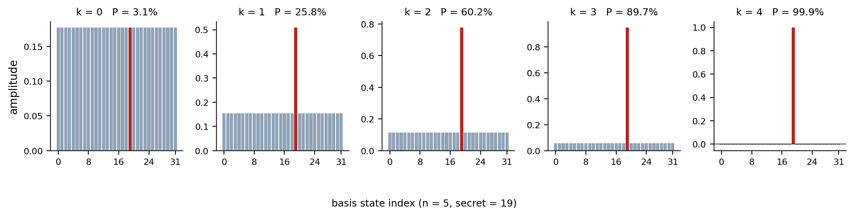
Watching the secret’s amplitude grow
3.1%
25.8%
60.2%
89.7%
99.9%
after k = 0
after k = 1
after k = 2
after k = 3
after k = 4
n = 5, secret item 19. Four iterations, against 16.5 classical guesses on average.
Notes:
This is the simulation for 32 items. Panel by panel you can see the red bar growing and the others shrinking. Below are the probabilities of measuring the secret after each iteration: about 3 percent to start, then 26, 60, 90, and 99.9 percent after four iterations. A classical search would need about 16 tries on average. This is the live demo on the Lab page, where you can change the number of qubits and the secret.

Slide 7
Queries: a quadratic reduction
82×
fewer queries at n = 14 (100 vs 8,199)
≈ 650×
at n = 20 (804 vs 524,288)
≥ 99.5%
success probability for every n ≥ 5
Notes:
The grey line is classical search, the blue line is Grover, on a log scale so you can see both. The gap widens with size: 82 times fewer queries at 14 qubits, about 650 times at 20 qubits. I measured the classical numbers by actually running linear search 2000 times per size and the Grover numbers by running the circuit; the lines beyond 14 qubits are the formulas. Success probability at the optimal iteration count is at least 99.5 percent for five qubits and up. For very small sizes it is a little lower, for example 94.5 percent at three qubits, because the number of iterations must be a whole number.

Slide 8
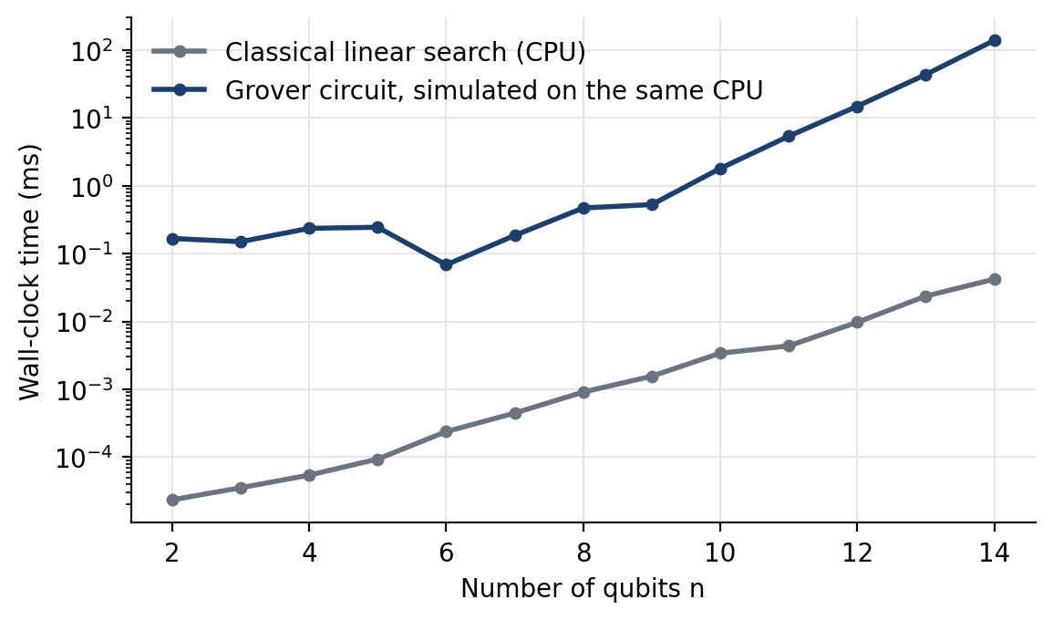
A simulator cannot show the speed-up
3,297×
slower to simulate than to search classically at n = 14 (139 ms vs 0.042 ms)
The simulator does 2ⁿ operations for every gate.
Simulation cost grows much faster with n than classical search does.
Only real quantum hardware can turn fewer queries into less time.
Wall-clock time on the same CPU, log scale.
Notes:
This slide is the honest part. If I time the classical search and my simulation of Grover on the same laptop, the simulation is thousands of times slower. That is expected, not a failure: a simulator has to store and update all 2 to the n amplitudes for every gate, while a real quantum computer holds them in n qubits. So the advantage of Grover is in the number of oracle queries on quantum hardware, not in simulator wall-clock time. Saying this clearly makes the evaluation more credible.

Slide 9
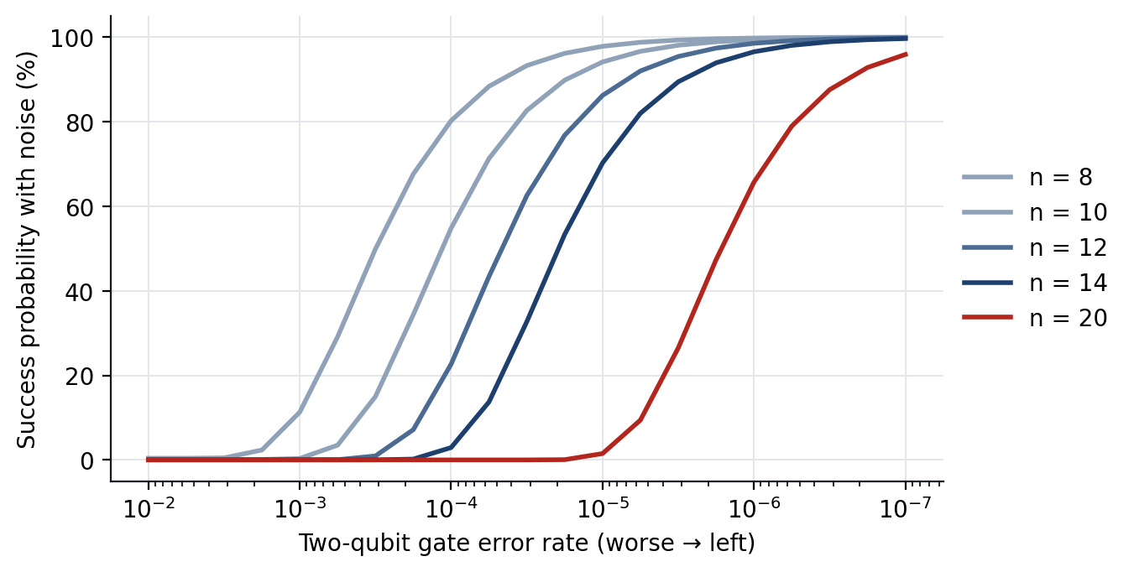
Reality check: noise and circuit depth
n = 14 needs 26 logical qubits and about 30,000 two-qubit gates.
At 10⁻³ error per gate, the run almost never succeeds.
At 10⁻⁶ it succeeds 96.5% of the time.
Faster and reliable only for n = 14–21, at 10⁻⁶ error and a simple oracle.
A 5,000-Toffoli oracle (hash-like) removes the window entirely.
Success probability against two-qubit gate error rate, for n = 8 to 20.
Notes:
Qubits are not the problem: 14 qubits of data need 26 logical qubits with ancillas. Circuit length is. Grover at 14 qubits needs 100 iterations and around 30,000 two-qubit gates. If every gate fails with probability 10 to the minus 3, which is roughly the best today, the whole circuit almost never works. You need around 10 to the minus 6 for it to work. Even then, under my model the quantum run is faster and reliable only for about 14 to 21 qubits with a simple oracle, and if the oracle is a realistic hash-like circuit of 5,000 Toffoli gates, there is no such window. These resource figures are estimates with stated assumptions; they show trends, not vendor numbers.

Slide 10
Classical search vs Grover’s algorithm
Factor | Classical | Grover
Queries | O(N), about N/2 on average | O(√N), about 0.785·√N
Result | Exact | Probabilistic, ≥ 99.5% for n ≥ 5
Needs to know | Nothing | Number of secrets M, to choose k
Oracle | Any function call | Reversible quantum circuit
Parallelism | p machines: p× faster | p machines: only √p×
Errors | Negligible | Depth grows as n√N: very sensitive
Hardware | Any CPU | Fault-tolerant quantum computer
Notes:
A one-slide summary. The important rows: results are probabilistic instead of exact, you need to know how many secrets there are to choose the number of iterations, the oracle must be built as a reversible quantum circuit, parallelism is worse for Grover, and it is very sensitive to errors because circuits are deep. Hardware today cannot run this at useful sizes.

Slide 11
Conclusion
1
The implementation is correct
A gate-level circuit that matches theory to 9 decimals at every iteration.
2
The query advantage is real, quadratic and optimal
82× fewer queries at n = 14, growing as √N.
3
It is not yet a practical advantage
Circuit depth, noise and oracle cost dominate. It needs error-corrected hardware.
Kavin-JS.github.io/GrovX
Notes:
Close with the three points. One: the implementation is correct, verified against the formula. Two: the advantage is real but quadratic, and provably optimal for unstructured search. Three: today it is not a practical advantage, because circuits are deep, noise is high and the oracle for a real problem is expensive; it needs error-corrected quantum computers. Its value now is as a foundation, as a building block for other algorithms, and as the reason symmetric keys are recommended to be doubled in length. Then take questions.

