Slide 1
Deep Learning Model Acceleration and Optimization Strategies for Real-Time Recommendation Systems
Problem Statement No. 149
Kavin J S
CH.SC.U4CSE24119

Slide 2
Problem Statement & Motivation
Recommendation systems, like the ones used by Amazon, Netflix, and YouTube, predict what a user will want to watch, buy, or listen to next.
The tricky part is doing this in real time — the system only has a few milliseconds to respond after a user clicks or scrolls.
The most accurate deep learning models (like self-attention or CNN-LSTM) are usually too slow and heavy to keep up with that speed.
Popular platforms also get huge traffic — sometimes tens of thousands of requests per second — so the system needs to scale too.
Goal: make these models faster and lighter, and able to handle more traffic, without losing the accuracy that makes them useful.
User Request
→
Deep Learning Model
→
Recommendation Output

Slide 3
Identifying Datasets & Evaluation Metrics
DATASETS USED
METHODOLOGY PIPELINE
EVALUATION METRICS
Alibaba Taobao User Behavior Dataset
User Behaviour Dataset
Metric | Interpretation
Latency | Response Time
Throughput | Requests / Second
Hit Rate@50 | Recommendation Accuracy
NDCG@50 | Ranking Quality
MRR | Ranking Performance
Memory Usage | Deployment Efficiency
50M
Interaction Logs
1M
Users
200K
Products
Baseline FP32 Model
Real-world e-commerce behaviour, ideal for evaluating real-time recommendation performance.
Structured Pruning
BEHAVIOUR TYPES
INT8 Quantization
Page View
Favourite
Add to Cart
Purchase
Knowledge Distillation
INTERPRETATION
PREPROCESSING FLOW
TensorRT FP16
The framework combines model compression and deployment optimization to reduce latency, memory usage and computational cost while maintaining recommendation quality.
Raw Logs
Latest 100 User Actions
Elastic Scheduling
Sequence Construction
Load Balancing
50 Candidate Items
Optimized Recommendation Model
Model Input

Slide 4
Results, Interpretation & Conclusion
Latency: 52.4 ms → 21.5 ms (59% faster)
Throughput: 190 → 460 req/s (2.4× more concurrent users)
Accuracy Loss: < 1% (Hit Rate, NDCG, MRR virtually unchanged)
Model Size: 128 MB → 12.8 MB (~10% of original)
Distillation + TensorRT FP16 wins — fastest, smallest, same accuracy
User benefit: same fast, relevant recommendations — even at 2.4× the traffic
Conclusion: Joint model + system optimization enables real-time, large-scale recommendation deployment for platforms like Amazon, Netflix, and YouTube.

Slide 5
PROBLEM STATEMENT 149
Deep Learning Model Acceleration and Optimization Strategies
for Real-Time Recommendation Systems
Authors: Junli Shao*, Dingzhou Wang, Dannier Li, Jing Dong, Kowei Shih, Chengrui Zhou
University of Michigan · Duke University · University of Nebraska–Lincoln · Columbia University · Independent Researcher, Shenzhen
SUBMITTED BY
Kavin J S
CH.SC.U4CSE24119 | B.Tech Computer Science Engineering
Amrita Vishwa Vidyapeetham, Chennai Campus
Phase – 2: Feature Selection & Learning Algorithm / Technique Identification
23CSE301 • ML CAPSTONE • PROBLEM STATEMENT 149
Kavin J S | CH.SC.U4CSE24119

Slide 6
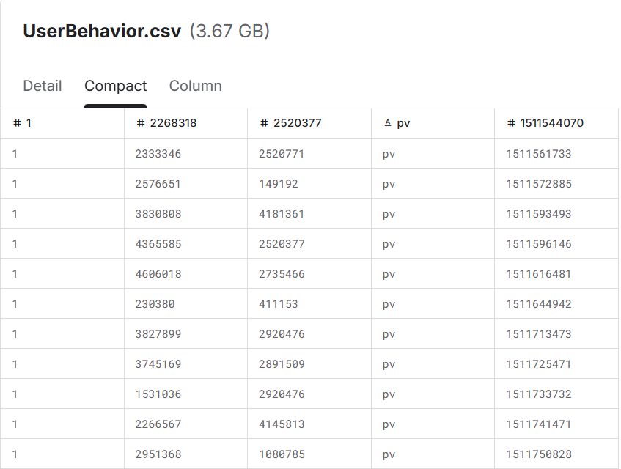
FEATURE SELECTION
02
From raw interaction logs to recommendation-ready representations
INPUT DATA
SELECTED FEATURES
01
USER IDENTIFIER
Links interactions to a user history.
02
ITEM / PRODUCT ID
Defines the item space being ranked.
03
CATEGORY
Adds product/category context.
04
BEHAVIOR TYPE
Encodes the interaction signal.
05
TIMESTAMP
Preserves temporal ordering of actions.
UserBehavior.csv • 3.67 GB • 5 columns
Roles: user • item/product • category • behavior • timestamp
DATA → REPRESENTATION → RECOMMENDATION
RAW LOGS
→
SEQUENCES
→
REPRESENTATION
→
RANKING
5 fields
latest 100/user
user + item
50 candidates
23CSE301 • ML CAPSTONE • PROBLEM STATEMENT 149
Kavin J S | CH.SC.U4CSE24119

Slide 7
IDENTIFICATION OF EXISTING ALGORITHM THROUGH LITERATURE SURVEY
03
Author and Year | Title | Objective of the Work | Achievements of the Work | Gaps from the Work
Shen et al. 2024 [4] | Accurate Prediction of Temperature Indicators in Eastern China Using a Multi-Scale CNN-LSTM-Attention Model | Predict temperature indicators in Eastern China accurately using a multi-scale CNN-LSTM-attention model. | Improves accuracy and speed by combining CNNs, LSTMs and attention for spatial-temporal modelling. | Cited only as a model example; the paper reports no recommendation-specific latency or throughput results for it.
Lin et al. 2024 [20] | Enhanced Recommendation Combining Collaborative Filtering and Large Language Models | Enhance recommendation by combining collaborative filtering with large language models. | Not explicitly reported in the paper. | Cited within [17–20] for self-attention’s quadratic latency and memory growth, which limits real-time inference.
Wu & Huang 2025 [33] | Psychological Health Prediction Based on the Fusion of Structured and Unstructured Data in EHR: a Case Study of Low-Income Populations | Predict psychological health by fusing structured and unstructured EHR data in a low-income population case study. | Not explicitly reported in the paper. | Cited for the 8-bit quantized baseline; alone it cuts GPU latency ~15.8% with ~1.0% Hit Rate drop (PS149 results).
Literature survey • PS149 paper
Kavin J S | CH.SC.U4CSE24119

Slide 8
IDENTIFICATION OF EXISTING ALGORITHM THROUGH LITERATURE SURVEY
04
Author and Year | Title | Objective of the Work | Achievements of the Work | Gaps from the Work
Kang & McAuley 2018 | Self-Attentive Sequential Recommendation | Apply self-attention to sequential recommendation, capturing long-term behaviour while predicting from a few relevant past actions. | Outperforms Markov-chain, CNN and RNN baselines on sparse and dense datasets; trains an order of magnitude faster than CNN/RNN models. | Attention cost grows as O(n²d); the authors state it cannot scale to very long sequences.
Jacob et al. 2018 | Quantization and Training of Neural Networks for Efficient Integer-Arithmetic-Only Inference | Enable efficient on-device inference through integer-only quantization, with co-designed training that preserves accuracy. | Improves the accuracy–latency trade-off of MobileNets; up to 50% lower running time with −1.8% relative mAP on COCO. | Tested only on vision models on ARM CPUs; the latency gain depends on the hardware’s float-vs-integer speed.
Tang & Wang 2018 | Ranking Distillation: Learning Compact Ranking Models With High Performance for Recommender System | Learn a compact recommender ranking model that keeps a large teacher’s accuracy with a small model’s inference speed. | Student has roughly half the teacher’s parameters and inference time, with no significant loss in ranking performance. | Evaluated only on Fossil and Caser with small check-in datasets; self-attention models and serving-level optimisation not tested.
Literature survey (continued) • Papers 4–6 of 6
Kavin J S | CH.SC.U4CSE24119

Slide 9
IDENTIFICATION OF LEARNING ALGORITHM / TECHNIQUE / METHOD
Kavin J S – CH.SC.U4CSE24119
SELECTED APPROACH
Joint model-level + system-level optimization
MODEL-LEVEL
SYSTEM-LEVEL
Pruning • Quantization • Knowledge Distillation
TensorRT / FP16 • Scheduling • Load Balancing
Experimental Comparison (Taobao User Behavior Dataset, NVIDIA V100)
Method
Parameters (M)
Model Size (MB)
GPU Latency (ms)
GPU Throughput (req/s)
Baseline (FP32, self-attention)
32.0
128.0
52.4
190
Quantized (INT8)
32.0
32.0
44.1
225
Pruned (40%)
19.2
76.8
36.7
260
Pruned + Quantized
19.2
19.2
29.8
325
Distilled + TensorRT (FP16)
6.4
12.8
21.5
460
LOW LATENCY + HIGH THROUGHPUT + LOW RESOURCE USAGE + PRESERVED RECOMMENDATION QUALITY
Method identification & results • PS149 paper, Table I
PS149 · Phase 2

