Slide 1
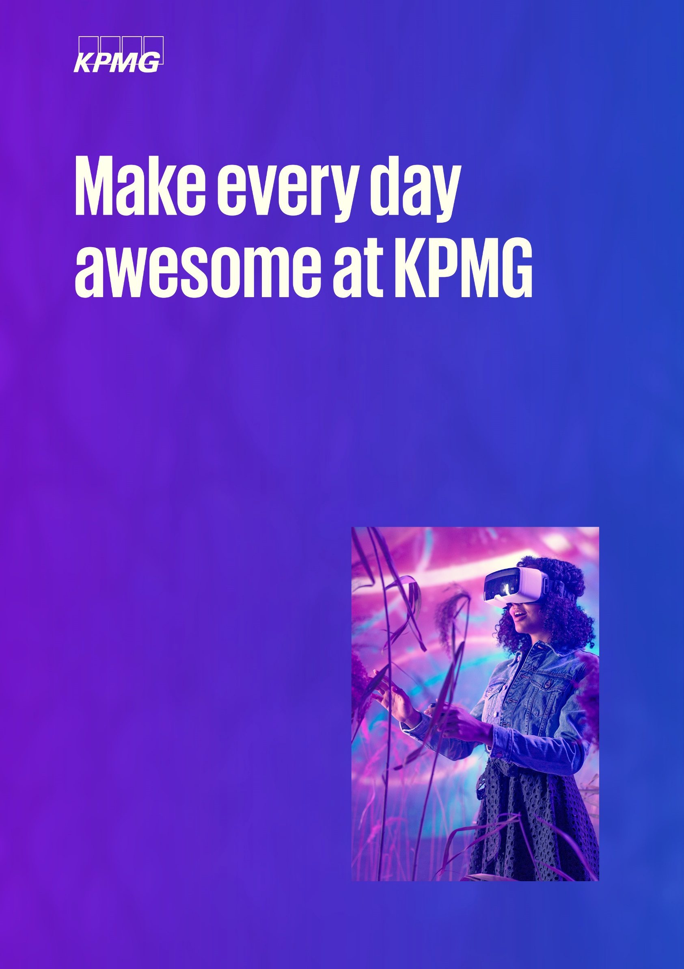

Job title:
Audit Associate 1
Business Unit: KGS Audit (KPMG Resource Center Private Limited)
Service Line: Audit
Location: Gurugram/Noida/Bengaluru/Mumbai

Slide 2

About us
Job details
Proposed designation
Audit Associate 1
Role type
Audit Associate 1
Reporting to
Grade D (Senior/ AM)
Work timings
9:00 am to 5:30 pm subject to client deliverables and commitments
KPMG Resource Centre (KRC) is a team of 3,300+ colleagues serving audit clients of primarily KPMG Europe and a few other countries. KRC’s services include end-to-end Audits, IT Audits, Data Analytics, Engagement Support Hub, Transaction
Assurance and ESG, among others. The business supports multiple sectors and is currently present in Bengaluru, Gurugram, Noida and Mumbai.
Through your work, you’ll build a global network and unlock opportunities that you may not have thought possible with access to great support, vast resources, and an inclusive, supportive environment to help you reach your full potential.
Roles & responsibilities
Auditing financial statements of companies as per country specific statutory requirements
Building relationships with onshore team members sitting across different locations
Reviewing financial statements of international companies for compliance with legislative and accounting standards, mathematical accuracy and consistency

Slide 3
Come as you are
at KGS
This role is for you if you have the below
Educational qualifications
Bachelor’s Degree in Commerce / Degree or Diploma in Finance or Accounting (ACCA pursing)
Work experience
0 – 1-year experience in relevant field
As a firm, we are deeply committed to diversity, inclusion and equity at our workplace. We offer a safe and inclusive environment built on trust, where all our colleagues can bring their authentic selves to work and know that their uniqueness is valued.
We prohibit unfair treatment of applicants and employees and discrimination on any ground, including but not limited to, caste, religion, color, ancestry, marital status, medical condition, sex, gender identity and/or expression, sexual orientation, age, nationality, cultural origin, family or parental status, defense veterans, physical, mental or sensory disability or any other status or characteristic protected by applicable Indian laws and regulations.
Preferred technical & functional skills
Intermediate level in Microsoft Excel and Microsoft Word
Book-keeping experience will be beneficial but not essential
Proficiency/ Working knowledge of Adobe Professional would be an added advantage
Key behavioral attributes/requirements
Excellent written and verbal communication skills
Personal drive and positive work ethic to deliver results within tight deadlines and in demanding situations
Flexibility to adapt to a variety of engagement types, working hours and work environments
Other information
Interview process: 3 round of interviews
Does the job role involve travelling: No

