Slide 1

Department of Computer Science and Engineering
Course name : Course code :
Data Science U23AD491
Title of the project :
Bus Passenger Demand Prediction
28-10-2026

Slide 2
Class / Section / Semester | III CSE / B / V
Batch | 2024-2028
Date | 28/10/2026
Faculty I/C | Dr. M. Suriya, M.E., Ph.D., AP/CSE
Title | Bus Passenger Demand Prediction
Student Name & Register No | Kavin Prakash T - 722824104111
28-10-2026

Slide 3
Abstract
Bus Passenger Demand Prediction
It is an intelligent transit demand forecasting system.
It uses a Scikit-learn Linear Regression pipeline trained on real-world bus trip records from several urban corridors.
The model takes in details such as the route, operating hour, weather condition, holiday status, peak-hour indicator, and calendar information to forecast how many passengers a bus is likely to carry.
A Flask REST API backend with a Chart.js operations console provides real-time single and batch predictions.
This lets transit authorities dispatch buses dynamically, manage headway intervals, and allocate their fleet according to predicted demand levels: Low, Medium, or High.
This project uses machine learning to predict bus passenger demand from historical data. By matching buses to expected demand, it helps optimize schedules, improve the use of vehicles and crew, and make journeys more comfortable for passengers.
28-10-2026

Slide 4
The Challenge
Bus demand changes sharply with hour, route, weather and day type.
Rush hours overload buses, while off-peak trips run almost empty and waste fuel and crew time.
Rain, holidays and weekends shift ridership in ways fixed timetables cannot follow.
Dispatchers need a quick way to turn a demand estimate into a bus type and headway.
Our Objective
“Develop a machine learning system that forecasts passenger load for each bus trip, classifies demand, and recommends the bus type and headway to dispatch.”
28-10-2026

Slide 5
Existing System & Limitations
Existing Approach
Fixed timetables prepared from historical averages.
Manual passenger counts and ticket audits.
Same vehicle type used on a route at all hours.
Weather and holiday effects estimated by hand.
Key Limitations
Delayed or inaccurate demand estimation.
Overcrowding and long waits during surges.
Underused buses burning fuel in low-demand periods.
No easy comparison of demand across routes.
Result: “Buses are not matched to the demand actually expected.”
28-10-2026

Slide 6
Proposed Solution
An Integrated, Data-Driven Demand Forecasting Platform
Collect trip records: route, date, hour, weather, bus type and holiday (593 trips, 10 routes).
Derive 11 features automatically, including day of week, weekend and peak-hour flags.
Predict passengers per trip with a Linear Regression pipeline (R² 0.8663, MAE 7.42, RMSE 9.26).
Classify demand as Low (≤ 40), Medium (41–80) or High (> 80) with bus type and headway advice.
Present forecasts through a Flask REST API and a Chart.js operations console.
How it improves existing operations
“Replaces static timetables with route- and hour-level forecasts, and turns each forecast into a dispatch action.”
28-10-2026

Slide 7
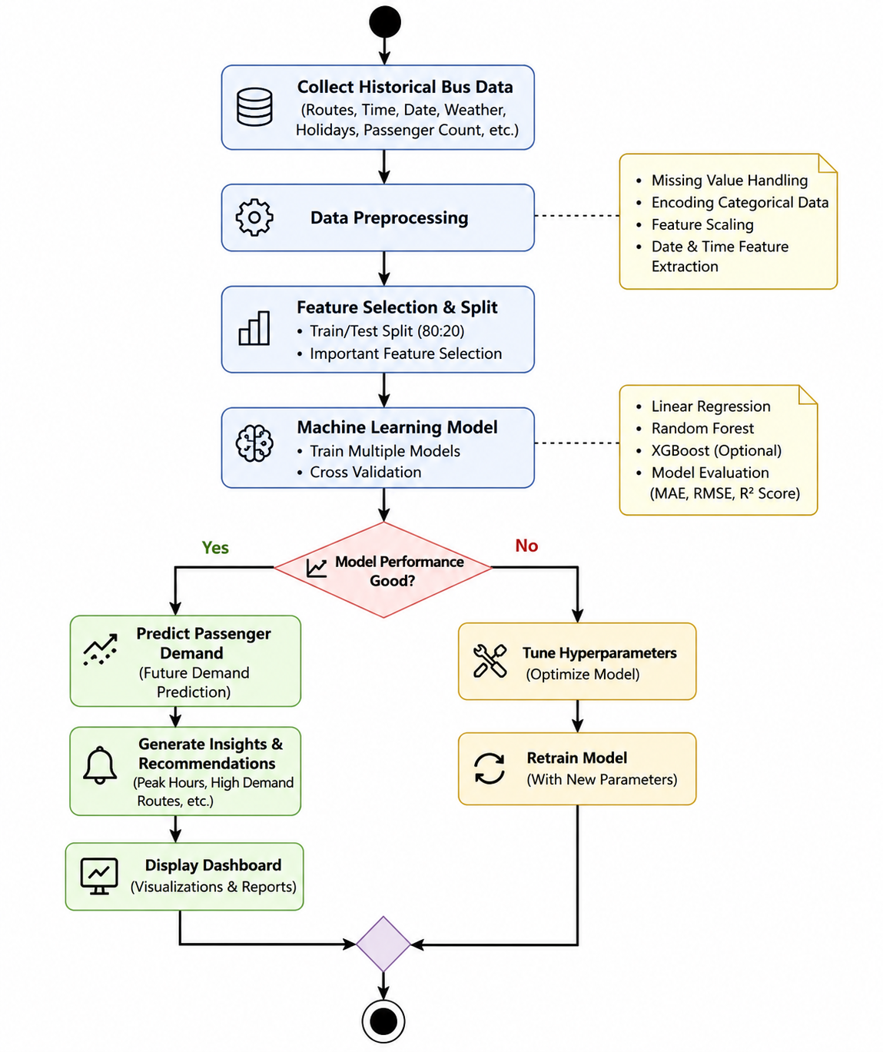
System Architecture And Workflow
28-10-2026
Work flow diagram

Slide 8
Data Sources, Preprocessing & EDA
Data Sources
593 cleaned trip observations.
10 bus corridors: 70, 101, 570, 18D, 21G, 23C, 27B, 5E, M1, P21.
January to June 2025, 18 operating hours a day (05:00–22:00).
Target: passengers per trip (5 to 138).
Preprocessing
Check passenger counts are non-negative and hours lie within 05:00–22:00.
Validate weather and bus-type categories.
Derive month, day, day of week, ISO week and weekend from the date.
Flag peak hours (7–9 and 17–19).
EDA Findings
Route 570 averages 91.6 passengers; Route M1 only 44.2.
Weekdays average 62.8 passengers; weekends 53.6.
Public holidays average 48.2; regular days 60.8.
Trips split Low 23.3%, Medium 54.5%, High 22.3%.
28-10-2026

Slide 9
Feature Engineering & Training
Feature Engineering
11 features: route, weather, bus type, hour, day of week, holiday, peak hour, weekend, month, day, week of year.
Route, weather and bus type are one-hot encoded.
Numerical and indicator features pass through the ColumnTransformer.
Calendar features are derived automatically from the trip date.
Training Pipeline
Compare Linear Regression, Random Forest and Gradient Boosting.
Evaluate with R², MAE and RMSE on held-out data.
Linear Regression selected: R² 0.8663 vs 0.8640 (Gradient Boosting) and 0.8384 (Random Forest).
Save the pipeline with Joblib as bus_passenger_demand_model.pkl, loaded once by Flask.
28-10-2026

Slide 10
Technology Used
Frontend: HTML5 / CSS3 / JavaScript (Vanilla JS + Chart.js) (Interactive dashboard and data visualization)
Backend: Flask 3.x + Flask-CORS (REST API and prediction services)
Database: File-based (CSV + Joblib .pkl) (Storage for passenger data and prediction results)
Machine Learning: Scikit-learn (Linear Regression, Random Forest, Gradient Boosting)
Data Processing: Pandas, NumPy (Data cleaning, preprocessing, and feature engineering)
Data Visualization: Chart.js (browser-side) + Pandas / NumPy (server-side data processing)
Model Evaluation: Scikit-learn Metrics (MAE, MSE, RMSE, R² Score)
Deployment: Joblib (model serialization) — served locally at http://127.0.0.1:5000
28-10-2026

Slide 11
Important Features & End Users
Important Features
Single-trip passenger prediction with presets.
24-hour hourly demand simulation.
Route comparison across 10 corridors.
Dataset insights and analytics.
Model benchmark view.
Demand tier with bus type and headway advice.
End Users & Benefits
Transit authorities: plan fleet and headways from forecasts.
Dispatchers: choose bus type for a given trip quickly.
Route planners: compare corridors and find peak windows.
Operations supervisors: simulate a full day of demand.
28-10-2026

Slide 12
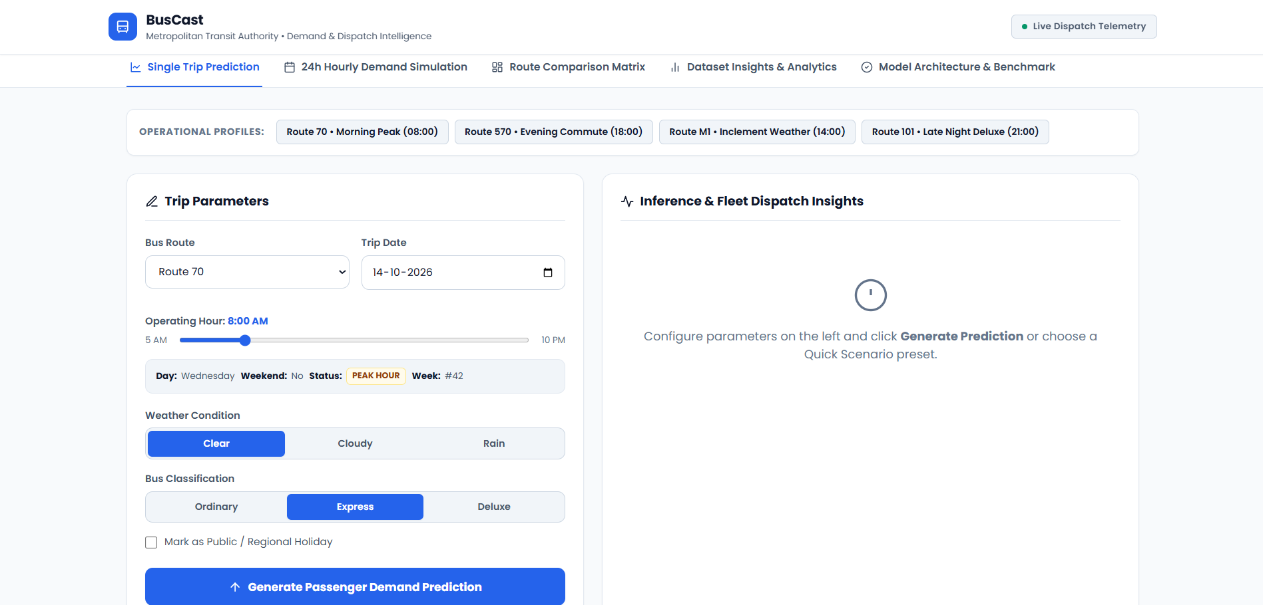
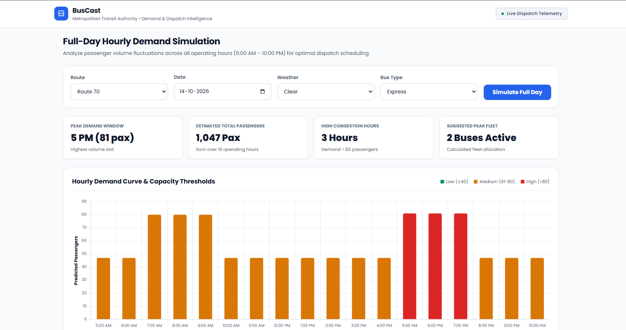
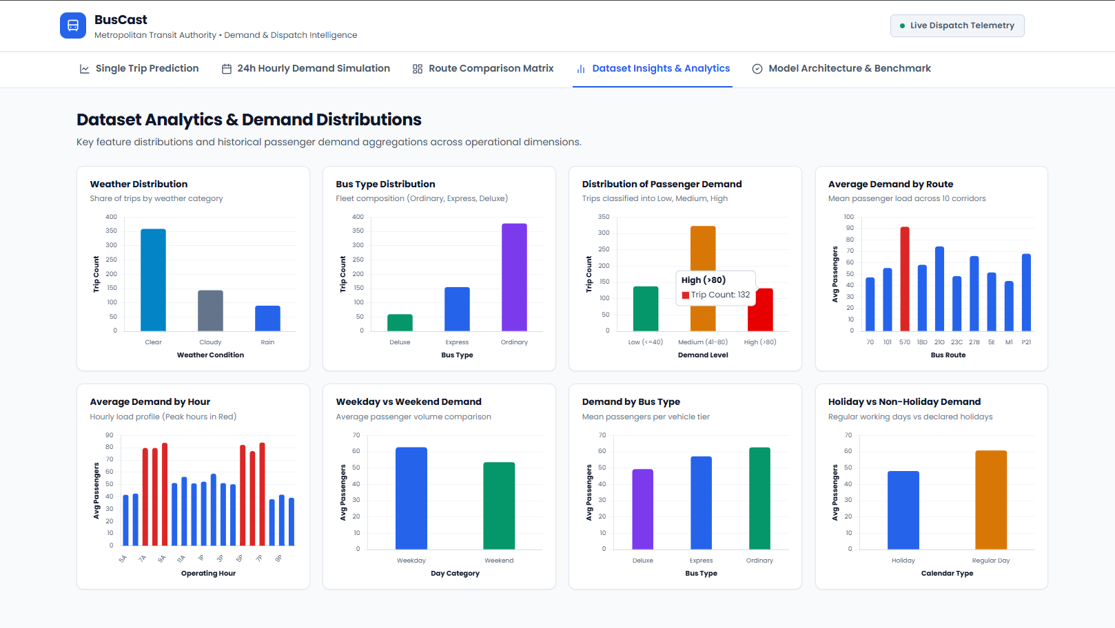
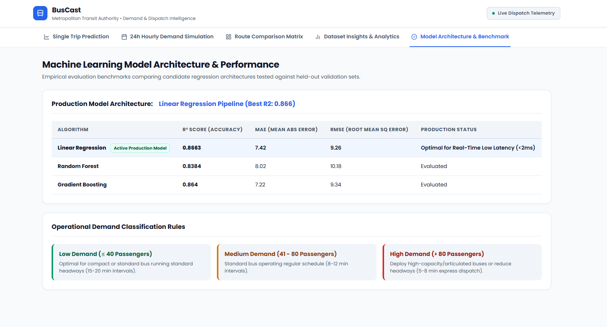
Results
Single trip prediction
24h hourly demand simulation
Dataset insights and analytics
Model benchmark
28-10-2026

Slide 13
Conclusion
BusCast shows that machine learning can make bus planning more responsive to real passenger demand.
It forecasts passenger load from trip history, weather, holidays, and calendar patterns, and groups the result into Low, Medium, or High demand with a matching dispatch recommendation.
Through its Flask API and interactive dashboard, transit authorities can adjust headways and allocate buses using data instead of fixed timetables.
28-10-2026

Slide 14
THANK YOU!

